Slide 1
Pipelined Processor Design
EE 204
Computer Architecture
Computer Science Department
FAST-NU Karachi

Slide 2
Pipeline for Multicycle Operations
4. Instructions can complete in a different order than issued, causing problems with exceptions
5. Stalls for RAW hazards will be more frequent because of longer latency of operations
Potential impact of RAW hazards
Problems arising from writes
Since floating point register file has only one write port, it may result in higher number of structural hazards
Increase the number of write ports
Additional write port will be used rarely
Structural hazard is acceptable
Implement Interlock to handle the above
There are two ways to implement this interlock

Slide 3
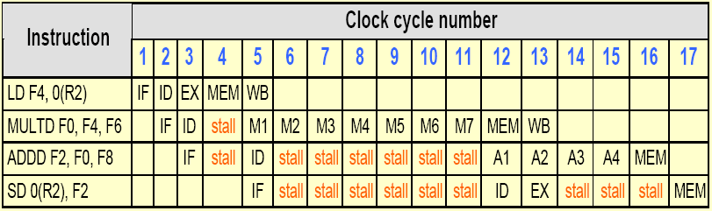
FP code showing stalls arising from RAW hazards

Slide 4
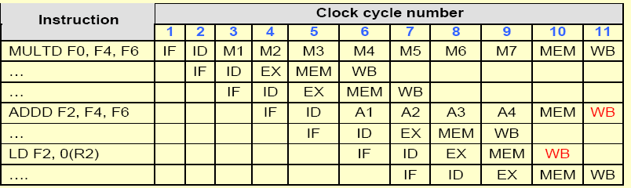
Three instructions want to perform WB to FP register file simultaneously

Slide 5
Pipeline for Multicycle Operations
Track the use of write port in the ID stage and stall an instruction before it issues
Implemented with a shift register
Indicates when already issued instructions will use the register file
Maintains the property of stalling instructions only in the ID stage
Cost is the shift register and the write conflict logic
Stall the conflicting instruction when it tries to enter either MEM or WB stage
Advantage - Detect the conflict at MEM stage where it is easy to see
Disadvantage - Complicates pipeline control as stalls can now arise from two places

Slide 6
Pipeline for Multicycle Operations
Possibility of WAW hazards:
WAW hazard occur only when a useless instruction is executed
Need to detect and handle it
There are two possible ways to handle WAW hazards
Delay the issue of load instruction until the ADD.D enters MEM
Stamp out the result of ADD.D by detecting the hazard and changing the control so that ADD.D does not write its result
It is difficult to detect this hazard
Use a simpler solution
If an instruction in ID wants to write the same register as an instruction already issued, do not issue the instruction

Slide 7
Pipeline for Multicycle Operations
Possible Hazards to deal with
Hazards among FP instructions
Hazards between a FP and an integer instruction
Only FP load-stores and FP-integer register moves
Separate register files
Three checks that must be performed in the ID stage before an instruction issue can take place
Check for structural hazards:
Wait until the required functional unit is not busy
Make sure the register write port is available when it will be needed
ii. Check for a RAW data hazard:
Wait until the source registers are not listed as pending destinations in a pipeline register

Slide 8
Pipeline for Multicycle Operations
iii. Check for a WAW data hazard: Determine if any instruction in A1, A2,.., A4; D; M1,.., M7 has the same destination register as this instruction
Hazard detection and forwarding logic are similar to the MIPS integer pipeline although it is more complex than the former
Multicycle FP operations also introduce problems for exception mechanisms
Maintaining Precise Exceptions
An instruction issued earlier completes after an instruction issued later
Out-of-order completion
Imprecise exceptions can occur

