Slide 1
Pipelined Processor Design
EE 204
Computer Architecture
Computer Science Department
FAST-NU Karachi

Slide 2
Pipeline for Multicycle Operations
Four approaches are used to deal with this problem
Ignore the problem and settle for imprecise exception
IEEE floating point standard requires precise exception
Two-mode implementation is seen in most processors
Buffer the results of an operation until the operations that were issued earlier are complete
Expensive when difference in running times among operations is large
Two viable variations
History file: Keep track of original values of registers
Future file: Keeps the newer values of registers
Update later from the future file

Slide 3
Pipeline for Multicycle Operations
Allow the exception to become somewhat imprecise
Keep enough information so that trap handling routines can create a precise sequence for the exception
Need to know the operations in the pipeline and their PCs
Only floating point instructions overlap need to be handled
A hybrid scheme
Allows the instruction issue to continue only if it is certain that all instructions before the issuing instruction will complete without causing an exception
May require to stall the CPU to maintain precise exceptions

Slide 4
Putting It All Together
The MIPS R4000 Pipeline
R4000 implements MIPS64
Uses a deeper pipeline
Cache access is made in multiple cycles reducing the clock cycle time
This type of deeper pipeline is referred to as superpipeline
Function of each stage of the pipeline
IF: First half of instruction fetch
PC selection and initiation of I-cache access
IS: Second half of instruction fetch
Completes I-cache access
RF: ID and Register fetch
Hazard checking and I-cache hit detection

Slide 5
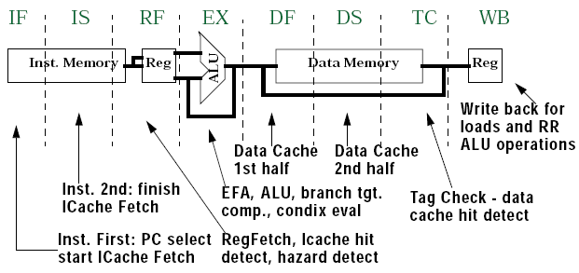
8-stage Pipeline of R4000
CA Fall2017
FAST-NU Karachi Campus

Slide 6
Putting It All Together – MIPS R4000 Pipeline
EX: Execution cycle, includes:
Effective address calculation
ALU operation
Branch target computation
Condition evaluation
DF: First half of data fetch
First half of D-cache access
DS: Second half of data fetch
Completion of D-cache access
TC: Tag check
D-cache access hit or miss is determined
WB: Write back for loads and register-register operations
Substantial increase in amount of forwarding required

Slide 7
Putting It All Together – MIPS R4000 Pipeline
Increase in both load and branch delays
Branch delay is of three cycles
Uses predict-not-taken strategy
Four possible sources of forwarding
EX/DF, DF/DS, DS/TC and TC/WB
MIPS 4000 Floating Point Pipeline
Reading Assignment
Performance of R4000 Pipeline
Four major causes of stalls
Load stalls
Branch stalls
FP result stalls
FP structural stalls
There is extra penalty for deeper pipeline

Slide 8
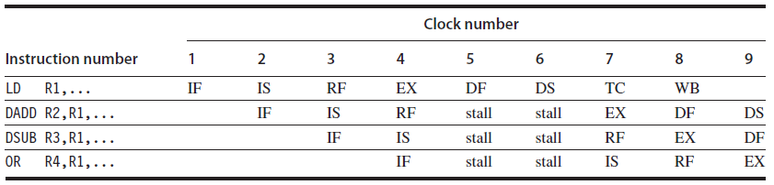
2-cycles Load delay

Slide 9
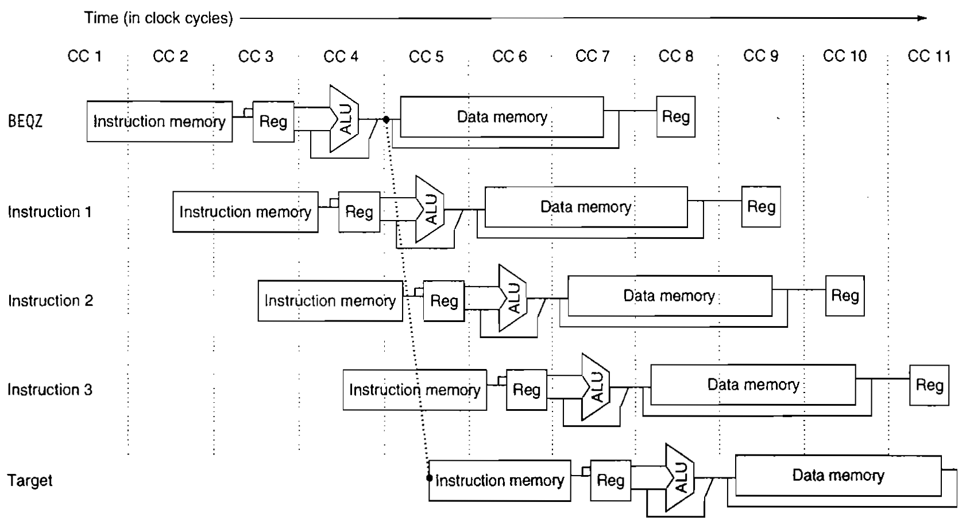
3-cycles Branch delay
CA Fall2017
FAST-NU Karachi Campus

Slide 10
Crosscutting Issues
RISC Instruction Sets and Efficiency of Pipelining
Simpler instruction sets make it easier to schedule code in a pipelined architecture
Recent pipelined implementations of complex instruction set
Translate complex instructions into simple RISC-like operations
Pentium III and Pentium IV
Dynamically Scheduled Pipelines
Static scheduling is done by compilers
Dynamic scheduling is performed by processors to solve the problem of too many stalls
Score-boarding technique of CDC 6600
To be discussed later

Slide 11
Fallacies and Pitfalls
Pitfalls
Unexpected execution sequence may cause unexpected hazards
WAW hazards should never occur in a code sequence
When the sequence is unexpected, they may occur
Extensive pipelining can impact other aspects of a design leading to overall lower cost/performance
Two implementations of VAX
8600, 8650 and 8700

Slide 12
Pipelining
Pitfalls ..
Evaluating a compile time scheduler on the basis of unoptimized code
Unoptimized code contains redundant loads, stores and other operations that might be eliminated by an optimizer
Concluding Remarks
Following were becoming common in microprocessors and also in high-end embedded processors by the early 1990s
Use of pipelining
Sophisticated dynamically scheduled pipelines
Multiple-issue approaches

Slide 13
Instruction-Level Parallelism and Its Exploitation
Instruction-Level Parallelism
Types of Dependences
Compiler Techniques for Exposing ILP
Dynamic Branch Prediction
Dynamic Scheduling of Pipelines

Slide 14
Instruction-Level Parallelism: Concepts and Challenges
Overlap among instructions is referred to as ILP
Techniques for extending and increasing the amount of parallelism exploited among instructions
Limitations are imposed by data and control hazards
Increase the ability of processor and compiler to exploit parallelism
Both hardware and software approaches are explored that exploit parallelism
Dynamic techniques depend on hardware to discover and exploit parallelism dynamically
These are the more dominating techniques
Static or compiler intensive approaches rely on software based methods to exploit parallelism
Have more limited uses in scientific or application specific environments

Slide 15
Concepts and Challenges of ILP
Discuss features of both programs and processors that limit the amount of parallelism that can be exploited among instructions
Critical mapping between program structure and hardware structure
Pipeline CPI = Ideal Pipeline CPI + Structural Stalls + Data Hazard Stalls + Control Stalls
Ideal Pipeline CPI is a measure of the maximum performance attainable by the implementation
Reducing each of the terms on the right results in minimizing the overall pipeline CPI
Various techniques are used to reduce the components
Define the concepts on which these techniques are built
Determine the limits on how much parallelism can be exploited

Slide 16
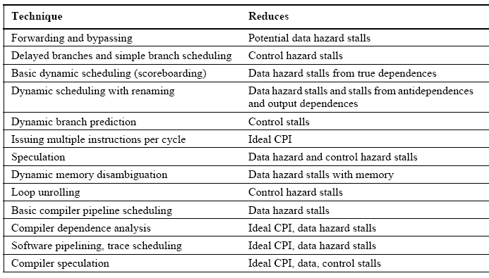
Major Techniques to Improve Performance in Processors
CA Fall2017
FAST-NU Karachi Campus

Slide 17
Instruction-Level Parallelism
What is Instruction Level Parallelism?
Amount of parallelism available within a basic block is quite small
Basic block: A straight line code sequence with no branches in except to the entry and no branches out except at the exit
Exploit ILP across multiple basic blocks
Exploit parallelism among iterations of a loop
Loop-level parallelism
for (i = 1; i <= 1000; i = i+1)
x[i] = x[i] + y[i];
Loop-level parallelism can be converted into ILP by unrolling loop either statically or dynamically
Another alternative is to use vector instructions
Used in both SIMDs and GPUs

Slide 18
Instruction-Level Parallelism
Data Dependences and Hazards
Determining how one instruction depends on another is critical
To determine how much parallelism exists in a program
How that parallelism can be exploited
If two instructions are parallel, they can execute simultaneously in a pipeline without causing stalls
Dependence of one instruction on another is the key issue
There are three types of dependences
Data dependences
Name dependences
Control dependences

Slide 19
Instruction-Level Parallelism
Data Dependences
Also called true data dependences
Instruction j is data dependent on instruction i if either of the following is true
Instruction i produces a result that is used by instruction j, or
Instruction j is data dependent on instruction k and instruction k is data dependent on instruction i
If two instructions are data dependent they cannot execute simultaneously or be completely overlapped
Dependences are a property of programs
Whether the dependence actually results in a hazard and whether that hazard actually causes a stall are properties of pipeline organization

Slide 20
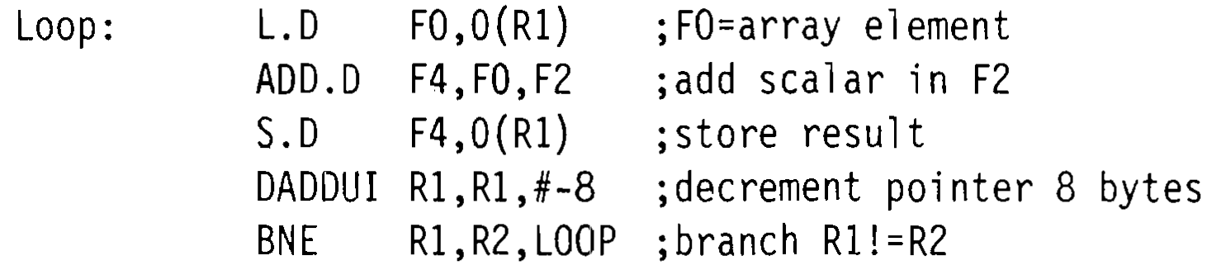
Dependences in MIPS code sequence
CA Fall2017
FAST-NU Karachi Campus

Slide 21
Instruction-Level Parallelism
A data dependence conveys three things
Indicates the possibility of a hazard
Determines the order in which results must be calculated
Sets an upper bound on how much parallelism can possibly be exploited
Dependence limits the amount of ILP
Dependence can be overcome by
Maintaining the dependence but avoiding a hazard
Scheduling of code both in hardware and software
Eliminating a dependence by transforming the code
A data value can flow either through registers or through memory locations
Dependence through registers are easier to detect but dependence through memory locations is not

Slide 22
Instruction-Level Parallelism
Name Dependences
Occurs when two instructions use the same register or memory location called a name but
There is no flow of data between the instructions associated with that name
There are two types of name dependences
Assuming i precedes j
❶Antidependence
When instruction j writes a register or memory location and instruction i reads it
Corresponds to a WAR hazard
❷Output dependence
When both i and j writes to the same register or memory location
Ordering between instructions must be preserved
Preserved by detecting WAW hazard

Slide 23
Instruction-Level Parallelism
Both antidependence and output dependence are only name dependences
Instructions can execute simultaneously or can be reordered if the name is changed
Register renaming: Can be done either statically by a compiler or dynamically by the hardware
Control Dependences
Determines the ordering of an instruction i with respect to a branch instruction so that
The instruction i is executed in correct program order and only when it should be
Every instruction except those in the first basic block is control dependent on some set of branches

