Slide 1
Pipelined Processor Design
EE 204
Computer Architecture
Computer Science Department
FAST-NU Karachi

Slide 2
How Name-Dependence is resolved?
Register Renaming
Renaming replaces architectural register names by, in effect, value names, with a new value name for each instruction destination operand.
Register renaming can be done either statically by a compiler or dynamically by the hardware.

Slide 3
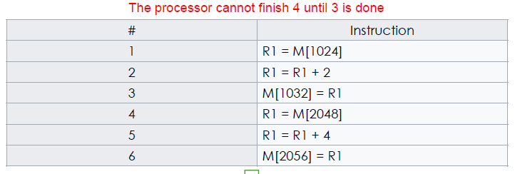
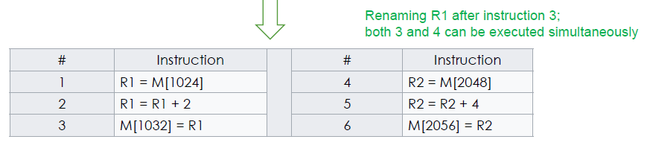
How Name-Dependence is resolved?

Slide 4
Compiler Scheduling
Consider the following statements:
  a = b + c; d = e – f;
Slow code:
  lw $10, ($1) # $1 = addr b
  lw $11, ($2) # $2 = addr c
  add $12, $10, $11 # Dependence
  sw $12, ($3) # $3 = addr a
  lw $13, ($4) # $4 = addr e
  lw $14, ($5) # $5 = addr f
  sub $15, $13, $14 # Dependence
  sw $15, ($6) # $6 = addr d
  lw $10, 0($1)
  lw $11, 0($2)
  lw $13, 0($4)
  lw $14, 0($5)
  add $12, $10, $11
  sw $12, 0($3)
  sub $15, $13, $14
  sw $14, 0($6)

Slide 5
Loop Level Parallelism (LLP)
LLP is exploiting parallelism among iterations of a loop.
Example: A loop that adds two 1000-element arrays and is completely parallel:
for (i=0; i<=999; i=i+1)
x[i] = x[i] + y[i];
Every iteration of the loop can overlap with any other iteration, although within each loop iteration there is little or no opportunity for overlap.
Dependent instructions cannot be executed simultaneously.

Slide 6
Loop Level Parallelism
There are a number of techniques for converting such loop-level parallelism into instruction-level parallelism.
Basically, such techniques work by unrolling the loop either:
  statically by the compiler
  dynamically by the hardware
SIMD (Single Instruction Multiple Data) is an alternative method for exploiting loop-level parallelism.

Slide 7
Loop Level Parallelism
The above loop code, in simple form, requires seven instructions per iteration (two loads, an add, a store, two address updates, and a branch) for a total of 7000 instructions.
It might execute in one-quarter as many instructions in some SIMD architecture where four data items are processed per instruction.

Slide 8
Loop Level Parallelism-Example
Each iteration is independent; adding a scalar to a vector
for (i=999; i>=0; i=i–1)
x[i] = x[i] + s;
Loop: L.D F0,0(R1) ;F0=array element
ADD.D F4,F0,F2 ;add scalar from F2
S.D F4,0(R1) ;store result
DADDUI R1,R1,#-8 ;decrement ptr 8B
BNE R1,R2,Loop ;branch R1!=R2

Slide 9
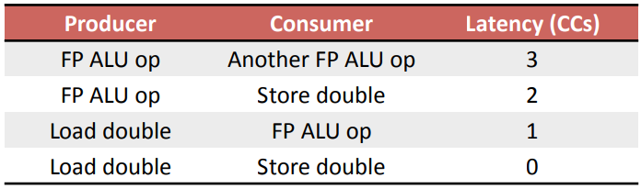
Assume the following FP latencies (averages):

Slide 10
Loop Example: Unscheduled Code
Loop: L.D F0,0(R1)
stall ;load interlock
ADD.D F4,F0,F2
stall ;data hazard (F4)
stall ;data hazard (F4)
S.D F4,0(R1)
DADDUI R1,R1,#-8
stall ;branch interlock
BNE R1,R2,Loop

Slide 11
Loop Example: Scheduled Code
Loop: L.D F0,0(R1)
DADDUI R1,R1,#-8
ADD.D F4,F0,F2
stall ;data hazard (F4)
stall ;data hazard (F4)
S.D F4,8(R1) ;0+8 = 8
BNE R1,R2,Loop
Still the actual work of operating on the array element takes just three (the load, add, and store) of those seven clock cycles.
The remaining four clock cycles consist of loop overhead—the DADDUI and BNE—and two stalls.

Slide 12
Loop Unrolling
Unroll the loop
  Replicate the body of the loop many times
  Adjust the loop termination code
Eliminating the branch allows instructions from different iterations to be scheduled together.
  In this case we can eliminate the data stall
  We also increase the ratio of useful work to overhead
  Doing so requires more registers

Slide 13
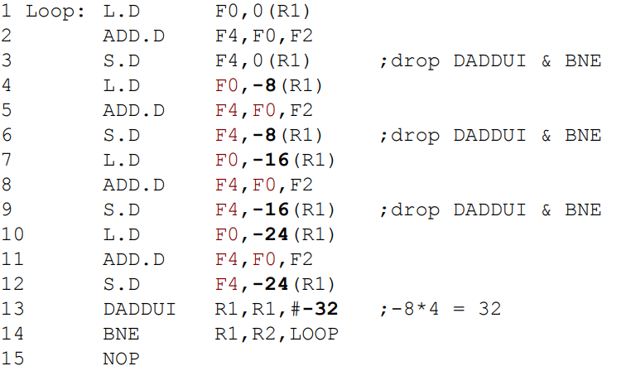
First Step: Copy the Loop

Slide 14
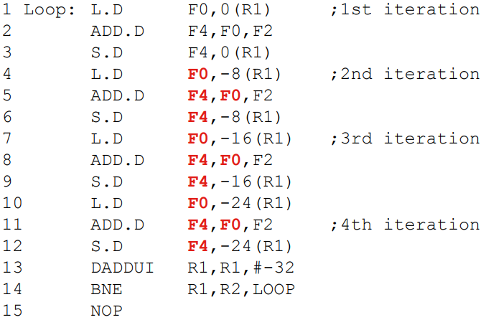
Second Step: Find Name Dependencies

Slide 15
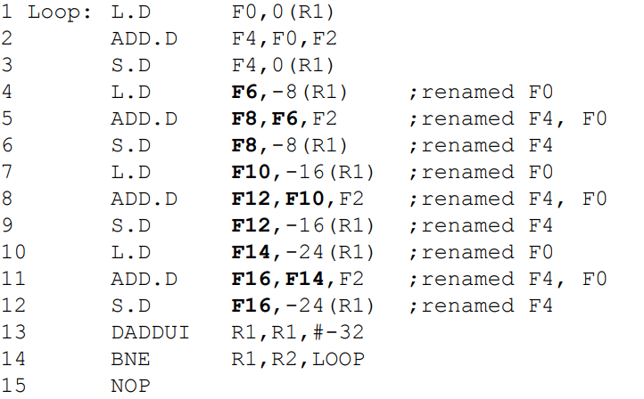
Third Step: Register Renaming

Slide 16
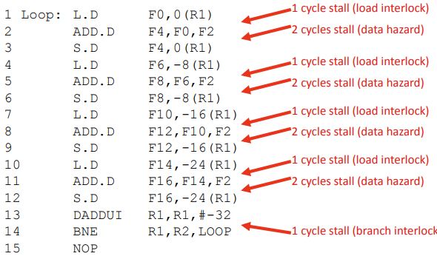
Unrolled: Unscheduled

Slide 17
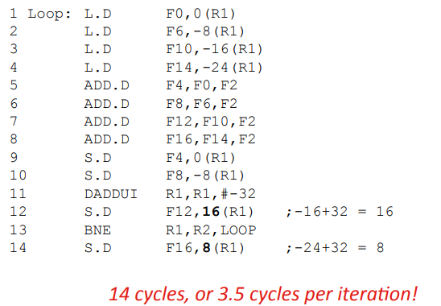
Unrolled: Scheduled

Slide 18
Loop Unrolling is not Free
Benefits decrease with additional unrolling
Code length increases with additional unrolling
  This is issue for embedded processors
  This can increase instruction cache miss rates
Uses lots of registers
  Renaming requires many registers
  When registers become scarce: “register pressure”
  Aggressive unrolling and scheduling and cause a compiler to run out of registers to use for renaming.

