Slide 1
Dynamic Scheduling Using
Tomasulo’s Algorithm
Notes:
Multics as foutainhead of OS; if understand Multics, understand OS
Before you were born, fountainthead of everything going on in MPUs today

Slide 2
Dynamic Scheduling
A major limitation of the simple pipelining techniques is in-order execution
If an instruction is stalled in the pipeline all the instructions behind it must wait
  Even if there would be enough hardware resources to execute them
Solution: Let the instructions behind the stalled instruction proceed
  Split the Instruction Decode phase of the pipeline into:
    Issue: decode instruction and check for structural hazards
    Read operands: wait until no data hazards, then read operands
  We will have out-of-order execution and out-of-order completion of the instructions.

Slide 3
Dynamic Scheduling Using Tomasulo’s Approach
RAW hazards are avoided by executing an instruction only when its operands are available
WAR and WAW hazards, which arise from name dependences, are eliminated by register renaming.
Register renaming eliminates these hazards by renaming all destination registers so that the out-of-order write does not affect any instructions that depend on an earlier value of an operand.

Slide 4
Tomasulo’s Algorithm
Designed for the IBM 360/91, by Robert Tomasulo
Goal: high performance without special compilers
IBM 360 had only 4 FP registers
  Solution: register renaming
Why Study? leads to Alpha 21264, HP 8000, MIPS 10000, Pentium II, PowerPC 604, …

Slide 5
Tomasulo’s Algorithm
Control & buffers distributed with Function Units (FU)
  FU buffers called “reservation stations”; have pending operands
Registers in instructions replaced by values or pointers to reservation stations(RS); called register renaming ;
  avoids WAR, WAW hazards
  More reservation stations than registers, so can do optimizations compilers can’t
Results to FU from RS, not through registers, over Common Data Bus that broadcasts results to all FUs
Load and Stores treated as FUs with RSs as well
Integer instructions can go past branches, allowing
FP ops beyond basic block in FP queue

Slide 6
Tomasulo organization

Slide 7
Reservation Station Components
Op—Operation to perform in the unit (e.g., + or –)
Vj, Vk—Value of Source operands
  Store buffers has V field, result to be stored
Qj, Qk—Reservation stations producing source registers (value to be written)
  Qj,Qk=0 => ready
  Store buffers only have Qi for RS producing result
Busy—Indicates reservation station or FU is busy
Register result status—Indicates which functional unit will write each register, if one exists. Blank when no pending instructions that will write that register.
Notes:
What you might have thought
1. 4 stages of instruction executino
2.Status of FU: Normal things to keep track of (RAW & structura for busyl):
Fi from instruction format of the mahine (Fi is dest)
Add unit can Add or Sub
Rj, Rk - status of registers (Yes means ready)
Qj,Qk - If a no in Rj, Rk, means waiting for a FU to write result; Qj, Qk means wihch FU waiting for it
3.Status of register result (WAW &WAR)s:
which FU is going to write into registers
Scoreboard on 6600 = size of FU
6.7, 6.8, 6.9, 6.12, 6.13, 6.16, 6.17
FU latencies: Add 2, Mult 10, Div 40 clocks

Slide 8
Three Stages of Tomasulo Algorithm
1. Issue—get instruction from FP Op Queue
  If reservation station free (no structural hazard),
  control issues instr & sends operands (renames registers).
2. Execution—operate on operands (EX)
  When both operands ready then execute;
  if not ready, watch Common Data Bus for result
3. Write result—finish execution (WB)
  Write on Common Data Bus to all awaiting units;
  mark reservation station available
Normal data bus: data + destination (“go to” bus)
Common data bus: data + source (“come from” bus)
  64 bits of data + 4 bits of Functional Unit source address
  Write if matches expected Functional Unit (produces result)
  Does the broadcast

Slide 9
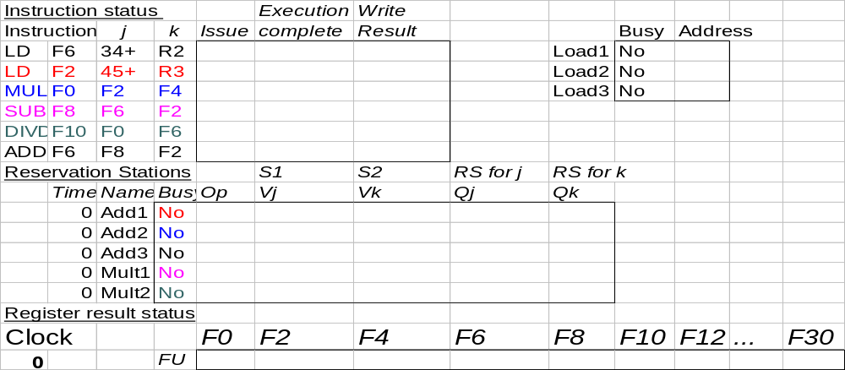
Tomasulo Example Cycle 0

Slide 10
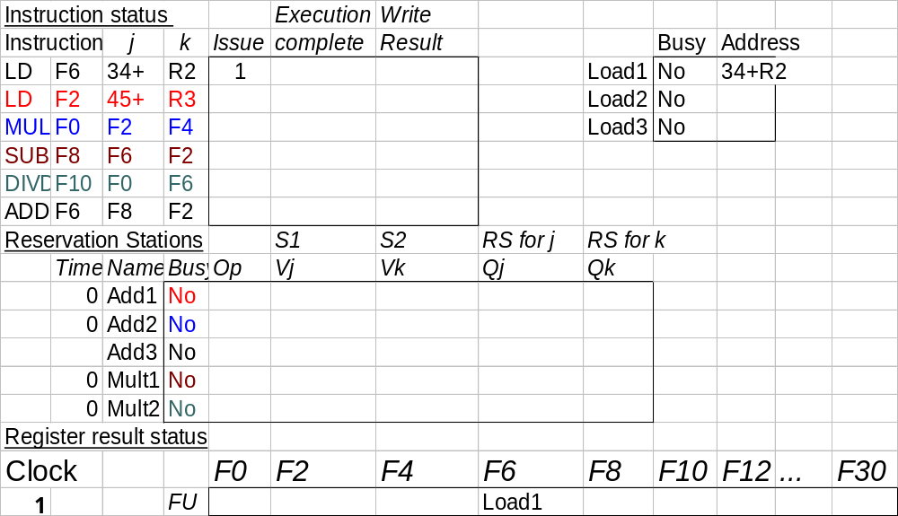
Tomasulo Example Cycle 1
Yes

Slide 11
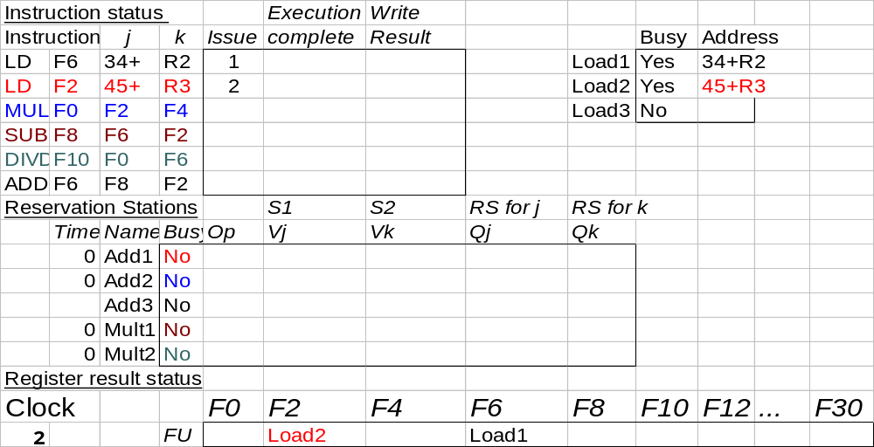
Tomasulo Example Cycle 2

Slide 12
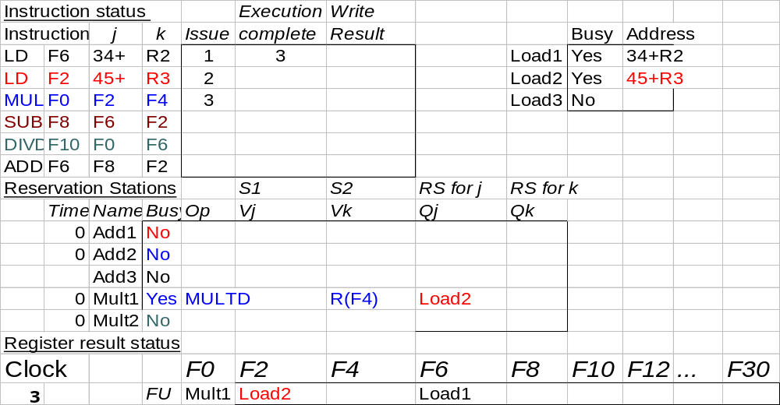
Tomasulo Example Cycle 3
Note: registers names are removed (“renamed”) in Reservation Stations
Load1 completing; what is waiting for Load1?

Slide 13
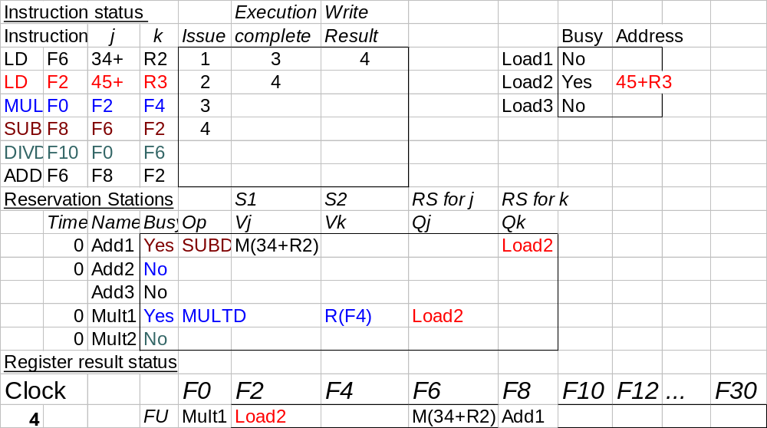
Tomasulo Example Cycle 4
Load2 completing; what is waiting for it?

Slide 14
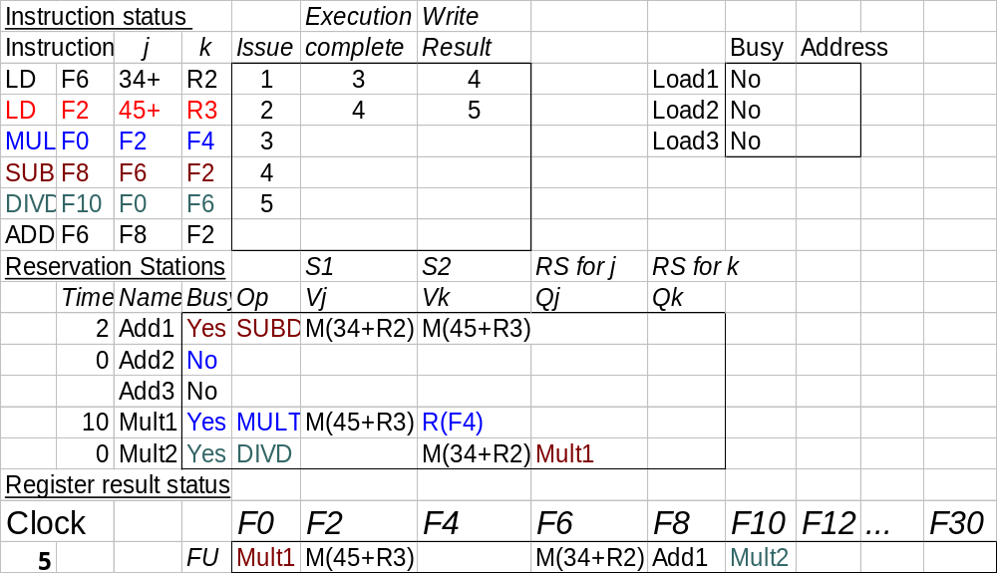
Tomasulo Example Cycle 5

Slide 15
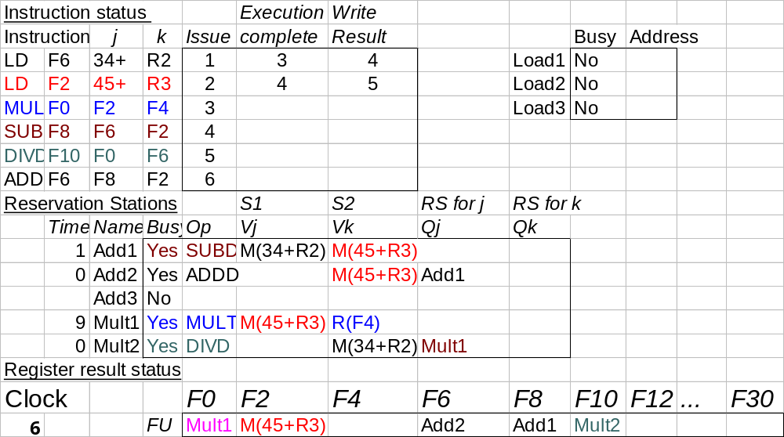
Tomasulo Example Cycle 6

Slide 16
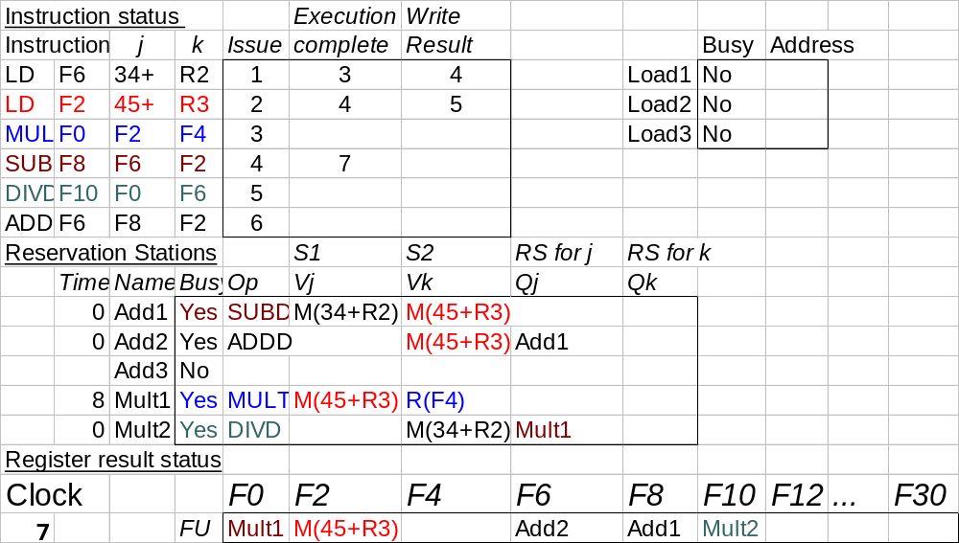
Tomasulo Example Cycle 7
Add1 completing; what is waiting for it?

Slide 17
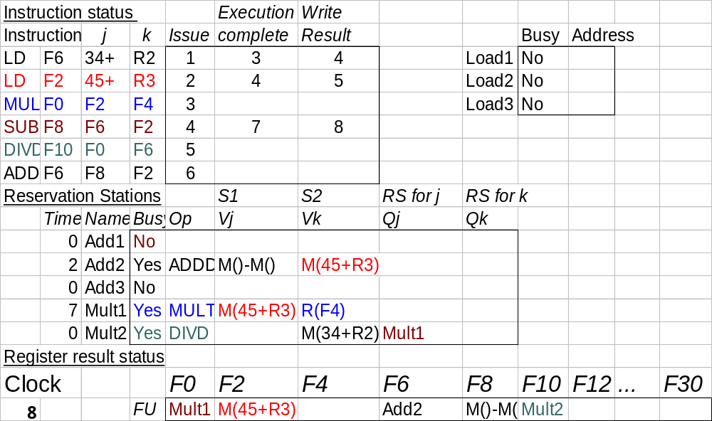
Tomasulo Example Cycle 8

Slide 18

Tomasulo Example Cycle 9

Slide 19
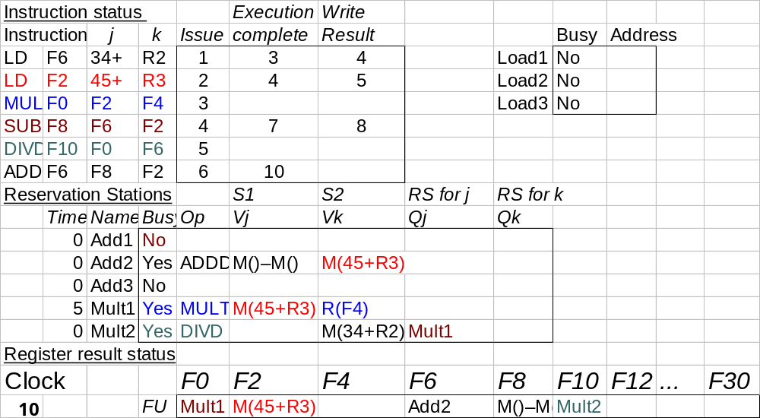
Tomasulo Example Cycle 10
Add2 completing; what is waiting for it?

Slide 20
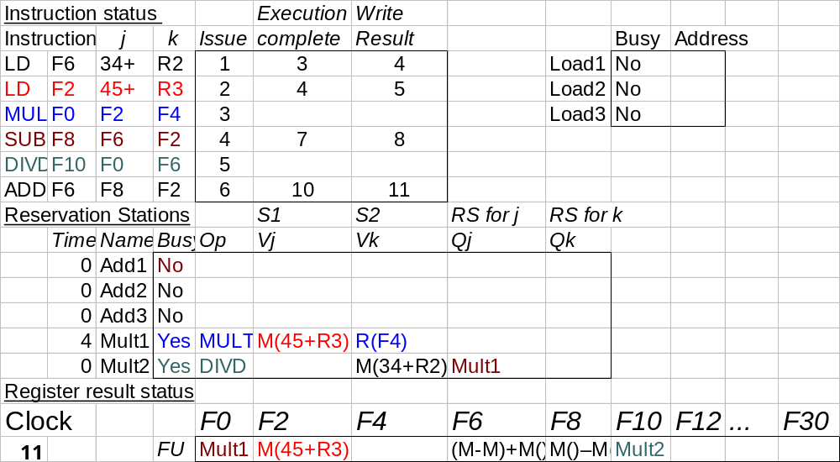
Tomasulo Example Cycle 11

Slide 21
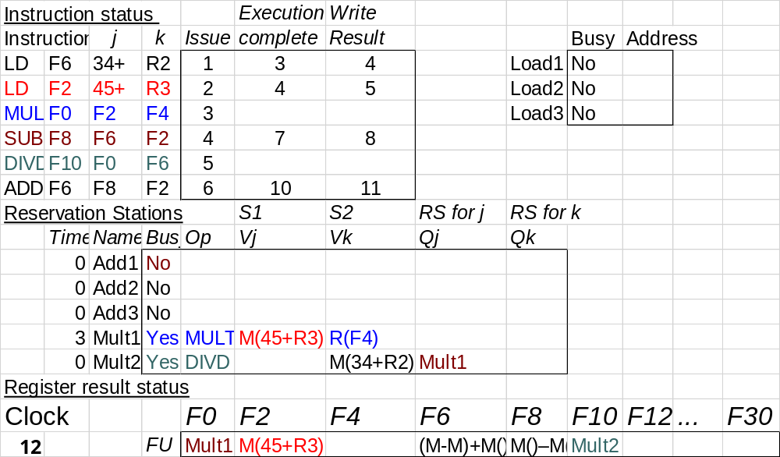
Tomasulo Example Cycle 12
Note: all quick instructions complete already

Slide 22

Tomasulo Example Cycle 13

Slide 23

Tomasulo Example Cycle 14

Slide 24
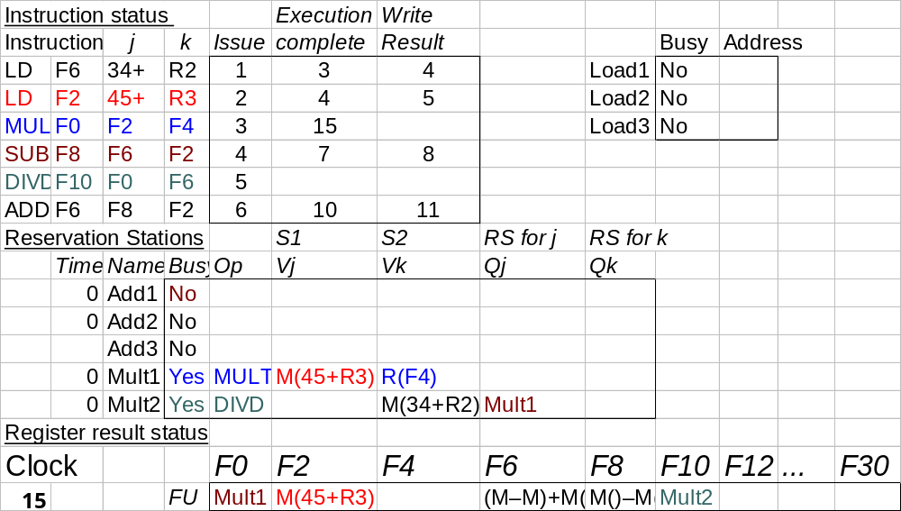
Tomasulo Example Cycle 15
Mult1 completing; what is waiting for it?

Slide 25
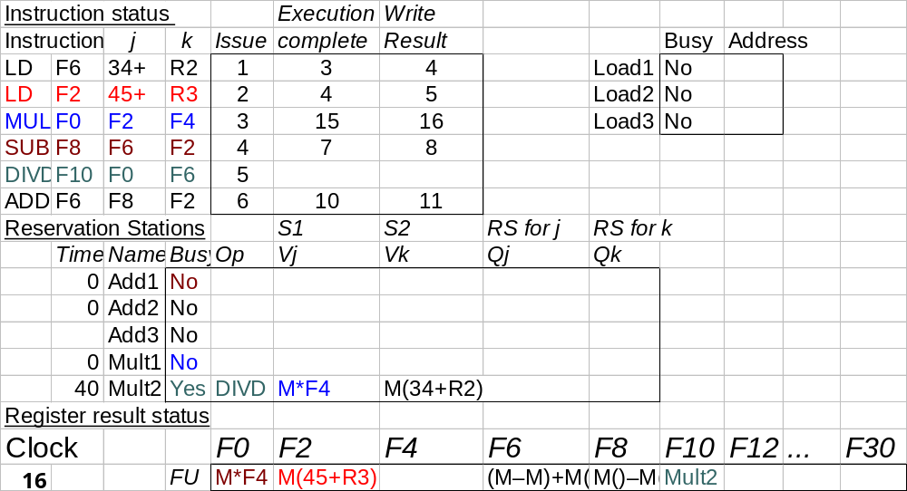
Tomasulo Example Cycle 16
Note: Just waiting for divide

Slide 26
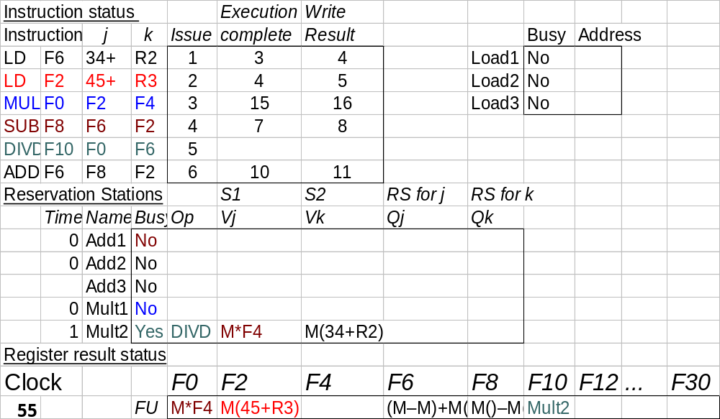
Tomasulo Example Cycle 55

Slide 27

Tomasulo Example Cycle 56
Mult 2 completing; what is waiting for it?

Slide 28
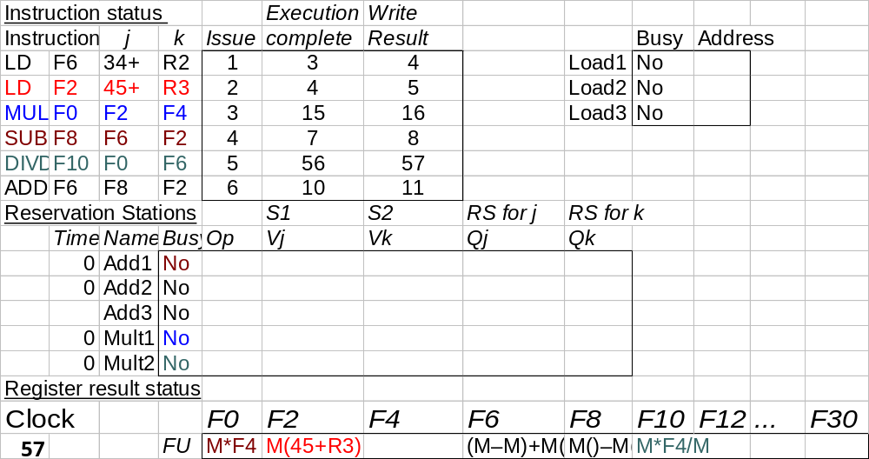
Tomasulo Example Cycle 57
Again, in-order issue,
out-of-order execution, completion

Slide 29
Tomasulo Drawbacks
Complexity
  delays of 360/91, MIPS 10000, IBM 620?
Many associative stores (CDB) at high speed
Performance limited by Common Data Bus
  Multiple CDBs => more FU logic for parallel assoc stores

