Slide 2
Welcome To The Presentation About Computer Hardware
–Salman Farshe

Slide 3

Salman Farshe
B.Sc in CSE, Eastern University of Dhaka, Bangladesh
ID: 222400010

Slide 4
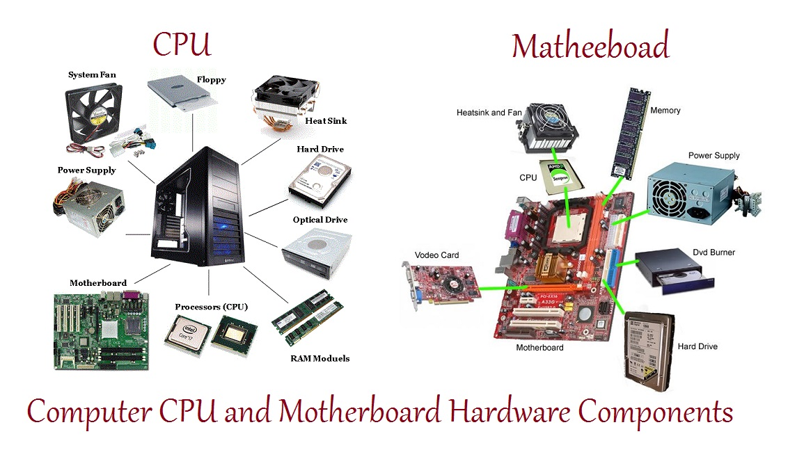
Computer hardware?
Computer hardware includes the physical parts of a computer.
Such as the case, central processing unit (CPU), random access memory (RAM), monitor and so more…

Slide 5
There are three types of computer hardware Components
1.Input Devices
An input device lets you to communicate with a computer, you can use input devices to enter information and issue commands.
2.Output Devices
An output device displays information on a screen, create printed copies or generates sound.
3.System Unit
The system unit is the part of the computer which is responsible for accepting and processing the data brought in by the input device

Slide 6
Some Example of Computer Hardware as input-output device and system unit
1.Input Devices | 2.Output Devices | 3.System Unit
Keyboard Mouse Joy Stick Track Ball Light Pen Scanner Microphone Web Cam | Printers Monitors Projector Speaker | Motherboard HDD CPU Power Supply RAM CD/DVD Drive Video card

Slide 7
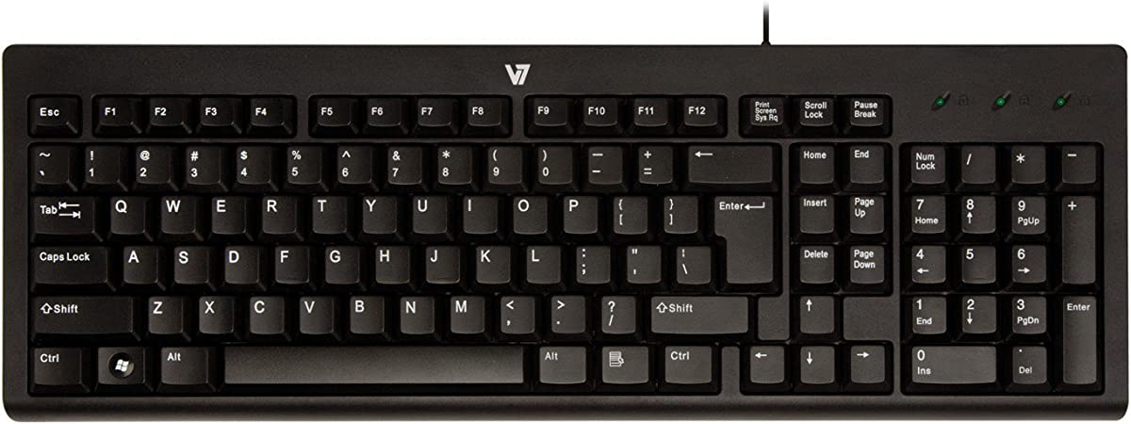
Computer Hardware as Input Devices
1.Keyboard

Slide 8
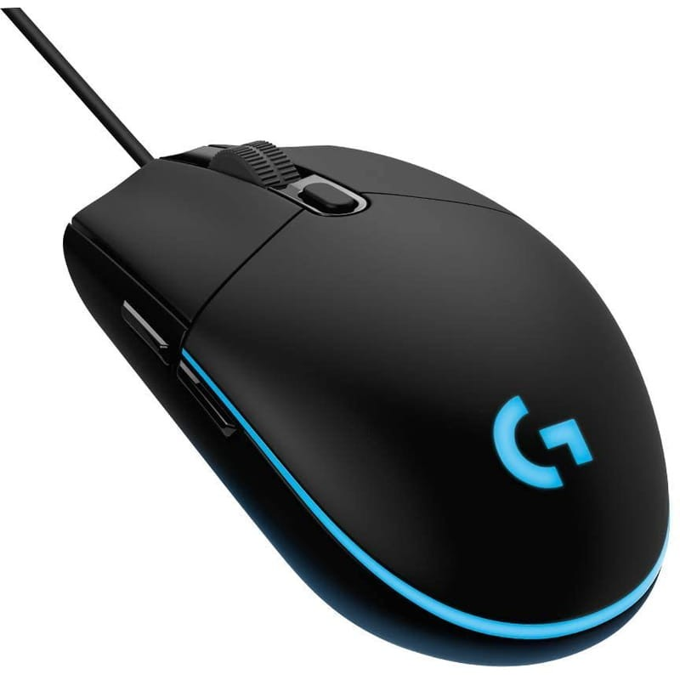
Computer Hardware as Input Devices
2.Mouse

Slide 9
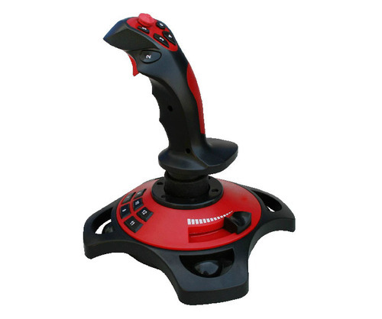
Computer Hardware as Input Devices
3.Joystick

Slide 10
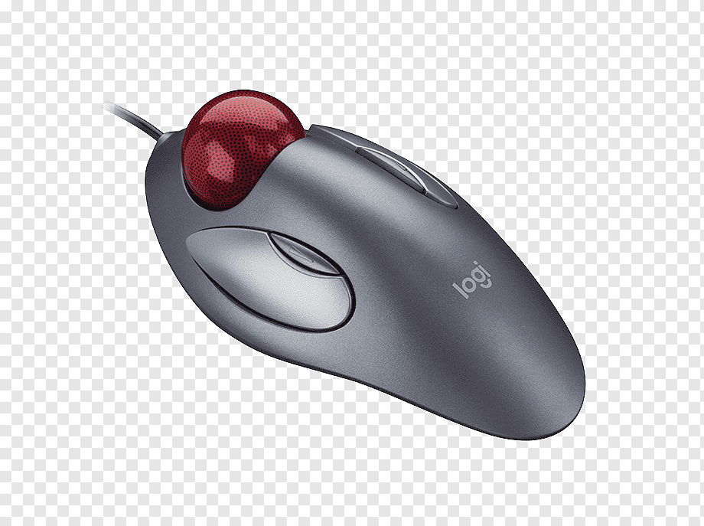
Computer Hardware as Input Devices
4.Track Ball

Slide 11
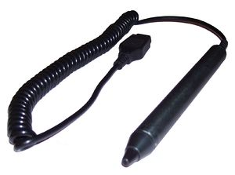
Computer Hardware as Input Devices
5.Light Pen

Slide 12
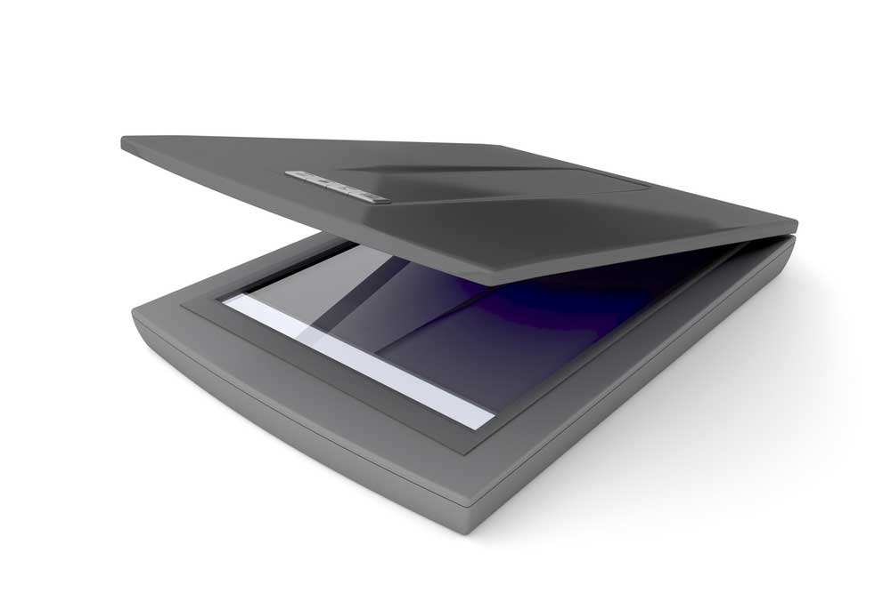
Computer Hardware as Input Devices
6.Scanner

Slide 13
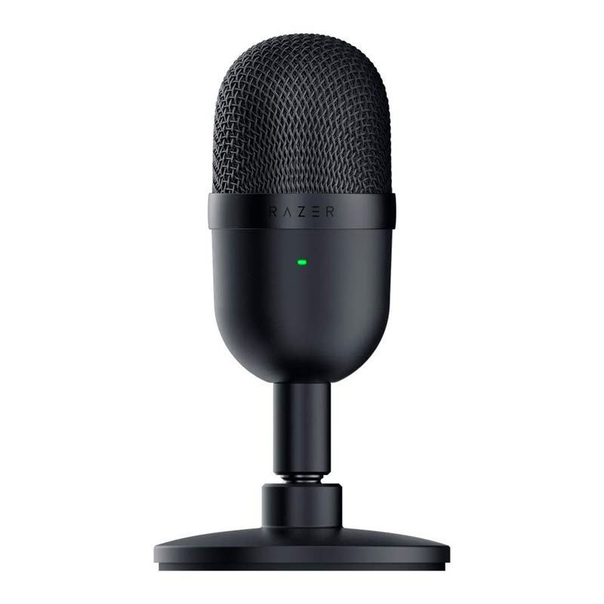
Computer Hardware as Input Devices
7.Microphone

Slide 14
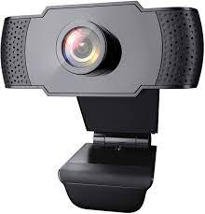
Computer Hardware as Input Devices
8.Web Cam

Slide 15
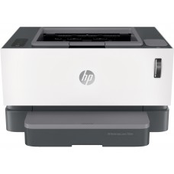
Computer Hardware as Output Devices
1.Printer

Slide 16
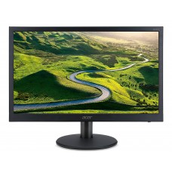
Computer Hardware as Output Devices
2.Monitor

Slide 17
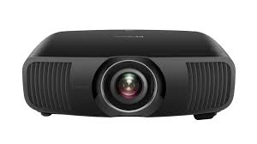
Computer Hardware as Output Devices
3.Projector

Slide 18
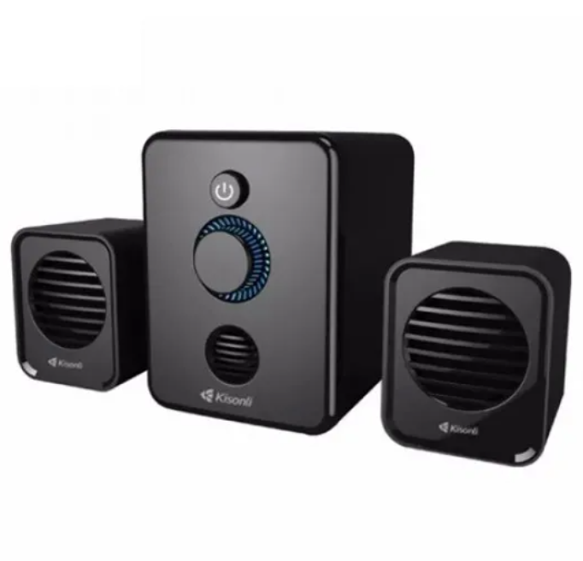
Computer Hardware as Output Devices
4.Speaker

Slide 19
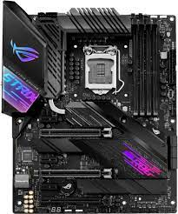
Computer Hardware as System Unit
1.Motherboard

Slide 20
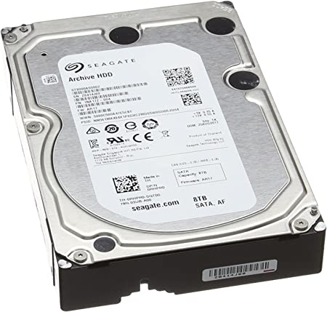
Computer Hardware as System Unit
2. HDD

Slide 21
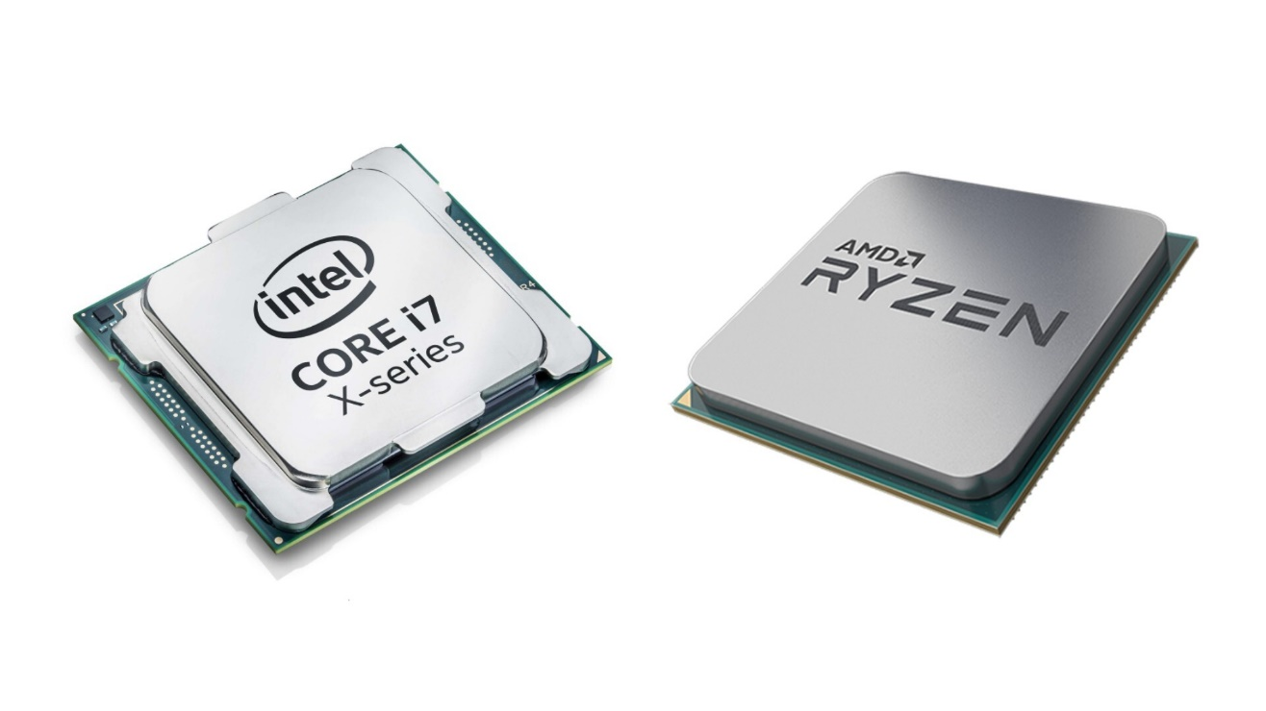
Computer Hardware as System Unit
3. CPU

Slide 22
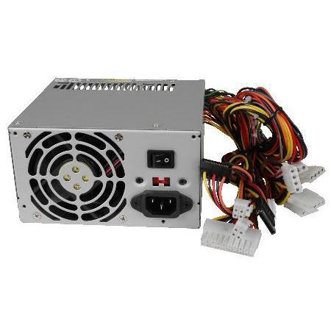
Computer Hardware as System Unit
4. Power Supply

Slide 23
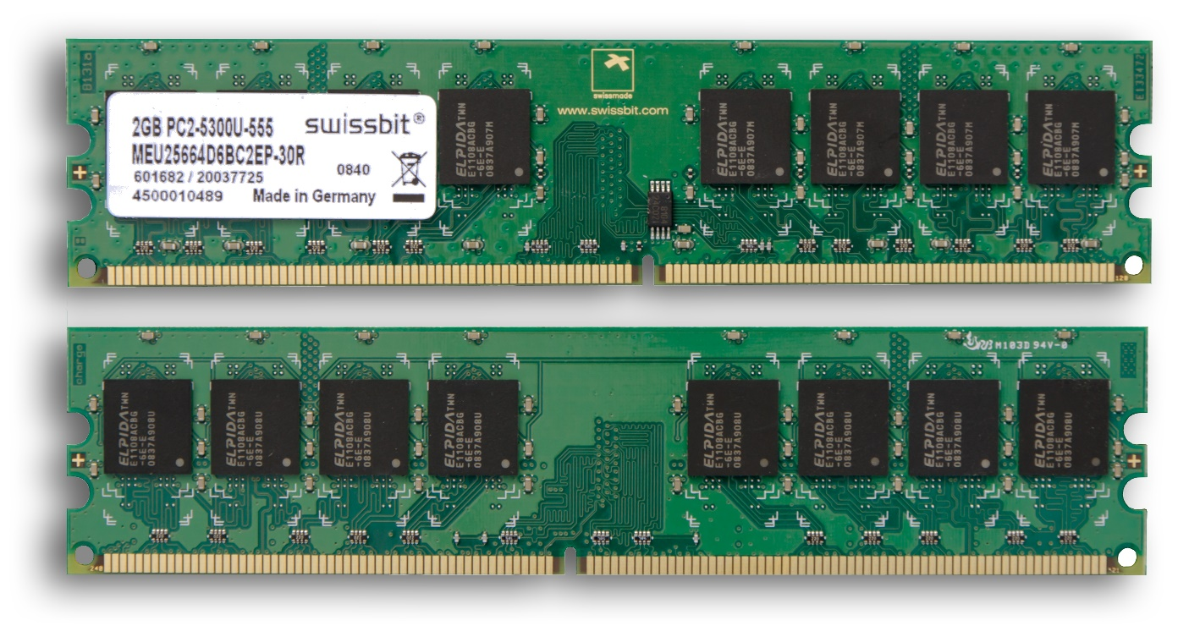
Computer Hardware as System Unit
5. RAM

Slide 24
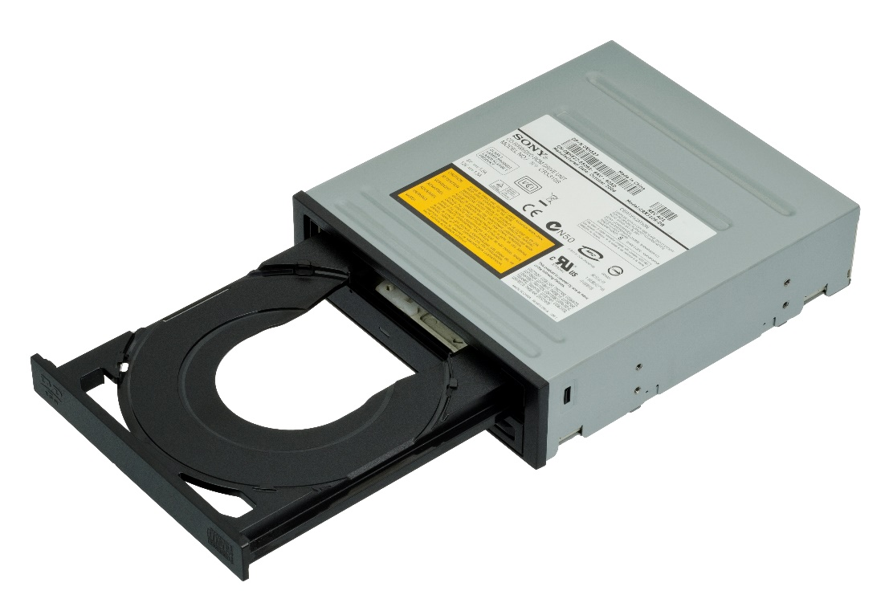
Computer Hardware as System Unit
6. CD/DVD Drive

Slide 25
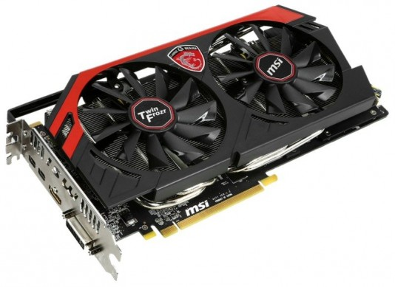
Computer Hardware as System Unit
7. Video card

Slide 26
That’s all about Computer Hardware
Thank you Everyone

