Slide 1


ECO346 • ASSIGNMENT
Data Visualization Techniques for Economists
Making Data
Tell a Clearer Story
Name: Salman Ali
Registration No: FA24-BED-094
Variant 6 | Rural Balochistan

Slide 2

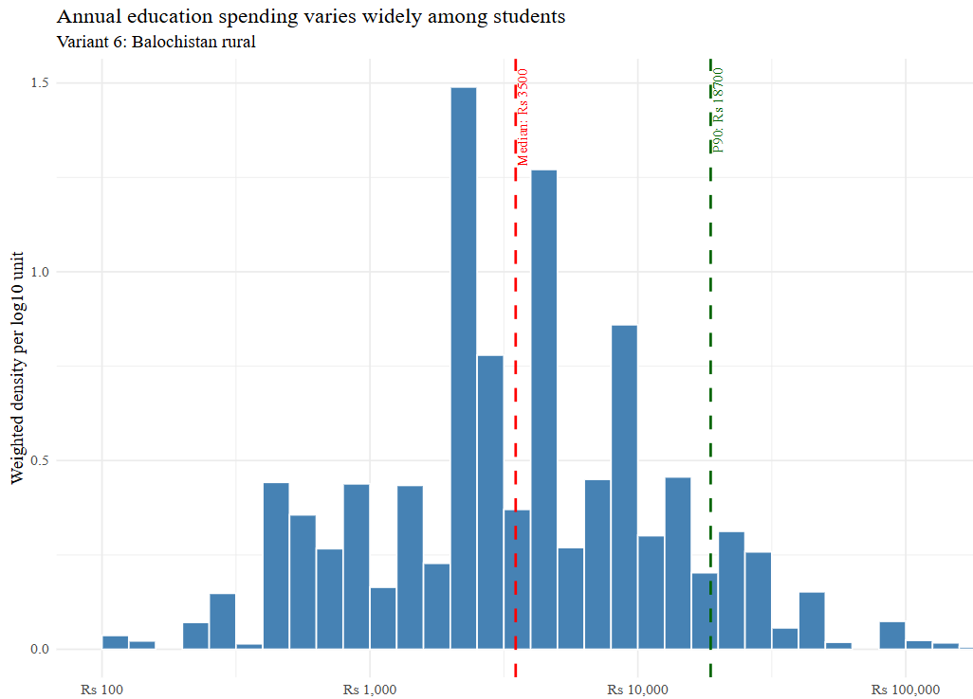
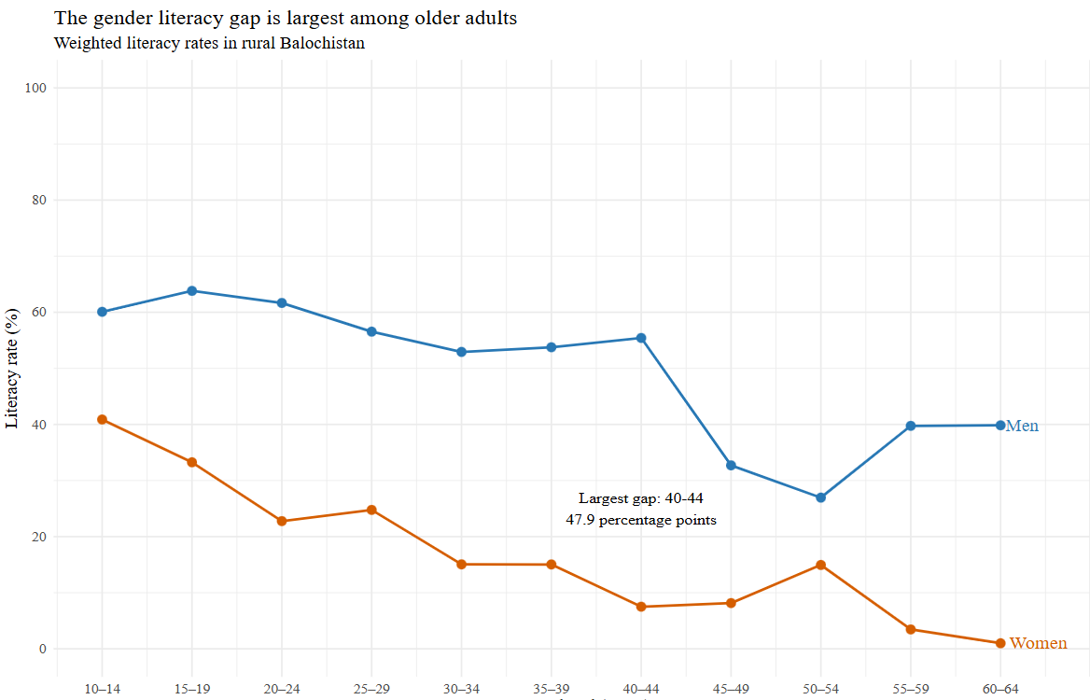
Education Spending Distribution
Literacy Rates by Age and Gender
Annual education spending is unevenly distributed among the observed students. The weighted 90th percentile is Rs 18,700, which is 5.34 times the weighted median of Rs 3,500. This indicates that spending is substantially higher toward the upper end of the distribution
Weighted literacy rates are higher for men than women in every age band shown. Among those aged 15–19, the rates are 63.8% for men and 33.3% for women. The largest difference is 47.9 percentage points among people aged 40–44, highlighting a substantial gender gap in the selected rural Balochistan sample

Slide 3
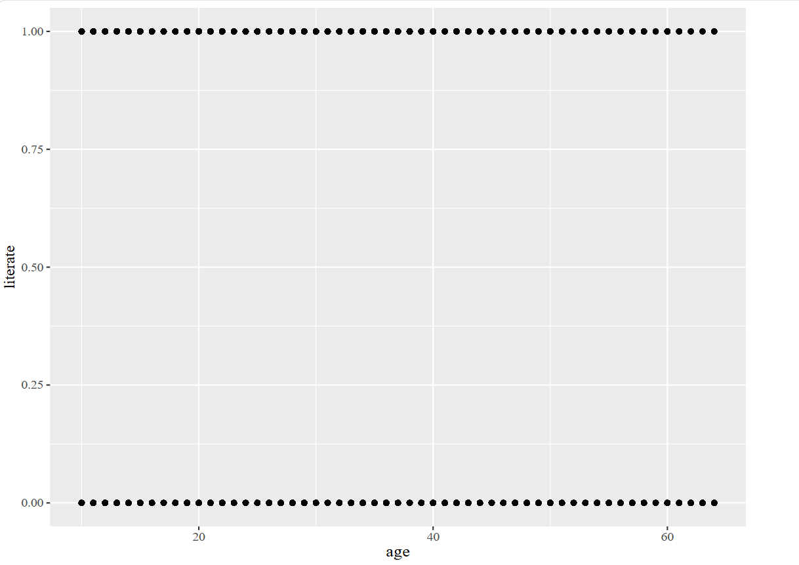
Default Plot: The default plot displays individual literacy observations across ages, but overlapping points make overall patterns and gender differences difficult to interpret
Redesigned Plot: The redesigned plot presents weighted literacy rates across five-year age groups, clearly highlighting differences between men and women and variations in literacy across age groups
Key Improvement: The redesigned graph makes literacy trends and gender differences easier to identify by presenting weighted literacy rates across age groups. However, it hides individual observations, focusing instead on clear comparisons between men and women.

Slide 4
Conclusion & Key Findings
1. Education Spending
The weighted 90th percentile was Rs 18,700, which is 5.34 times the weighted median of Rs 3,500, showing an uneven distribution of education spending.
2. Gender Gap in Literacy
Men had higher literacy rates than women in every age group. The largest gap was 47.9 percentage points among people aged 40–44.
3. Cross-Language Verification
The Python results matched the R results to one decimal place. The literacy rate for women aged 15–19 was 33.3% in both languages.
Final Takeaway
Data visualization makes important patterns and inequalities easier to identify, compare, and communicate. However, these findings describe the selected rural Balochistan sample and do not explain the causes of the observed differences.
Thanks

