Slide 1

Analysis of the Movie Industry
PHASE 1 FINAL PROJECT
SALMAN YUSUF

Slide 2
Problem Statement
Microsoft sees all the big companies creating original video content and they want to get in on the fun. They have decided to create a new movie studio, but they don’t know anything about creating movies. You are charged with exploring what types of films are currently doing the best at the box office. You must then translate those findings into actionable insights that the head of Microsoft's new movie studio can use to help decide what type of films to create.

Slide 3
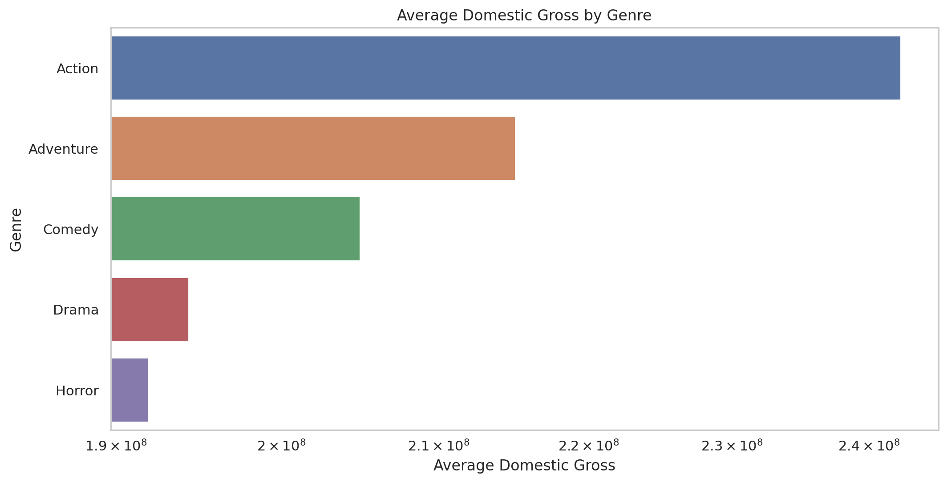
Project Goals
Establish clear objectives:
Understand top-performing genres and their profitability.
Analyze the correlation between movie ratings and box office success.
Identify the ideal movie runtime and its impact on revenue

Slide 4
Methods
To address the project goals and provide business recommendations based on the data, we should consider the following methods:
Descriptive Analysis
To understand the current state of the data, such as total gross revenues, performance by studio, and yearly trends.
Comparative Analysis
To compare the performance of different studios or movies across different regions and over time.
Trend Analysis
To identify patterns over time, which can help in forecasting and strategic planning.

Slide 5
Data Understanding
We will be using the dataset from:
TheMovieDB
bom.movie_gross.csv

Slide 6
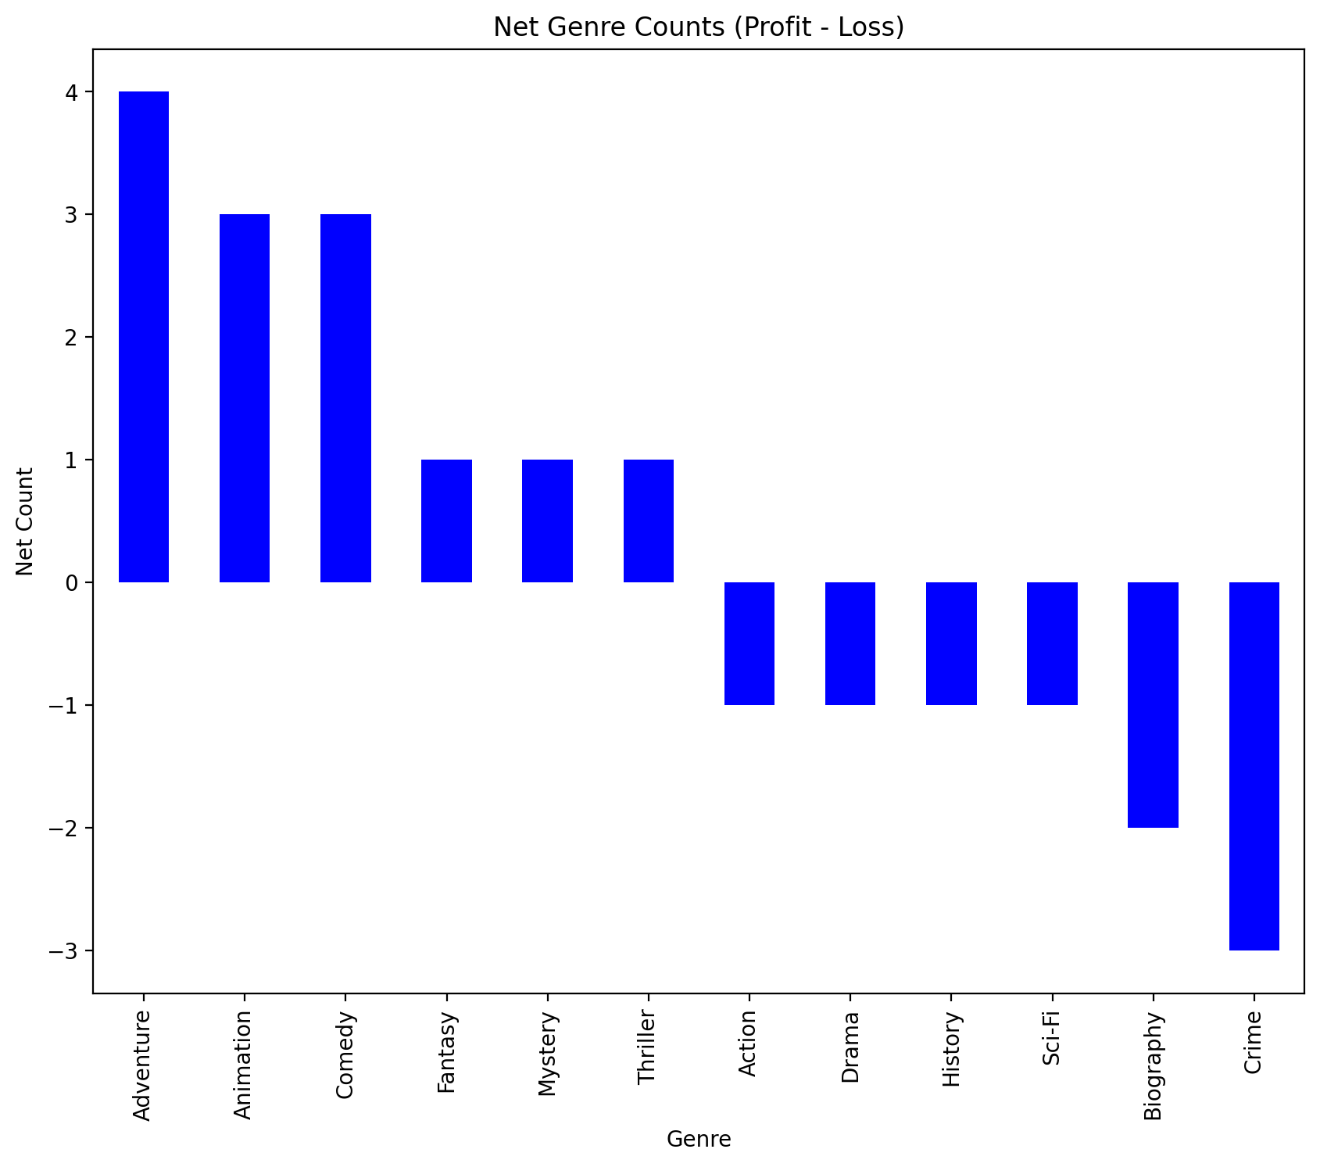
Net genre(profit – Loss)

Slide 7
Top 10Profitable Movies
This will help Microsoft in determining which type of Genre to choose in order to succeed.

