Slide 1

Capstone Project:
Analytical CRM Development for a Bank
By
Machavarapu Salman Raju

Slide 2

Customer relationship management (CRM)
Customer relationship management (CRM) refers to the principles, practices and guidelines that an organization follows when interacting with its customers. From the organization’s point of view, this entire relationship encompasses direct interacting with customer, such as sales and service-related processes and forecasting and analysis of customer trends and behaviors. Ultimately CRM services to enhance the customer’s overall experience.

Slide 3






CRM Six elements
Customer Acquisition
Maintaining CRM through
General Policies
Customer acquisition and retention can be practiced by the firms in a well-established manner than ever before.
CRM through General Policies it is found that the bank employees posses
Customer Satisfaction
Implementation of CRM
The banks should concentrate highly on the valid elements of their CRM strategy for generating customer satisfaction and customer loyalty
Implementation of CRM poses a greater challenge to the banks after acquiring the customers.
Customer Loyalty
Maintaining CRM through
Specific Strategies
Loyalty is considered to be the ultimatum as far as CRM is concerned.
CRM through General Policies it is found that the bank employees posses

Slide 4
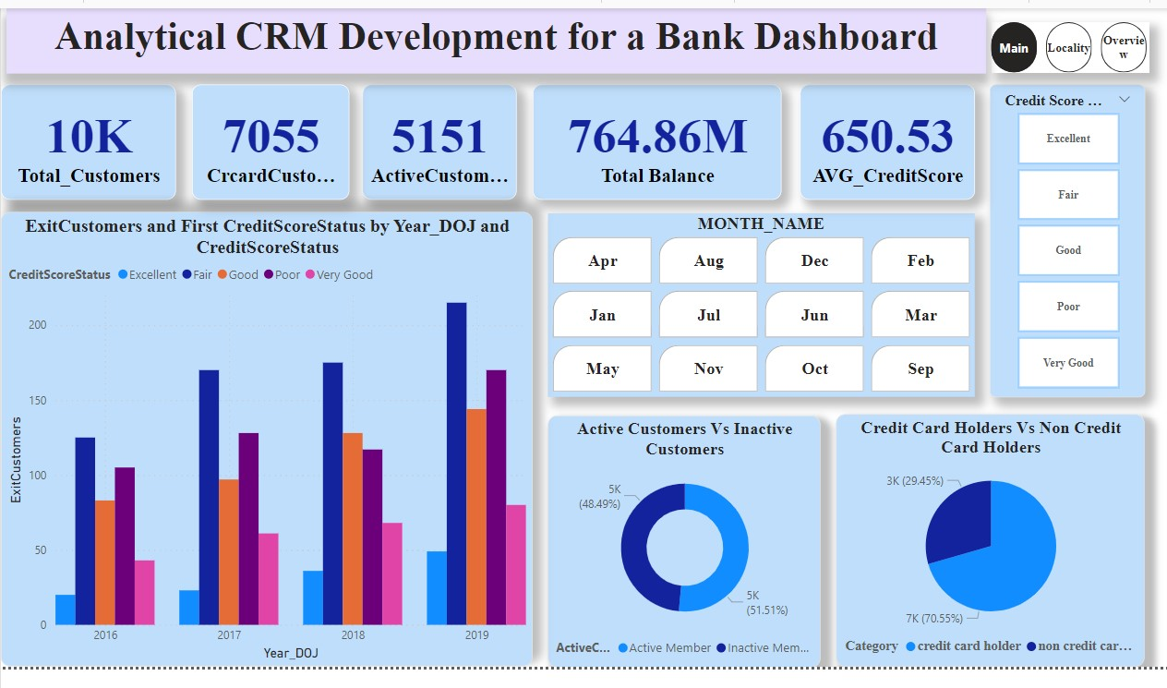
KPIs :
In a bustling financial landscape, a bank boasted a diverse customer base of 10,000 individuals. Among them, 7,055 were credit card holders, signifying a strong product uptake. However, active engagement was lower, with only 5,151 regularly using their cards. These active users collectively managed a substantial total balance of $764.86 million. Despite the impressive financial activity, the average credit score among all customers was moderately positioned at 650.53, indicating a mix of both fiscal prudence and challenges within the customer base.

Slide 5
The graph shows a bank attracting new customers across credit scores between 2016 and 2019. Most new customers came in 2019, with a healthy mix of “Excellent” and “Fair” credit scores. It’s clear how many customers left the bank (ExitCustomers) based on this graph. However, it does show the number of customers who joined in a given year based on their credit score when they first joined. Overall, this suggests the bank has been successful at attracting new customers, but we can’t say for sure if they are retaining them.

Slide 6
The pie chart shows two groups of customers: active and inactive credit card holders. In 2019, there were more active customers (48.49%) than inactive customers (29.45%). This suggests that the bank might be doing well at retaining customers.

Slide 8
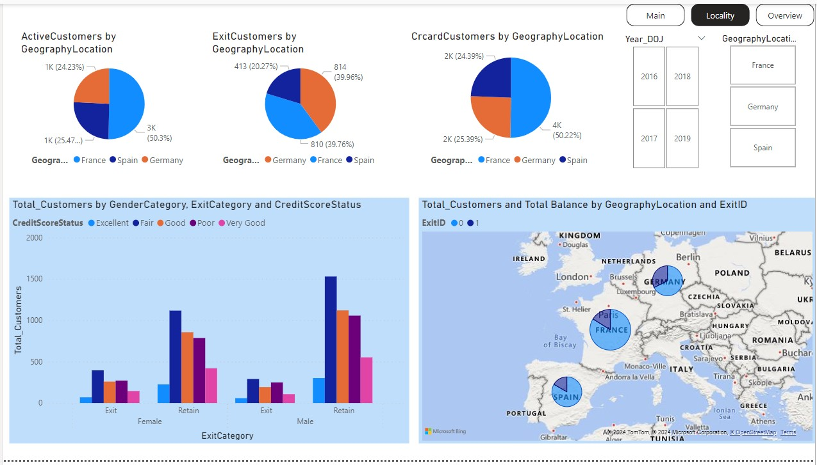

Slide 11
