Slide 1
Welcome
to
Our Presentation
1

Slide 2
Presentation Topic:
‘Proverfier’
Course Code: CSE-498
2

Slide 3
Presented By:
Md. Salman Shamil
ID: 151382347
&
Md. Rokonozzaman
ID: 151382349
3

Slide 4
Project Supervisor:
Rashidul Hasan Nabil
Lecturer
Department of CSE
City University
4

Slide 5
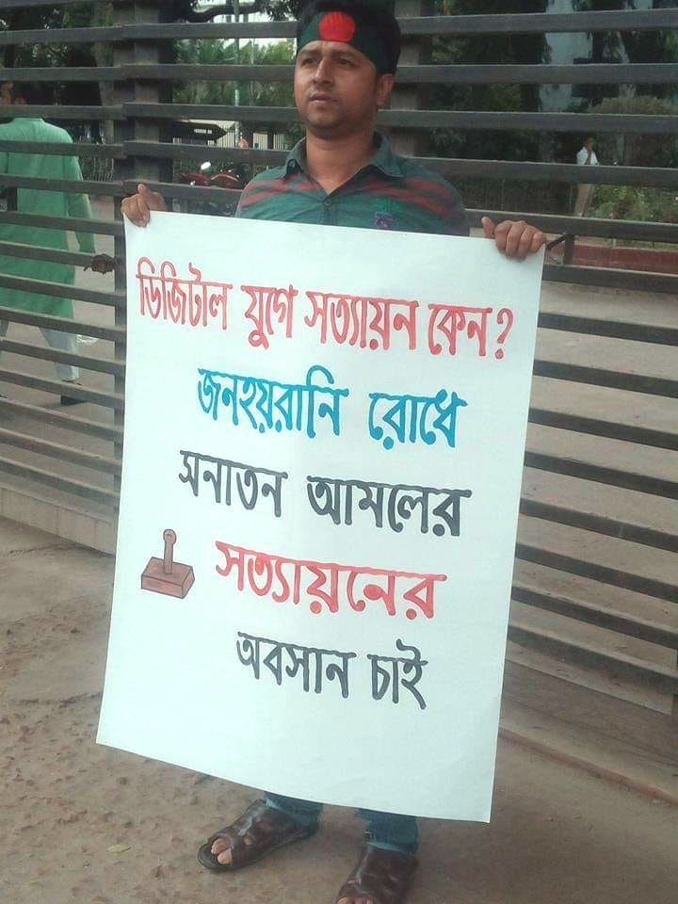
Problem Context:
We have noticed
that, a boy is pleading against ancient document attestation system
Source: Internet
Look at the picture
Figure: A boy pleading against ancient attestation system
5

Slide 6
Background Study:
The picture we have seen at the previous slide recollect that,
**We need to make our document authentication system modern
Because in our daily life, often we need document authentication for various purposes like government and non-government job.
But our document authentication/attestation system is ancient.
That is why we have planned for ‘Proverifier’
6

Slide 7

Abstract:
We want to make a system that will help a user:
Upload documents to a secure cloud
Easy Document Authentication/Attestation
Use verified documents for various purposes
7

Slide 8

Introduction:
Proverifer = Property + Verifier
What is property in our perspective ?
We considering your valuable documents as a property.
Example: S.S.C, H.S.C, Engineering or other certificates, NID etc.
8

Slide 9

What is ‘Proverifier’?:
‘Proverfier’ is a web based document verification/attestation and personal document hub.
9

Slide 10
Features:
Registration as verifier or general user.
Upload pdf, jpg,png type file as document
Send verification request to a verifier to verify document
Verified file archive
10

Slide 11
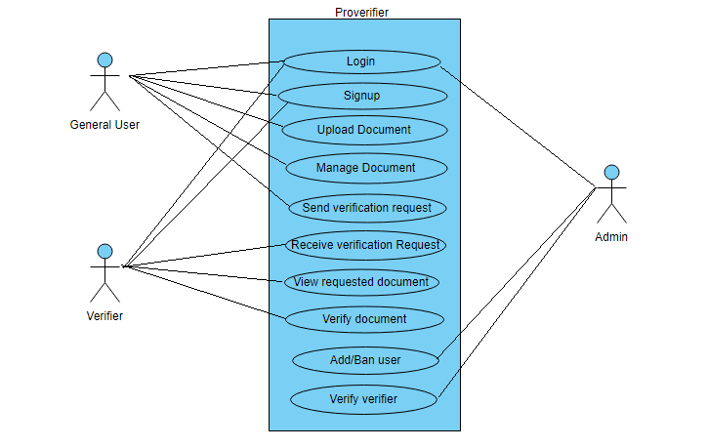
Use Case Diagram:
11

Slide 12
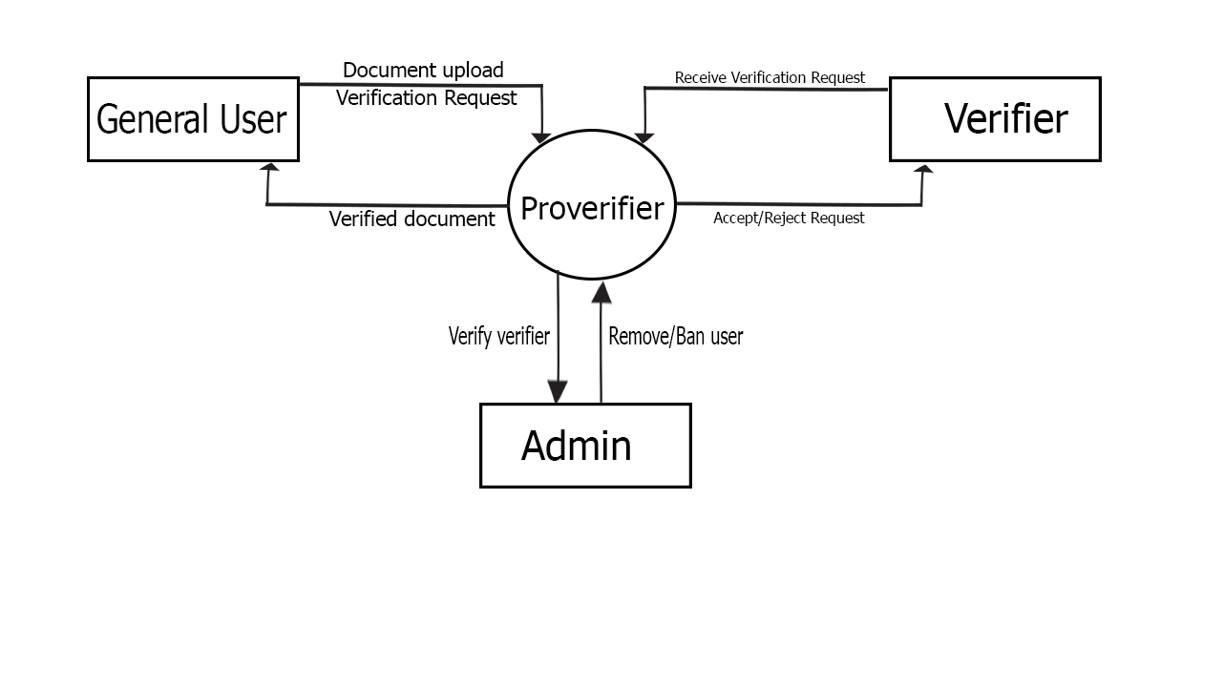
Data Folw Diagram:
12
Figure: Context/Level 0 Data Flow Diagram

Slide 13
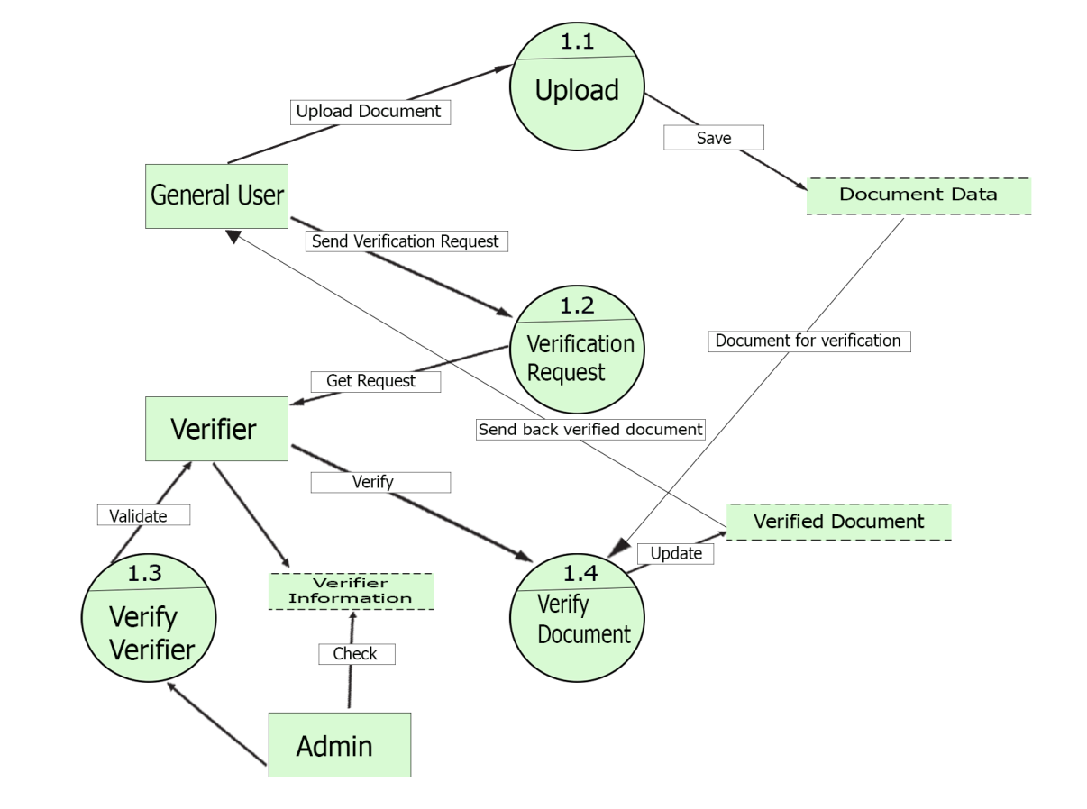
Data Folw Diagram:
13
Figure: Level 1 Data Flow Diagram

Slide 14
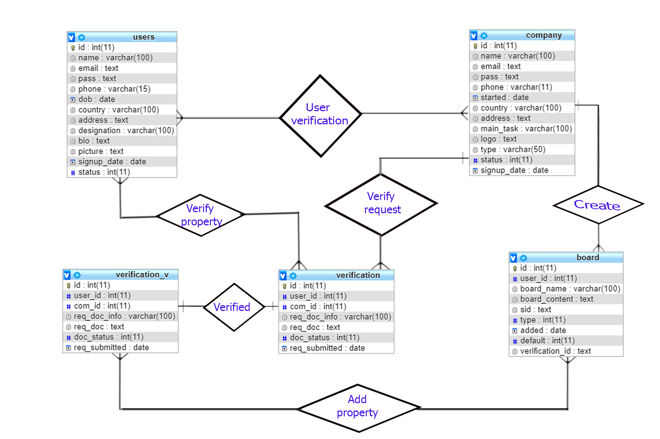
Entity Relationship Diagram:
14

Slide 15
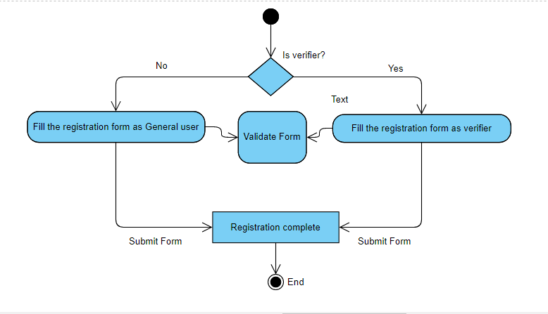
Activity Diagram:
15
Figure: Signup Activity Diagram

Slide 16
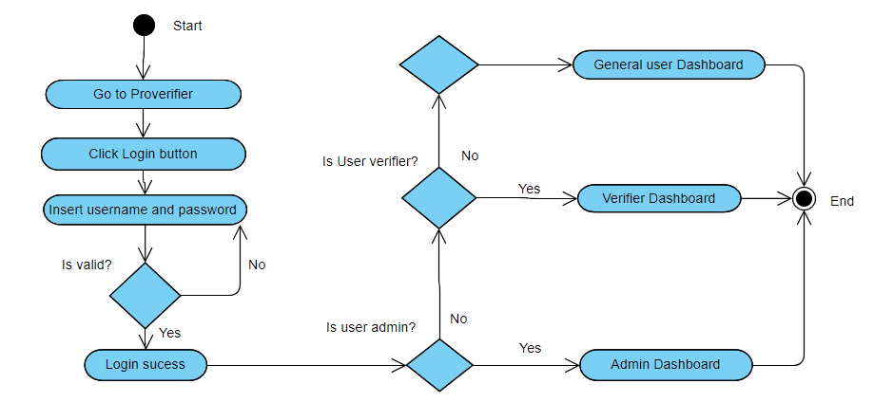
Activity Diagram:
16
Figure: Login Activity Diagram

Slide 17
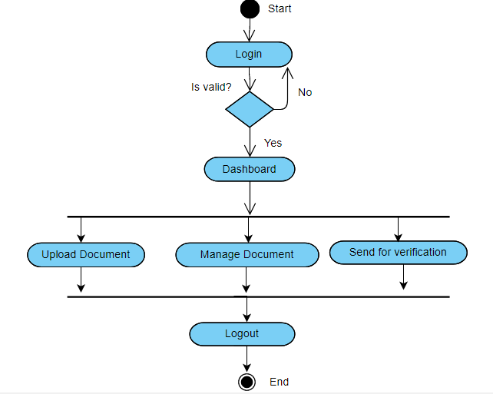
Activity Diagram:
17
Figure: General User Activity Diagram

Slide 18
Requirements & Overview:
Requirements for this project is:
System Type: Web Based
Front End: HTML, JavaScript, Bootstrap
Backend: Raw PHP & Codeigniter MVC Framework
Database: MySQL
Web Server: Apache web server.
18

Slide 19
Advantage:
Making the documents as a verified portable soft copy.
Send verified documents using system email.
Easy for the requisition authority to check the attestation.
Reducing fake attestation or verification.
Suitable for future paperless world.
Time saving and less trouble for verification/attestation
19

Slide 20
Limitations:
Only fewer document file type is supported.
Require huge database storage space.
Hard copy of the documents need to convert
info specific file format before uploading.
20

Slide 21
Project Scope:
Online attestation
Document Verification
Authentication
21

Slide 22
Future Scope:
Adding some functionality this system can be converted into verified document hub
Can be use as a e-certification system
Copyright statement reservation
Product Registration
22

Slide 23
Thanks All
23

