Slide 1

Impact of increased screentime on kids
By Md Afsar Uddin Salman
12190848
Professional communications skills for ICT

Slide 2
Introduction
Many research paper suggests on how the amount of time spent on using technology has been strongly associated with changes in brain; this is critical during developmental stage.

Slide 3
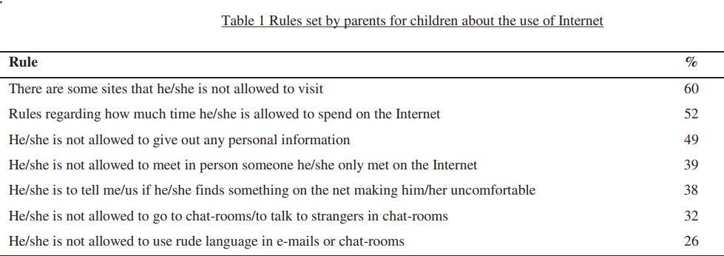
Why we SHOULD restrict
Increasing dependence on technology for the basic knowledge
(Çankaya & Odabaşı, 2009)

Slide 4
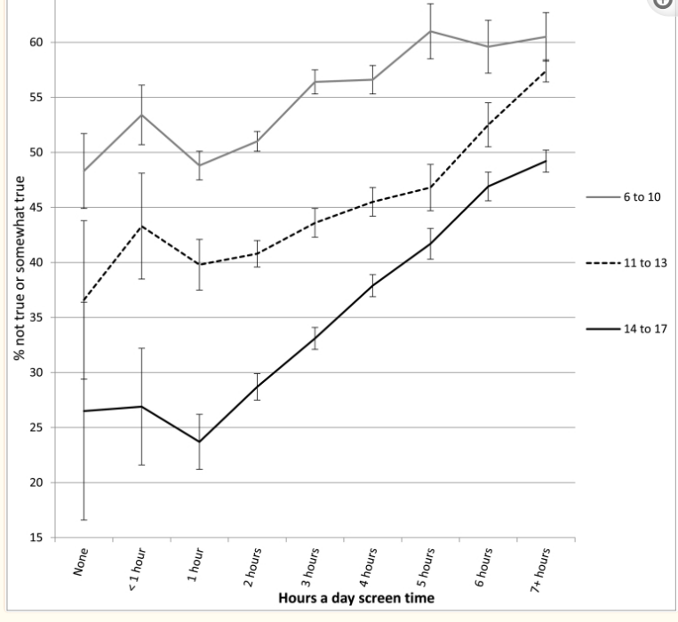
Impact: Psychological
Research highlighted spending long hours has been correlated with symptoms of mental illness including depression and anxiety.
Incline in screen time has been associated with poor emotion regulation (not staying calm, arguing too much, being difficult to get along with), an inability to finish tasks, lower curiosity, and more difficulty making friends.
Percentage who do not stay calm when challenged, by age and level of screen time, with controls, U.S., 2016.
(Twenge & Campbell, 2018)

Slide 5
Impact: Social effects
Reports highlight that two-thirds of parents in the U.S. consider parenting harder compared to 20 years ago.
More screen time reduces person-person interactions, increasing the rate of family conflicts.
Hinders communication skills during early development stage.

Slide 6
Impacts: Health
Long screen time hours affects weight and diet in children aged 5-17 years old.
Recommendation by Australian Government: no screen time for children aged under 2 years.
Negative outcomes of prolonged usage include obesity, chronic back and neck pains, sleeping habits
A 2018 findings indicated 2 hours screen time usage limited language and learning abilities while 7 hours screen time usage showed that the thinning of cortex; critical thinking and reasoning.

Slide 7
Irrespective of the pros…
The extent of educational content in internet is vast
The ability to access and search information effectively
Ability to multitask with lesser distractions
The limitations on:
understanding of cyberbullying and staying safe online
gaining knowledge on digital skills and emotional resilience

Slide 8
Conclusion
Despite the fact that there are benefits associated with certain amount of screen times like cognitive and communication, the advantages of restricting technology usage outweigh the disadvantages.
An approach to tackle this raising concern would be the usage of parental control software or apps that help limit screen time.
Another strategy in reducing screen time among young adolescents include reinforcing activities that involve outdoor and social interactions like football or picnic.

Slide 9
Questions ?

Slide 10
References
Auxier, B., Anderson, M., Perrin, A., & Turner, E. (2020, July 28). Parenting Children in the Age of Screens. Pew Research Center: Internet, Science & Tech. https://www.pewresearch.org/internet/2020/07/28/parenting-children-in-the-age-of-screens/
BBC. (2017, June 30). Limiting time online “won’t protect children.” BBC News. https://www.bbc.com/news/education-40443509
Çankaya, S., & Odabaşı, H. F. (2009). Parental controls on children’s computer and Internet use. Procedia - Social and Behavioral Sciences, 1(1), 1105–1109. https://doi.org/10.1016/j.sbspro.2009.01.199
Cross, J. (2019, August 8). What Does Too Much Screen Time Do to Kids’ Brains? NewYork-Presbyterian; Health Matters. https://healthmatters.nyp.org/what-does-too-much-screen-time-do-to-childrens-brains/
Netnanny. (n.d.). Why Parents Should Limit Internet Time After School | Net Nanny. Www.netnanny.com. https://www.netnanny.com/blog/why-parents-should-limit-internet-time-after-school/#:~:text=Setting%20restrictions%20on%20Internet%20use

Slide 11
Pandya, A., & Lodha, P. (2021). Social Connectedness, Excessive Screen Time During COVID-19 and Mental Health: A Review of Current Evidence. Frontiers in Human Dynamics, 3. https://doi.org/10.3389/fhumd.2021.684137
Poveda, A. (2020, February 28). 10 Reasons to put Internet Control on your child’s devices. Www.iKydz.com. https://www.ikydz.com/10-reasons-to-put-internet-controls-on-your-childs-devices/
Too much time on screens? Screen time effects and guidelines for children and young people. (2021, August 5). Child Family Community Australia. https://aifs.gov.au/cfca/2021/08/05/too-much-time-screens-screen-time-effects-and-guidelines-children-and-young-people#:~:text=For%20screen%20time%2C%20the%20guidelines
Twenge, J. M., & Campbell, W. K. (2018). Associations between screen time and lower psychological well-being among children and adolescents: Evidence from a population-based study. Preventive Medicine Reports, 12(12), 271–283. https://doi.org/10.1016/j.pmedr.2018.10.003
Wheelwright, T. (2020, May 18). Experts Reveal the Benefits of Screen Time for Kids. HighSpeedInternet.com. https://www.highspeedinternet.com/resources/experts-reveal-benefits-of-screen-time-for-kids

