Slide 1

KACST Website:

Slide 2
Project Phases:
01
ANALYSIS:
We analysis the plan we have in use cases and ER diagram.
02
DESIGN:
We design the interfaces using HTML.
03
IMPLEMENTATION:
We write a database using XAMPP, then we write PHP code in Sublime.
04
TESTING:
We test the tasks that we add it in the website.

Slide 3

ANALYSIS:

Slide 4
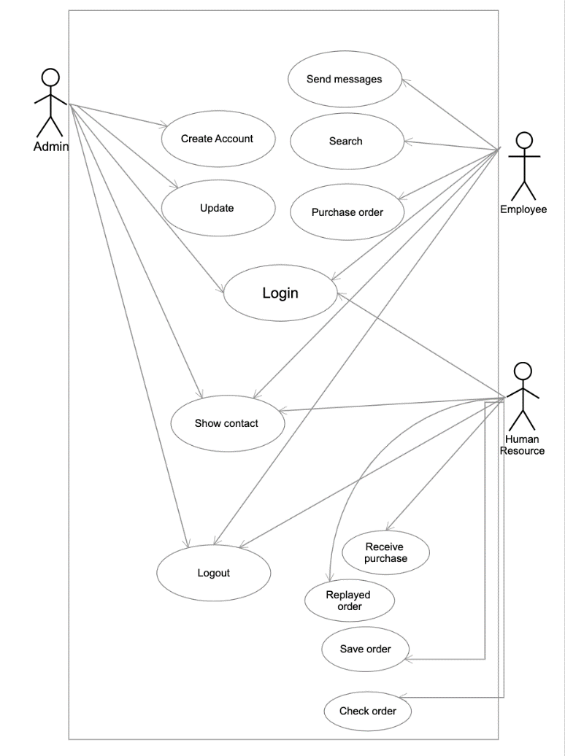
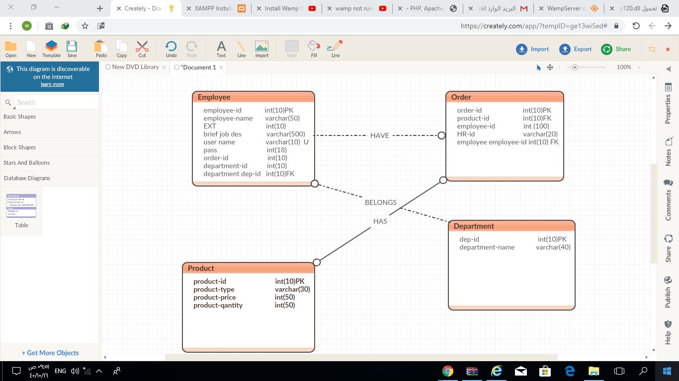

Slide 5
DESIGN:

Slide 6
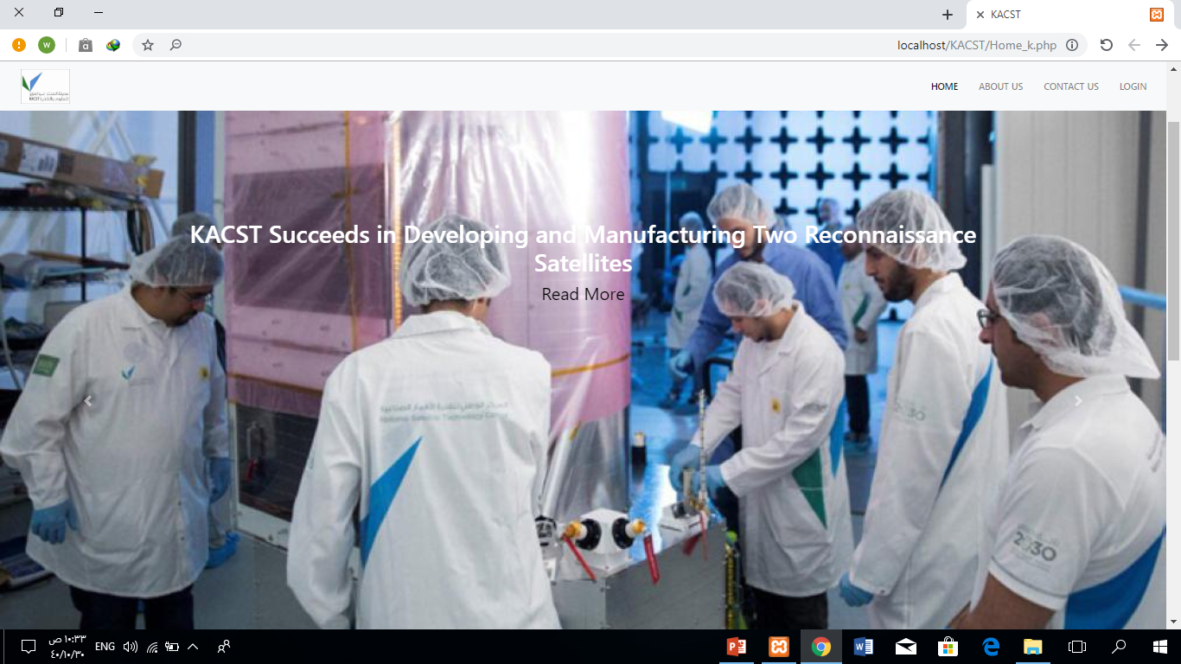
Home interface that we design it using HTML and CSS:
.

Slide 7
IMPLEMENTATION:

Slide 8
Our Services
The site offers six staff services:
Delete:
Edit:
01
The admin can delete in the Departments and Employees.
02
The admin can EDIT in the Departments, Employees.
Add:
Request:
03
The admin can add new departments and employees , and the Human recourse can add new products.
04
Any employee can request products from HR.
Search:
Direct messages:
05
06
The employee can search for another employees.
The employees can send a direct message for another one.

Slide 9
Testing:

Slide 10
Thank you

Slide 11
WORK TEAM:
Salma Albalawi.
Whad AlShehri

