Slide 1
Numerical Method
INTRODUCTION TO NUMERICAL METHODE
Okta Qomaruddin Aziz, S.Si, M.Kom.

Slide 2
Class Rule
Zoom Class will be announced later and based on our agreement
There will be an update in e-learning once a week (keep checking)
Attendance will be counted on e-learning
Some of material will not be available after certain time passed. So it is recommended to save it while it available. (such like videos)
Question can be asked in WA group (more discussion more benefit)

Slide 3
Marking (Nilai)
Type | Percentage
Task (Tugas) | 20
Midterm (UTS) | 35
Final term (UAS) | 35
Other (Discussion, activity, etc) | 10

Slide 4
Tasking (Tugas)
Task will be given after certain period (not every week).
Task will available for a limited period.
Need to complete certain task/condition to make another task occur.
You can bravely ask for a task (in WA group) but it will not always easy to complete.
Midterm and Final Term is also a task, I will decide it according to your accomplishment, whether you need it or you don’t.

Slide 5
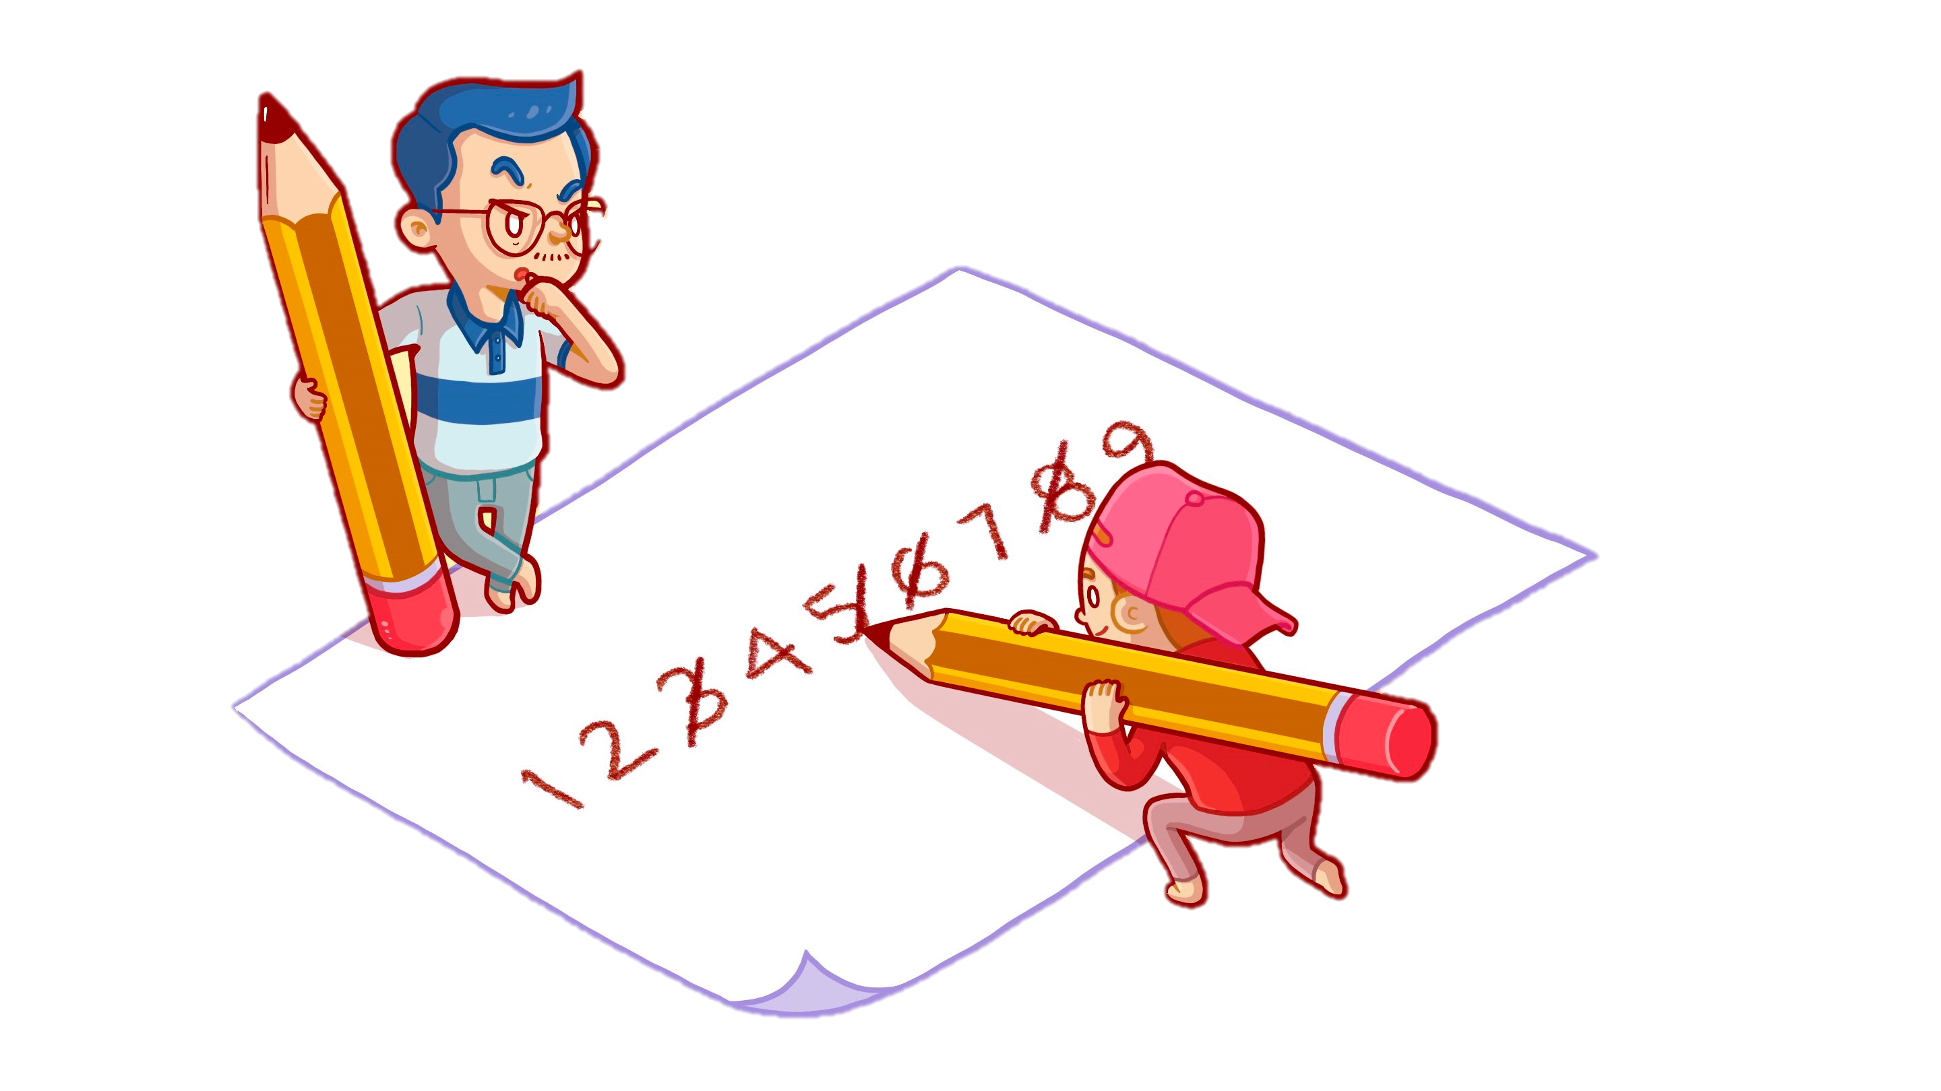
What is Numerical Method
Using basic operation
Give an approximate solution

Slide 6

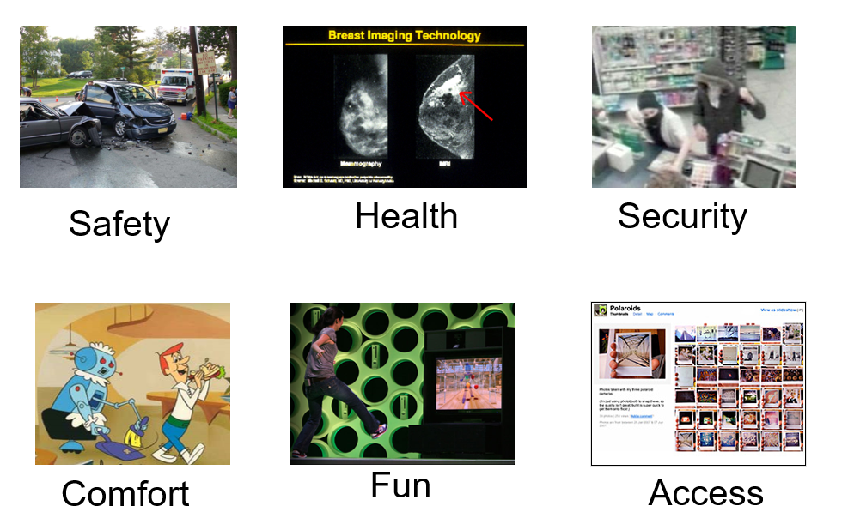
Why Numerical Method
Help solving Mathematical Problem (a lot)

Slide 7
Numerical Method vs Analytical Approach
Numerical Method | Analytical Approach
Approximate Solution | Exact Solution/True Solution
Has Error | No Error
Solve some Problem | Sometimes solve problem
Designed to do with Computer | Easier to do with Capable Human
Easy to understand | Hard to understand
Based on Hard Work | Based on mathematical manipulation

Slide 8
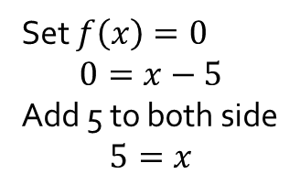
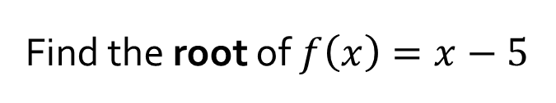
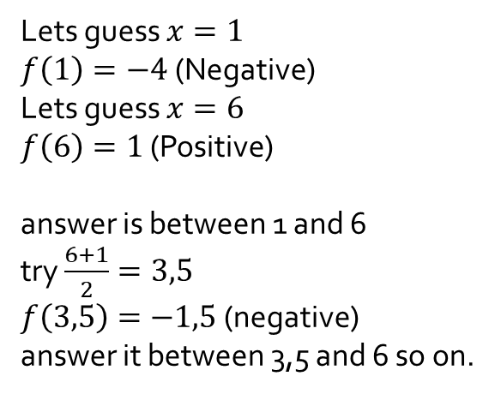
Example
Find the root of $f\left(x\right)=x−5$
Analytic
Numerical
Set $f\left(x\right)=0$ $$0=x−5$$ Add 5 to both side $$5=x$$
Lets guess $x=1$ $f\left(1\right)=−4$ (Negative) Lets guess $x=6$ $f\left(6\right)=1$ (Positive) answer is between 1 and 6 try $\frac{6+1}{2}=3,5$ $f\left(3,5\right)=−1,5$ (negative) answer it between 3,5 and 6 so on.
Pivot
Main Method
Iteration

Slide 9
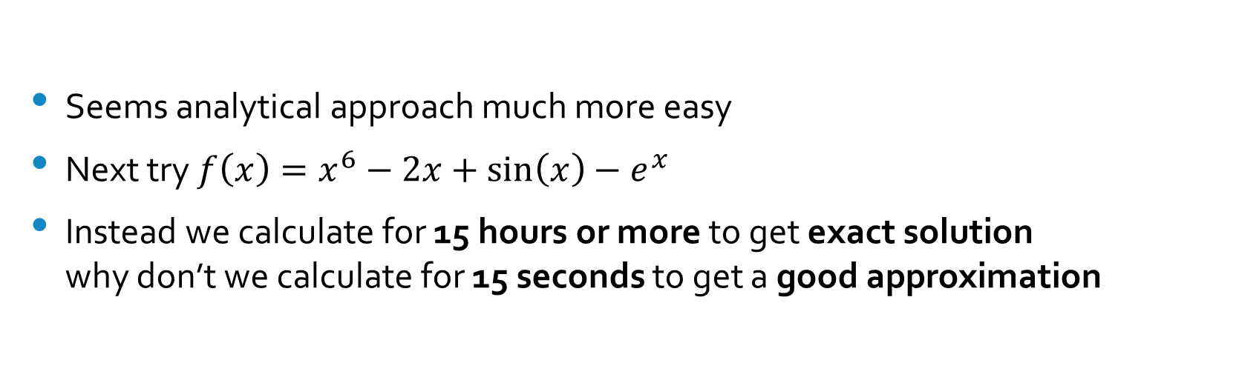
Example (Cont.)
Seems analytical approach much more easy
Next try ${f\left(x\right)=x}^{6}−2x+\sin\left(x\right)−e^{x}$
Instead we calculate for 15 hours or more to get exact solution why don’t we calculate for 15 seconds to get a good approximation

Slide 10
Numerical Method (Content)
Basic
Numerical Approach
Problem and Algorithm
Algebraic Equation
Numerical Problem
Algorithm
Differentiation
Matrix
Interpolation

Slide 11
Numerical Method (term)
Numerical Problem A problem that can be solved by numerical method
Approximate Solution A solution that close to exact/true solution
Numerical Error An Error that generated by Numerical Method - Exact Error - Relative Error

Slide 12
Numerical Problem
Non linear equation
Metode Tertutup : Tabel, Biseksi, Regula Falsi,
Metode Terbuka : Secant, Newton Raphson, Iterasi Sederhana
Linear equation
Eliminasi Gauss, Eliminasi Gauss Jordan, Gauss Seidel
Differentiation
Selisih Maju, Selisih Tengahan, Selisih Mundur
Integration
Integral Reimann, Integrasi Trapezoida, Simpson, Gauss
Interpolation
Interpolasi Linier, Quadrat, Kubik, Polinom Lagrange, Polinom Newton
Regression
Regresi Linier dan Non Linier
Differential Equation
Euler, Taylor

Slide 13
Task 1
Rank : ©
Available to : All Class
Type : one per class
Completion : Must Complete before 4 February 2021
Reward : Unlock subsequent task
Penalties : Increased difficulties in subsequent task
Description : Give an resume of this presentation in e-learning max 150 words
“I’m just an NPC, you are the Protagonist”

Slide 14
There are Infinite possibility in this world just like Infinite numbers between finite numbers, we only need to find the correct one
Okta Qomaruddin Aziz
Thank you

