Slide 1
Numerical Method
BISECTION METHOD
Okta Qomaruddin Aziz, S.Si, M.Kom.

Slide 2
Bisection’s Basic
Theorem
An equation f(x)=0, where f(x) is a real continuous function, has at least one root between x_{l} and x_{u} if f(x_{l}) f(x_{u}) < 0.
Figure 1 At least one root exists between the two points if the function is real, continuous, and changes sign.

Slide 3
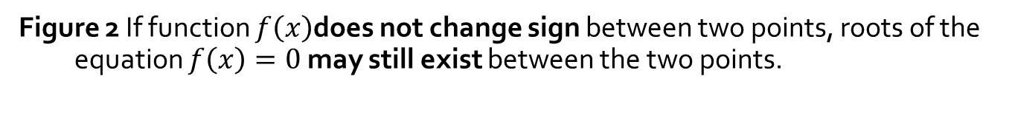
Bisection’s Basic
Figure 2 If function $f\left(x\right)$does not change sign between two points, roots of the equation $f\left(x\right)=0$ may still exist between the two points.

Slide 4
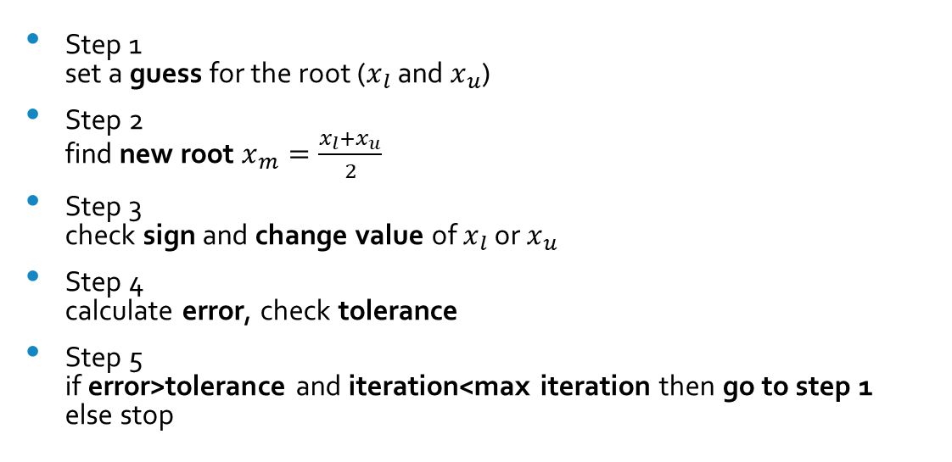
Algorithm
Step 1 set a guess for the root ($x_{l}$ and $x_{u}$)
Step 2 find new root $x_{m}=\frac{x_{l}+x_{u}}{2}$
Step 3 check sign and change value of $x_{l}$ or $x_{u}$
Step 4 calculate error, check tolerance
Step 5 if error>tolerance and iteration<max iteration then go to step 1 else stop
1 Iteration

Slide 5
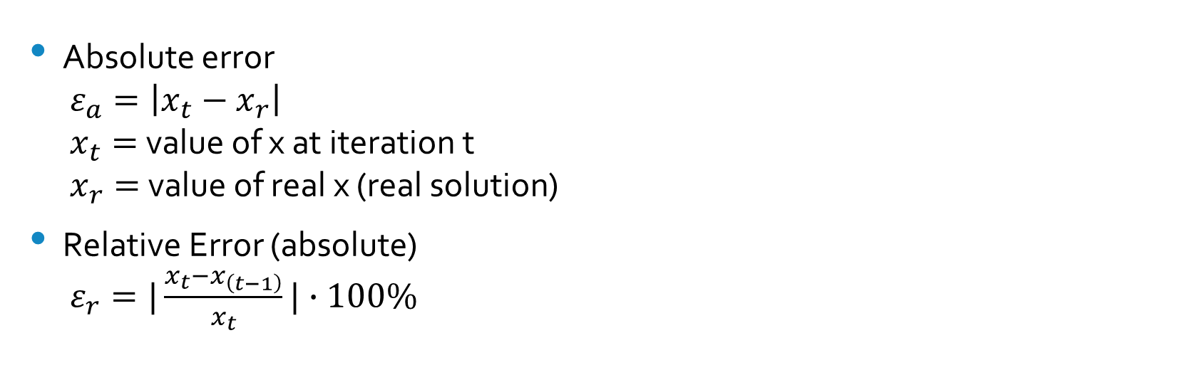
Error’s Calculation
Absolute error $ε_{a}=\left|x_{t}−x_{r}\right|$ $x_{t}=$value of x at iteration t $x_{r}=$ value of real x (real solution)
Relative Error (absolute) $ε_{r}=|\frac{x_{t}−x_{\left(t−1\right)}}{x_{t}}|∙100\%$

Slide 6

Example
Finding roots of
$$f\left(x\right)=x^{3}−0.165x^{2}+3.993×10^{−4}=0$$
With maximal three iteration or relative error of 5%

Slide 7
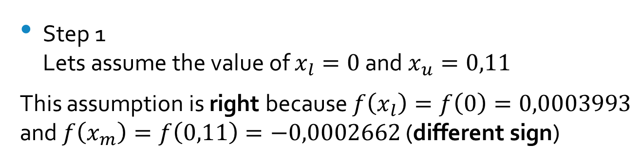
Example
Step 1 Lets assume the value of $x_{l}=0$ and $x_{u}=0,11$
This assumption is right because $f\left(x_{l}\right)=f\left(0\right)=0,0003993$ and $f\left(x_{m}\right)=f\left(0,11\right)=−0,0002662$ (different sign)

Slide 8
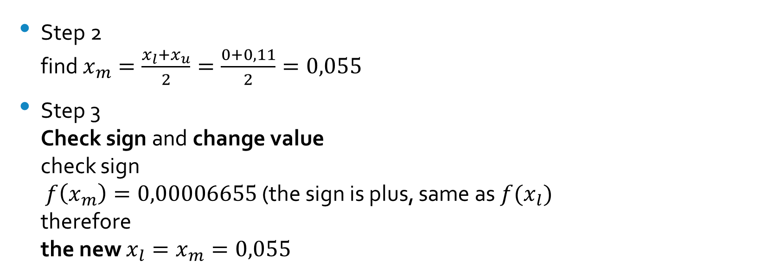
Example
Step 2 find $x_{m}=\frac{x_{l}+x_{u}}{2}=\frac{0+0,11}{2}=0,055$
Step 3 Check sign and change value check sign $f\left(x_{m}\right)=0,00006655$ (the sign is plus, same as $f(x_{l})$ therefore the new $x_{l}=x_{m}=0,055$

Slide 9
Example
Step 4 calculate relative error or check max iteration since this is 1st iteration, so it wont have a relative error since max iteration is three (3) and its still 1st iteration so we back to step 1

Slide 10
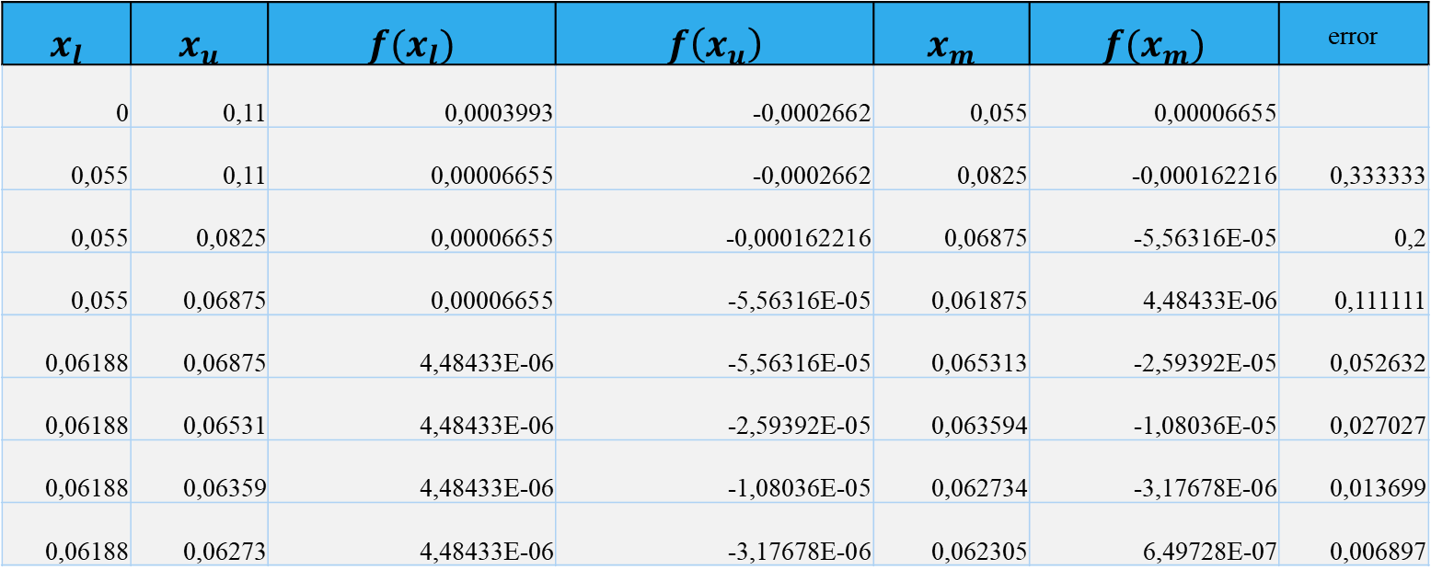
Example
$$x_{l}$$ | $$x_{u}$$ | $$f(x_{l})$$ | $$f\left(x_{u}\right)$$ | $$x_{m}$$ | $$f(x_{m})$$ | error
0 | 0,11 | 0,0003993 | -0,0002662 | 0,055 | 0,00006655
0,055 | 0,11 | 0,00006655 | -0,0002662 | 0,0825 | -0,000162216 | 0,333333
0,055 | 0,0825 | 0,00006655 | -0,000162216 | 0,06875 | -5,56316E-05 | 0,2
0,055 | 0,06875 | 0,00006655 | -5,56316E-05 | 0,061875 | 4,48433E-06 | 0,111111
0,06188 | 0,06875 | 4,48433E-06 | -5,56316E-05 | 0,065313 | -2,59392E-05 | 0,052632
0,06188 | 0,06531 | 4,48433E-06 | -2,59392E-05 | 0,063594 | -1,08036E-05 | 0,027027
0,06188 | 0,06359 | 4,48433E-06 | -1,08036E-05 | 0,062734 | -3,17678E-06 | 0,013699
0,06188 | 0,06273 | 4,48433E-06 | -3,17678E-06 | 0,062305 | 6,49728E-07 | 0,006897

Slide 11
No Action = No Reaction
Okta Qomaruddin Aziz
Thank you

