Slide 1
Numerical Method
FALSE POSITION (REGULA FALSI) METHOD
Okta Qomaruddin Aziz, S.Si, M.Kom.

Slide 2
Regula Falsi’s Basic
Very much Like Bisection but it converge faster
Getting a boost/brand new calculation for root

Slide 3
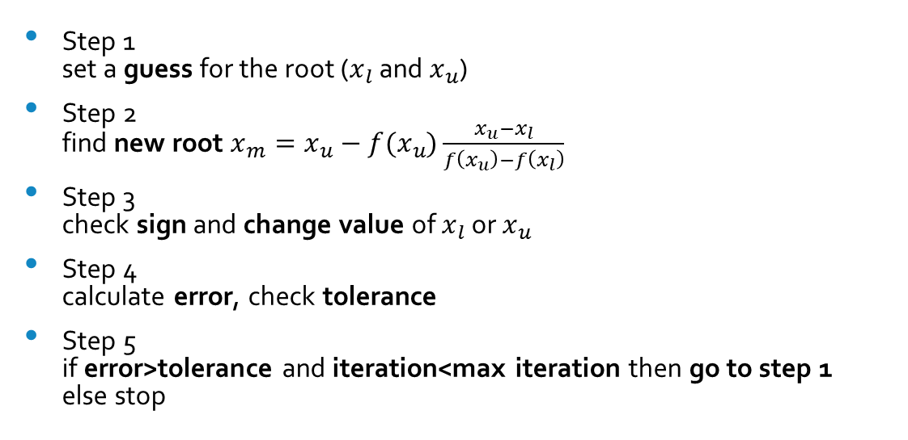
Algorithm
Step 1 set a guess for the root ($x_{l}$ and $x_{u}$)
Step 2 find new root $x_{m}=x_{u}−f(x_{u})\frac{x_{u}−x_{l}}{f\left(x_{u}\right)−f\left(x_{l}\right)}$
Step 3 check sign and change value of $x_{l}$ or $x_{u}$
Step 4 calculate error, check tolerance
Step 5 if error>tolerance and iteration<max iteration then go to step 1 else stop
1 Iteration

Slide 4
Example
Finding roots of
$$f\left(x\right)=x^{3}−0.165x^{2}+3.993×10^{−4}=0$$
With maximal three iteration or relative error of 5%

Slide 5
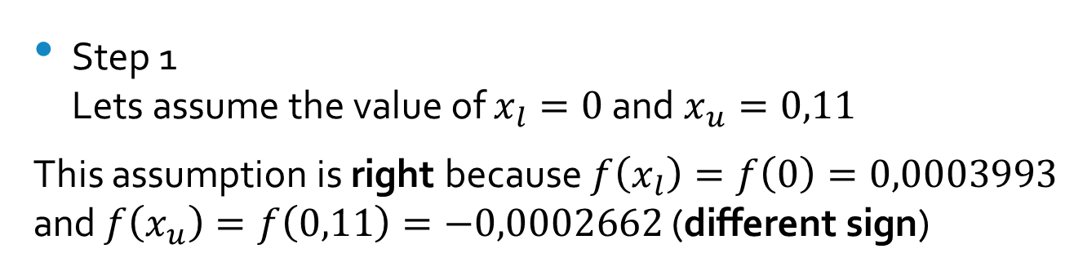
Example
Step 1 Lets assume the value of $x_{l}=0$ and $x_{u}=0,11$
This assumption is right because $f\left(x_{l}\right)=f\left(0\right)=0,0003993$ and $f\left(x_{u}\right)=f\left(0,11\right)=−0,0002662$ (different sign)

Slide 6
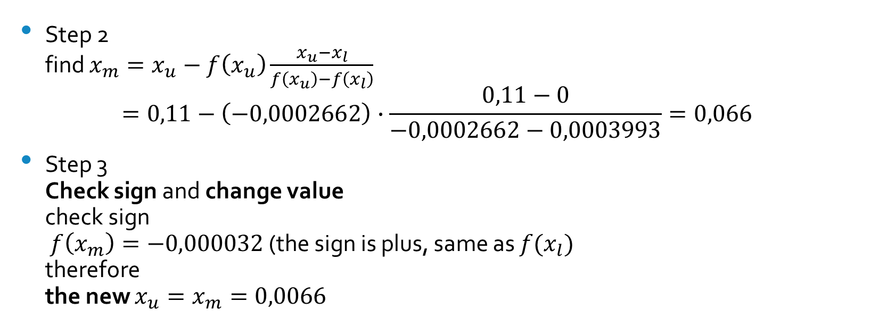
Example
Step 2 find $x_{m}=x_{u}−f\left(x_{u}\right)\frac{x_{u}−x_{l}}{f\left(x_{u}\right)−f\left(x_{l}\right)}$ $=0,11−\left(−0,0002662\right)∙\frac{0,11−0}{−0,0002662−0,0003993}=0,066$
Step 3 Check sign and change value check sign $f\left(x_{m}\right)=−0,000032$ (the sign is plus, same as $f(x_{l})$ therefore the new $x_{u}=x_{m}=0,0066$

Slide 7
Example
Step 4 calculate relative error or check max iteration since this is 1st iteration, so it wont have a relative error since max iteration is three (3) and its still 1st iteration so we back to step 1

Slide 8
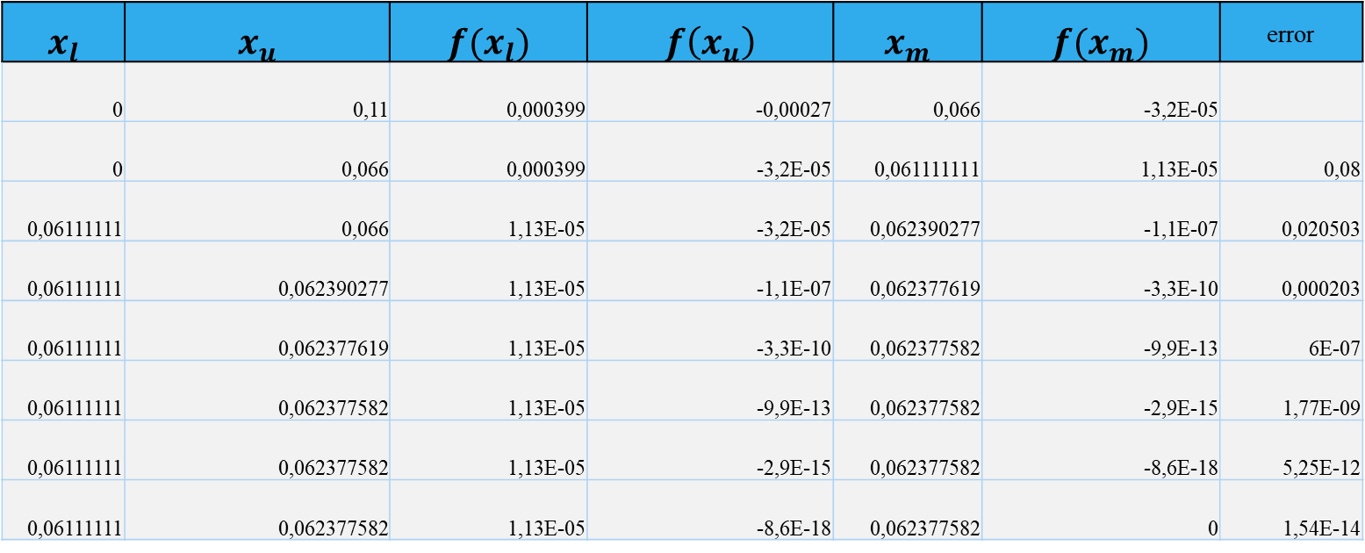
Example
$$x_{l}$$ | $$x_{u}$$ | $$f(x_{l})$$ | $$f\left(x_{u}\right)$$ | $$x_{m}$$ | $$f(x_{m})$$ | error
0 | 0,11 | 0,000399 | -0,00027 | 0,066 | -3,2E-05
0 | 0,066 | 0,000399 | -3,2E-05 | 0,061111111 | 1,13E-05 | 0,08
0,06111111 | 0,066 | 1,13E-05 | -3,2E-05 | 0,062390277 | -1,1E-07 | 0,020503
0,06111111 | 0,062390277 | 1,13E-05 | -1,1E-07 | 0,062377619 | -3,3E-10 | 0,000203
0,06111111 | 0,062377619 | 1,13E-05 | -3,3E-10 | 0,062377582 | -9,9E-13 | 6E-07
0,06111111 | 0,062377582 | 1,13E-05 | -9,9E-13 | 0,062377582 | -2,9E-15 | 1,77E-09
0,06111111 | 0,062377582 | 1,13E-05 | -2,9E-15 | 0,062377582 | -8,6E-18 | 5,25E-12
0,06111111 | 0,062377582 | 1,13E-05 | -8,6E-18 | 0,062377582 | 0 | 1,54E-14

Slide 9
Do your best or don’t do it at all
Okta Qomaruddin Aziz
Thank you

