Slide 1
Numerical Method
NEWTON RAPHSON METHOD
Okta Qomaruddin Aziz, S.Si, M.Kom.

Slide 2
Newton Raphson’s Basic
Using gradient as direction
One starting point
Have to know the derivative

Slide 3
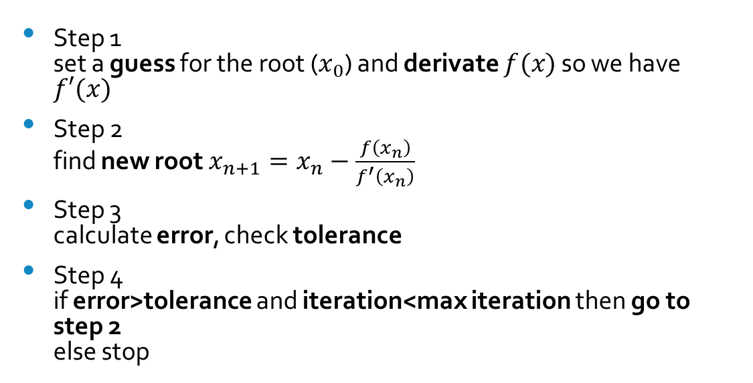
Algorithm
Step 1 set a guess for the root ($x_{0}$) and derivate $f(x)$ so we have $f′(x)$
Step 2 find new root $x_{n+1}=x_{n}−\frac{f\left(x_{n}\right)}{f^{′}\left(x_{n}\right)}$
Step 3 calculate error, check tolerance
Step 4 if error>tolerance and iteration<max iteration then go to step 2 else stop
1 Iteration

Slide 4
Example
Finding roots of
$$f\left(x\right)=x^{3}−0.165x^{2}+3.993×10^{−4}=0$$
With maximal three iteration or relative error of 5%

Slide 5
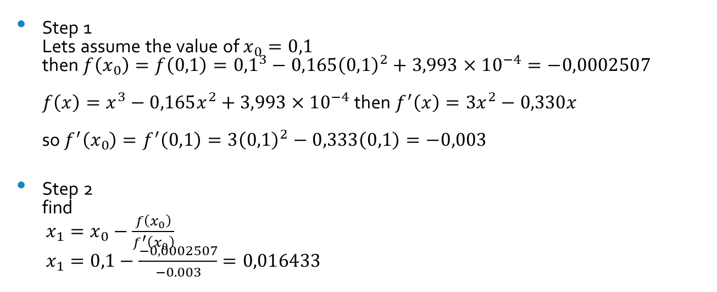
Example
Step 1 Lets assume the value of $x_{0}=0,1$ then $f\left(x_{0}\right)=f\left(0,1\right)={0,1}^{3}−0,165{\left(0,1\right)}^{2}+3,993×10^{−4}=−0,0002507$ ${f\left(x\right)=x}^{3}−0,165x^{2}+3,993×10^{−4}$ then $f^{′}\left(x\right)=3x^{2}−0,330x$ so $f^{′}\left(x_{0}\right)=f^{′}\left(0,1\right)=3{\left(0,1\right)}^{2}−0,333\left(0,1\right)=−0,003$
Step 2 find $x_{1}=x_{0}−\frac{f\left(x_{0}\right)}{f^{′}\left(x_{0}\right)}$ $x_{1}=0,1−\frac{−0,0002507}{−0.003}=0,016433$

Slide 6
Example
Step 3 calculate relative error or check max iteration since this is 1st iteration, so it wont have a relative error since max iteration is three (3) and its still 1st iteration so we back to step 2

Slide 7
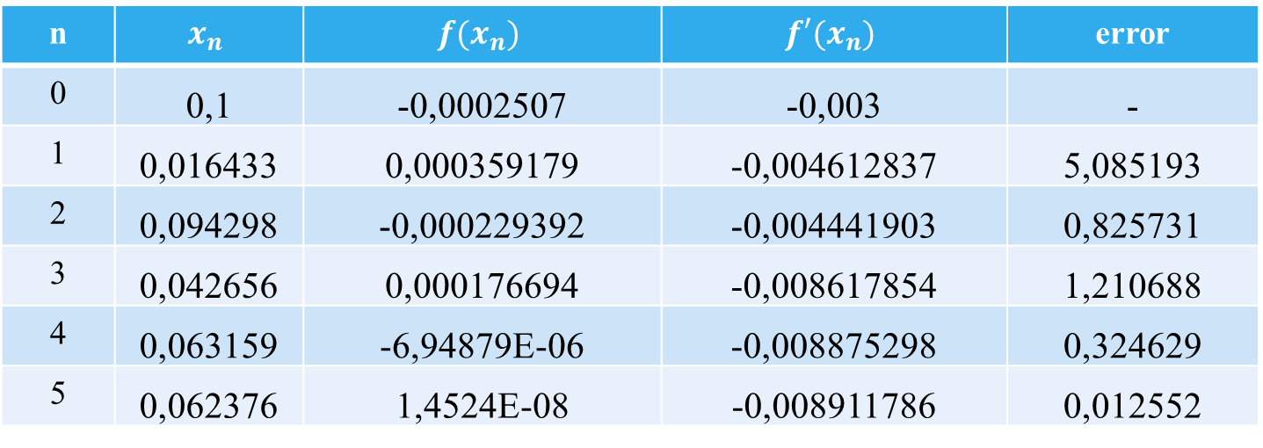
Example
n | $$x_{n}$$ | $$f(x_{n})$$ | $$f′(x_{n})$$ | error
0 | 0,1 | -0,0002507 | -0,003 | -
1 | 0,016433 | 0,000359179 | -0,004612837 | 5,085193
2 | 0,094298 | -0,000229392 | -0,004441903 | 0,825731
3 | 0,042656 | 0,000176694 | -0,008617854 | 1,210688
4 | 0,063159 | -6,94879E-06 | -0,008875298 | 0,324629
5 | 0,062376 | 1,4524E-08 | -0,008911786 | 0,012552

Slide 8
Luck is based on your effort
Okta Qomaruddin Aziz
Thank you

