Slide 1
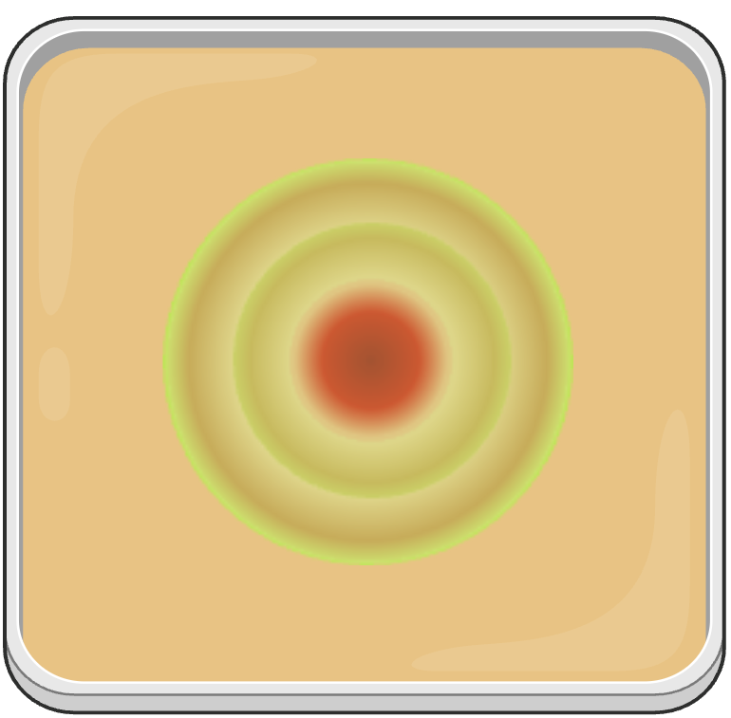

P_{proA}-fhlDC
R3
R1
R2
R4
P_{proB}-fhlDC

