Slide 1
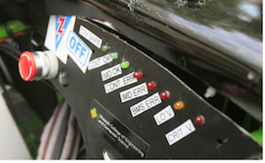
Digital Dashboard for the Viking Motorsports Electric Vehicle
Prior Work
Implementation
Testing
Haltech
Motivation
Further Improvements
The Viking Motorsports Team
Conclusions
Block Diagram

