Slide 1
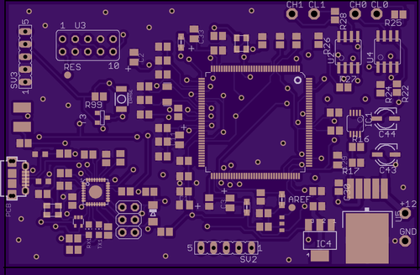
Prototype boards/Enclosure
Final board has been ORDERED
Cost: $35.95
Has been sent off to fabrication (notified by OSH Park)
May take 2 weeks to deliver
Already have components for final board

Slide 2

Demo Code
Wrote code to test our system, if by chance EV Car is not completed on time
When testing with EVCU, we are not getting any data from the RMS line.
We don’t know if the connected car had other components that worked with EVCU

Slide 3
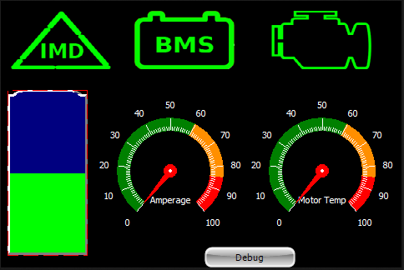
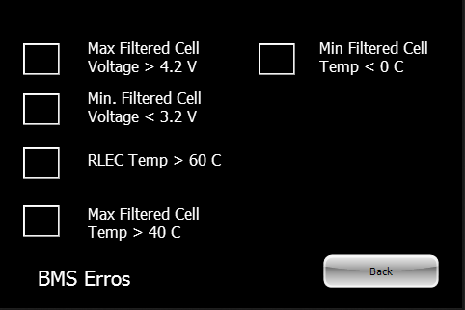
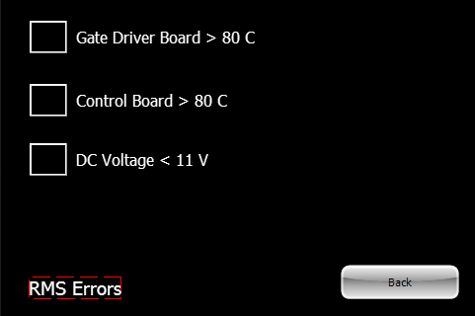
Display Updates
GUI
- Main screen has been designed
Subsystem menus
- Additional screen options to troubleshoot

Slide 4
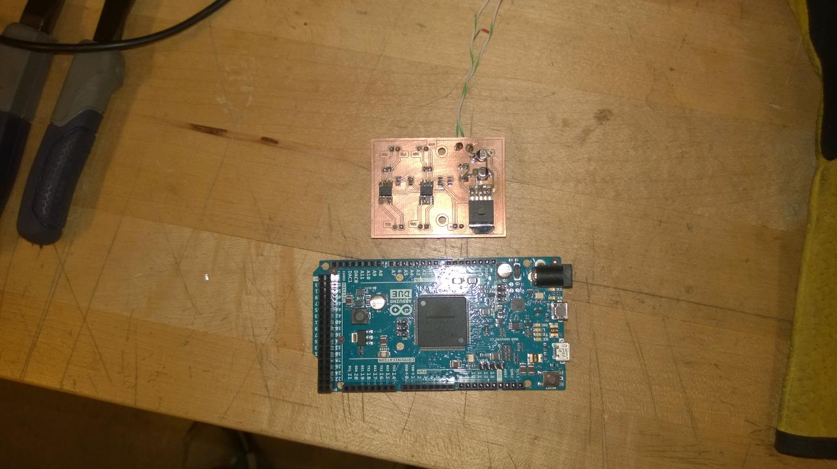
Prototype boards
Boards to be used in prototype enclosure
Power Board steps 12V down to 5V also includes CAN transceiver circuitry
Arduino Due interprets data from CAN lines and passes data to the display
Production board will be same size as due and will contain the power supply CAN transceiver circuitry

