Slide 1


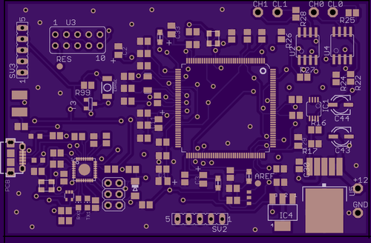
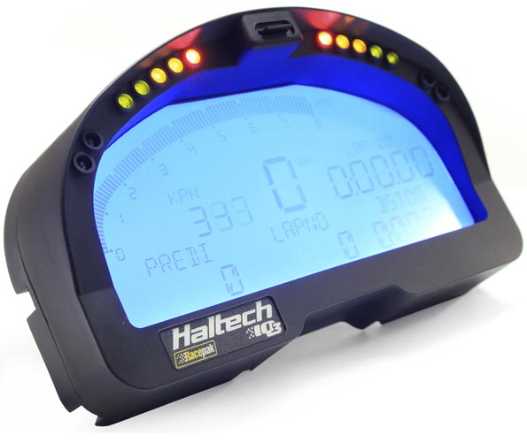
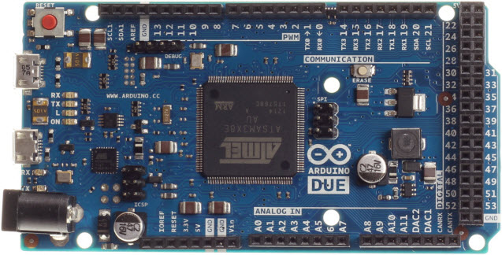
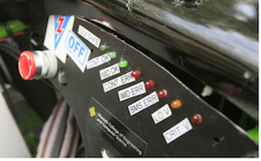
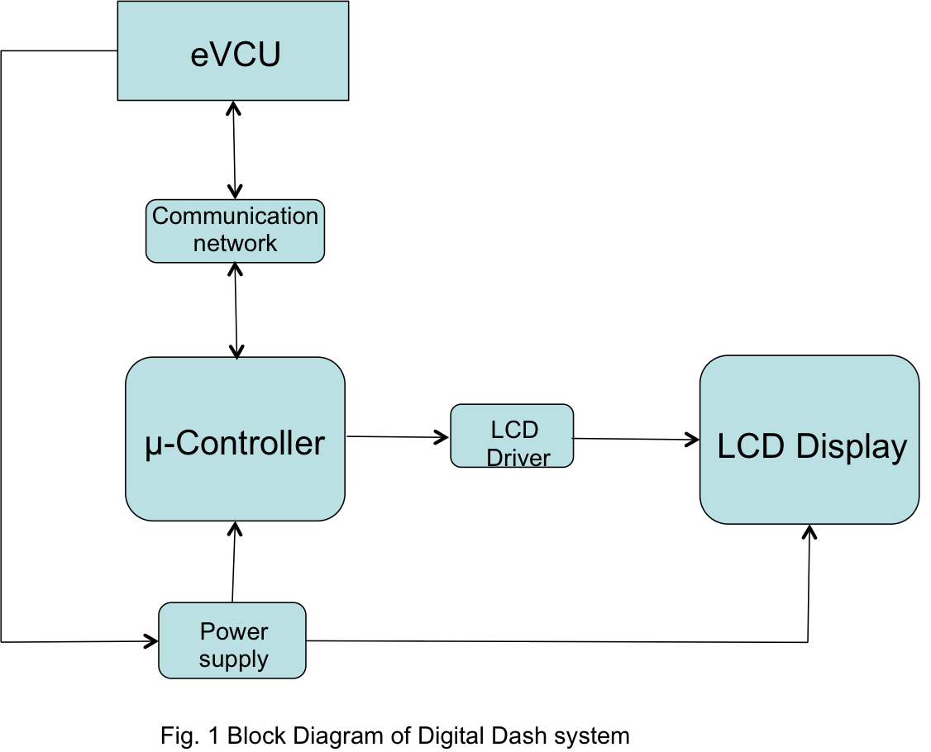
Digital Dash for SAE Electric Race Car
Prior Work
Implementation
Testing
The real estate that the digital dash unit took up on the physical dash needed to be minimal. This requirement dictated two large design choices:
The 3.5” Display Size
The custom PCB to cut down size
The entire system was first prototyped using an Arduino Due which was slightly too large for the solution we had in mind. The screen was slightly smaller than the LCD and the Arduino Due would have a lot of wires plugging into the screen. We wanted our device to be as plug-and-play as possible so we created a custom PCB that would plug directly into the LCD with no “mod wires”.
The Viking Motorsports team could’ve chosen a number of different solutions for their digital dash. All of these solutions came at the expense of cost and would not be a custom fit for their vehicle.
Motivation
Further Improvements
In the current design of the SAE Electric Race Car, the various messages produced by the vehicle was displayed by simple LEDs. Although this method works, major issues such as a blown LED and low visibility of the LED when on could occur. These issues will prevent the driver to address any dangerous issues that the vehicle may have.
With an LCD screen integrated into the system. The driver can see all errors clearly and address them appropriately.
The digital dash can be installed on the VMS car if it works.
Picture of LCD screen on Car goes here!!
Conclusions
Block Diagram

