Slide 1

Sean Koppenhafer, Jaime Rodriguez,
Chad Thueson, Noah Erickson, Rishal Dass
Digital Dash
Portland State University
Department of Electrical and Computer Engineering (ECE)
Notes:
1
1

Slide 2
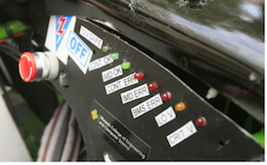
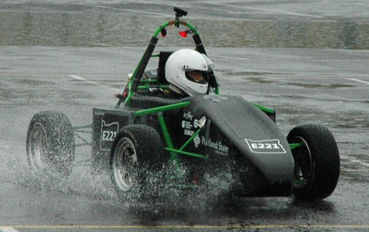
Project Overview
Electric systems add complexity and a traditional LED dash won't suffice
Drivers must be aware of system faults and warnings
An LCD Dashboard must be created to accommodate additional electrical systems
Formula SAE Electric Car
Current Traditional LED Dash

Slide 3
Progress
Completed
Still to accomplish
Arduino can get RMS and BMS data
Screen can output BMS and RMS data
Prototype software and hardware works completely
Lots of documentation
Assemble final board
Program final board
Assemble the demo unit
Create enclosure

Slide 4
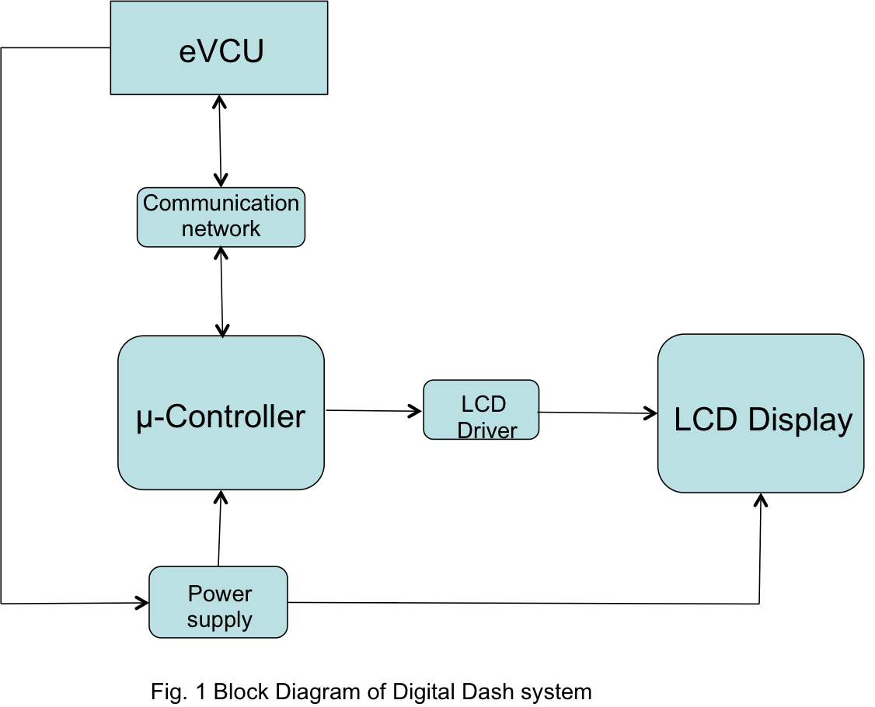
Block Diagram

Slide 5


Software
Arduino Code
4D Visi-Genie
Searches for specific CAN message ID’s, specified in code
Sends messages via serial to the screen module (uses a visi-genie library)
Currently running on an Arduino Due but will port over to the custom PCB
Controls the positioning of the gauges, bars and symbols
Handles button presses and their submenus
Scales code sent from Arduino Due to match output data

Slide 6
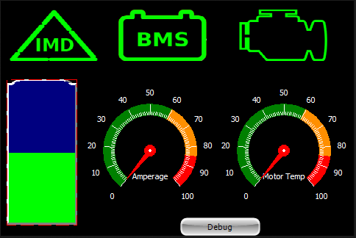
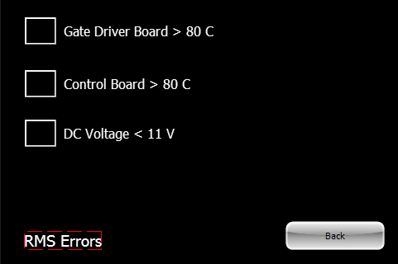
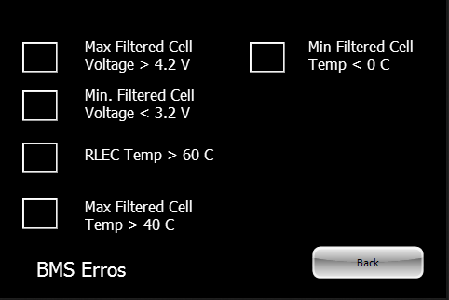
Screen Module
4D Systems uLCD-35DT
3.5” Resistive Touch Screen
Display Module handles graphics processing and image storage
User Interface
IMD, BMS and Motor symbols act as buttons to get into submenus
Battery level, Motor
temp and amperage
displayed

Slide 7
Enclosure Designs
?

Slide 8
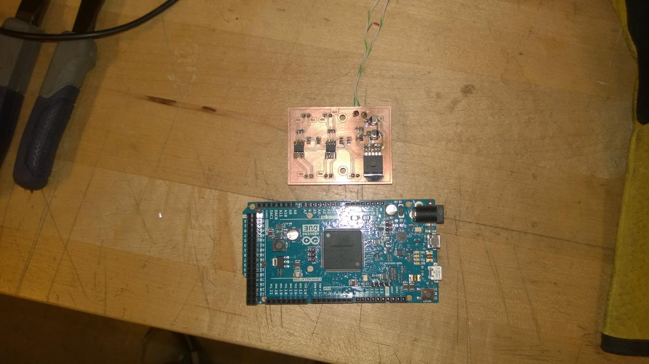
Prototype Boards
Power & Can Transceivers
The CAN transceivers receive data from the BMS and RMS and send them to the Arduino Due
Power Board steps 12V down to 5V also includes CAN transceiver circuitry
The TLF1963 Voltage runs very hot
May end up just using 5V from GeVCU
Arduino Due
Runs the software for processing CAN messages and mapping them to the screen module

Slide 9
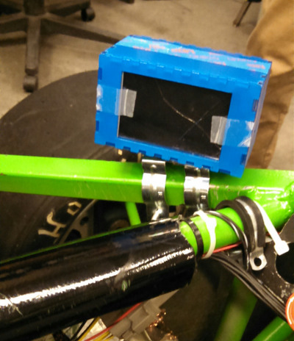
Prototype Enclosure
Simple enclosure for track day testing
Mounted to the driver side pod to eliminate blind spots
Track day enclosure is also water resistant
Arduino Due, power board and screen secured in box
This enclosure was quickly created for a track day prototype and is not intended for the final unit

Slide 10
Custom PCB
Why a custom PCB?
Cut down on total dash board size
Designed to plug directly into the back of the screen module
Components
Contains the essentials of an Arduino Due and the prototype power board with CAN transceivers
Other Details
Manufactured by OSH Park
3 boards were manufactured
Include a side by side picture of the Arduino Due size vs PCB

Slide 11
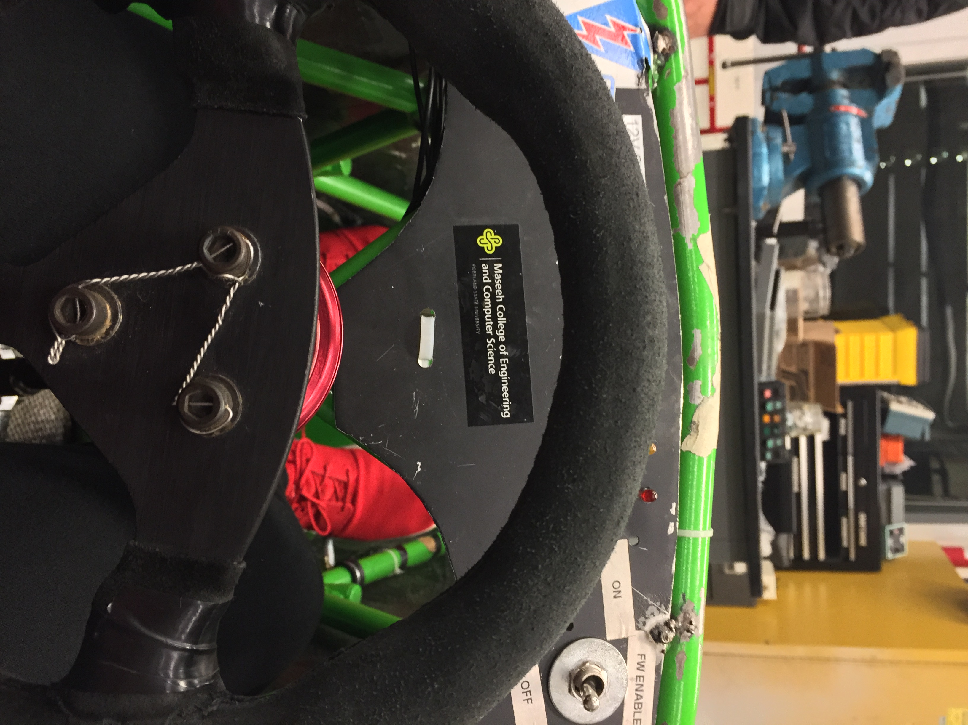
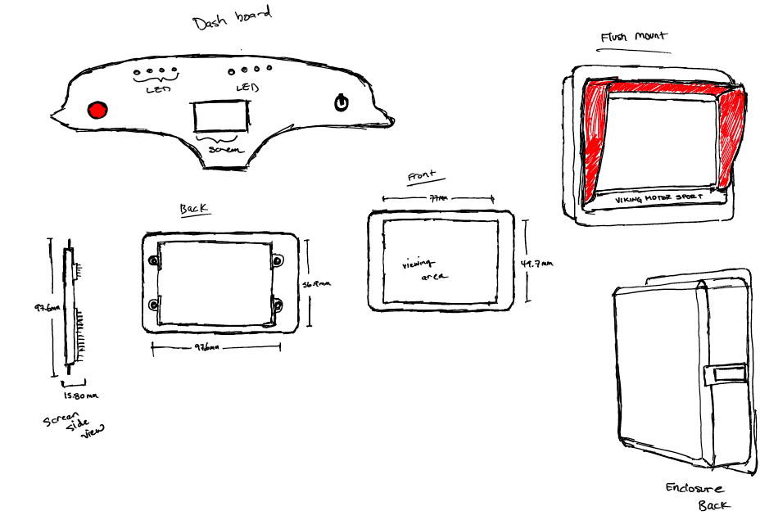
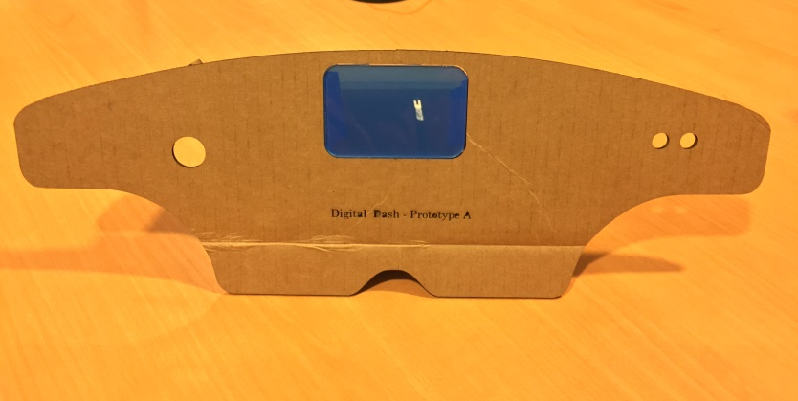
Final Enclosure
Requirements
Waterproof
Dimensions
Must be low profile to fit in dash
Viewing angle is a bit awkward, through the steering wheel

Slide 12
Demonstration Unit
Unit Created to Simulate Car
Runs off the Arduino Due used for prototyping
Will be used to demonstrate project
Hardware
Potentiometers and buttons to simulate functionality of the car
Software
Sends input data from potentiometers and buttons to the digital dash unit

