Slide 1
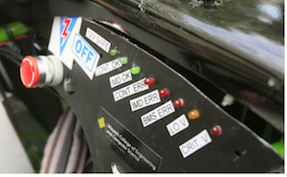
Digital Dashboard for the Viking Motorsports Electric Vehicle
Motivation
The Viking Motorsports Team

