Slide 1
Sean Koppenhafer, Jaime Rodriguez,
Chad Thueson, Noah Erickson, Rishal Dass
Weekly meeting, 05/06/2015
Digital Dash
Portland State University
Department of Electrical and Computer Engineering (ECE)
Notes:
<number>
<number>

Slide 2
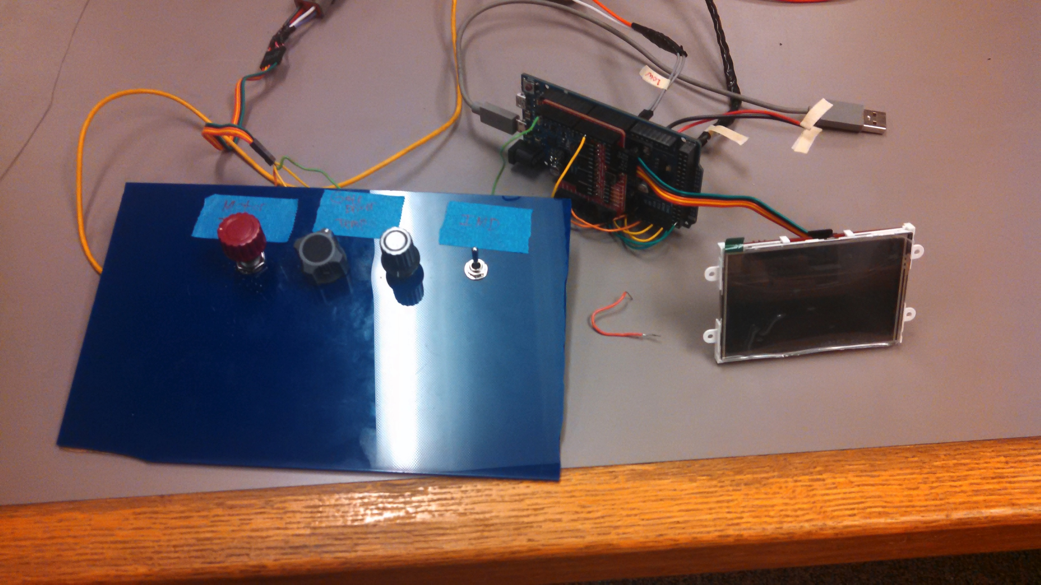
Demo Unit Updates
A debounce circuit was added to the IMD switch.
The pots sweep in voltage when read by analog pins. Need a solution for the RMS state potentiometer.
Motor temp has been switched out for motor torque.
Still debugging battery level potentiometer.

Slide 3
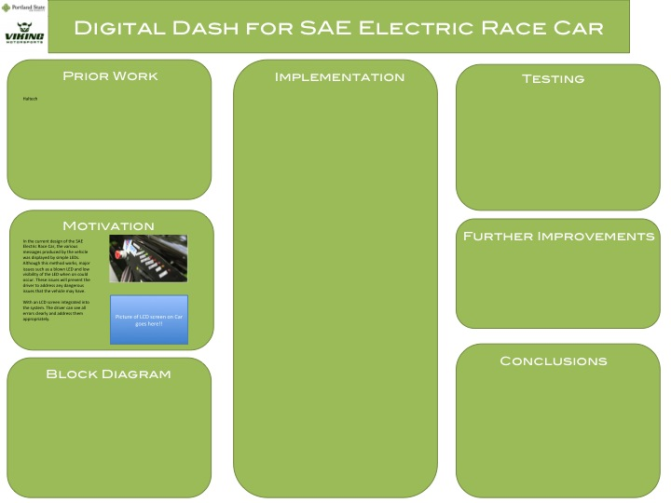
Report and Poster
Need to update this.

Slide 4
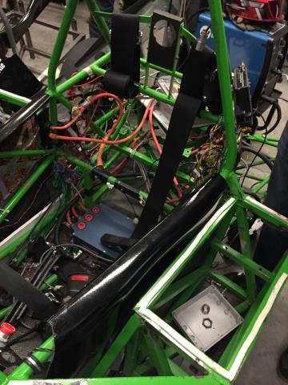
Electric Vehicle Update
In Progress
The old car is still in pieces.
The new frame is still being put together.
Progress is slow to happen.

Slide 5
Goals For The Upcoming Week
System
- Get all potentiometers working on the current iteration of the demo board.
-
Enclosure
- On hold until we decide on PCB vs Due
Documentation
- Keep working on report
- Keep working on poster
- Update wiki with information about the demo board
- Create a users manual for the device.
Other
- VMS progress report presentation was moved to a later date.
Notes:
<number>

