Slide 1
Digital Dashboard Capstone
Team Members: Sean Koppenhafer, Jaime Rodriguez,
Chad Thueson, Noah Erickson, Rishal Dass

Slide 2
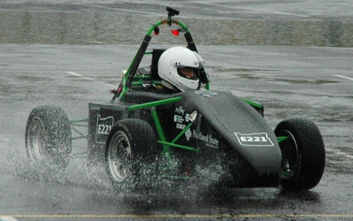
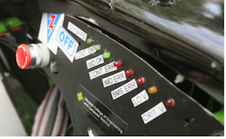
Project Overview
Electric systems add complexity and traditional LED dash would not suffice
Drivers must be aware of system faults and warnings
A Digital Dashboard must be created to accommodate additional electrical systems
Formula SAE Electric Car
Traditional LED Dashboard

Slide 3
Requirements
Size
Price
Reproducible
User-Friendly
4D Systems 3.5” Screen
Custom PCB
4D Systems 3.5” Screen
Arduino Based
Arduino Based
Arduino Based
Custom PCB
4D Systems 3.5” Screen
4D Systems 3.5” Screen

Slide 4
Consideration – Microprocessor
 | Cost | Custom Board | CAN Controller | CAN Library | SPI, I²C, UART, etc
ATMEGA328 | $3 | Yes | No | No | Yes
AT90CAN | $8 | Yes | Yes | Yes | Yes
Arduino Uno | $25 | No | No | No | Yes
Arduino Due | $50 | No | Yes | No | Yes
ATSAM3X | $12 | Yes | No | Yes | yes
The ATSAM3X was chosen with the following consideration:
External MCP-2551 CAN Tranceivers
Notes:
Should we do this all on one slide or split it up?

Slide 5
Consideration – Screen
 | Cost | Size | Color | Visibility | Software
EarthLCD | $219 | 3.5” | Yes | Yes | Yes
New Haven | $60 | 4.9” | No | Yes | No
Sun LCD | ??? | 3.5” | Yes | Yes | No
4D Systems | $89 | 3.5” | Yes | No | Yes
The 4D Systems Screen was chosen with the following consideration:
Overdriven Display Voltage
Polarizing Shield
Notes:
Need to fill this in

Slide 6
Consideration – Comm. Protocol
 | Complexity | Available
I²C | Simple | Yes
SPI | Simple | Yes
CAN | Complex | Yes
Wi-Fi |  | No
ATSAM3X
4DSystems LCD
Digital Dashboard
CAN Communication

Slide 7
System Overview
CAN Buses
GEVCU
Microcontroller
LCD Screen
Power Supply

Slide 8
Printed Circuit Board
Features
Programming port
CAN Inputs
12V Power Supply
Screen Mating Header
Decision
Reproducible via your favorite PCB manufacturer
Cheaper than an Arduino Due
Fits
Functionally an Arduino Due
LCD Mating
Header
CAN Inputs
Programming Circuit
12V Supply

Slide 9
Software

Slide 10
GUI

Slide 11
Testing

Slide 12
Conclusion

