Slide 1
Sean Koppenhafer, Jaime Rodriguez,
Chad Thueson, Noah Erickson, Rishal Dass
Weekly meeting, 2/18/2015
Digital Dash
Portland State University
Department of Electrical and Computer Engineering (ECE)
Notes:
1

Slide 2
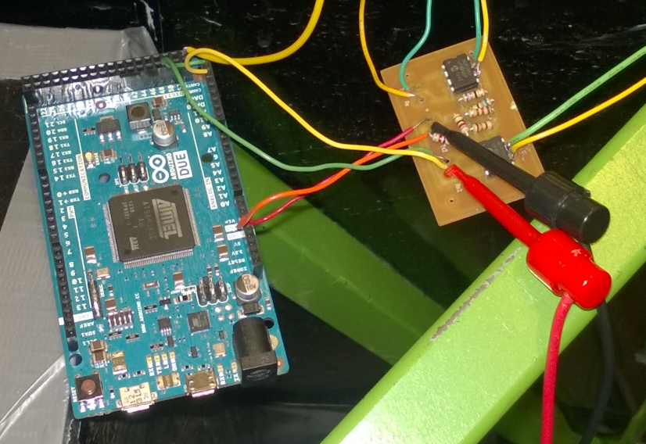
Prototyping Progress
Breakout Board for MCP2551 Transceivers
Integrated prototype board into RMS CAN network in electric car
- Messages being received
Test integration with BMS CAN network
Notes:
2
1/23/15, Thinking about Arduino Due for prototyping, in March send out CAD design for PCB manufacturing to cut down on real estate for the arduino due

Slide 3
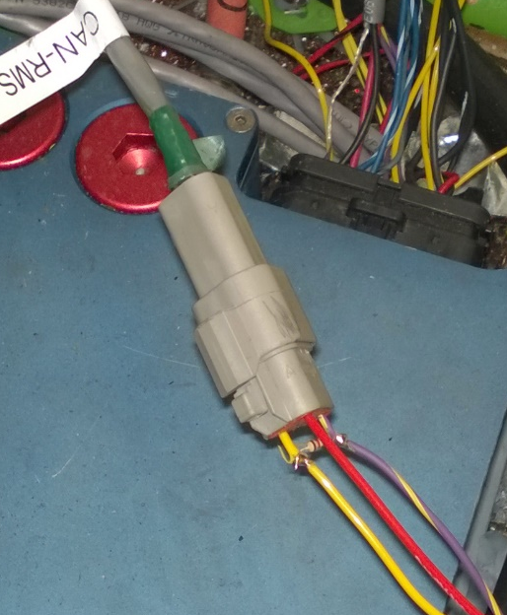
Prototyping Progress
Layout wiring for Deutsch connectors
Resistance values for CAN network
Display ordered should arrive in next couple days
Basic GUI designed
Debugging using IDE
Notes:
3
1/23/15, Thinking about Arduino Due for prototyping, in March send out CAD design for PCB manufacturing to cut down on real estate for the arduino due

Slide 4
Goals for upcoming week
The 4D systems screen
Upload code to display and test
Integrate with DUE and troubleshoot
Documentation
Document troubleshooting steps for DUE when integrating into car
Debug Prototype
- Test Prototype with actual messages from the car’s CAN Buses
Custom Board
- Continue with custom board design/layout

