Slide 1


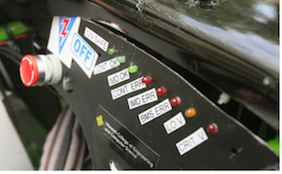
Digital Dash for SAE Electric Race Car
Prior Work
Implementation
Testing
Haltech
Motivation
Further Improvements
In the current design of the SAE Electric Race Car, the various messages produced by the vehicle was displayed by simple LEDs. Although this method works, major issues such as a blown LED and low visibility of the LED when on could occur. These issues will prevent the driver to address any dangerous issues that the vehicle may have.
With an LCD screen integrated into the system. The driver can see all errors clearly and address them appropriately.
Picture of LCD screen on Car goes here!!
Conclusions
Block Diagram

