Slide 1

Road Accidents Analysis in the United States
By: Salmon Rajneol B

Slide 2
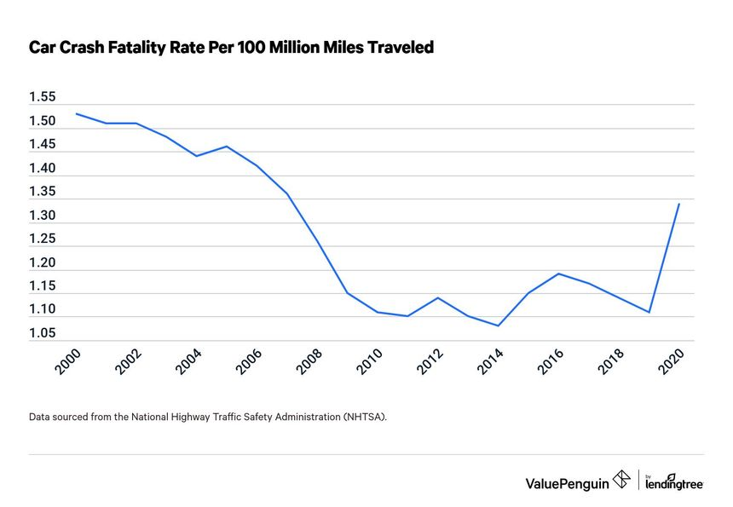
Overview
Objective: Analyze road accidents in the United States
Utilizing packages such as 'ggplot2,' 'sf,' and 'proj4' for effective data manipulation and visualization.

Slide 3

Data Import:
You began by loading your dataset into R Studio using the read.csv() function. This step ensured that your data is ready for analysis.
Plot Initialization:
Utilizing the ggplot2 library, you initialized a plot object using the ggplot() function. This set the foundation for your visualization, with the dataset and aesthetics specified within the function.
Line Geometry Addition:
To represent your data as a line graph, you added the line geometry to the plot using geom_line(). This step instructed R Studio to connect the data points with lines, visually depicting trends or patterns.
Customization (Optional):
If needed, you customized your plot by adding labels, titles, and adjusting the theme. This step enhanced the clarity and aesthetics of your line graph, making it more informative and visually appealing.

Slide 4
Install and Load Required Packages:
Use the install.packages() function to install the necessary packages. For mapping, popular choices include ggplot2, sf (simple features), and leaflet. Install them using:
install.packages(c("ggplot2", "sf", "leaflet"))
After installation, load the packages using the library() function:
library(ggplot2)
library(sf)
library(leaflet)
Load and Prepare Your Dataset:
Import your dataset into R using functions like read.csv() or read.table().
If your dataset contains spatial information, convert it to a spatial object using the st_as_sf() function from the sf package.
Create a Basic Plot with ggplot2:

Slide 5
A road accident map of the United States was made by me using the 'ggplot2' software.The database is integrated with geographic boundaries and accident information. A tidy and aesthetically pleasing appearance is achieved by applying the'map_theme' to style the plot.Red denotes "fatal" accidents, whereas grey denotes "non-fatal" accidents. These colors were carefully defined.Geospatial representation is guaranteed by 'coord_equal()'.

Slide 6

Use ggplot() to create a basic plot of your spatial data. If your dataset is in the sf format, ggplot2 will automatically recognize it as a spatial object.
Add layers using geom_point(), geom_polygon(), or other appropriate functions based on your data type.
Enhance the Map with ggplot2:
Customize the map using ggplot2 functions. For example, adjust aesthetics with functions like labs(), theme(), and scale_*().
If needed, you can add additional layers, such as borders or labels.
Interactive Mapping with leaflet:
Create an interactive map using the leaflet() function.
Add layers using functions like addTiles(), addMarkers(), or addPolygons() depending on your data type.
Customize the interactive map with additional functions, such as addPopups() or addLegend().

Slide 7
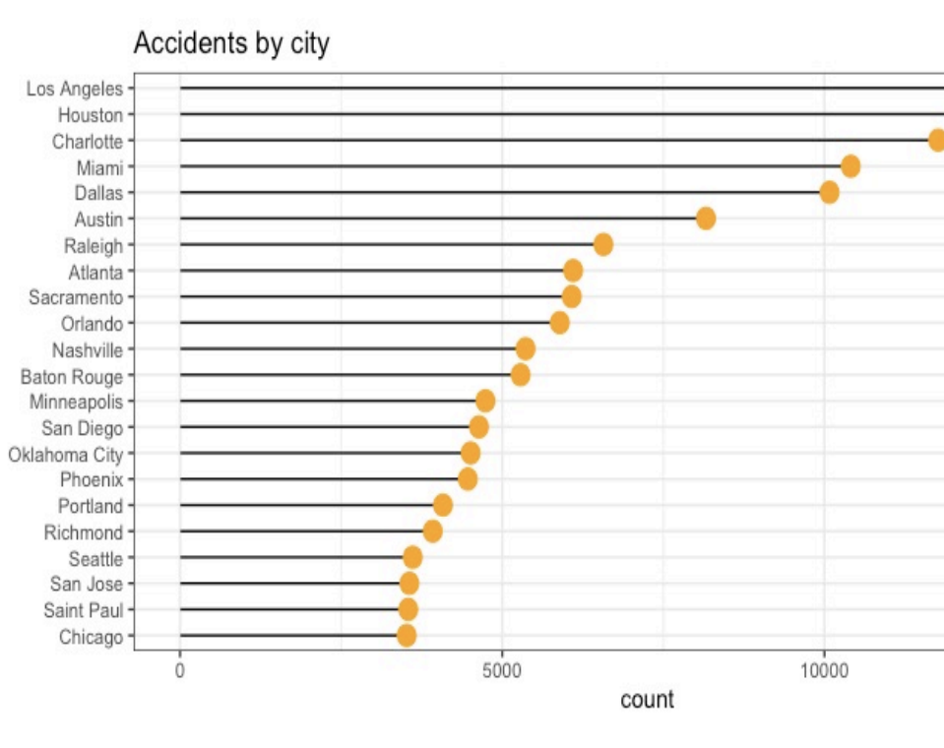
Geographic Distribution Map The map displays the geographic distribution of road accidents. Points represent accident locations, colored by severity.

Slide 8
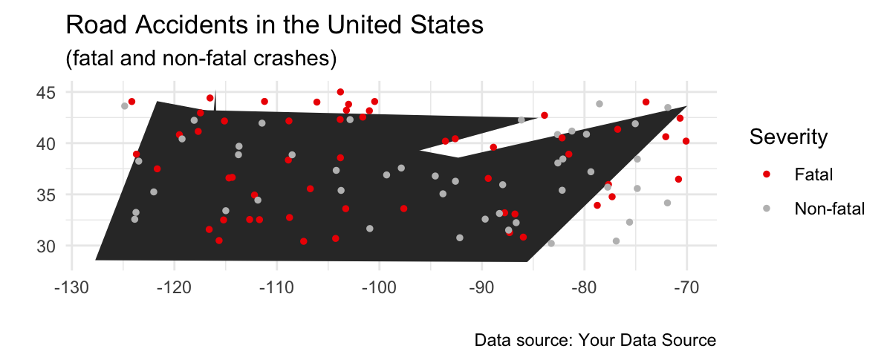
Severity Analysis: Fatal Accidents Red Points: Fatal accidents Analyze patterns, hotspots, and contributing factors. Non-Fatal Accidents Grey Points: Non-fatal accidents Explore trends and geographical variations Visualization Details: This chart provides a visual representation of accidents by crash type.

Slide 9
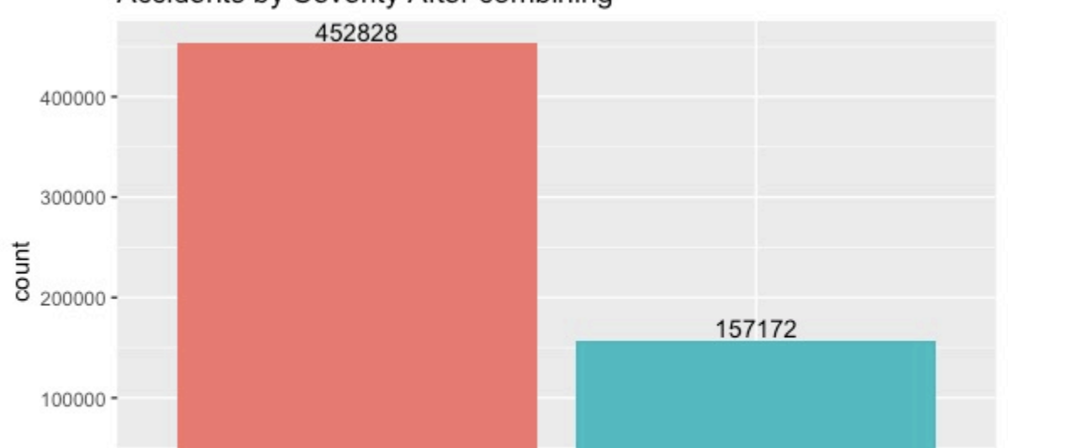
Time of Day Examine the impact of time on accident severity. Identify peak hours for accidents

Slide 10
Conclusion: The visuals shown have helped to clarify the intricate patterns of traffic accidents in the United States. We acquire a more nuanced knowledge of the spatial distribution and intensity of these episodes thanks to the attractive data visualization. Our investigation yielded critical insights, indicating hotspots of fatal and non-fatal accidents. This information establishes the framework for targeted actions and policy changes to improve road safety. Weather conditions and time of day were examined, providing a full view of the variables determining accident severity. We make strategic recommendations based on our findings. Improved traffic education, better infrastructure in high-risk areas, and proactive weather alert systems emerge as critical approaches to reduce the effect of road accidents.

