Slide 1
RNN Text Generation
Nicolas Teo Zhi Yong (S10206093)

Slide 2
STUDY OBJECTIVES
LSTM vs GRU vs SimpleRNN vs BiDirectional LSTM + GRU
Developing an accurate sequence generator model
Batch VS Layer
Normalization
Comparing the effectiveness of RNN layers
Comparing the effectiveness of normalization layers
Developing an accurate sequence generator model

Slide 3
01
02
03
Overview
Data loading and preprocessing
Development of sequence generator models
04
05
06
Summary
Choosing of best model
Input Real text

Slide 4
Overview
The problem, objective and approach

Slide 5
Problems
Artistic, colourful language found in the Dataset
01
03
Use of RNN to develop sequence generator model
Analysis of quality of generated text
02

Slide 6
Objective
Creating an English Language character generator capable of building semi-coherent English sentences from scratch

Slide 7
APPROACH
Highest validation accuracy with least overfitting
Final
Using Dropout layers, regularizers and Batch and Layer Normalization
Fine Tune Hyperparameters
Overfitting of Model
Increase network size
Baseline Model
Choice of RNN layer

Slide 8
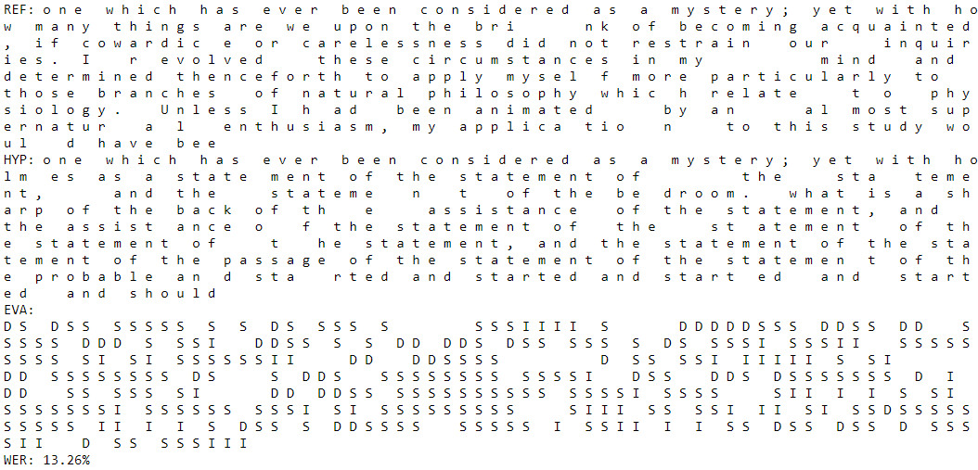
WORD ERROR RATE
S + I + d
WER =
N
Substitution
Refers to the amount of words substituted
Deletion
Refers to the amount of words deleted by the model compared to the original text
Insertion
Refers to the amount of words predicted and added by the model

Slide 9
Data preprocessing and loading

Slide 10
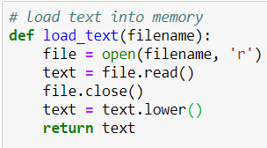
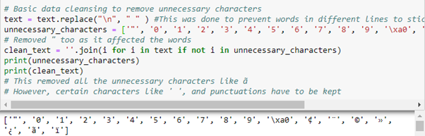
Data loading
Non english characters deleted
All characters are lowercase
Reduce vocabulary
More accurate model
Numbers and non english characters deleted.
Punctuation is kept as it is vital to have in the building of complete English Sentences

Slide 11

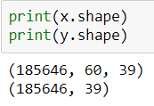
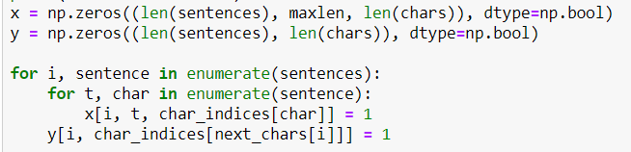
Data preprocessing
Character Sequencing
One Hot Encoding
Resulting shape

Slide 12
Development of sequence generator models

Slide 13
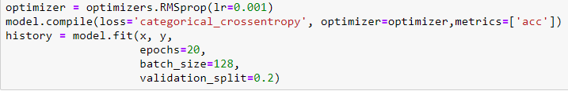
Development of sequence generator models
All models used RMSprop optimizers and a batch size of 128

Slide 14
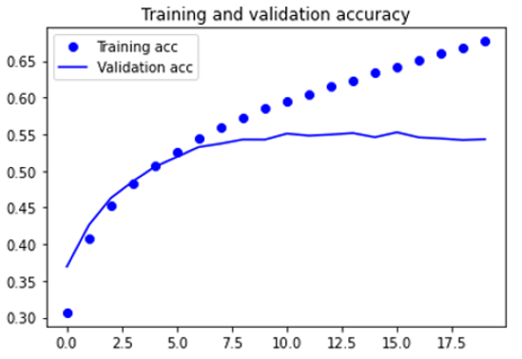
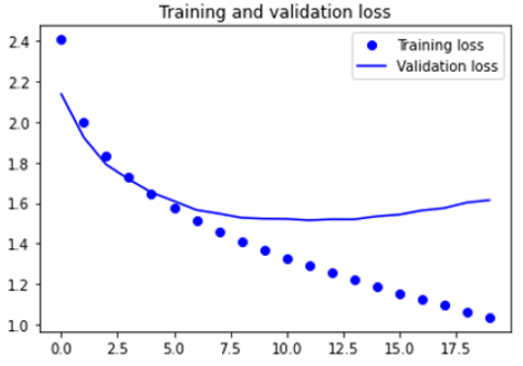
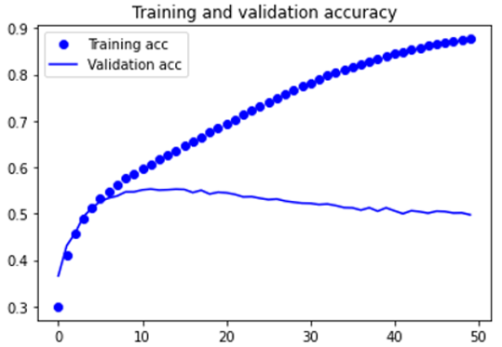
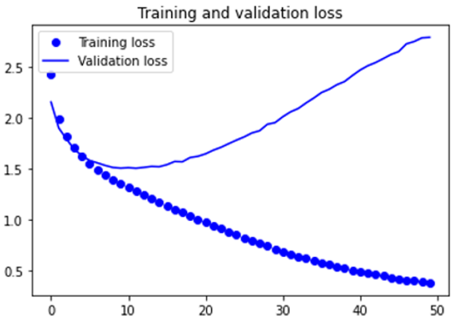
LSTM Model (Baseline)
LSTM Layer
128 Filters
LSTM Layer
128 Filters
LSTM Layer
128 Filters
LSTM Layer
128 Filters
LSTM Layer
128 Filters
Softmax Dense layer
RMSProp Optimizers
Learning rate 0.001
Softmax Dense layer
RMSProp Optimizers
Learning rate 0.001

Slide 15
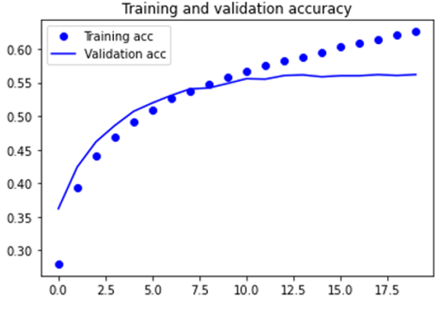
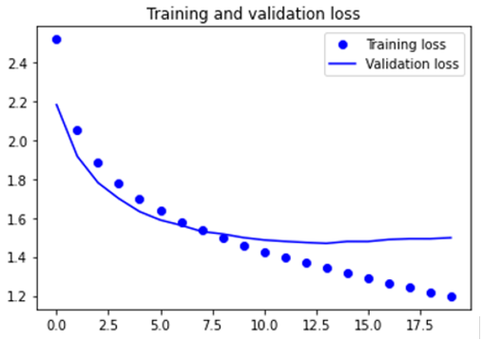
LSTM Model (Prevent overfitting)
LSTM Layer
128 Filters
LSTM Layer
128 Filters
LSTM Layer
128 Filters
Dropout layer
0.3
Softmax Dense layer
RMSProp Optimizers
Learning rate 0.001

Slide 16
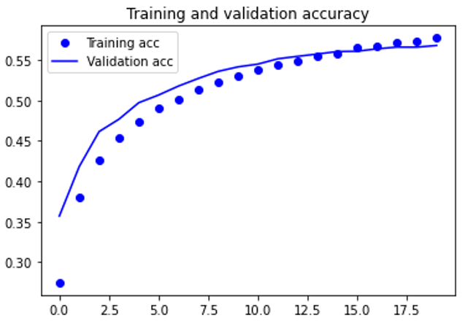
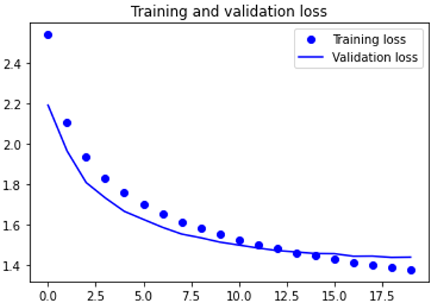
LSTM Model (Prevent overfitting)
LSTM Layer
128 Filters
Dropout layer
0.3
LSTM Layer
128 Filters
LSTM Layer
128 Filters
Dropout layer
0.3
Dropout layer
0.3
Softmax Dense layer
RMSProp Optimizers
Learning rate 0.001

Slide 17
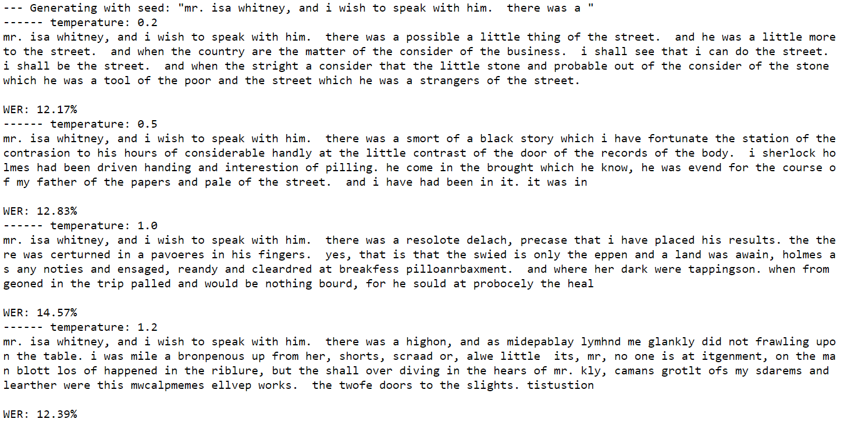
LSTM Model (Prevent overfitting)

Slide 18
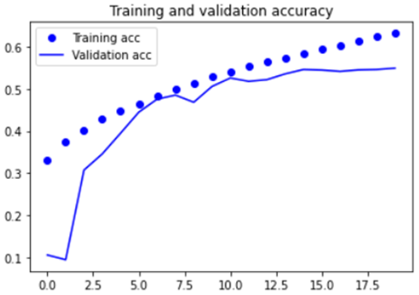
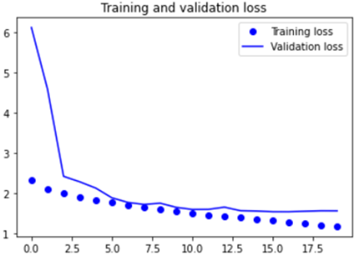
LSTM Model (Prevent overfitting with Batch normalization)
LSTM Layer
128 Filters
LSTM Layer
128 Filters
LSTM Layer
128 Filters
Batch Normalization
Softmax Dense layer
RMSProp Optimizers
Learning rate 0.001

Slide 19
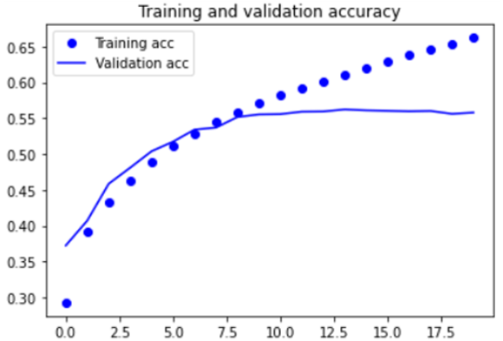
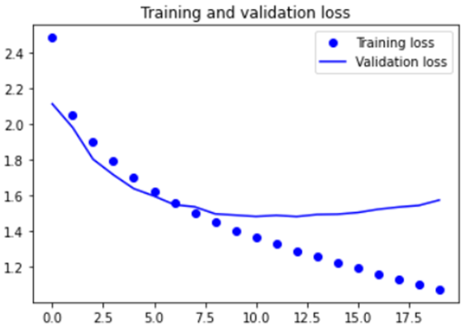
LSTM Model (Prevent overfitting with Batch normalization)
LSTM Layer
128 Filters
LSTM Layer
128 Filters
LSTM Layer
128 Filters
Dropout layer
0.3
Batch Normalization
Softmax Dense layer
RMSProp Optimizers
Learning rate 0.001

Slide 20
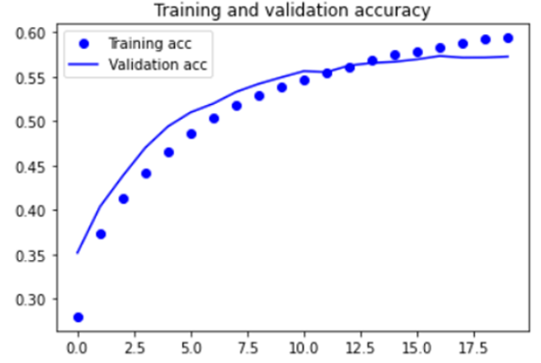
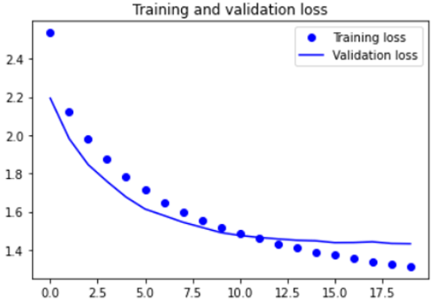
LSTM Model (Prevent overfitting with batch normalization)
LSTM Layer
128 Filters
Dropout layer
0.3
LSTM Layer
128 Filters
LSTM Layer
128 Filters
Dropout layer
0.3
Batch Normalization
Softmax Dense layer
RMSProp Optimizers
Learning rate 0.001

Slide 21
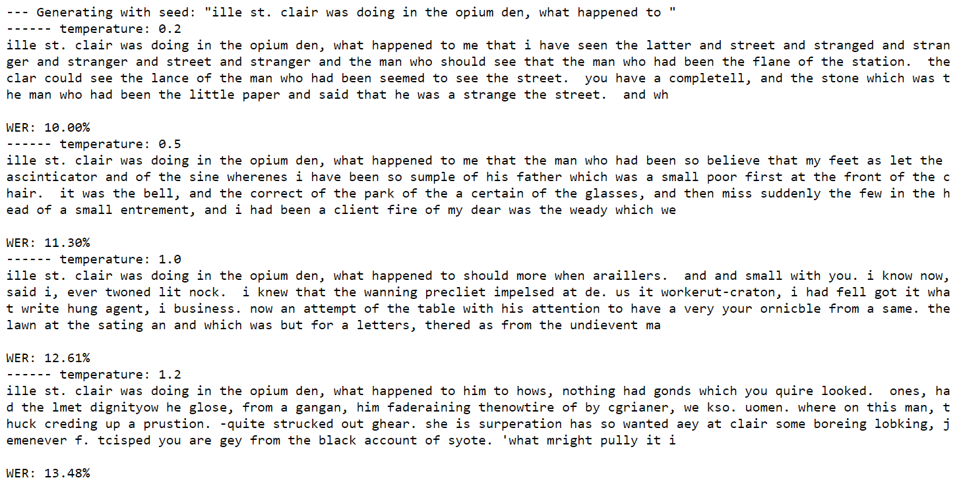
LSTM Model (Prevent overfitting with batch normalization)

Slide 22
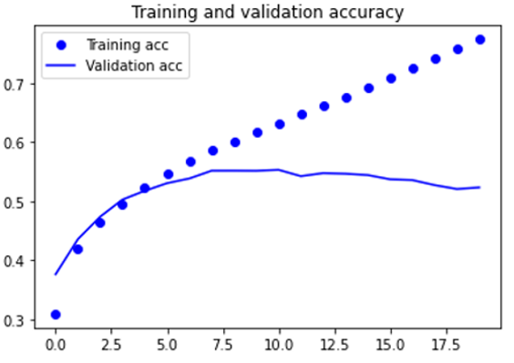
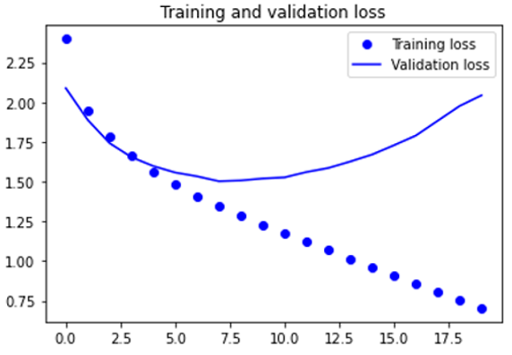
LSTM Model (Prevent overfitting with layer normalization)
LSTM Layer
128 Filters
LSTM Layer
128 Filters
LSTM Layer
128 Filters
Layer Normalization
Softmax Dense layer
RMSProp Optimizers
Learning rate 0.001

Slide 23
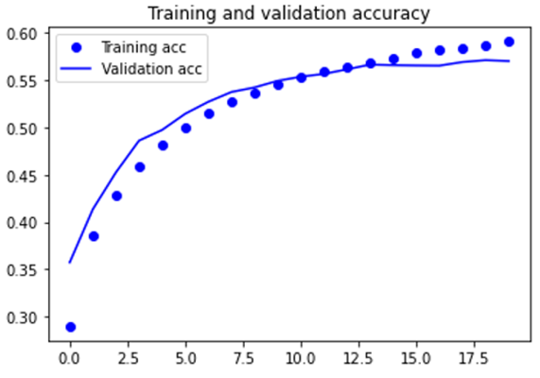
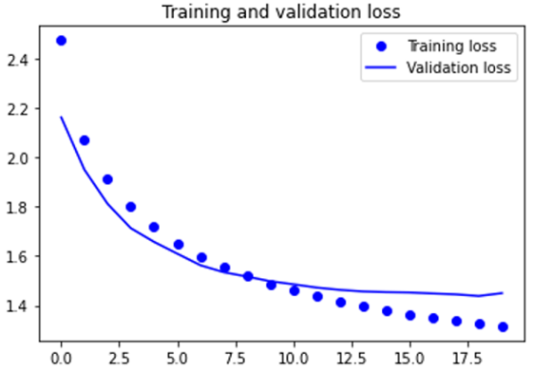
LSTM Model (Prevent overfitting with layer normalization)
LSTM Layer
128 Filters
Dropout layer
0.3
LSTM Layer
128 Filters
LSTM Layer
128 Filters
Dropout layer
0.3
Layer Normalization
Softmax Dense layer
RMSProp Optimizers
Learning rate 0.001

Slide 24
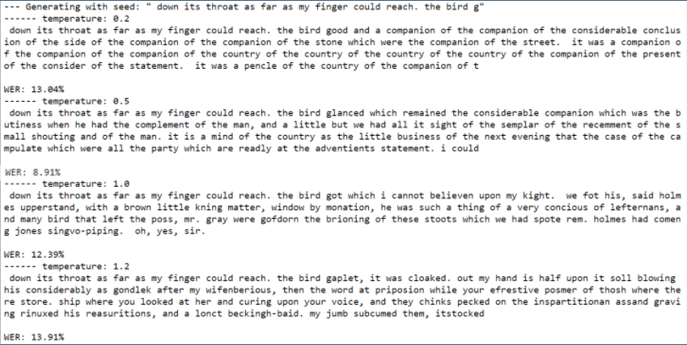
LSTM Model (Prevent overfitting with layer normalization)

Slide 25
Model REVIEW
LSTM
GRU
Bidirectional LSTM + GRU
SimpleRNN
Highest Validation Accuracy: 0.567
Highest Validation Accuracy: 0.557
Highest Validation Accuracy: 0.544
Highest Validation Accuracy: 0.556

Slide 26
Choosing of best model

Slide 27
Model | Word Error Rate | Temperature | Validation Accuracy
SimpleRNN 1 | 7.83% | 0.5 | 0.534
SimpleRNN 2 | 8.26% | 0.5 | 0.544
SimpleRNN 3 | 9.78% | 0.2 | 0.541
LSTM 1 | 10.65% | 0.5 | 0.551
LSTM 2 | 10.22% | 0.5 | 0.564
LSTM 3 | 8.91% | 0.5 | 0.567
Legend
1 | Prevent Overfit
2 | Batch Normalization
3 | Layer Normalization

Slide 28
Model | Word Error Rate | Temperature | Validation Accuracy
GRU 1 | 10.87% | 0.5 | 0.547
GRU 2 | 8.04% | 0.2 | 0.557
GRU 3 | 10.65% | 0.5 | 0.553
BiDirectional 1 | 9.13% | 0.5 | 0.553
BiDirectional 2 | 6.96% | 0.2 | 0.556
BiDirectional 3 | 10.00% | 0.2 | 0.553
Legend
1 | Prevent Overfit
2 | Batch Normalization
3 | Layer Normalization

Slide 29
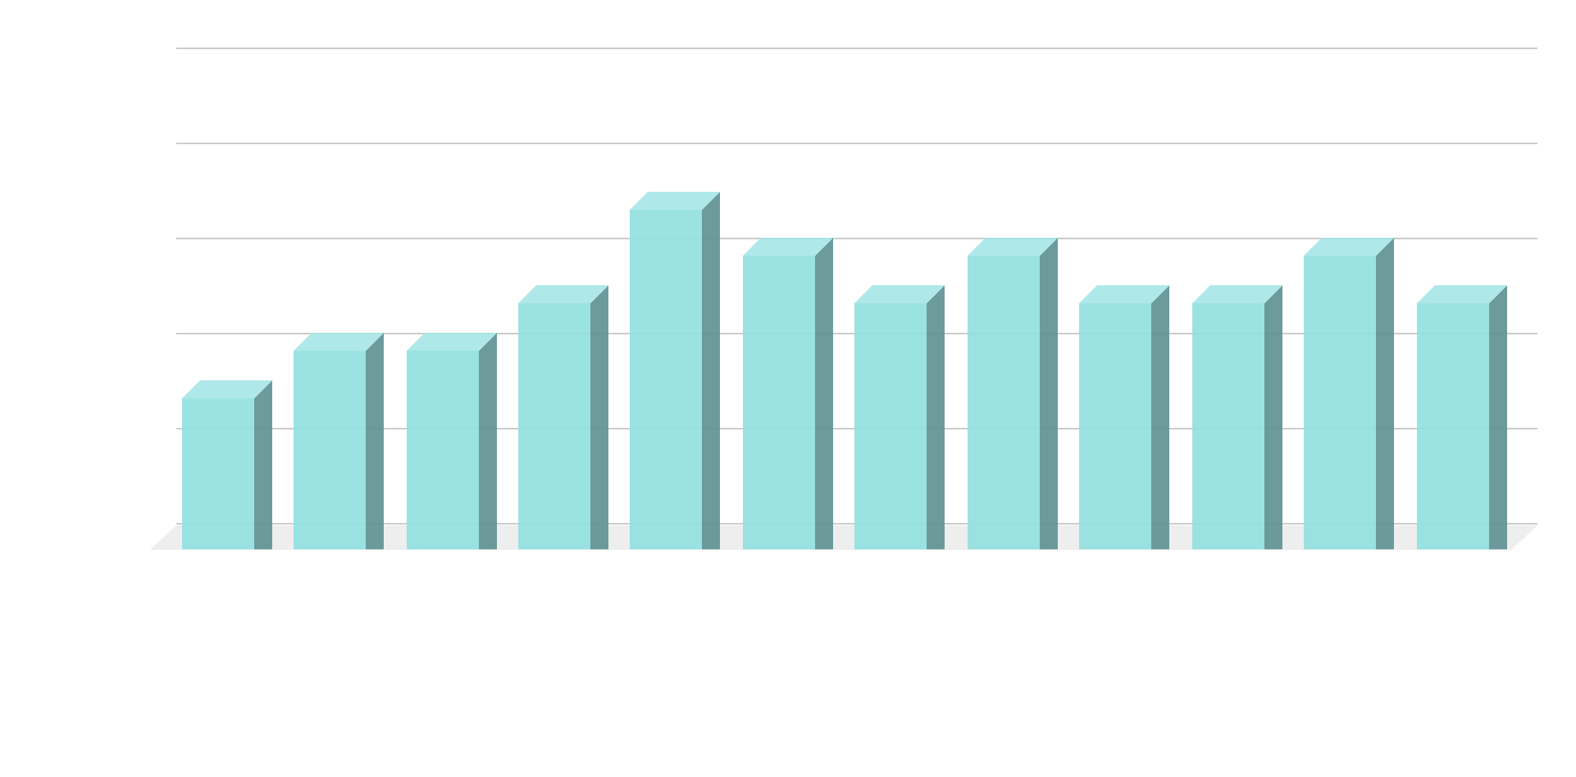
MODEL VS. VALIDATION ACCURACY
Legend
1 | Prevent Overfit
2 | Batch Normalization
3 | Layer Normalization

Slide 30
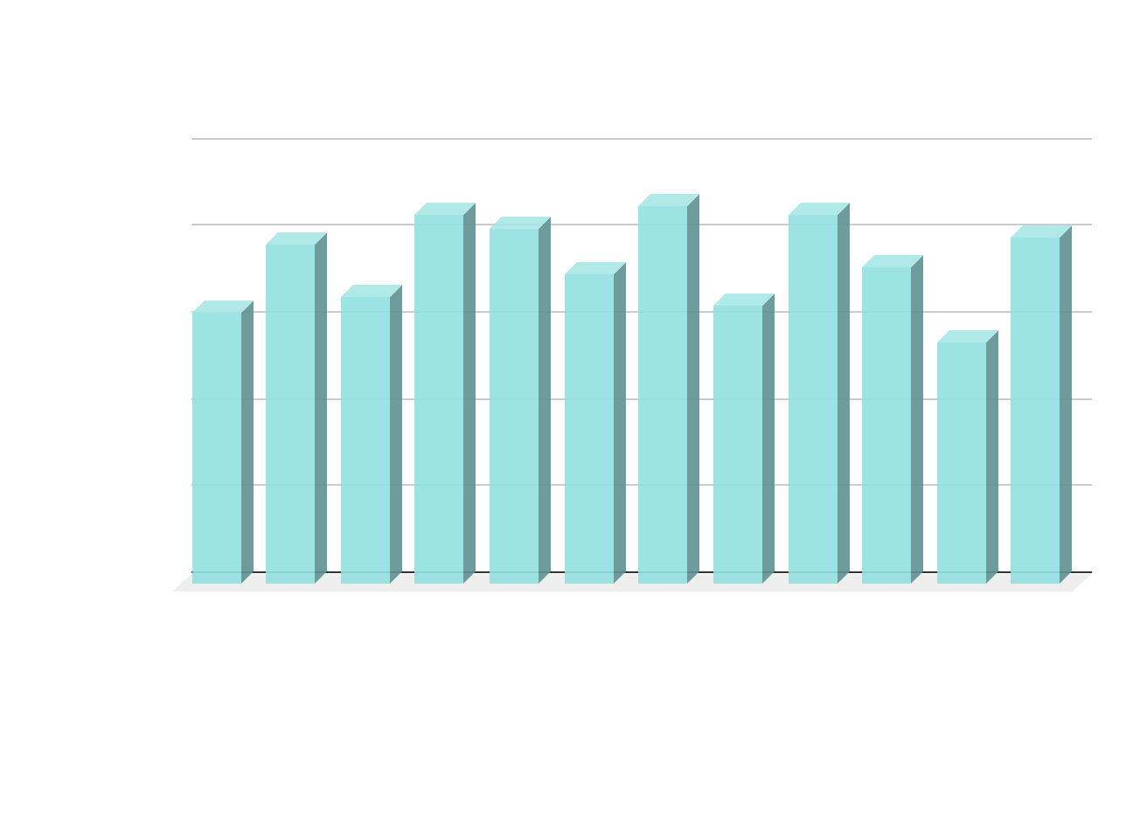
Model VS WORD ERROR RATE
Legend
1 | Prevent Overfit
2 | Batch Normalization
3 | Layer Normalization

Slide 31
Best model
Model | Word Error Rate | Temperature | Validation Accuracy
LSTM 3 | 8.91% | 0.5 | 0.567
Lstm model with layer normalization:
Extremely low word error rate
Highest validation accuracy across all models

Slide 32
Input real text

Slide 33

Text chosen
Book Chosen:
Frankenstein the 1818
Reasons:
Released in the same time era as Sherlock Holmes
Has similar use of artistic language
Model will generate text more inclined to the writing in Sherlock Holmes

Slide 34
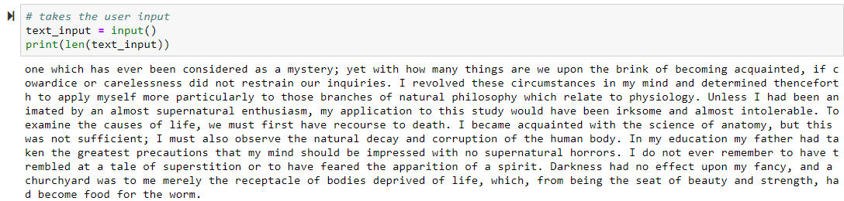
Text chosen
Extra words added to allow for Word Error Rate(WER) to work

Slide 35
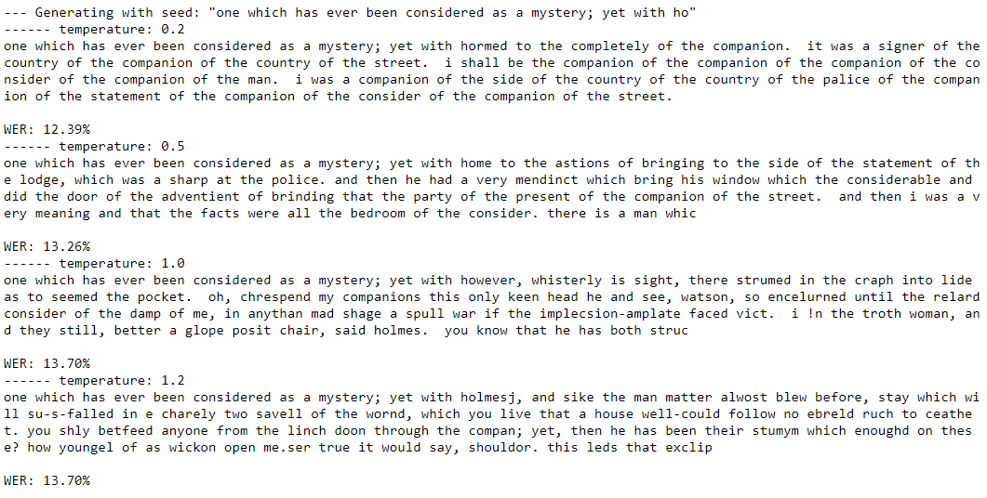
Output from best model

Slide 36
Summary

Slide 37
Key learning points
The best performing RNN layer was LSTM
Layer Normalization generally resulted in better performances
Layer Normalization works better in RNN compared to Batch Normalization
Optimal Temperature is 0.5

Slide 38
Improvements to be made
Other RNN layers like Conv1D could have been tested
Other evaluation techniques like Bleu and METEOR could have been tested
Larger variety of texts could have been used to increase the dataset which would result in better results

Slide 39
Thank You!!

