Slide 1
MEDLoader Reading and Writing MED Files
SALOME Training | Adrien Bruneton, Elie Saikali

Slide 2
Agenda
Basic API
Quick export to VTU (visualization)
Reading and writing a MED file
Overview of the MEDLoader
Fundamental differences with MEDCoupling model
Advanced API
Some insights into the MED file format
Class diagramm
Advanced concepts
Families and groups
Profiles

Slide 3
BASIC API

Slide 4
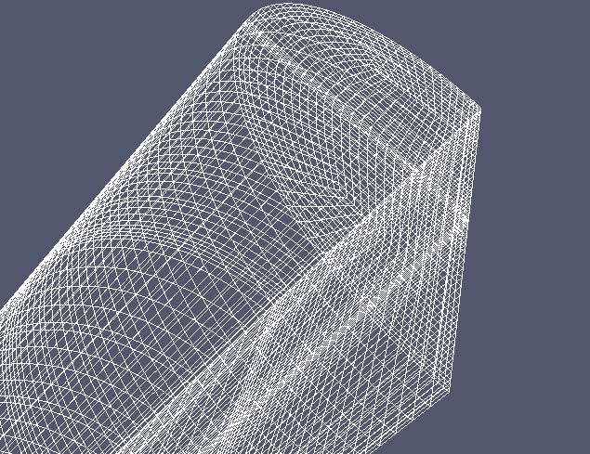
Basic API - overview
Let’s keep it simple
If you just a need a quick look at what you’re doing: VTK/VTU export
m = <some mesh/field I just created>
m.writeVTK(“/tmp/toto.vtu”)
Visualization with ParaView
A step further -- the basic MEDLoader API:
Directly reading/writing a mesh to a file on disk
WriteMesh() / ReadMesh()
Directly reading/writing a field
WriteField() / ReadField()
WriteFieldUsingAlreadyWrittenMesh() if you have several fields on a single mesh
All dealing with MEDCoupling objects (e.g. MEDCouplingUMesh, etc …)
Main entry point: static methods at the MEDCoupling namespace level
Only static methods (i.e. no internal state). File reopened each time!
In Python, directly at the medcoupling level:
import medcoupling as mc
mc.WriteField(…) ## e.g. writing a field to a file

Slide 5
Basic API - Example
Reading a multi-dimensional mesh
Take a look at this Python snippet
import medcoupling as mc
medFile = 'file.med'
meshName = ‘mesh‘
mesh3D = mc.ReadUMeshFromFile(medFile,meshName,0)
mesh2D = mc.ReadUMeshFromFile(medFile,meshName,-1)
mesh1D = mc.ReadUMeshFromFile(medFile,meshName,-2)
Works fine, but:
The 3 meshes have 3 independent coordinate arrays
Could be shared – see later slide on mesh dimension …

Slide 6
Overview

Slide 7
MEDLOADER Overview
MEDLoader … not only a “loader”
Why do we need a loader/writer? Obviously:
Communicate between processes / tools
Load / backup results
Very unfortunate name (history, history …)
Can obviously read, but also write meshes and fields …
… into a file with the MED type (“.med” extension): “Modèle Echange de Données” (Data Exchange Model)
Part of the MEDCoupling library
Requires MED-file library (currently version 3.0.8) to compile and run
MED-file is the low level C/Fortran API to deal with MED files
And hence, requires also HDF5 (prerequisite of MED-file library)
(and MPI if you’re working in parallel)
You can use the core structures of MEDCoupling without MEDLoader
the reverse does not work (and would not be very useful anyway!)
Like before, most of it in C++, but wrapped in Python
Most of the algorithms are actually pure MEDCoupling core

Slide 8
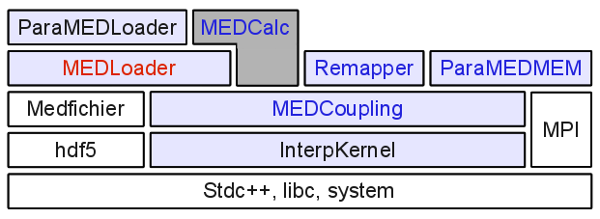
MEDLOADER Overview
From a memory model to a file
The tool to save / load what you do in memory with MEDCoupling

Slide 9
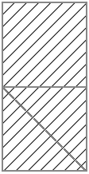
MEDLOADER Services
A short tour
Read / write … obviously!
Families and groups manipulation
Group : a collection of entities on the mesh (volumes, faces, points …)
Families : same idea, at a lower implementation level
Geometric algorithms
convertAllToPoly()
unPolyze()
zipCoords()
duplicateNodes()
… etc
Those services often have a MEDCoupling equivalent
But (see next), not dealing with the same model!
For example: unPolyze() in MEDLoader takes care of groups, etc …
MED file conversion tools
Between MED versions, from SAUV, etc …
Group G

Slide 10
Fundamental Differences with MEDCoupling

Slide 11
Comparison with MEDCoupling
Why do we have 2 data models?
MEDCoupling tries to rationalize the large flexibility provided by the MED-file format
Target: covering 95% of the use cases
Loosing some advanced functionalities, but a HUGE gain on user-friendliness!
Short list of “restrictions” -- in a MED-file, a field:
can have a partial support (defined only on a part of the mesh): “profiles“
can have more than one spatial discretization (ON_CELLS, ON_NODES, …)
Also, a mesh:
can have multiple dimensions (see next slide)
groups (and families) are not accessible in MEDCoupling objects
A med-file field can have multiple time-steps (MEDCouplingFieldDouble = single step)
Solution: use multiple MEDCouplingFieldDouble
Solution: use MEDCouplingFieldOverTime
Rule of thumb: try to do it with the MEDCoupling data model only (MEDCouplingUMesh, MEDCouplingFieldDouble, …) and look at the advanced stuff only if needed.

Slide 12
MED-FILE – Mesh Dimension
Up to 4 dimensions for a single mesh
Better than words, a picture:
Start point = most upper level – here 3D
Decreasing indexing (levelRelativeToMax) used in the API
For example: getGenMeshAtLevel(int)
Level relative to max = -2
(edges)
Level relative to max = 0
(volume)
Level relative to max = -1
(faces)

Slide 13
Other things you should know
Things to keep in mind when doing I/O
« Objects » need to have a name
Mesh and fields need to be named
setName() method
You’ll get a nice exception if you do not comply ☺
Don’t use too long names … (MED-file has a max length of 64 char.)
Cells need to be ordered by geometric type
E.g. if you mix TRIA3 and QUAD4 in your mesh (sometimes called a hybrid mesh)
Invoke sortCellsInMEDFileFrmt()
Again, an exception if you don’t comply
Main consequence: renumbering of the cells in your mesh!
Try to keep cell types ordered if you can (will avoid save/load time)
Or convert everything to polyhedrons!
MEDCouplingUMesh::convertAllToPoly()
Only one cell type
Can be converted back with unPolyze()

Slide 14
Advanced API

Slide 15
Advanced API - Introduction
Use cases
Advanced API provides a fine-grain access to a MED file
Need the advanced API, if
Dealing with multiple time-steps
Dealing with multiple mesh dimensions
Typically a volumic mesh (space dim = mesh dim = 3)
And some boundary conditions on the faces (mesh dim = 2)
The two mesh share the same nodes
Dealing with mesh groups
A group is a named set of cells in a given mesh
Frequently used for boundary conditions assignment
Dealing with partial support (rare case): profiles
Close relationship with the MED-file format
To be expected for a low level API!
Let’s take a look at the format:

Slide 16
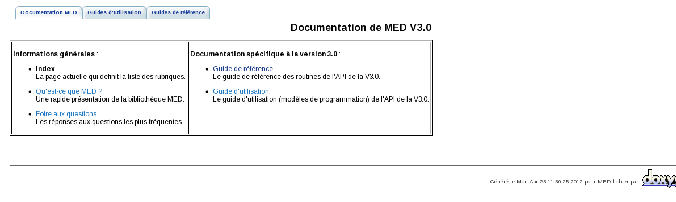
Advanced API – MED-file format (1/2)
What does a MED file look like?
A specialization of the HDF5 standard
Take a look at http://www.hdfgroup.org/HDF5/
Focus on (potentially) big amount of data
Parallelism in mind
Official documentation of the MED-file format available on-line at
${MEDFILE_ROOT_DIR}/share/doc/html/index.html (in French)
Reminder: MED-file denotes both
A file format on disk (I/O)
A comprehensive low level C library to read/write MED files
Now with a Python wrapping
Author: Eric FAYOLLE (EdF R&D)
MED-file existed before MEDCoupling!

Slide 17
Advanced API – MED-file format (2/2)
Meshes:
(1) mesh name
(1) coordinates
(?) fam Ids
(?) numbers
(*) geometric type
(1) connectivity
(1) fam Ids
(?) number
(+) famillies
(*) groups
MED-file structure
Global
Fields:
(1) field name
(1) mesh name
(+) component names
(*) Dt It, Time
(+) entity
(+) geometric types
(1) values
(?) profil
(?) localization
Profiles :
(1) profile name
(1) ids
Localizations :
(1) name
(1) dim
(1) number of pts
(1) ref. cells
(1) weights
Each box is independent in the MED-file format
Cardinality:
? : 0 or 1
* : 0→∞
+: 1→∞

Slide 18

Advanced API – Class diagramm
Helps navigate the advanced API
All names prefixed with “%” actually start with “MEDFile …” (e.g MEDFileData)
« gives access to »
« specializes into »
%Data
%Meshes
%Fields
%Parameters
%MeshMultiTS
%AnyTypeFieldMultiTS
%AnyTypeField1TS
%Mesh
MEDCouplingMesh
%FieldMultiTS
%Field1TS
%UMesh
%StructuredMesh
%IntFieldMultiTS
%IntField1TS
MEDCouplingUMesh
….
MEDCouplingFieldDouble
MEDCouplingFieldInt
Highlight the links with the MEDCoupling data model

Slide 19
Advanced API – Important options
Writing a file
Write options :
2 : force writing from scratch (an existing file will be reset)
1 : append mode (no corruption risk if file already there).
0 : overwrite mode: if the file and the MED object exist, they will be overwritten, otherwise write from scratch
Reading a field (MEDFileField1TS, MEDFileFieldMultiTS)
Read everything in the file by default
For large size fields:
Set the boolean loadAll to False in constructors
Use loadArrays() or loadArraysIfNecessary() to load data on demand
Use unloadArrays() or unloadArraysWithoutDataLoss() to free memory

Slide 20
Advanced API - Example
Writing a multi-dimensional mesh
Take a look at this Python snippet
import medcoupling as mc
medFile = "myWrittenFile.med"
coo = mc.DataArrayDouble([…])
mesh1D = … <MEDCoupling object>; mesh1D.setCoords(coo)
mesh2D = … <MEDCoupling object>; mesh2D.setCoords(coo)
mesh3D = … <MEDCoupling object>; mesh3D.setCoords(coo)
mesh = mc.MEDFileUMesh.New()
mesh.setName(“myMesh”)
mesh.setMeshAtLevel(0,mesh3D)
mesh.setMeshAtLevel(-1,mesh2D)
mesh.setMeshAtLevel(-2,mesh1D)
mesh.write(medFile,2)
Better than with the basic API
All 3 meshes share the same coordinates array
Saving space and write/load time
Ensure consistency

Slide 21
BASIC / Advanced API - Summary
Basic API is well suited for
Meta information of a MED-file, without loading everything
E.g.: GetMeshNames, GetComponentsNamesOfField, GetFieldIterations
Reading / Writing single instances of MEDCoupling objects
Reading / Writing MEDCoupling meshes (without groups nor families)
Reading / Writing MEDCouplingFieldDouble (without profiles)
You need the advanced API to
Handle (part of) a MED-file in memory (e.g. to rewrite part of it only, a single time-step, etc …)
Deal with families and groups
Deal with field profiles
Note to C++ developpers: adanced API classes are also RefCount-ed (incrRef() / decrRef())

Slide 22
Advanced Concepts

Slide 23
FAMILIES and Groups
How are groups defined?
In a mesh cells are partitioned by families
Each cell has a unique family ID (reverse not true)
A group is a list of families
Families are also named
See next slide with an illustration
Families do not need to be manipulated directly in normal usage!
MEDLoader advanced API gives access to both families and groups
getGroups(), getFamilies(), getFamiliesArr()
… and many more

Slide 24
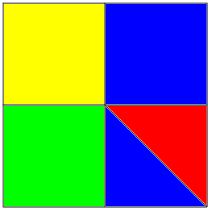
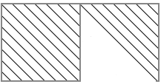
FAMILIES and Groups - ILLUSTRATION
Take a look at this example:
Family #0 in yellow
Family #2 in blue
Family #3 in red
Family #7 in green
Group A = Families 2 & 3
= Cells 0,1,4
3
4
1
2
0
Group B = Families 7 & 3
= Cells 2,1
Family array = [2, 3, 7, 0, 2]

Slide 25
Recording a Group
Best explained with an example
Create a group
myCouplingmesh = …
tabIdCells = mc.DataArrayInt()
tabIdCells.setName("meshGroup")
tabIdCells.setValues(…)
fmeshU = mc.MEDFileUMesh()
fmeshU.setName("Name")
fmeshU.setDescription("description")
fmeshU.setCoords(myCouplingmesh.getCoords())
fmeshU.setMeshAtLevel(0,myCouplingmesh)
fmeshU.setGroupsAtLevel(0,[tabIdCells])
A group is simply seen as a list of cell IDs at the MEDLoader API level
Careful with cell indices! Remember that MEDLoader has to sort cell by types

Slide 26
READING a Group
Again, an example
Reading a group
fmeshU = mc.MEDFileUMesh(fname)
gpNames = fmeshU.getGroupsNames()
...
myGroupArr = fmeshU.getGroupArr(0, gpNames[0])
…
myGroup = fmeshU.getGroup(0, gpNames[0])
print myGroup
Unstructured mesh with name : "groupe2"
Description of mesh : "Maillage converti au format MED V3"
…
Either get the result as a DataArrayInt or as a sub-mesh or as If you only need the identifiers of the sub-elements

Slide 27
Conclusion

Slide 28
Conclusion
Try it!
Any question?
Let’s get ready for the exercises!

Slide 29
Direction Département Service
Commissariat à l’énergie atomique et aux énergies alternatives
Centre de Saclay | 91191 Gif-sur-Yvette Cedex
T. +33 (0)1 XX XX XX XX | F. +33 (0)1 XX XX XX XX
Etablissement public à caractère industriel et commercial | R.C.S Paris B 775 685 019

