Slide 1
MEDCoupling Introduction and overview
SALOME Training | Adrien Bruneton, Elie Saikali

Slide 2
Agenda
Training overview & objectives
Introduction to the MED world
Functionalities
Basic concepts
DataArrays
Meshes
Fields
Library and code structure
Some practical details for the exercises
API changes in V8+
Notes for C++ developpers

Slide 3
Training overview & objectives

Slide 4
Training Overview
Agenda
1. General introduction to the SALOME MED module
Exercises
2. MEDLoader: reading and writing MED files
Exercises
3. Interpolation: what MED do for you
Exercises
Objectives
Understand what MED offers
Discover the main concepts used in MED (meshes, fields, indexing techniques)
Be able to use via Python on simple (but representative!) use cases

Slide 5
Introduction Functionalities

Slide 6
MEDCoupling Introduction
Mesh, fields, … what for?
Simulation studies require manipulations of
Mesh = spatial discretization of a geometric domain
Fields = physical data / boundary conditions on the above discretization
They often form the main input of a numerical solver
And can be used to store the simulation results too
Building, accessing and interacting with these elements demands suited tools
Many possible routes
Ad-hoc libraries : still often the case in dedicated codes
Problem: interaction with the rest of the world (other codes, post-processing tools, etc …)
SALOME’s philosophy: common building block
A shared tool to work on meshes and fields
But MEDCoupling is much more than just a way to standardize interaction!!
A powerful library to perform all this: MEDCoupling
Credit: Anthony GEAY (now at EdF R&D ;-( )
Difference with SMESH??
In SMESH, the geometry is the starting point. No field.
MED acts more as an interface with the numerical code

Slide 7
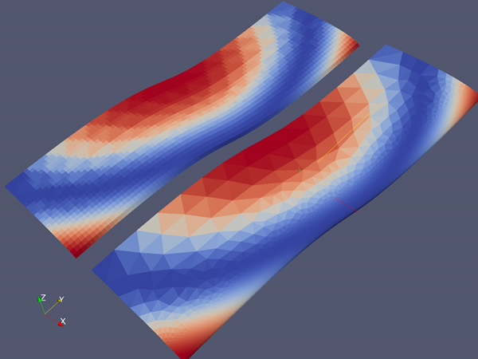
MEDCoupling Functionalities (1/2)
A short tour
Mesh manipulation
Build from scratch
Refinement & sub-splitting
Intersection (some spatial configurations only!)
Fields
Projection from one mesh to another
Taking into account physical nature of the field
Parallel codes – for field projection mainly
Work splitting between groups of processors
MEDPartitioner
Serialization, data exchange and projection between groups of procs
ParaMEDMEM
Most of the functionalities accessible with Python
Field projection example

Slide 8

MEDCoupling Functionalities (2/2)
Continued …
Convex hull computation
Useful for boundary conditions
Duplicate nodes identification
Degenerated cells reduction
Typically a flat triangle
Point localization
In which cell is my point
Algebraic volume, area, length computation
How big is my tetrahedron
Mesh concatenation
What you need is not there yet? Ask for it!
Eigen values computation
Gauss points management
And many, many others!

Slide 9
Who’s WHO?
What do we understand under MED in SALOME?
Graphical user interface
Interactive field manipulation
(MED GUI client)
Core structures
Arrays, meshes, … and algorithms
(libmedcoupling.so)
MED GUI
Projection
MED
Reader
File I/O
I/O and advanced operations on MED files
(libmedloader.so)
Projection
Interpolation and field projection
(remapper)
Core structures
MEDCoupling
-
I/O
Paral-
lelism
MPI
MED
File
Parallelism
MPI based functionalities (DEC – Data Exchange Channel)
(libParaMEDMEM.so)
MEDReader
ParaView plugin to visualize MED files
(libMEDReader.so)

Slide 10
History
An ongoing effort
1996: study about the standardisation of data exchange between EdF R&D simulation codes
1997: first version of the data model
1998-1999: first version of the MED-file library at EdF and joint work with CEA (ELAN)
2001: including MED into the SALOME platform for data exchange (meshes and fields)
2003: first version of MED in memory (MEDMEM): exchanging objects between processes directly in memory
2010: first version of MEDCoupling
2013: removing MEDMEM from SALOME 7
2014: MEDCoupling/MEDLoader: engine behing the new MED reader in ParaView / PARAVIS

Slide 11
BASICS

Slide 12
DataArrays (1/2)
OK, let’s get started
To do all this, surely, we need
Arrays of points (mesh nodes coordinates, centers of mass, …)
Arrays of “data” (fields, etc …)
First building block: DataArray
“Similar” to a list with several columns
Usually much more rows than columns!
Example: array of 2D points = DataArrayDouble
coo = mc.DataArrayDouble([(1.0,2.0), (2.0,3.5), (1.5,3.4)])
Array of 3 tuples and 2 components
Main sub-types: DataArray’s of int or double
All indices start at ZERO! (apologies to Fortran’s fan club ☺)
In Python, DataArray-s are manipulated very much like NumPy arrays
Do you know NumPy? (take a look, it’s worth it: http://www.numpy.org/)
See the first exercises on indexing + see dedicated NumPy exercise
Important point for I/O: DataArray-s have a name, and so have their components
comp #0
comp #1
comp #2
tuple #0
a, b, c
tuple #1
d, e, f
tuple #2
g, h, i
tuple #3
j, k, l
Example of DataArray with 4 tuples and 3 components

Slide 13
DataArrays (2/2)
Basic operations
All standard operators directly accessible using operators:
da = mc.DataArrayInt([1,2,3])
da *= 2 da = (1-da)
Similarity with NumPy: by default, operations are done at the tuple level (no matrix-like operations)
Advanced operations: intersection (for DAInt), min/max extraction, etc …
Link with NumPy (need to have a MED compiled with NumPy support!)
DataArrayInt and DataArrayDouble can be converted to NumPy array
Efficient in both ways (no copy, just ownership transfer)
Advantages
mmap, serial/deserial with multiprocessing
Usage with arrays of bool ( where() clauses )
Syntactic sugar for dimension management (translate, newaxis, …)
Link with SciPy for linear algebra
Link with pyCUDA
Restrictions
Some services missing: getMinMaxPerComponent(), findCommonTuples(), … or to be invoked with another approach
No names associated to arrays/components

Slide 14
Renumbering
Easy index manipulation
Powerful indexing methods – some examples
da[[1,3,4]] : gets the 2nd, 4th and 5th elements
da[:, 0] : extract the first component of all tuples
Another classical indexing technique: array renumbering.
Say you have an array of int:
da = mc.DataArrayInt([2,3,4,5,6])
You might want to re-organize it according to the following surjection (a mapping works too, obviously)
surj = mc.DataArrayInt([0,2,4,1,4])
Expecting this result
[2,4,6,3,6]
Easily done – in Python for example
result = da[surj]
And you’re done ☺
The point: a lot of MEDCoupling functions work with (or return) arrays in the format of surj above.
See exercises for more on this and section Array Renumbering in the doc.

Slide 15
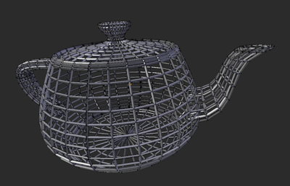
MESHES
Some geometry
In the MED world, a mesh is
The spatial discretization of a continuous geometrical domain
Associated to only one array of underlying point coordinates (a DataArrayDouble, called the nodes of the mesh)
With only one single mesh dimension
You can NOT mix a mesh representing 3D volumes (say cubes) with 2D areas (triangles)
A mesh also has a name (important for I/O) and a time-step ID
Do not confuse
Mesh dimension: dimension of the cells
Spatial dimension: number of components in the array of coordinates
Example: an helix-shaped curve (= a wire shaped like a corkscrew) has
Mesh dim = 1 (this is a simple wire made of segment cells)
Spatial dimension = 3
A curved surface has mesh dimension = 2, space dimension = 3
A mesh is made of cells: segments in 1D, surfaces in 2D, volumes in 3D.
Main types of mesh in MEDCoupling: structured, unstructured and extruded

Slide 16
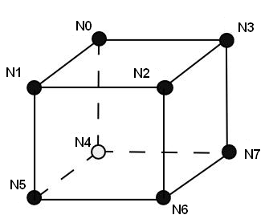
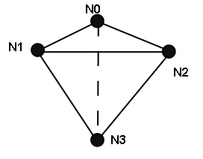
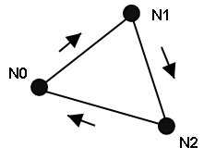
More on (unstructured) CElls
Cell representation (unstructured)
A cell is described by the list of point identifiers (not point coordinates) delimiting it
[0,1,2,3,4,5,6,7]
“cell” is somewhat of a misnomer – can be a segment in 1D
Need conventions!
E.g., more than one way to index a cube’s vertices:
No explicit notion of “edges” for a 2D cell, no notion of “faces” for a 3D volume
Only points
But you can re-compute this if needed: buildDescendingConnectivity()
You will see those code names
HEXA8, HEXA20: e.g. hexahedron with 8 points = a “cube” really. The one with 20 points represent a “quadratic” element (“cube with curved faces”).
TETRA4, TETRA10
Etc …
The MED file documentation has them all
Note: in 2D, the reverse trigonometric convention is used

Slide 17

Connectivity representation
Focus on a typical way to store indices
Internal representation of the cell connectivity
By no means mandatory to memorize(!)
Just gives a good example of the indirect index format
pack #0
pack #1
pack #n-1
0 1 2 3 4 5 6 7 8 9 10
3 1 4 6 4 3 2 6 5 ….
Two arrays:
[3, 1, 4, 6, 4, 3, 2, 6, 5, … ] : cell types and node identifiers
[0, 4, 9, …] “offset array”
For example, second cell (pack #1) has node IDs:
3,2,6 and 5
And has type 4 (= NORM_QUAD4)
[ 0, 4, 9, … ]

Slide 18
Fields
Just an array of values?
A field represents some physical quantity associated with the spatial domain
No continuous description of the physical quantity over the domain
A finite set of values, associated to some constituents of the mesh
At a low level, a DataArray associated to a given mesh
Can have more than one component!
A field can be supported by nodes (vertices) ON_NODES, cells (elements) of the mesh ON_CELLS, or more complex items
A field has a temporal discretization
NO_TIME
ONE_TIME
CONST_ON_TIME_INTERVAL
For some operations (interpolation), one need to define the physical nature of the field (extensive field or intensive field)
More on all this with interpolation …
Examples
Magnetic field: tensor field of double values: 3 components (B_{x}, B_{y}, B_{z})
Temperature field: scalar field of double values: 1 component

Slide 19
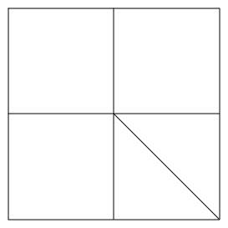
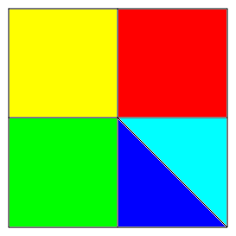
Illustration
A picture to wrap it up
0
1
2
4.
3
4
3.
4
2.
3
5
1.
1
0.
2
0
6
7
8
An unstructured 2D mesh, with:
- three QUAD4
- two TRIA3
For example, cell #2 has connectivity
[3,4,7,6]
An example of field on this mesh
- ON_CELLS
- with 5 different (double) values

Slide 20
Library and code Structure

Slide 21
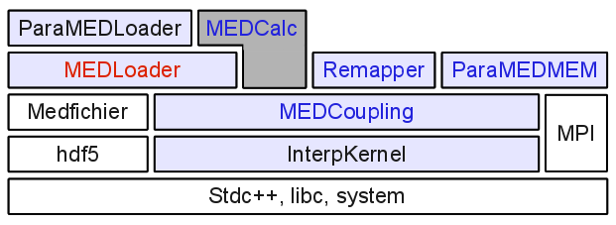
Dependency Structure
Library structure
Several sub-parts each dedicated to a specific task
MEDCoupling: memory model and general processing
MEDLoader: persistence
ParaMEDMEM: parallelism
A big effort to have little dependencies
Swigged
Swigged and wrapped with CORBA
System dependencies

Slide 22

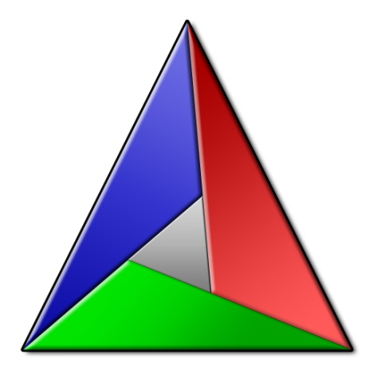
A few words about the code
Software quality
138k+ lines of C++ code (35k+ for tests purposes)
41k+ lines of Python (35k+ for test purposes)
More than 1600 unit tests
Valgrind 0 on all unit tests
More than 80% test coverage
Everything in C++ with a thin layer of Python to wrap it
Source control via Git
Configuration and build with CMake
Help with portability (compiling on Win64 for example)
A very dynamic library
Regular improvements and bug fixes
LGLS team at CEA, and Anthony GEAY (initial author) at EdF supporting the dev

Slide 23
Practicalities

Slide 24
PYTHON & Environment setup
Python language
Don’t know Python yet? Take a look on-line, for example
http://hetland.org/writing/instant-python.html
Quickest way to get started:
./salome context or ./salome shell
Why is this is not working?!
“ImportError: No module named medcoupling”
Have you:
Set your LD_LIBRARY_PATH and PYTHONPATH correctly?
Should be done for you if you are in the SALOME environment
LD_LIBRARY_PATH:
${MEDCOUPLING_ROOT_DIR}/lib/salome
PYTHONPATH:
${MEDCOUPLING_ROOT_DIR}/ lib/python3.6/site-packages/salome
${MEDCOUPLING_ROOT_DIR}/ bin/salome

Slide 25
Help!
Where can I get help
From Python
Auto-completion: set your PYTHONSTARTUP to a file with import rlcompleter,readline readline.parse_and_bind(«tab:complete»)
Direct help: help(m.rotate)
Take a look at the FAQ
Take a look at the doc
Getting better and better (we are really investing time in it!)
${MEDCOUPLING_ROOT_DIR}/share/doc/developer/index.html
Take a look at the on-line tutorial
Take a look at the unit tests
${MEDCOUPLING_ROOT_DIR}/bin/MEDCoupingBasicsTests{0-5}.py
Ask around you
SALOME Support is here to help: support-salome@cea.fr
LGLS team members
After having tried everything, and if this is still not working, you can try to reach the Grand Guru: anthony.geay@edf.fr (be prepared to pay some beers)

Slide 26
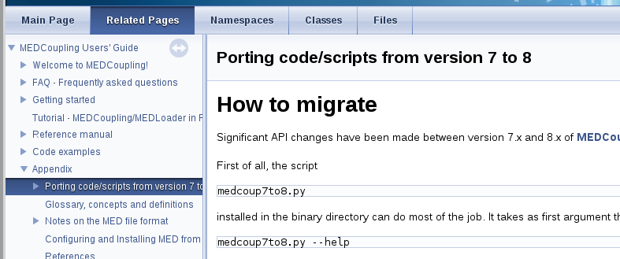
API CHANGES in V 8.x
API changes since version 8.x of SALOME
Be ware that some of the names have changed in versions 8 of SALOME
Mostly simplifications / shortening of names
E.g. MEDCouplingAutoRefCountObjectPtr becomes MCAuto
A dedicated page has been written in the doc to guide you through the migration:

Slide 27
Note for C++ developers

Slide 28
Base classes
RefCountObject abstract class
Similarities with VTK code structure
Ease the interaction with VTK (ParaView plugins)
Historically, there’s been a reflection about using VTK directly
All (significant) MEDCoupling classes inherit from
RefCountObject
A pointer and a counter
Memory management philosophy: someone owns the object after its creation
incrRef() to take ownership of the object / decrRef() to release it
Template class MCAuto is here to help
Smart pointer behaviour (no Boost dependency)
No need to decrRef() if used
valgrind is your friend
Careful, some MEDCoupling functions
give you pointer ownership: e.g. mergeNodes()
Some don’t: getCoords()

Slide 29
Code Quality
Documentation, unit-test, valgrind
The following should not be specific to MEDCoupling …
But MEDCoupling does it well! So keep this philosophy ☺
1. Write unit-tests for your code
Helps debugging
Forces you to organize your thoughts in well-defined units
Helps other understand how your code should be used
2. Write documentation
Even you will need it at some point later
3. valgrind your unit-tests (and optionally) do a coverture test on them
Actually points 1. and 2. above should stand for all languages, not only C++ …
Some IDEs (like Eclipse) provide an easy interface to all those tools

Slide 30
Conclusion

Slide 31
Conclusion
Try it!
Any question?
Let’s go for the exercises!

Slide 32
Direction Département Service
Commissariat à l’énergie atomique et aux énergies alternatives
Centre de Saclay | 91191 Gif-sur-Yvette Cedex
T. +33 (0)1 XX XX XX XX | F. +33 (0)1 XX XX XX XX
Etablissement public à caractère industriel et commercial | R.C.S Paris B 775 685 019

