Slide 1
MEDCoupling Projection Methods & Parallelism
SALOME Training | Adrien Bruneton, Elie Saikali

Slide 2
Agenda
Interpolation, extrapolation or projection?
Spatial discretization and nature of a field
What MEDCoupling can do for you
Parallelism in MEDCoupling

Slide 3
Interpolation, extrapolation or projection?

Slide 4
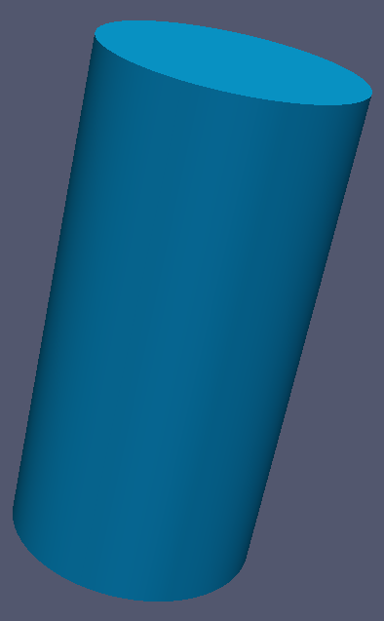
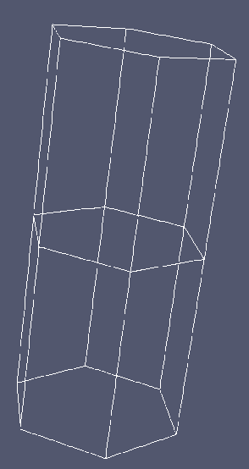
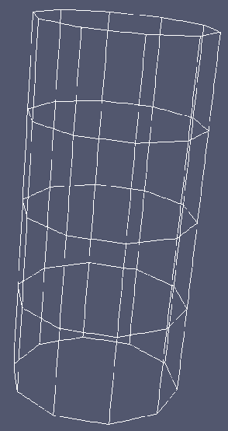
Illustration
Code coupling
A common technological problem
Code A
Code B
??
Spatial discretization from A
Spatial discretization from B

Slide 5
Introduction
A typical use case: code coupling
Different numerical codes simulate different physics
And hence (might) use different numerical schemes
E.g. temperature computed on nodes in code A and on elements in code B
And/or different spatial discretization (i.e. different meshing of the same geometrical domain)
A cylinder meshed with hexahedrons in code A, and with tetrahedrons in code B
Or even worse, use different dimensions
A heat flux on a 2D surface for code A and a 3D source term (e.g. fuel rode) for code B
How do you “transfer” information from one to the other?
I need to provide code B with the temperature computed by code A
Solution A: ad-hoc solution. For each pair (code A, code B), write a mapper … good luck
Solution B: use generic projection methods thanks to MEDCoupling ☺

Slide 6
Projection, Interpolation?
Some vocabulary … or not
Normally
Interpolation: computing a function’s value at a given point inside a domain where the function’s values are known at discrete points
Extrapolation: computing a function’s value outside a domain, but in relationship with points where the function’s values are known: hazardous!
Projection: from linear algebra, expression of a function (a vector) into a new basis of a (another) vector space (often with a smaller dimension)
Well, well, … in MEDCoupling, we do not take sides, and hence we
Prepare the operation (given the two meshes)
Transfer one or several fields (but apologies, sometimes you will still see interpolate or project)
Fields on cells are called P0 fields
Fields on nodes are called P1 fields (don’t ask me why)
Two meshes are overlapping if they cover exactly the same spatial domain
Temporal interpolation is not covered!

Slide 7
A Trivial Example
In Python naturally ☺
Transfer a field on cells onto a new field on cells
import medcoupling as mc
remap = mc.MEDCouplingRemapper()
remap.setPrecision(1.e-12) # setting general options
remap.prepare(srcMesh,trgMesh,”P0P0”) # cells to cells
srcField.setNature(mc.IntensiveConservation) # nature of the field – see next...
trgField = remap.transferField(srcField,1e+300) # default value to 1e+300
srcField is a MEDCouplingFieldDouble
srcMesh and trgMesh are MEDCouplingMesh-s

Slide 8
Spatial Discretization & Nature Of A Field

Slide 9
Spatial discretization of a Field
Where are the discrete values defined?
A field can be supported by:
The nodes (or vertices) of the mesh: ON_NODES → also called P1
The cells (or elements) of the mesh: ON_CELLS → also called P0
By more complex reference locations:
Gauss Points (ON_GAUSS_PT, ON_GAUSS_NE),
Kriging points (ON_NODES_KR)
Obviously the projection methods will differ according to the localization
Generally P0 → P0 projection is the best supported option
Source field is defined on cells
Desired result: a target field expressed on cells
Very common case
Not all combinations are possible
See the reference table at the end of the presentation
If you don’t find what you need, ask for it!
P0
P1

Slide 10
Field Nature (1/2)
Where physics comes into play
A meaningful projection needs to know whether the physical quantity being projected is:
Extensive: mass, power … quantity that scales with the volume of a cell
Intensive: density, temperature … quantity that do not scale with the volume
For each of the two above, two sub-methods are available, governing the behavior in case of non-overlapping meshes
“Maximum” value preserved in the result
“Integral” value preserved in the result
→ see detailed formula in the documentation
Invoke method: setNature() on the field
If you don’t call it, no projection will be possible
Possible argument values (warning different names prior to V8)
 | Intensive | Extensive
Conservation | IntensiveConservation | ExtensiveConservation
Maximum principle | IntensiveMaximum | ExtensiveMaximum

Slide 11
Field Nature (2/2)
Example of non-overlapping mesh
Understanding the problem of non-overlapping meshes:
Take a look at the illustration right
Mesh A in blue
Mesh B in green
For a projection from B to A, should:
the full volume (here surface) of the cell from mesh A be taken into account?
Knowing that only part of it coincides with the two cells in mesh B
or only the volume covering both mesh A and mesh B?
Letting aside what is not overlapping
Depends on the nature of the physical quantity you’re handling
Again, take a look at the full formulas + exercises:
${MEDCOUPLING_ROOT_DIR}/ share/doc/developer/InterpKerRemapGlobal.html#TableNatureOfField

Slide 12
Functionalities

Slide 13
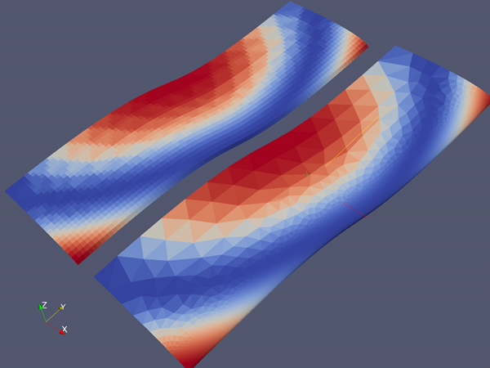
Projection Methods
General principle
To project one field onto a new target mesh, one has to:
1.Prepare (required only once):
The weight matrix is internally computed
Ratios of the volumes between source cells and target cells
From the source mesh and the target mesh only
W_{ij}: how much from source cell (i) will contribute to target cell (j)
API: prepare(source, target, method)
2.The source field must have a valid nature set!
3.Transfer (can be done several times):
A field on the source mesh can be transferred to the target mesh
API: transfer(srcField, tgtField, defaultValue)
Default value covers non-overlapping cases

Slide 14
Supported configurations
What you can do
Mesh combination (U: unstructured, C: cartesian, E: extruded)
U → U
U → C
C → U
C → C
E → E
Dimensions
1D
2D curve, full 2D
3D surface, full 3D
Spatial discretization
P0 → P0
P1 → P0
P0 → P1
P1 → P1
P1 → P0Bary
PG → PG

Slide 15
Parallelism

Slide 16
Parallel Interpolation
Code name: DEC!
Many codes today runs in « parallel »
Here we cover inter-process exchange, MPI-like
Still a need to exchange information between two parallel codes
Simple transfer of information
Or more complex projection as seen before
Solution: Data Exchange Channels (DEC)

Slide 17
ParaMEDMEM - OVerview
Where is the DEC used?
DEC
MESH
Code A
MESH
MESH
Code A
Code B
Data reduction
CAD
MESH
MESH
Code A
Code B
MESH
Code A
Parallel meshing
PARAVIS
Mesh splitter

Slide 18
DEC – Step by step
The DEC step by step
Objective
Exchange data between two codes (yellow and purple) working on many sub-domains of the mesh
Main objects in the DEC world: InterpKernelDEC and OverlapDEC
InterpKernelDEC: code A and B run on separate procs
OverlapDEC: code A and B share all the procs
Algorithm
1. Computation of bounding box per proc
2. Exchanging the 2D sub-meshes potentially intersecting the domains
Using the sequential Remapper (what we’ve seen before):
3. Locate intersecting cells (BBTree)
4. Compute pairewise contributions
5. Final computation of the distributed weight matrix
P₀
P₁
P₀’
P₁’
P₂
P₃
P₂’
P₀
P₁
P₀’
P₁’
P₂
P₃
P₂’
P₀
P₁
P₀’
P₁’
P₂
P₃
P₂’

Slide 19
example
In C++ this time
InterpKernelDEC dec(boite_group, canal_group); // Field transfer example if (senderSide) {
MEDCouplingFieldDouble *f = T.getOutputField("vitesse_sortie"); dec.attachLocalField(f); dec.synchronize(); dec.sendData();
}
else if (receiverSide) { MEDCouplingFieldDouble*f = T.getInputFieldTemplate("vitesse_entree"); dec.attachLocalField(f); dec.synchronize(); dec.recvData(); T.setInputField("vitesse_entree",dec->getField()); }

Slide 20
Conclusion

Slide 21
Conclusion
Try it!
Any question?
Let’s go for the exercises!

Slide 22
Direction Département Service
Commissariat à l’énergie atomique et aux énergies alternatives
Centre de Saclay | 91191 Gif-sur-Yvette Cedex
T. +33 (0)1 XX XX XX XX | F. +33 (0)1 XX XX XX XX
Etablissement public à caractère industriel et commercial | R.C.S Paris B 775 685 019

