Slide 1
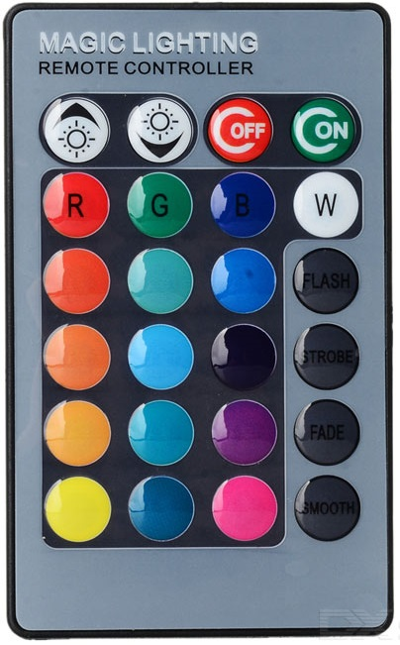
Normal mode
Key | Strip turned on | Strip turned off
1 | Brightness + | -
2 | Brightness - | -
3 | Off | -
4 | Settings mode (press twice in 5secs) | On
5-11 13-14 17-19 21-23 | Change color (Static or Pulse) | -
12 | Change music effect | -
15 | Change color to custom one
16 | Change replication amount | -
20 | Change strip selection | -
24 | Change smooth effect color | -
1
2
3
4
5
6
7
8
9
10
11
12
13
14
15
16
17
18
19
20
21
22
23
24

Slide 2
Settings mode
Key | Strip turned on
1 | Backlight maximum +
2 | Backlight maximum -
3 | Off (and leave settings mode)
4 | Leave settings mode
5 | Manually add 5 to red
6 | Manually add 5 to green
7 | Manually add 5 to blue
8 | Load custom color
9 | Manually reduce 5 from red
10 | Manually reduce 5 from green
11 | Manually reduce 5 from blue
12 | Save custom color
13 | -
14 | -
15 | -
16 | Toggle 'shiftOneRight'
17 | -
18 | -
19 | -
20 | Manually save settings to EEPROM (Only 100,000 write cycles!)
21 | -
22 | -
23 | Toggle keystroke showing (green flash)
24 | Reset all settings to defaults
1
2
3
4
5
6
7
8
9
10
11
12
13
14
15
16
17
18
19
20
21
22
23
24

