Slide 1
Black and white Images Colorization
By: Salomon Malka and Aviv Ish Shalom
Deep learning course

Slide 2
The colorization problem
The problem of colorizing an image is very interesting and was not possible to do automatically before machine learning was introduced.
One of the biggest challenges in this problem is finding a loss function that is compatible with human perception of images.
Our goal was Using different types of loss functions to find out which one works better for this task, without using GAN loss.

Slide 3
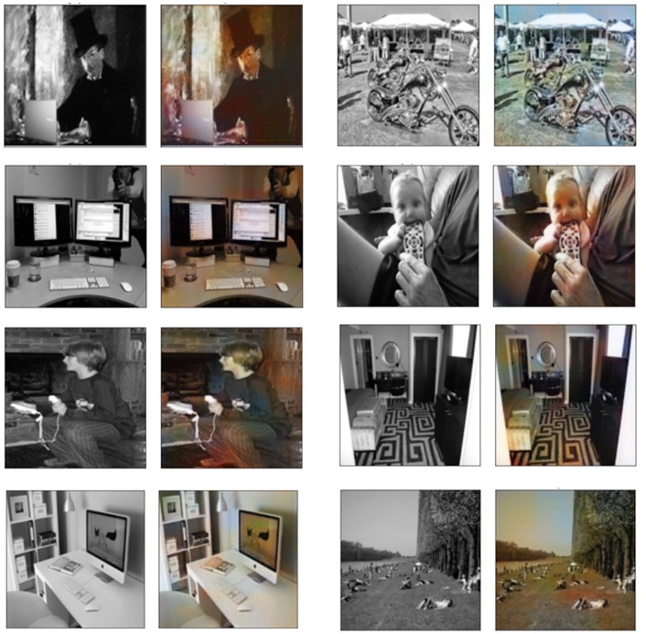
The Training Process:
Original
Grey
UNET
Colored

Slide 4
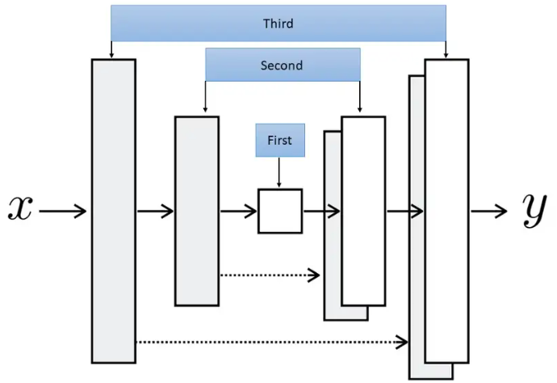
UNET architecture
Unet structure:

Slide 5
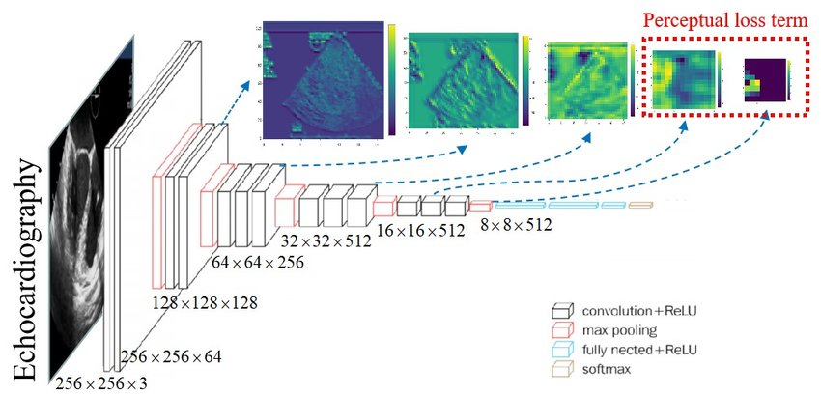
loss functions
MSE
L1
Perceptual loss
GAN

Slide 6
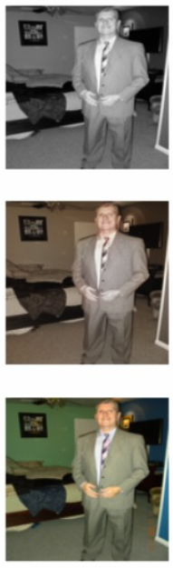
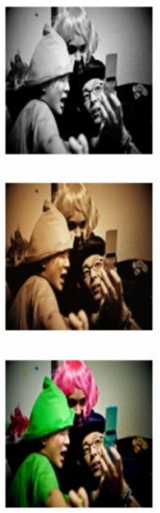
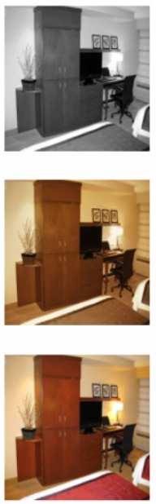
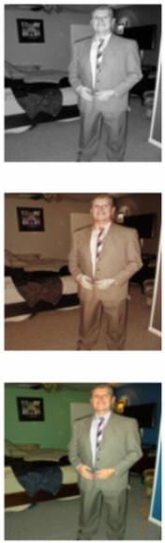
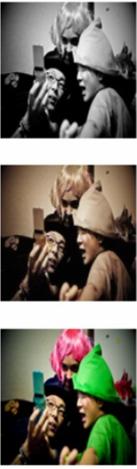
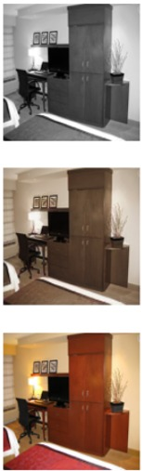
Challenges along the way
Perceptual loss based on VGG
LPIPS loss

Slide 7
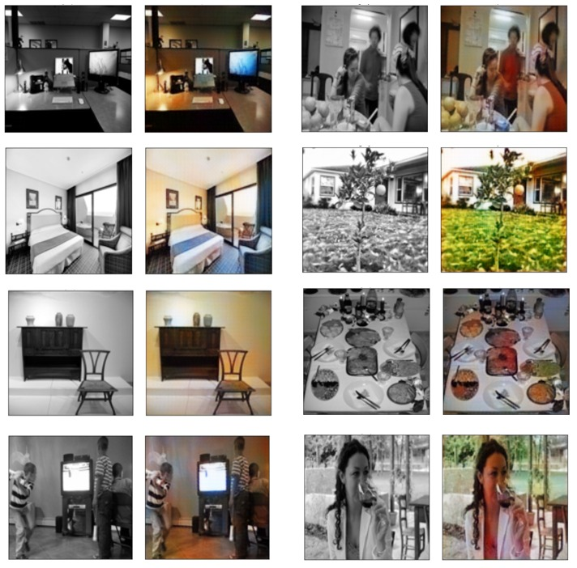
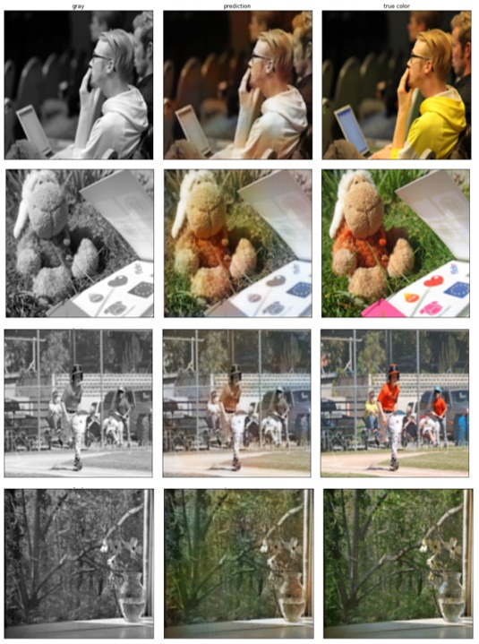
Final Results

Slide 8
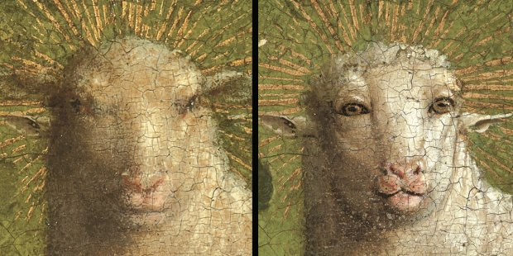
THANK YOU!
Next…image restoration!

