Slide 1



ADVERSARIAL MACHINE LEARNING IN IOT
Submitted by:
Saksham Gupta
2018A7PS0281H

Slide 2
CONTENTS:
Overview
MQTT Protocol
MQTT overview
MQTT concepts
Our Setup
Implementation
Implementation-Adversary
References.

Slide 3
Overview
Our previous presentation was based on various IoT Networking Protocols and an introduction on Contiki OS was given with an emphasis on Cooja Simulator.
In this presentation we give the details on our work and also provide with the demonstration.
We will start by introducing the MQTT Protocol (Message Queuing Telemetry Protocol) which was implemented in Cooja Simulator.
How we extracted the information from Cooja into .pcap and its conversion to csv.
What algorithms were implemented for Intrusion Detection System.
How an Adversary affects our IDS.

Slide 4
MQTT Protocol
MQTT stands for Message Queuing Telemetry Protocol , which is a simple messaging protocol designed for constrained devices with low-bandwidth.
The protocol uses a publish/subscribe communication pattern which makes it easy to send and commands to control outputs, read and publish data from sensor nodes and much more.
The MQTT protocol is a good choice for wireless networks that experience varying levels of latency due to occasional bandwidth constraints or unreliable connections.
The protocol is used for machine to machine communication and plays an important role in the Internet of Things (IoT).

Slide 5
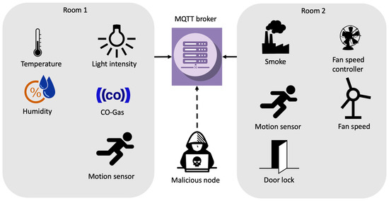
Overview
The MQTT protocol surrounds two subjects : a client and a broker.
An MQTT broker is a server while the clients are the connected devices.
When a device or client sends data to a server or broker, it is called publish. When the operation is reversed it is called subscribe.

Slide 6
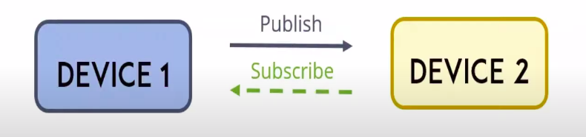
MQTT Concepts
Publish / Subscribe
In a publish subscribe system , a device can publish a message on a topic or it can be subscribed to a particular topic to receive messages.
For example Device 1 publishes on a topic.
Device 2 is subscribed to the same topic as device 1 is publishing in.
So, device 2 receives the messages.

Slide 7
Concepts - continue
MQTT Messages- these are the information that you want to exchange between your devices. Whether it’s a command or data.
MQTT Topics- topics are the way to register interest for incoming messages or how you specify where you want to publish the message.
MQTT Broker= primary responsibility of broker is for receiving all messages , filtering the messages ,decides who is interested in them and then publishing the messages to all subscribed clients.
An MQTT session is divided into four stages:
Connection
Authentication
Communication
Termination

Slide 8
Connection- A client starts by creating a TCP/IP connection to the broker by using either a standard port or custom port defined by the broker’s operators.
Authentication- During the SSL/TLS handshake , the client validates the server certificate and authenticates the server. The client may also provide a client certificate to the broker during the handshake.The broker can use this to authenticate the client.
Communication- During the communication phase a client can perform publish, subscribe, unsubscribe and ping operations. The publish operation sends a binary block os data --the content-- to a topic that is defined by the publisher . Topic subscriptions are made using a SUBSCRIBE/SUBACK packet pair, and unsubscribing is similarly performed using an UNSUBSCRIBE/UNSUBACK packet pair.
Termination- When a publisher or subscriber wants to terminate an MQTT session, it sends a DISCONNECT message to the broker and then closes the connection. THis is called a graceful shutdown because it gives the client the ability to easily re-connect by providing its client identity and resuming where it left off.

Slide 9
Our Setup
We have generated data by real-life equivalent simulations using the open source Contiki/Cooja simulator , because of lack of availability of public IoT attack data sets.
Our Simulation contains 11 nodes, of which 5 are publisher nodes , 5 subscriber nodes and 1 server node i.e border-router node.
The Cooja simulation generates raw packet capture (PCAP) files, which are first converted into Comma Separated Values (CSV) files using the tshark which involves the feature extraction while converting to csv.

Slide 10
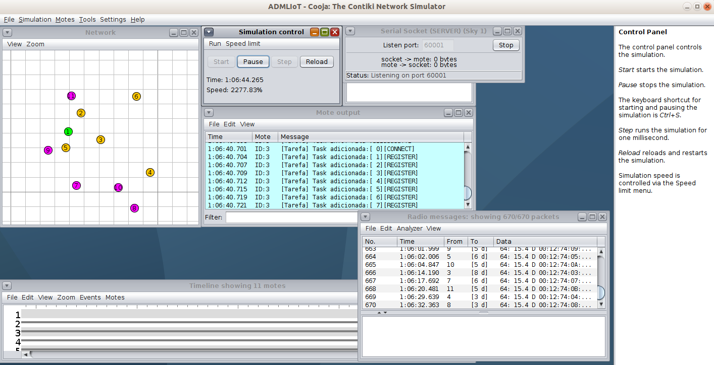

Slide 11
Implementation
Previously we simulated 11 nodes that was a legitimate data without any network intrusion or any attack. The .pcap files generated were converted to csv with the help of tshark and features were extracted into csv.
Next we simulated the same network with a malicious node causing the flood attack for network intrusion and similarly the data obtained was converted to csv.
A number of other attacks data was also collected namely:
Brute-force attack
Malaria attack
Malformed attack
Slowite attack

Slide 12
As of now we had 6 csv data files one of which was legitimate and others were attack based.
Next we added a attribute to each csv indicating its type i.e legitimate or attack based.
All the csv were then combined to form a mqttdataset.csv and preprocessed where features were extracted as too many unnecessary features leads to overfitting.
This was then split into training and test dataset in a 7:3 ratio .
As a part of network intrusion detection we developed few machine learning (neural network, random forest, naive biased, multi level perceptron, decision tree and gradient boost) models to predict the intrusion attack correctly and compared their accuracy scores and graphs were generated for the same.
From our work we found Random Forest to be best for intrusion detection.

Slide 13
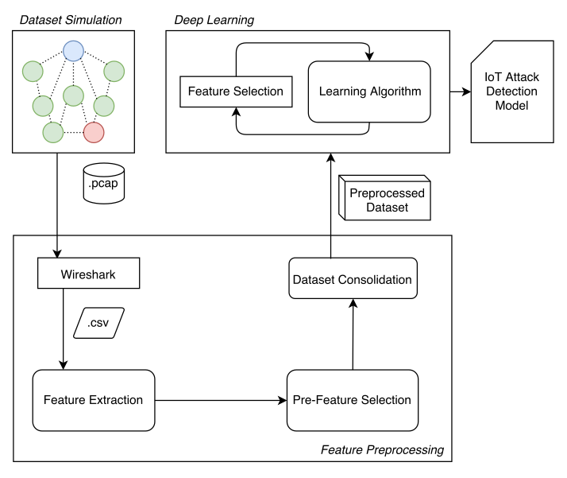

Slide 14
Implementation- Adversarial Machine Learning
We implemented the Poisoning attack on our Machine Learning models.
Poisoning is adversarial contamination of training data.
Machine learning systems can be retrained using data collected during operations.
An attacker may poison this data by injecting malicious samples during operation that subsequently disrupt training.
In our Intrusion detection Machine Learning model we re-trained our model with such manipulated data and observed the accuracy of prediction to fall.

Slide 15
REFERENCES:
https://www.mdpi.com/1424-8220/20/22/6578/htm
Wikipedia.com
opensourceforu.com
Networkworld.com
Research papers provided in the Study Material.

