Slide 1
Sentiment Analysis of Movie Data Set

Slide 2
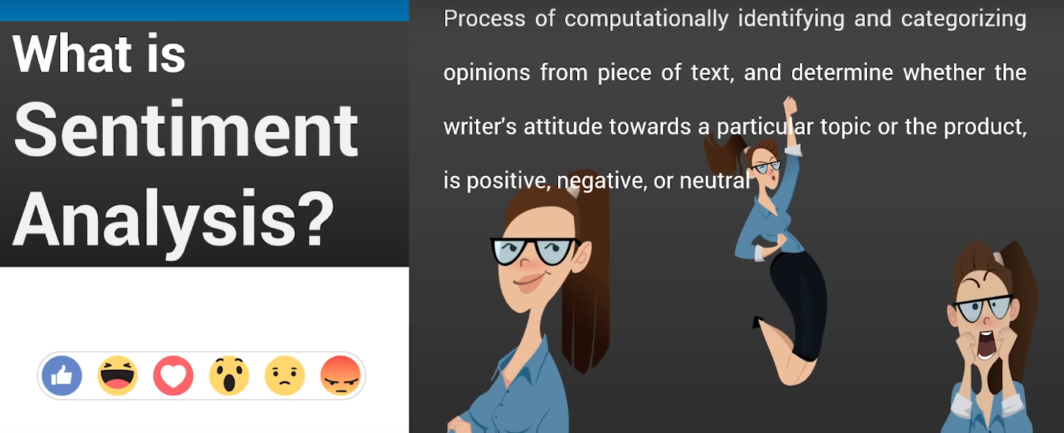

Slide 3
Library used :
TextBlob is a python library and offers a simple API to access its methods and perform basic NLP tasks.
A good thing about TextBlob is that they are just like python strings. So, you can transform and play with it same like we did in python.

Slide 4
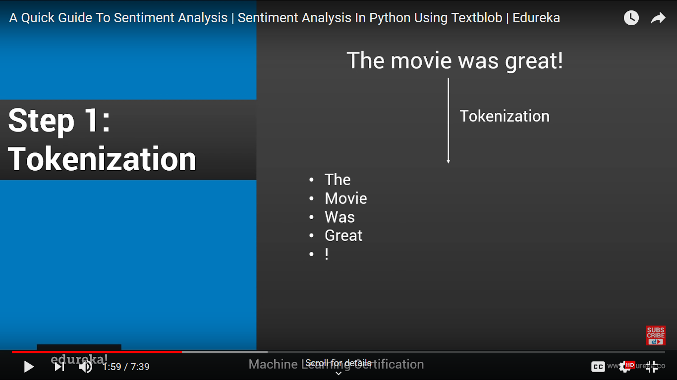

Slide 5
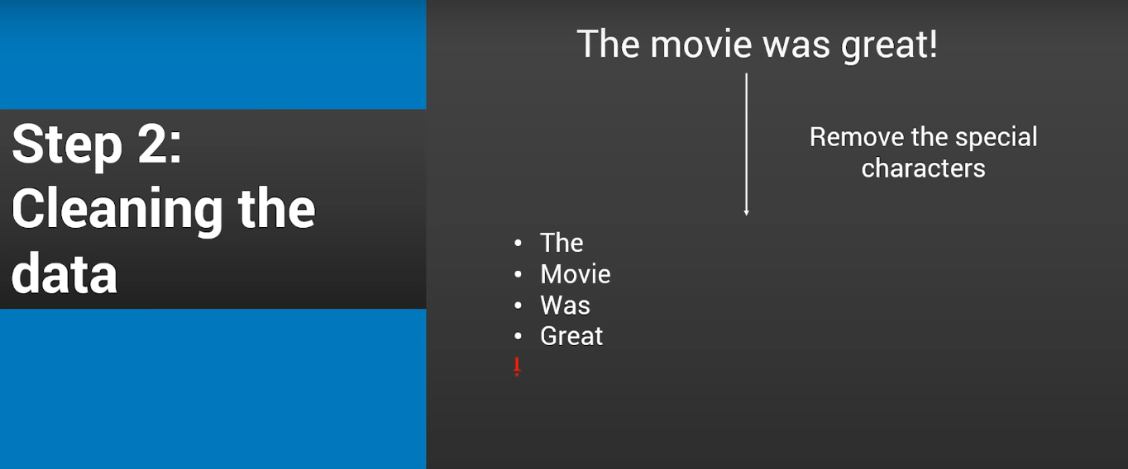

Slide 6
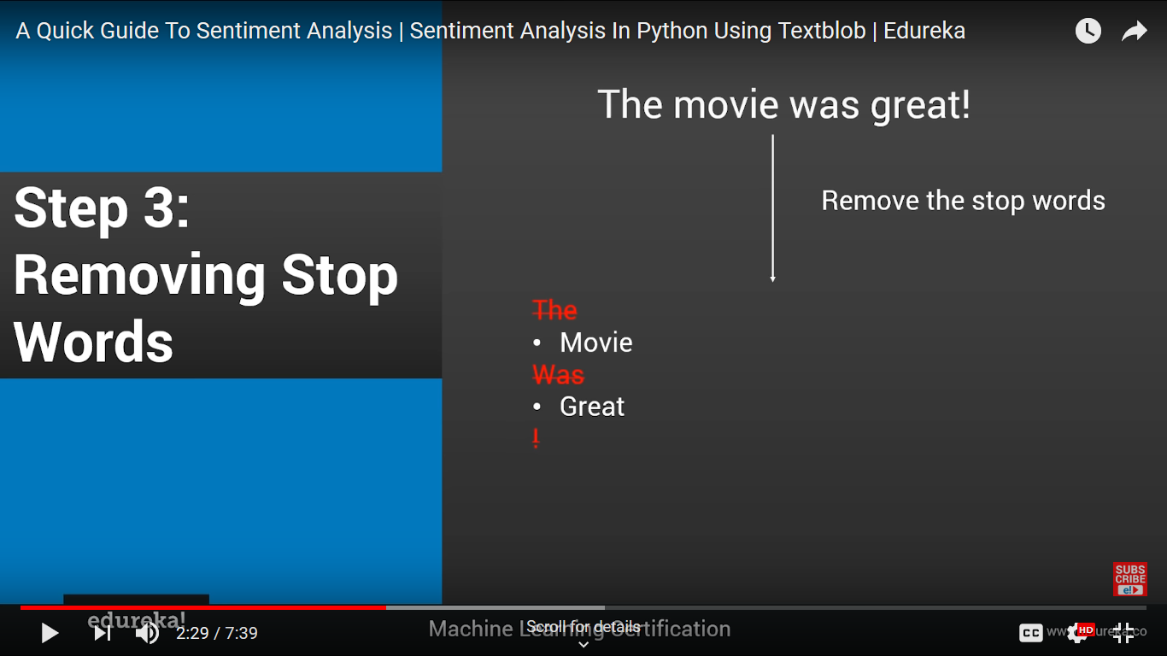

Slide 7
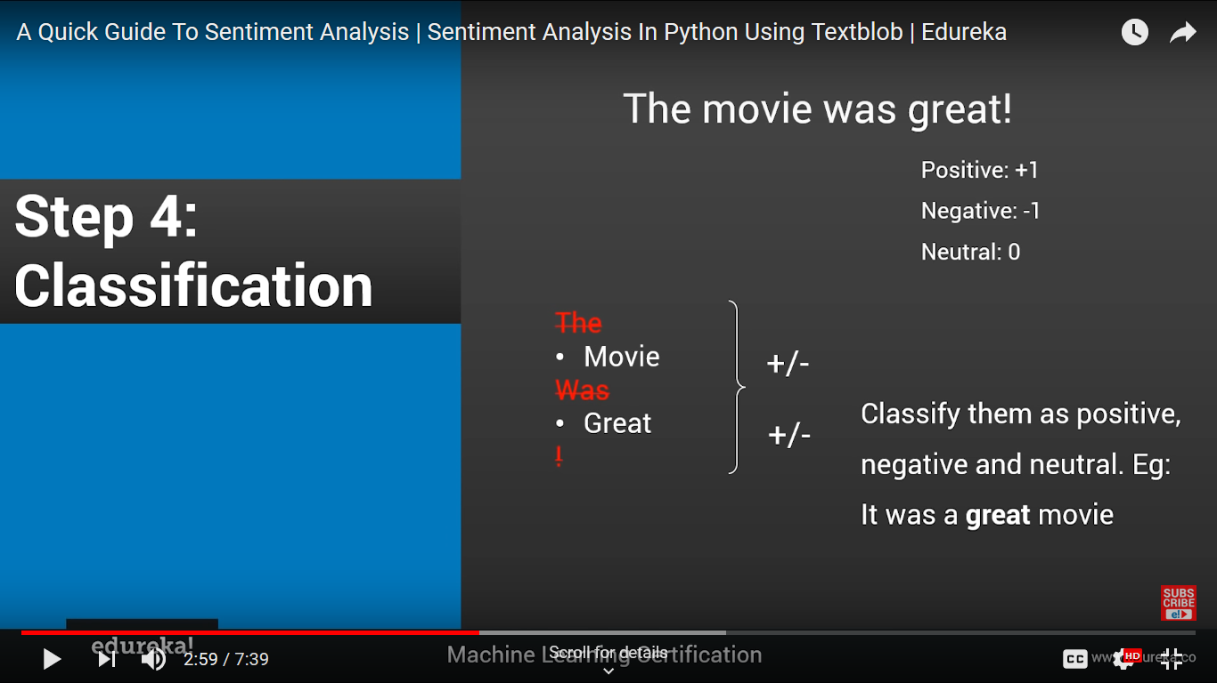

Slide 8
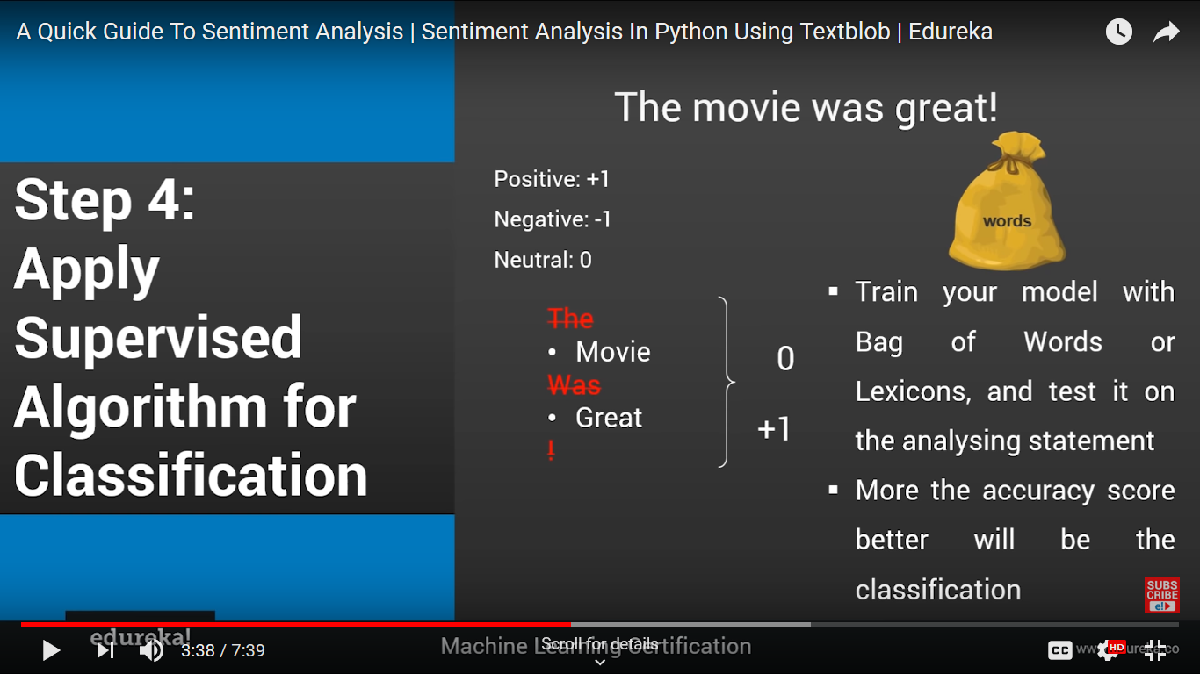

Slide 9
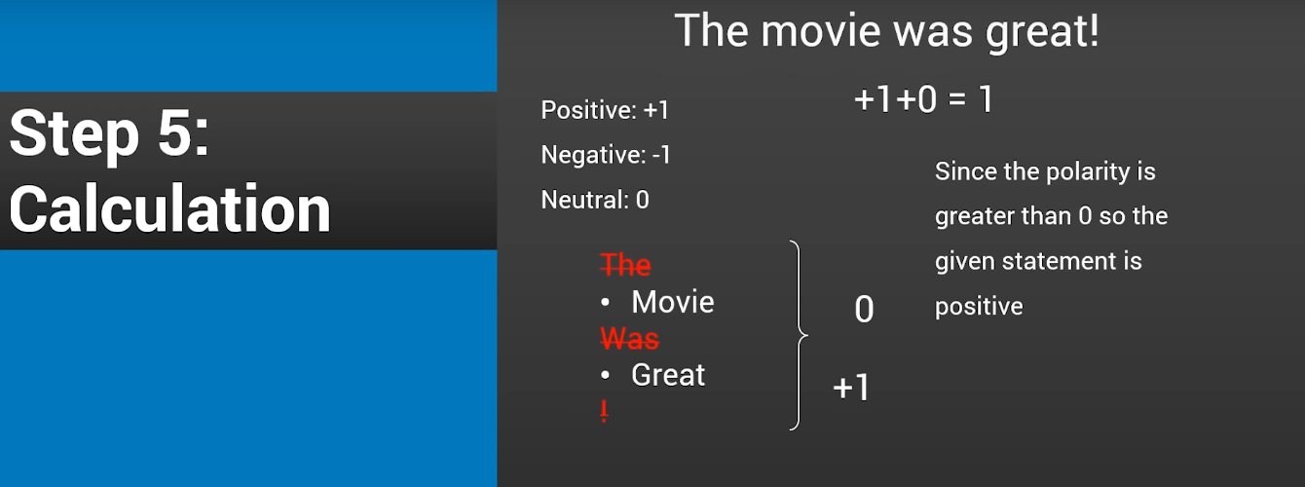

Slide 10
Thank You

