Slide 1



Presentation on Check IT
Guided By: Presented By:
Prof. Shahida Khan Kratika Jain (0827IT221079)
Pratham Bothra(0827IT221112)
Saloni Jain(0827IT221128)
Urvashi Yadav(0827IT221147)

Slide 2
Contents
Introduction
1.1 Overview
1.2 Purpose
Requirement Engineering
2.1 Requirement Collection
2.2 Functional Requirements
2.3 Non Functional Requirements
2.4 Use Case Diagram
Technical Design
3.1 Technical Architecture
3.2 Sequence Diagram
3.3 Class Diagram
3.4 DFD
User Interface Design
Data Design
5.1 Schema Design
5.2 E-R Diagram
REFERENCES

Slide 3
1. Introduction
1.1 Overview
Automated Attendance Tracking: Integrates Google Forms API to collect and store attendance data in a centralized database, replacing manual methods and ensuring accuracy and efficiency.
Faculty & Student Management: Faculty can manage subjects, schedules, and attendance records, while students receive real-time notifications about their attendance status.
Task Management & Reminders: Includes a to-do list and reminder module for students and faculty, with admins able to assign and monitor task completion for better coordination.
Resource Sharing & Announcements: Faculty can upload study materials and post class-related notices, enhancing communication and access to academic resources.
1.2 Purpose
To automate and simplify the attendance tracking process, eliminating manual errors and saving time for faculty and students.
To centralize student academic records for easy access, monitoring, and analysis by authorized users.
To improve communication and coordination through features like notifications, reminders, and academic announcements.
To enhance productivity and organization with task management tools and resource-sharing capabilities.

Slide 4
2. Requirement Engineering
2.1 Requirement Collection
Interviews & Discussions: Conducted one-on-one and group discussions with faculty members and students to understand their challenges with the current attendance and academic management systems.
Surveys & Questionnaires: Distributed Google Forms to collect feedback on user needs, expectations, and preferred features for attendance tracking, task management, and communication tools.
Observation: Observed the traditional attendance process (paper registers and Excel sheets) to identify inefficiencies and pain points in real-time classroom settings.
Document Analysis: Reviewed existing academic processes, institutional guidelines, and attendance policies to align the system with official requirements.

Slide 5
2.2 Function Requirements
1)User Login & Role Management
Role-based access for Admin, Faculty, and Students.
2)Attendance Management
Collect attendance via Google Forms.
Real-time attendance tracking and report generation.
Low attendance alerts to students.
3)Task & Reminder Module
To-do lists and custom reminders for users.
Task assignment and progress tracking by Admin.
4)Notification System
Automated alerts for lectures, tasks, and attendance.
5)Notes & Announcement Sharing
Faculty can upload study materials and post academic notices.

Slide 6
2.2 Non-Functional Requirements
).
Performance – Real-time data access; quick report generation.
Security – Role-based access control; secure data handling.
Availability – System available 99% during working hours; timely email alerts.
Usability – Easy-to-use, responsive UI for all users.
Maintainability – Modular code and proper documentation.
Portability – Runs on all major browsers and server platforms.
Scalability – Supports many users and expandable to more departments.
Integration – Works with Google Forms/Sheets and JavaMail API.

Slide 7
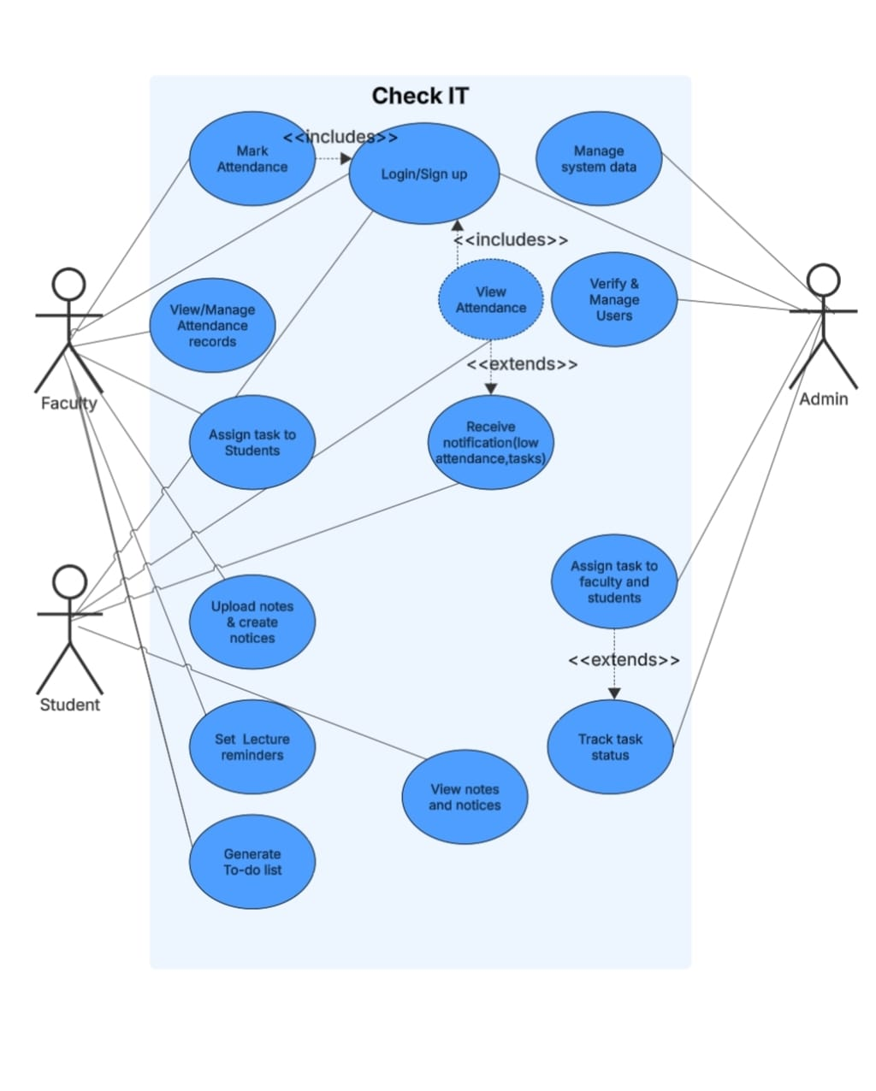
2.3 Use Case Diagram

Slide 8
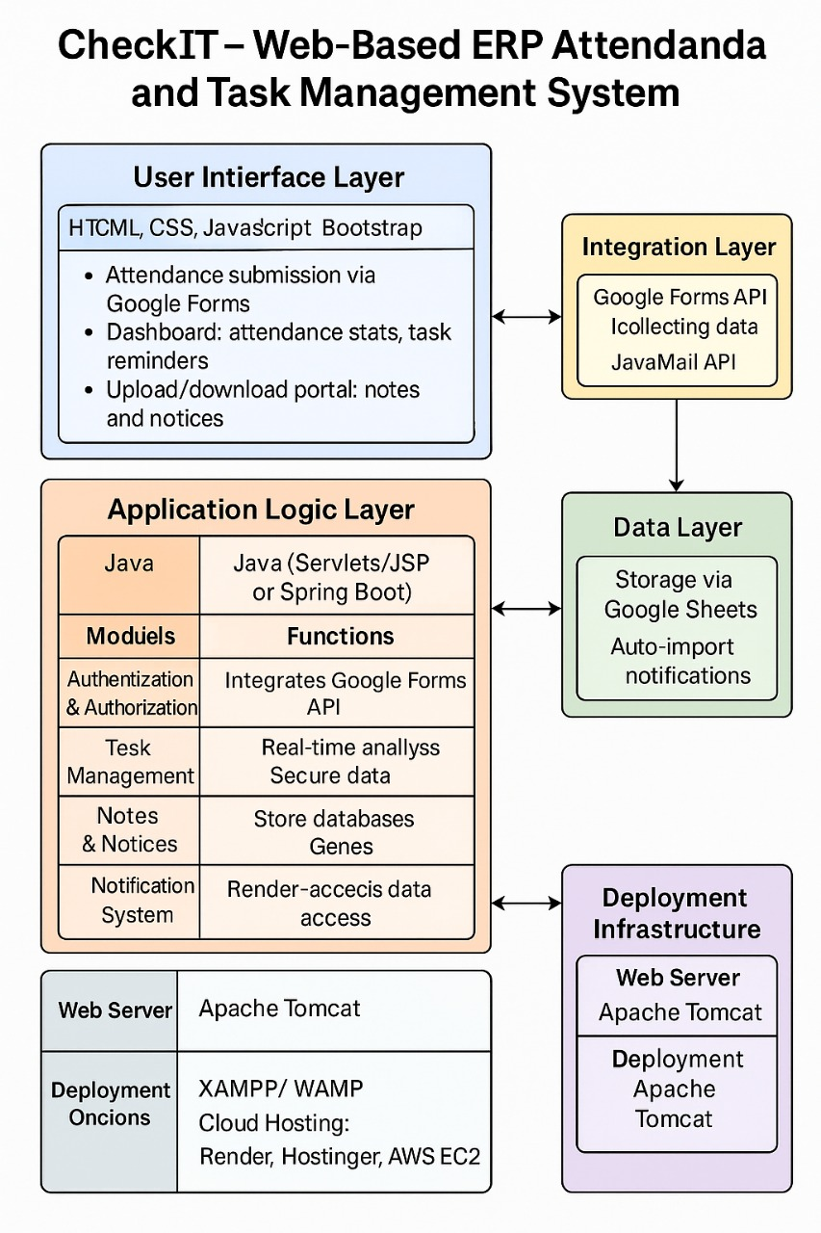
3. Technical Design 3.1 Technical Architecture

Slide 9
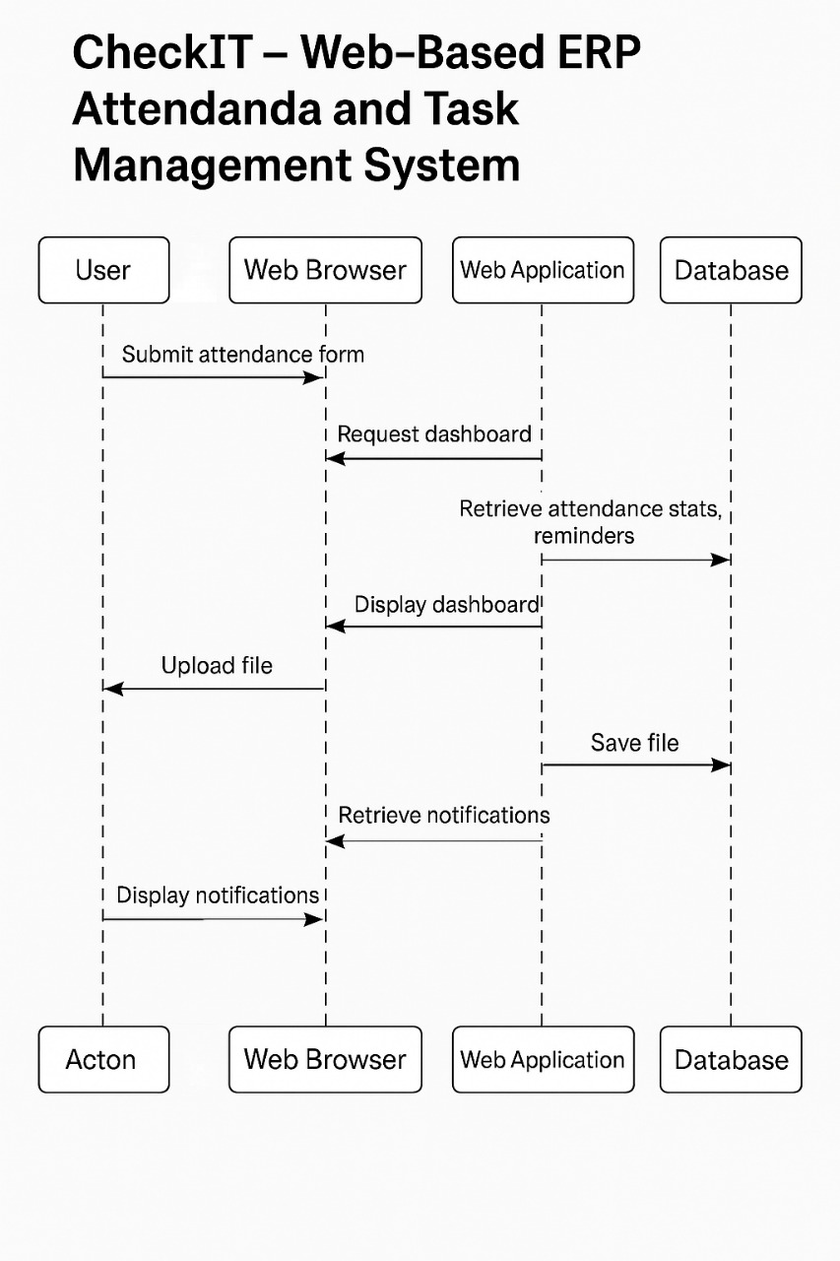
3.2 Sequence Diagram

Slide 10
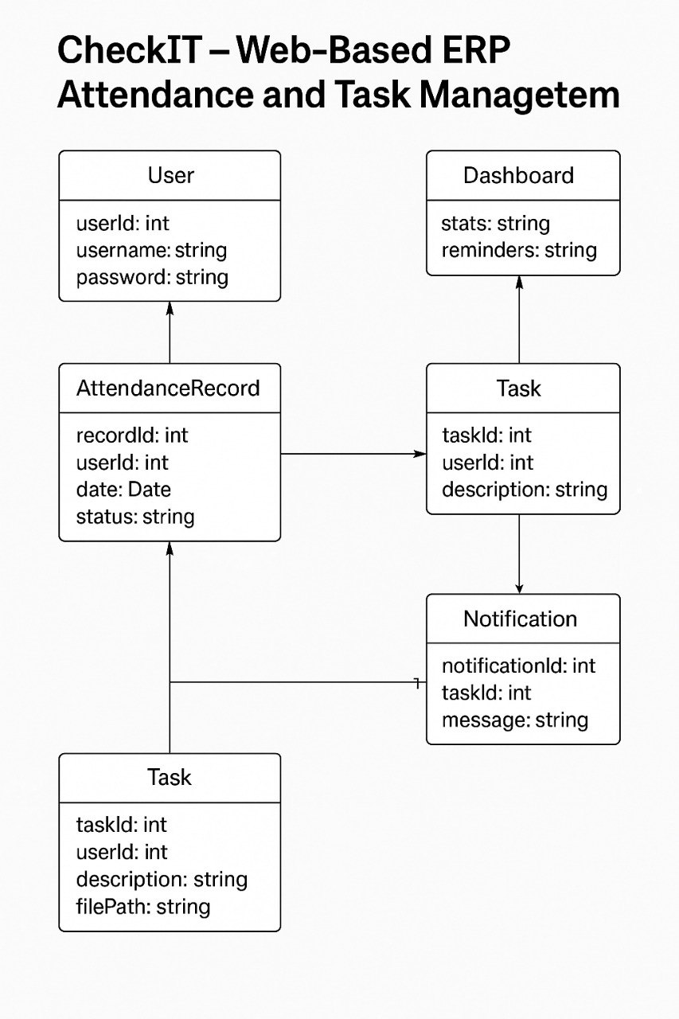
3.3 Class Diagram

Slide 11
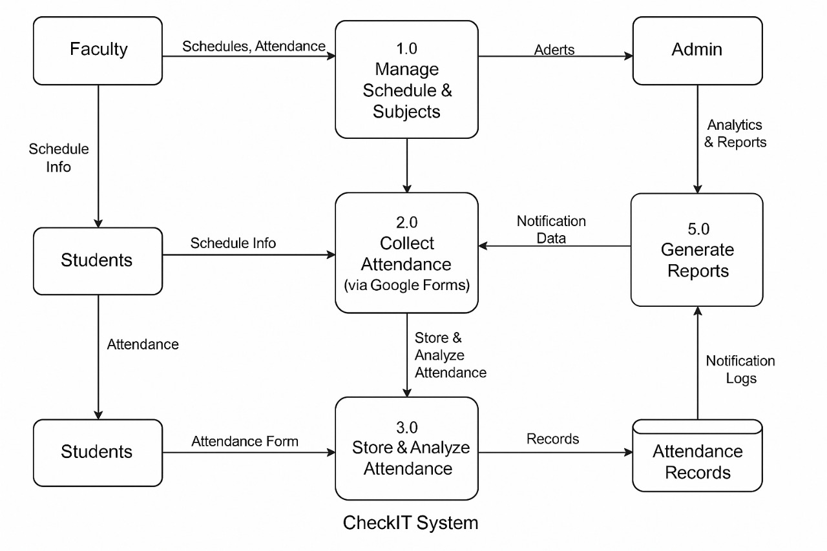
3.4 DFD

Slide 12
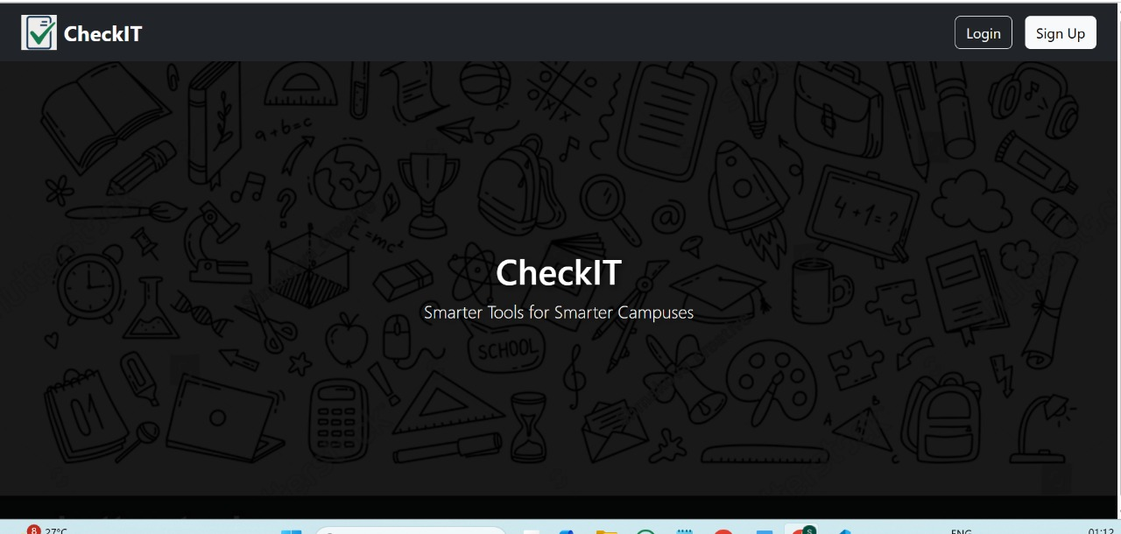
4. User Interface Design

Slide 13
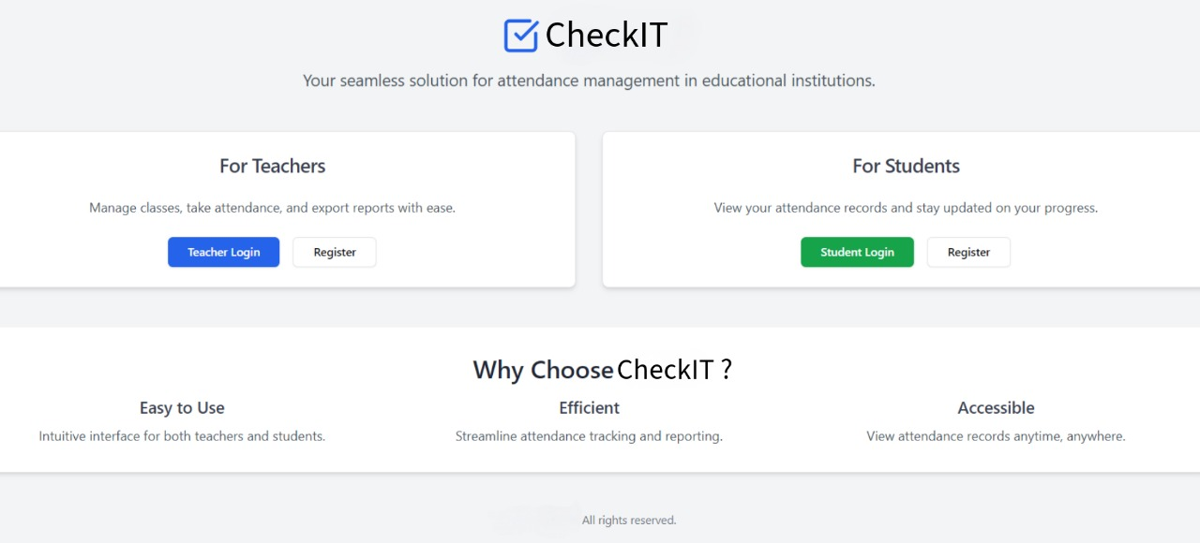

Slide 14
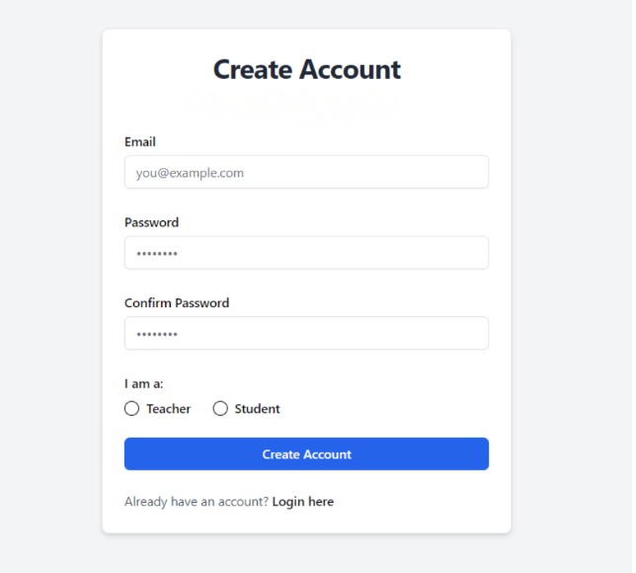

Slide 15
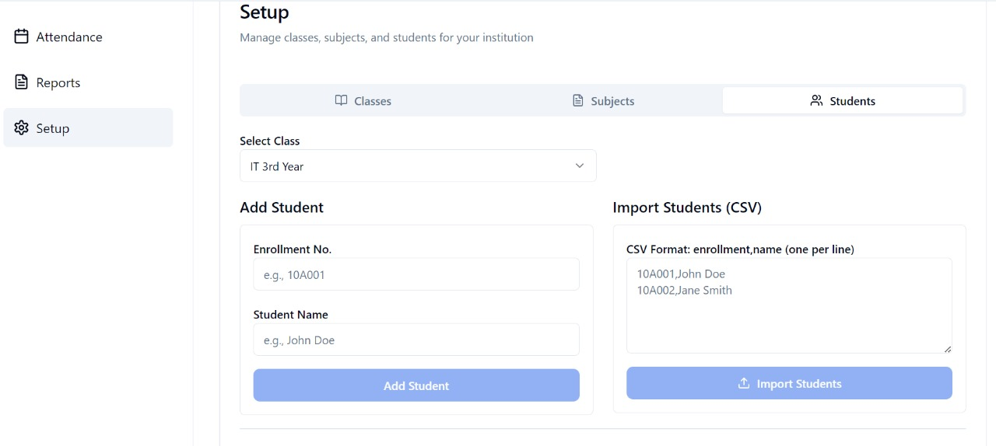

Slide 16
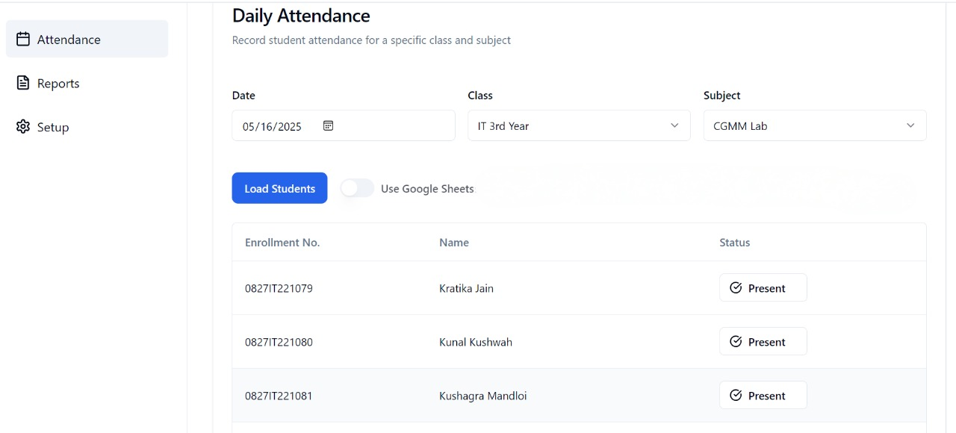

Slide 17
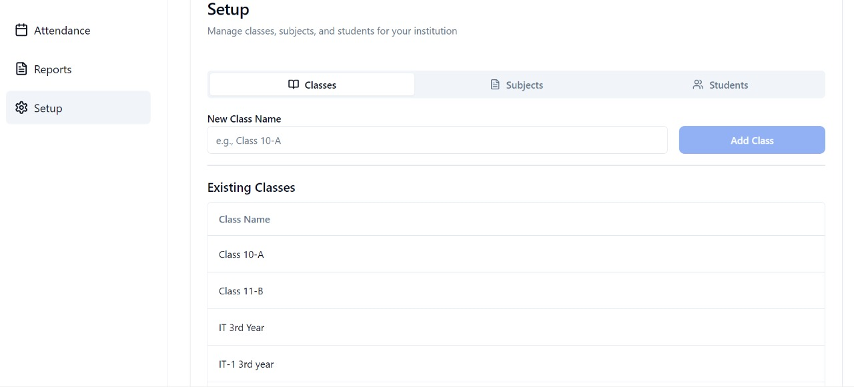

Slide 18
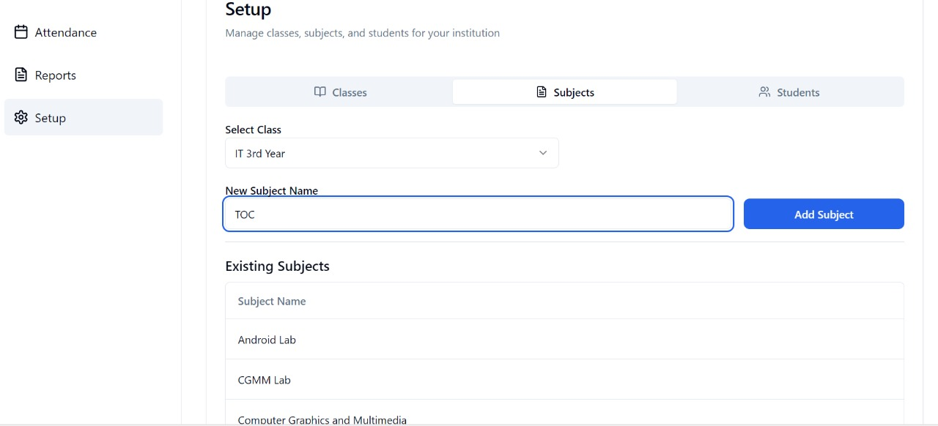

Slide 19
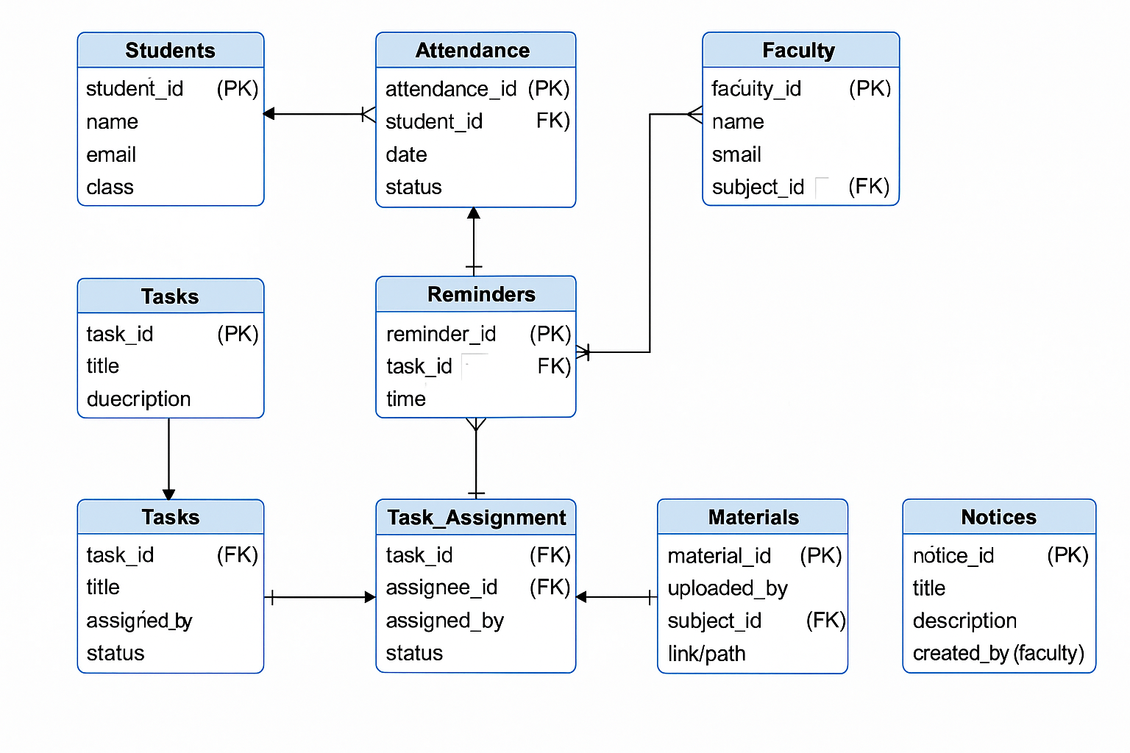
4. Data Design 4.1 Schema Definition

Slide 20
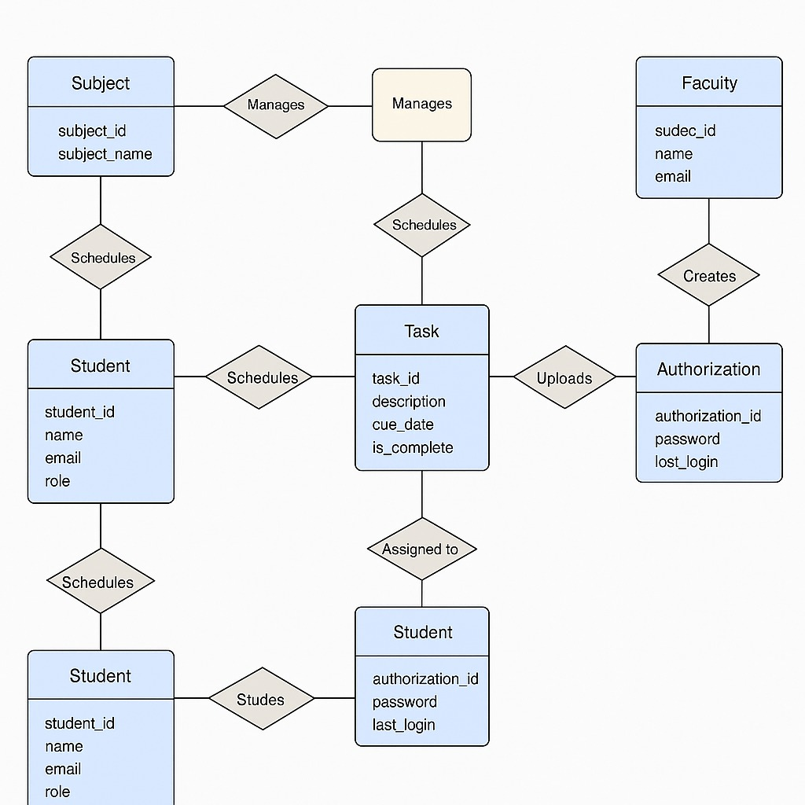
4.2 E-R Diagram

Slide 21
GitHub Link
https://github.com/Saloni-Jain25/checkit

Slide 22
REFERENCES
Sonawane, R. K., & Singh, A. T. (2023). Importance and Impact of Attendance Management System: A Literature Review. International Journal of Advanced Research in Science, Communication and Technology, 3(5), 328.
Ali, N. S., Alhilali, A. H., Rjeib, H. D., Alsharqi, H., & Al-Sadawi, B. (2022). Automated Attendance Management Systems: Systematic Literature Review. International Journal of Technology Enhanced Learning, 14(1), 37–65.
Soundarya, S., Ashwini, P., Rucha, W., Gaurav, K., & Patil, M. S. A Review Paper on Attendance Management System Using Face Recognition. International Journal of Computer Research Trends.

Slide 23
Thank You
Queries ?

