Slide 1
Threat Intelligence Report
Prepared by: Saloni Kumari
Role: Cybersecurity Analyst Intern
Date: 07-04-2026

Slide 2
Introduction
Cybersecurity: Cybersecurity is a field where we give high importance to digital security. We ensure that data is not leaked and remains private, while also maintaining individual privacy. Overall, whatever activities are happening in the digital world such as data transfer, uploading and downloading of data, and data sharing, proper security is maintained among all of these so that no one faces financial loss, reputational damage or any other kind of loss.

Slide 3
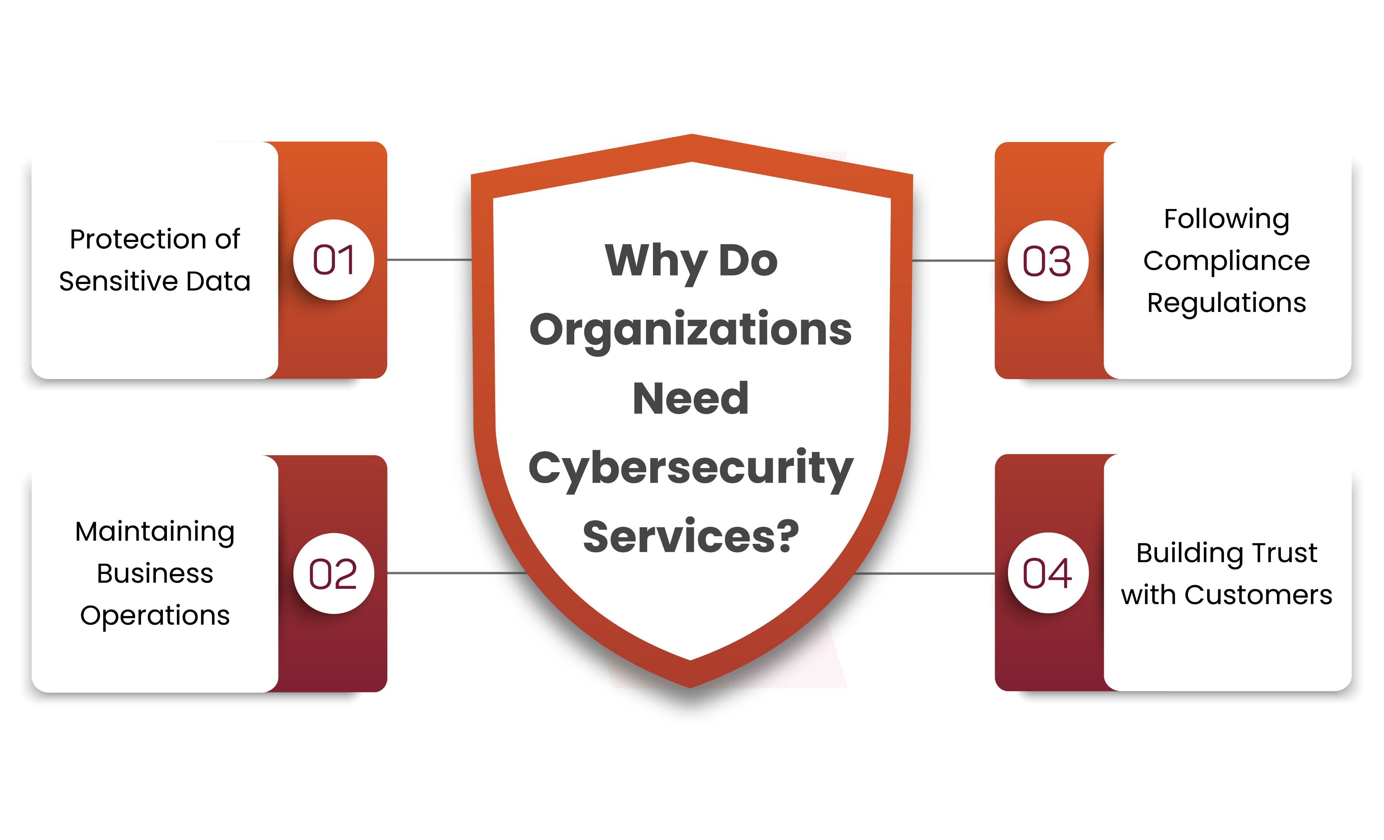
For individuals: For individuals the main purpose of cybersecurity is to keep personal data safe, protect against online fraud and scams, secure social media accounts and prevent identity theft.
For Organizations: For Organizations the role of cybersecurity is even greater because they have a large amount of sensitive data. If a cyber attack occurs and customer or company data gets hacked, it can damage the company’s reputation, cause financial loss and also lead to a loss of customer trust.

Slide 4
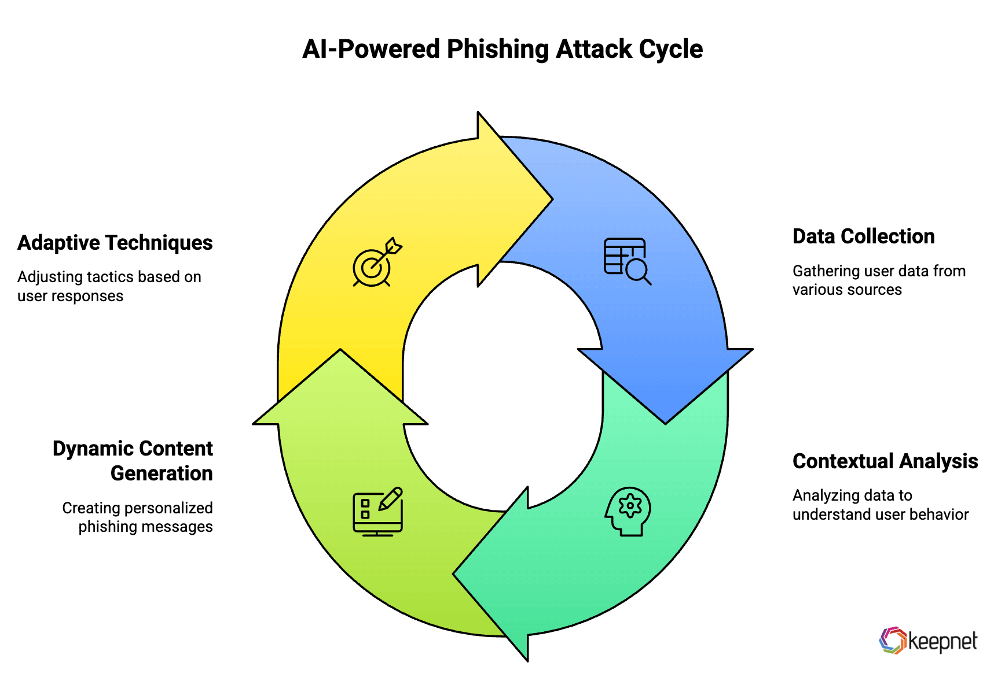
Threat #1: AI-Powered Phishing
An AI-powered phishing attack is an advanced cyber attack in which attackers use Artificial Intelligence to send fake messages, calls, or emails to people. These messages appear so real that people easily fall for them and become victims of phishing.

Slide 5
Examples:
Emails: Attackers send an email to a person that looks like it is from a bank. It contains the correct name and a professional-looking message. As soon as the person clicks on the link mentioned in the email and fills in their details, all their information goes to the attackers.
Messages and calls: Attackers send a message to a person’s inbox saying that ₹1000 has been credited to their account. After that, they receive a call with an AI-generated voice saying that ₹1000 was credited by mistake and asking them to return it.
OTP login: You receive a message on WhatsApp from a known person saying, ‘Hey, I urgently need an OTP or login help. I’m in a meeting, please send it. This message is created using Artificial Intelligence, and it looks so real that you trust it and share your OTP or login details..

Slide 6
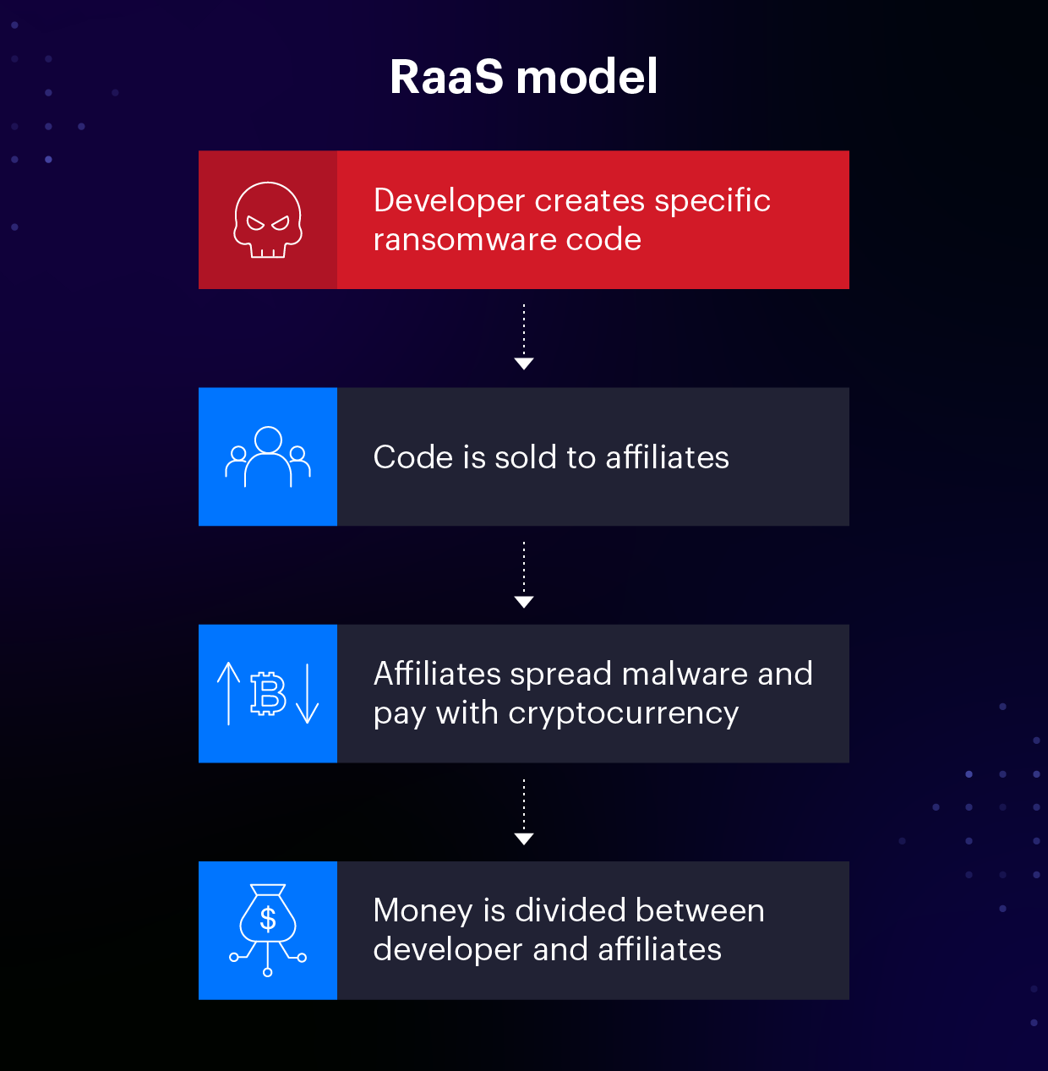
Threat #2: Ransomware-as-a-Service(RaaS)
Ransomware encrypts data, and to decrypt that data, a key is required. The attacker demands money in exchange for that key. Ransomware usually enters a system through illegal, unknown, or untrusted websites and sources, often via installing applications from such platforms.

Slide 7
Precautions:
Taking backups helps maintain security, and if such an attack occurs, the first step is to turn off the system to stop further data encryption. Then, a bootable USB drive can be used to start a Linux operating system. The advantage of this is that ransomware designed to work on Windows will not work on Linux, so once Linux starts, the ransomware remains inactive. At that point, important data can be copied using external hardware and saved from encryption.
Therefore, we should always use trusted platforms to avoid ransomware attacks.

Slide 8
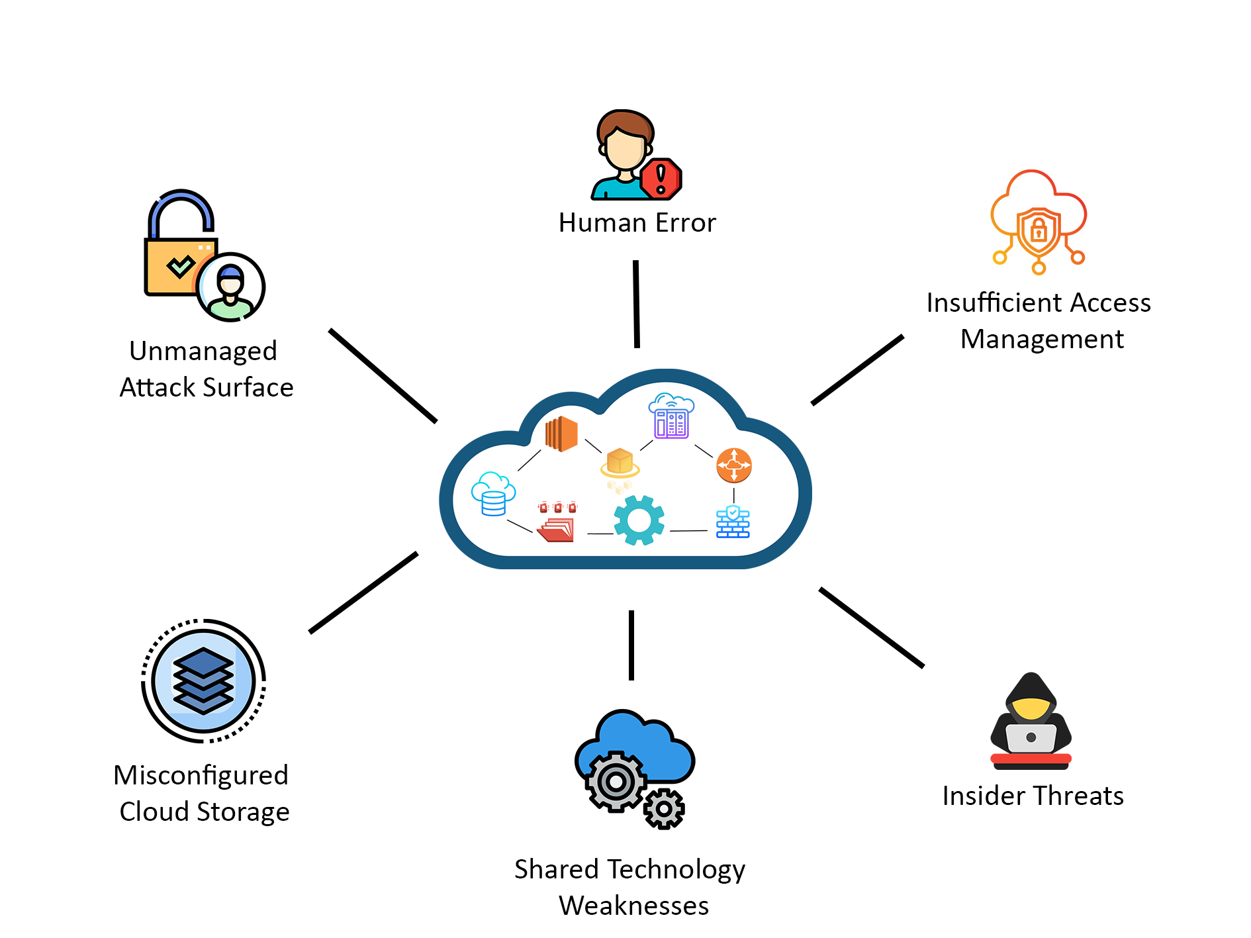
Threat #3: Cloud Security Misconfigurations
Cloud security misconfiguration is a human error in which incorrect settings put the entire system or data at risk. When cloud service settings are not properly secured, hackers can easily gain access. It is very dangerous because it can lead to data leaks, unauthorized access by hackers, and financial as well as reputational loss.

Slide 9
Precaution:
Ensure proper configuration
Perform regular security checks
Use strong passwords and multi-factor authentication
Enable data encryption
Maintain proper access control
Use automated security tools
Monitor and log activities
Apply least privilege access (Access Control)

Slide 10
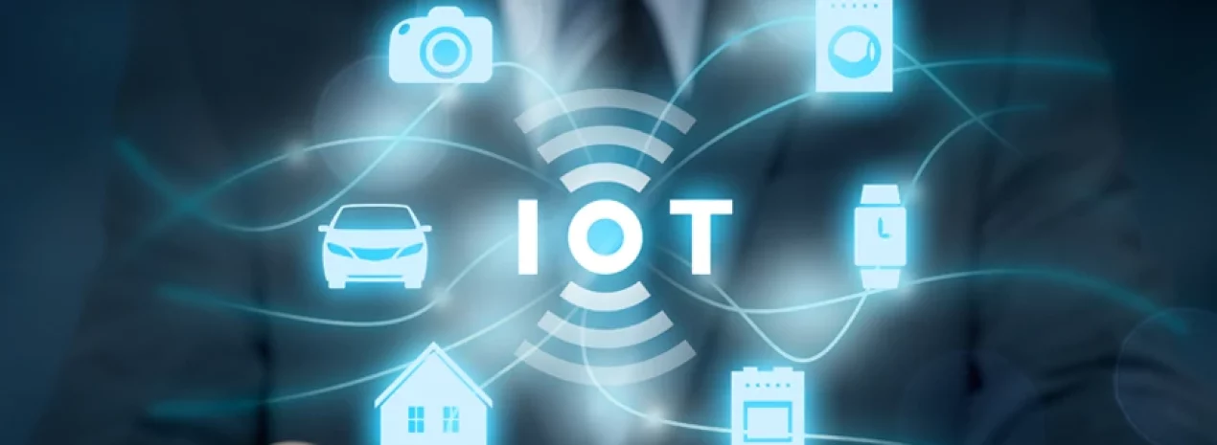
Threat #4: IoT Vulnerabilities
IoT vulnerabilities refer to weaknesses or security flaws present in Internet of Things devices (such as smart cameras, smart TVs, smart locks, and wearables), through which hackers can hack or misuse them. This is very dangerous because it can put personal privacy at risk, allow devices to be controlled remotely, lead to data leaks, and even compromise the entire network.

Slide 11
Precaution:
Use strong and unique passwords
Install regular updates
Use devices from trusted brands
Keep the network secure (use a strong Wi-Fi password)
Disable unnecessary features and ports.
Example: If a smart camera has a simple password like “admin123,” a hacker can easily log in and gain access to it.

Slide 12
Threat #5: Zero-Day Exploits
Attackers first identify the flaws and vulnerabilities present in a software. After discovering a vulnerability, the exploitation phase begins. At this stage, attackers create a malicious code or a specific method, which is called a zero-day exploit.
After exploitation, the system gets compromised, and hackers cause damage to it—they may steal data, install malware, or gain remote access. After exploiting the system using that vulnerability, attackers may publicly disclose or leak the vulnerability so that others can also misuse it. This is usually done after the attack.

Slide 13
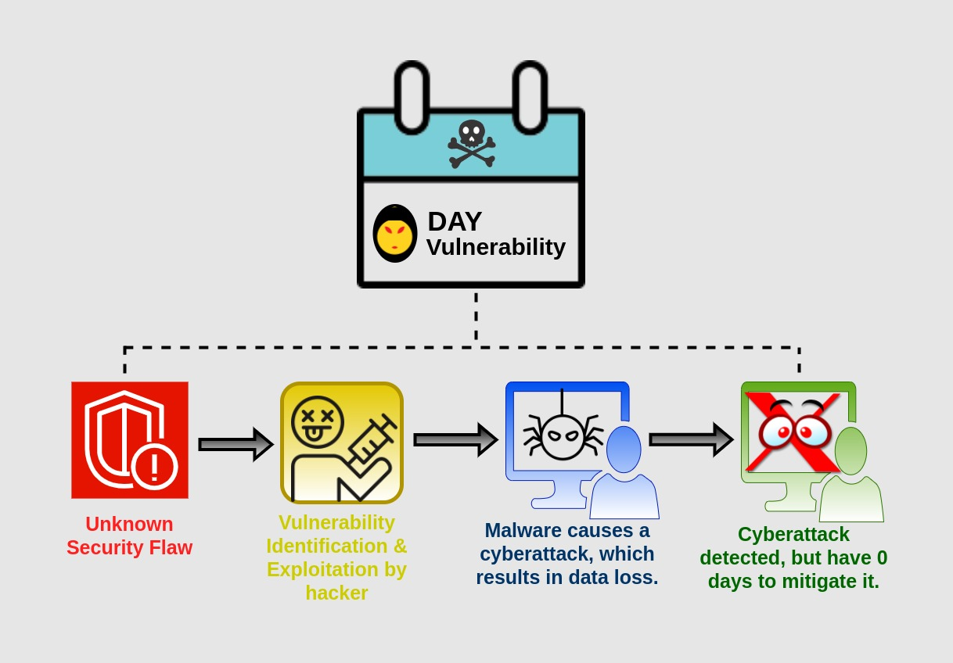
Example:
Suppose there is an unknown flaw in a browser. A hacker uses that flaw through a malicious website to install malware on your system—this can be a zero-day attack.

Slide 14
Impact Analysis: Individuals vs. Organizations
Threat | Impact on Individuals | Impact on Organizations
AI Phishing | Personal data can be stolen. Financial fraud may occur. Social media and email accounts can be hacked. | Attackers can gain access through employees. Sensitive business data may be leaked. Company reputation and customer trust are damaged.
RaaS | Personal files get encrypted. Victims may have to pay money to recover data. Causes financial and emotional stress | Entire systems or networks can be locked. Business operations may stop. Heavy financial losses and ransom payments. Serious reputational damage.

Slide 15
Threat | Impact on Individuals | Impact on Organizations
Cloud Misconfiguration | Personal data may become publicly accessible. Privacy is at risk. | Sensitive data can be exposed. Hackers may gain unauthorized access. Leads to legal issues, financial loss, and reputational damage.
IoT Vulnerabilities | Smart devices can be hacked. Privacy breaches can occur. Devices may be controlled remotely. | Entire networks can be compromised. Industrial systems may be attacked. Data leaks and operational disruptions can occur.
Zero-Day | Malware can be installed without their knowledge. Personal data can be stolen. | Attackers exploit unknown vulnerabilities. High-risk data breaches occur.

Slide 16
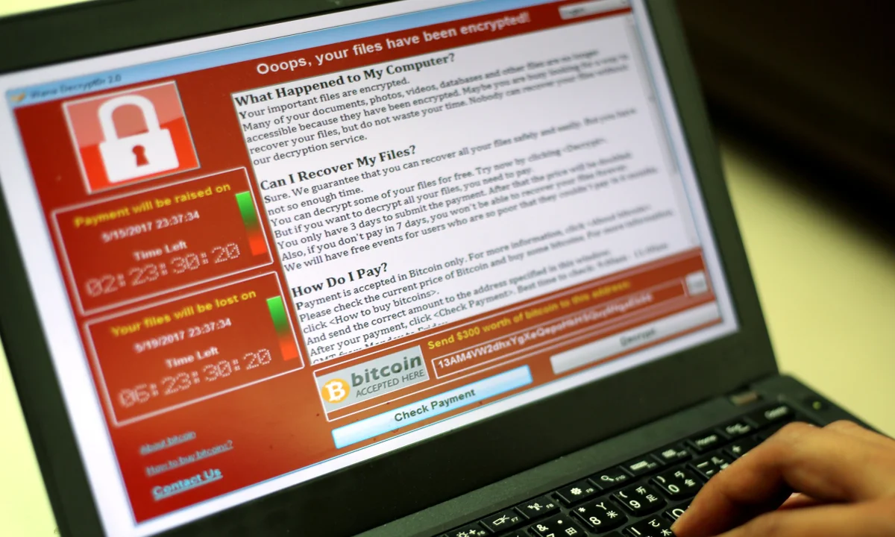
Real-World Case Study
WannaCry Ransomware Attack(2017):
Attackers exploited the Eternal Blue vulnerability to encrypt data and demanded a ransom in Bitcoin in exchange for the decryption key.

Slide 17
Impact:
The National Health Service (NHS) in the UK had to shut down many of its systems. As a result, patient data could not be accessed, appointments had to be canceled, and emergency services were affected.
Forensic Investigation of the attack:
The digital forensics team worked together with the malware analysis team to investigate WannaCry. They analyzed how it worked, which vulnerability it exploited, how it executed its code, and how it performed encryption. During this analysis, the malware analysis team discovered a kill switch—a specific domain name which, when registered, helped stop the spread of the attack. The forensics team was also able to recover some data.
This vulnerability was first reported to Microsoft, which quickly released patches to prevent future attacks.
Lessons:
Regular backups should be maintained.
We should stay aware and vigilant about cybersecurity threats.

Slide 18
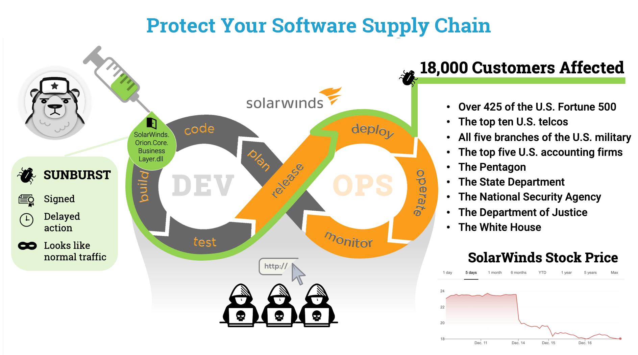
SolarWinds Supply Chain Attack (2020):
Attackers inserted malicious code into SolarWinds’s software (Orion platform). When companies downloaded updates for this software, the malware was also installed in their systems. As a result, attackers gained access to those systems. This was very dangerous because a trusted source was compromised, thousands of systems were infected through a single attack, and detection was very difficult.

Slide 19
Impact:
Government agencies and large companies were affected, sensitive data was accessed, and the attack remained undetected for a long time.
Incident Response:
As soon as it was discovered that the Orion software contained malware, the infected updates were immediately blocked. All affected systems were disconnected (isolated) from the network to prevent further spread. SolarWinds released clean and safe updates and patches to fix the vulnerability. Cybersecurity teams worked together to investigate the attack and trace its source. Affected organizations changed passwords, keys, and access permissions. Advanced monitoring tools and security practices were implemented to detect future attacks.
Lessons:
The software supply chain must be kept secure.
Updates should not be blindly trusted.
Continuous monitoring and regular security checks are important.

Slide 20
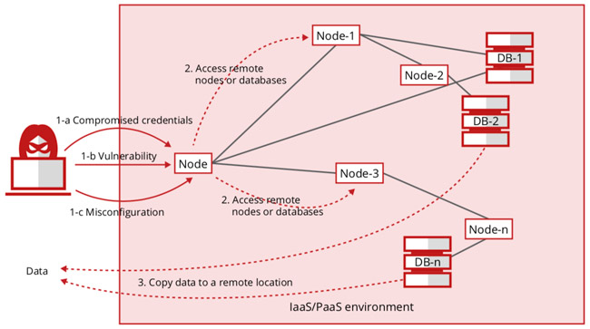
Capital One Cloud Misconfiguration (2019):
Capital One stored its data on the cloud, and there was a misconfiguration in the cloud firewall. The attacker exploited this vulnerability and used Server-Side Request Forgery technique to gain access to the internal system. After that, the attacker obtained credentials and used them to access cloud storage, reached sensitive data, and exfiltrated it.
Impact:
Personal information (names, addresses, credit details) was exposed.
The company had to face heavy financial penalties.
Data of millions of customers was leaked.
Reputation and customer trust were damaged.

Slide 21
Incident Response:
The vulnerability was fixed as soon as it was identified.
The misconfigured firewall was corrected.
Compromised credentials were revoked (disabled).
Security monitoring and logging were improved.
Authorities and affected customers were informed.
Lessons:
Cloud configuration should always be properly secured.
Least privilege access must be followed.
Regular security audits and monitoring are important.
Sensitive credentials should be kept secure.
Misconfiguration can also be a major cause of breaches.

Slide 22
Conclusion
Cybersecurity will continue to be one of the most important fields in the future, offering high career opportunities, innovation and global importance.
Future Scope of Cybersecurity:
Rise of Artificial Intelligence in security.
Increasing demand for cybersecurity professional.
Growth of cloud security.
Security for Internet of Things.
Advanced threat detection system.
Stronger laws and regulations.
Reference: https://www.youtube.com/@davidbombal/playlists

