Slide 1
Build My Personal Cybersecurity lab
Prepared by: Saloni Kumari
Role: Cybersecurity Analyst Intern
Date: 18-04-2026

Slide 2
Objective:
To build a safe and isolated cybersecurity practice environment:
Component | Details
Attacker OS | Kali Linux (VMware)
Target App | OWASP Juice Shop
RAM Allocated | 4 GB
CPUs | 4
Network | NAT(Internet) + Host-Only(Lab)

Slide 3
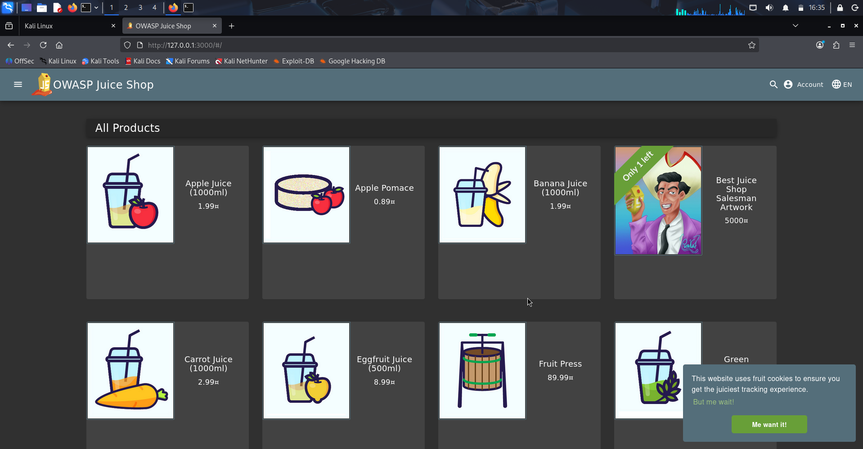
Juice-Shop Homepage

Slide 4
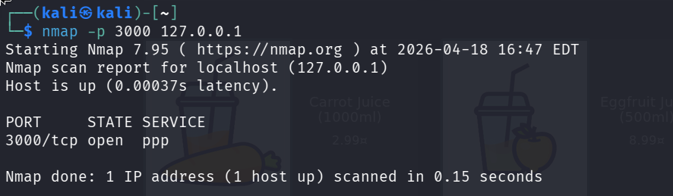
Docker PS(Juice-Shop Running)
Nmap Scan(Port 3000 Open)

Slide 5
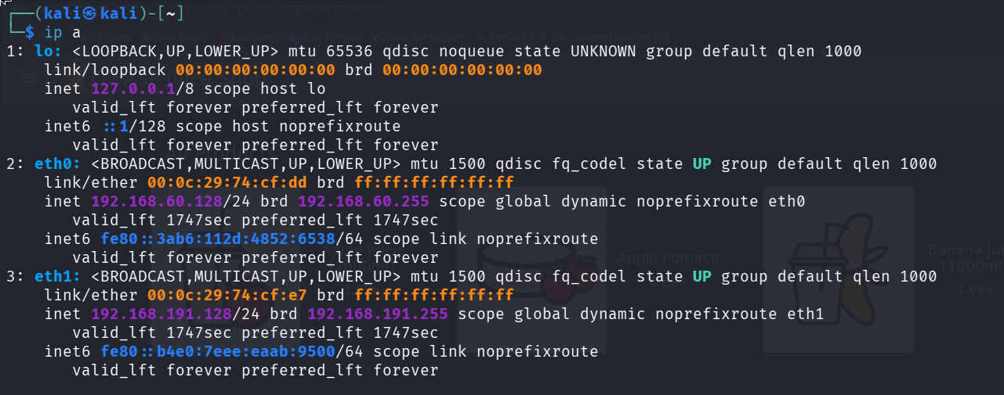
IP Configuration(Kali Linux)

Slide 6
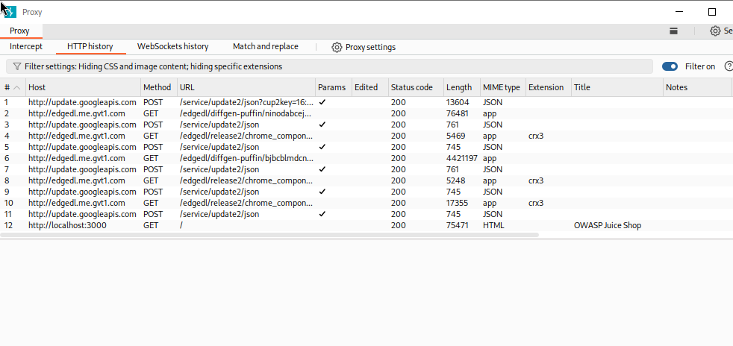
Burp Suite(HTTP History)

Slide 7
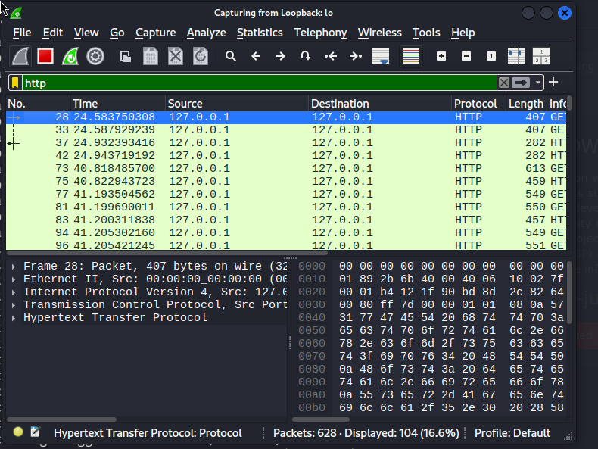
Wireshark(HTTP Capture)

Slide 8
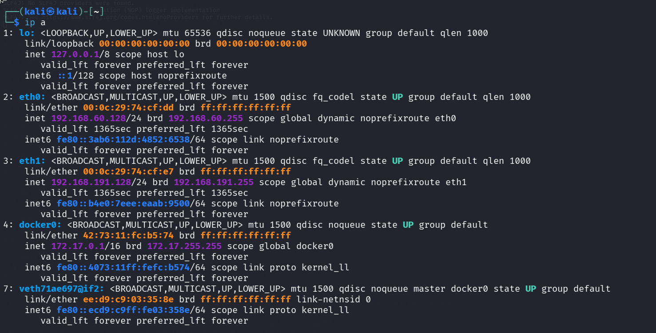
IP Configuration

Slide 9
Command Used
Purpose | Command
Update System | sudo apt update && sudo apt upgrade -y
Install Docker | sudo apt install docker.io -y
Run Juice Shop | sudo docker run –d –p 3000:3000 --name juice-shop bkimminich/juice-shop
Check Docker status | sudo docker ps
Nmap Scan | Nmap –p 3000 127.0.0.1
IP Config | ip a
Burp Suite | burpsuite
Wireshark | wireshark

Slide 10
Conclusion
Successfully built a personal cybersecurity lab with:
✅ Kali Linux attacker machine
✅ Juice Shop vulnerable target
✅ Connectivity verified via Nmap
✅ Burp Suite intercept working
✅ Wireshark HTTP capture working

