Slide 1
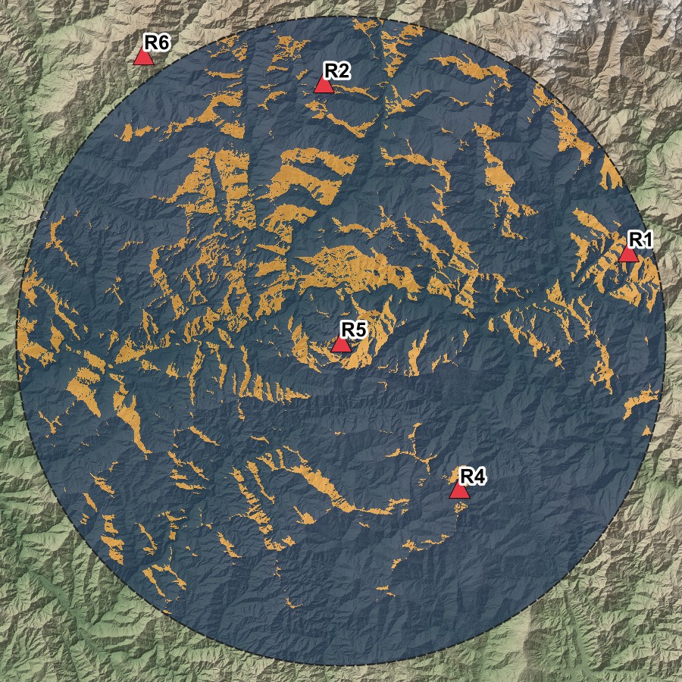
Radar Visibility
Assessment
Which terrain can a stationary radar see, and what does it cost to compute?
Large-Scale Terrain Data Analysis · Garhwal Himalaya · Copernicus GLO-30
Viewshed of radar R5 in QGIS: orange visible, blue blocked
Notes:
My part of the project is radar visibility assessment. The question is simple: given a radar standing on the ground in mountain terrain, which parts of the terrain can it actually see? The picture on the right is one real result, the viewshed of our radar R5 drawn in QGIS.

Slide 2
Objective and evaluation criteria
Compute which terrain a stationary ground radar can see, then measure what each method costs and how accurate it is.
Evaluated for
Computational complexity
Runtime and scalability
Memory efficiency
Accuracy
Visualization
expected big-O against the fitted exponent
time against cells, range and radars
peak memory of every run
agreement and kappa against the exact method
QGIS maps and render time
Radar mast 30 m · range 40 km · DEM cells 30 m · study area 120 × 120 km in the Garhwal Himalaya
Radar visibility assessment
2
Notes:
The objective has two halves. First build the application: compute the visible terrain for a radar. Second, evaluate it against the criteria in the problem statement. These five boxes are the criteria, and under each is how I measured it. The next slide shows the whole methodology as a flow chart.

Slide 3
Methodology flow chart
DATA
METHOD
EXPERIMENTS
OUTPUTS
EVALUATION
Copernicus GLO-30
4 tiles, 30 m cells
Visibility model
30 m mast, line of sight, Earth curvature, target 0 or 150 m
Scenario
six radars, 40 km range
Rasters and vectors
GeoTIFF and GeoJSON
Visualization
QGIS maps, render time
Mosaic and reproject
UTM zone 44N
Benchmarks
E1 to E6, 5 repeats each
Benchmark tables
time, memory, fitted exponents
Complexity, runtime, memory
scaling and optimisations
Four nested DEMs
0.25M to 16M cells
Three algorithms
naive, R2, GDAL
Synthetic terrains
flat, valley, ridge, cone
Validation
known answers, exact reference
Agreement tables
agreement and kappa
Accuracy
fast methods against exact
Radar visibility assessment
3
Notes:
This is the whole methodology on one page; read it from left to right. Data: we download the Copernicus elevation tiles, join and reproject them, and cut four DEM sizes; separately we generate four synthetic test terrains. Method: the visibility model defines what visible means, and three algorithms implement it. Experiments: the same algorithms feed three activities, the six-radar scenario, the benchmarks E1 to E6, and the validation, which also uses the synthetic terrains. Each produces an output, and each output answers one of the evaluation criteria: the rasters give the QGIS maps, the benchmark tables give complexity, runtime and memory, and the agreement tables give accuracy.

Slide 4
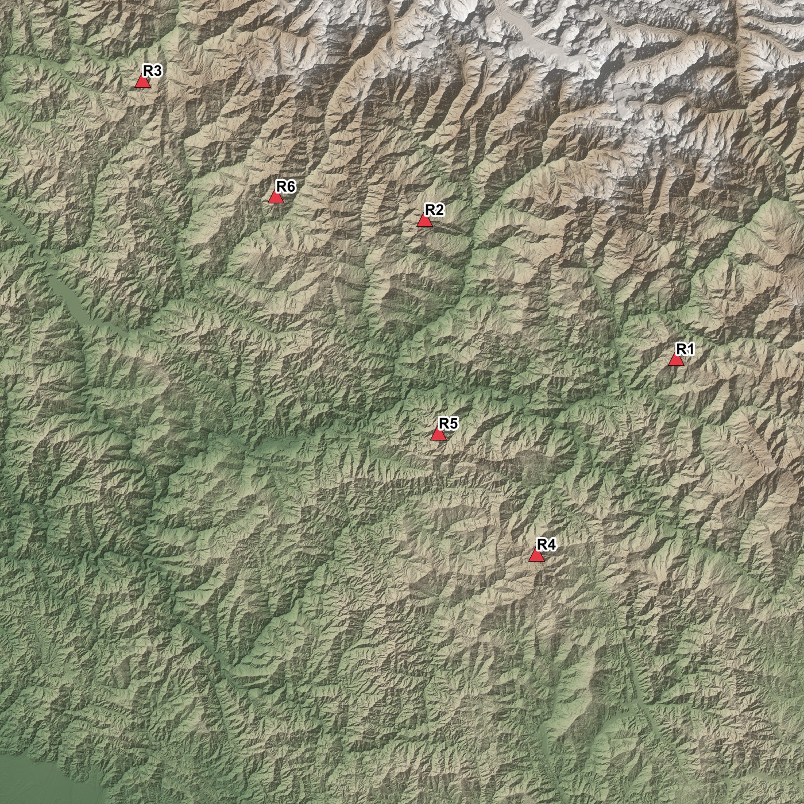
The terrain data
Source Copernicus GLO-30 surface model, 30 m cells, four tiles from the public AWS archive.
Area Garhwal Himalaya, centred on Rudraprayag, reprojected to UTM zone 44N.
Sizes four nested DEMs with the same resolution and growing coverage.
0.25M
1M
4M
16M
500 × 500
15 km wide
1000 × 1000
30 km wide
2000 × 2000
60 km wide
4000 × 4000
120 km wide
Cells per DEM. Elevation in the largest ranges from 315 m to 7,074 m. Red triangles mark the six radar sites.
Radar visibility assessment
4
Notes:
The only real input is a digital elevation model: a grid where every cell stores the ground height. We use Copernicus GLO-30, which has 30 metre cells, over the Garhwal Himalaya around Rudraprayag. We cut four square DEMs around the same centre. The resolution stays at 30 metres and only the area grows, from a quarter of a million cells to 16 million. That lets us measure how cost grows with data size. The red triangles are the six radar sites used later.

Slide 5
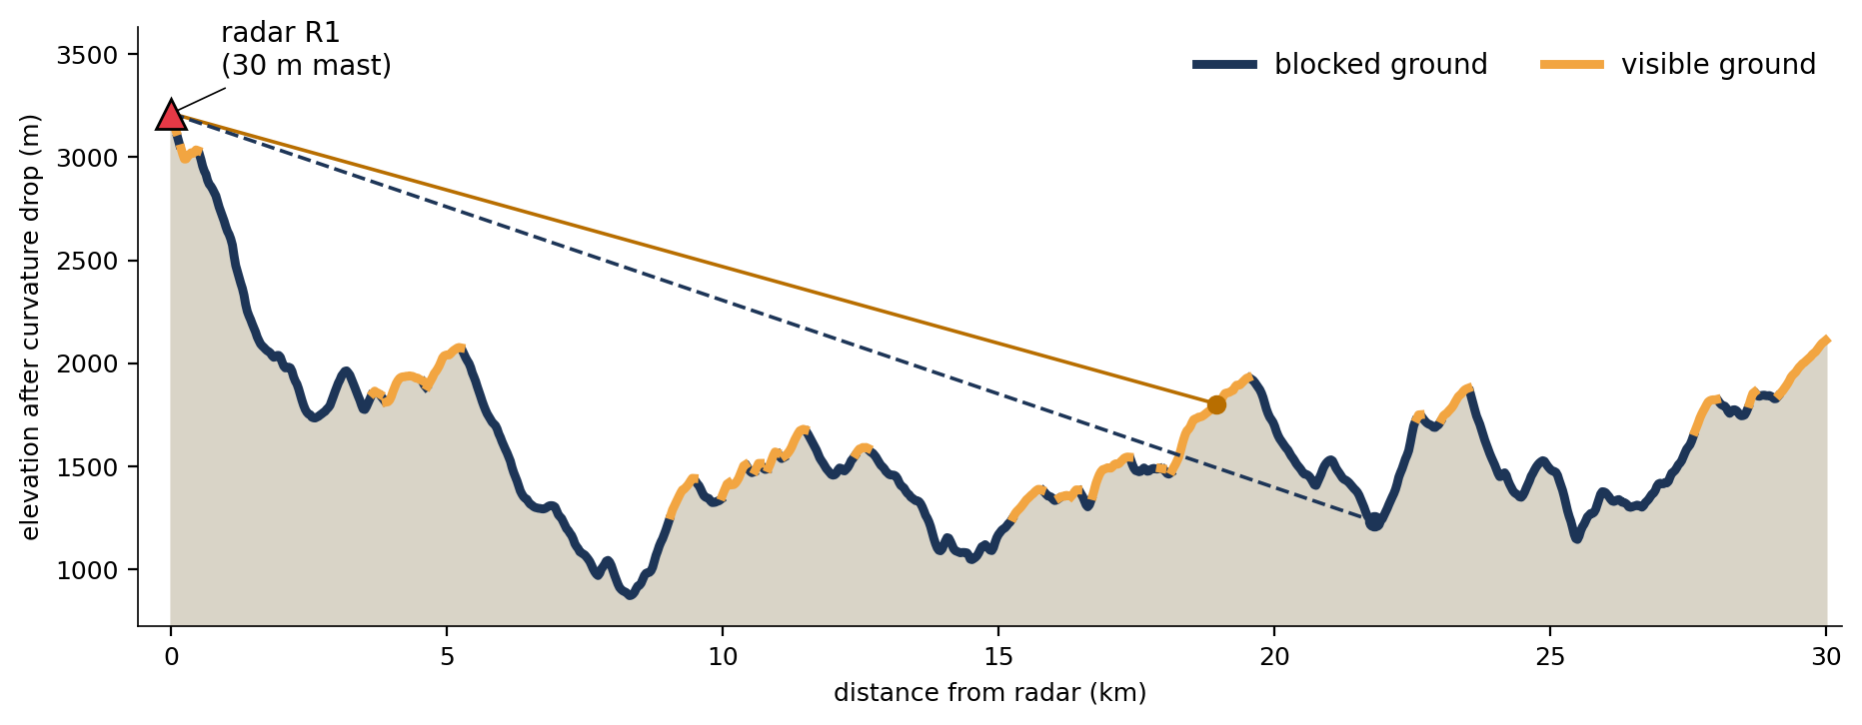
How visibility is decided
Radar
On a 30 m mast at the centre of its cell
Line-of-sight rule
Visible if no terrain in between rises above the sight line
Earth curvature
Real 30 km terrain profile west of radar R1. The solid sight line reaches its target; the dashed one is cut by the ridge in front.
With refraction, far terrain drops by about 108 m at 40 km
Output raster, one value per cell
Target height
0 m for ground, 150 m for a low-flying aircraft
1 visible
0 blocked
255 out of range
Radar visibility assessment
5
Notes:
This is the core concept. A cell is visible if the straight line from the radar to that cell is not cut by any terrain in between. The figure is a real 30 kilometre profile from radar R1. The solid line reaches its target, so that ground is visible. The dashed line hits the ridge in front, so its target is blocked. Two refinements: the Earth curves, so far terrain drops below the horizon, about 108 metres at 40 kilometres; and the target can be the ground or an aircraft 150 metres above it. Every algorithm applies exactly this same rule.

Slide 6
Three algorithms, one interface
Naive line of sight
R2 ray casting
GDAL viewshed
How A separate sight line to every cell, sampled every half cell.
Cost cells × radius, about N^1.5
Role Exact but slow: the reference
How Rays only to the boundary cells, with a running horizon along each ray.
Cost proportional to N
Role Fast approximation, written in NumPy
How Sweeps outward from the radar; each cell is derived from its nearer neighbours (C++).
Cost proportional to N
Role Fastest: used for all real runs
160 min
4.6 s
0.25 s
for 16M cells (projected)
for 16M cells
for 16M cells
N is the number of DEM cells. All three share one function interface, so every experiment can swap the algorithm.
Radar visibility assessment
6
Notes:
I compared three ways to compute the viewshed. Naive draws a separate line to every single cell, so it is exact but slow: the cost is cells times radius. R2 only shoots rays to the cells on the boundary and remembers the highest slope seen so far along each ray, the horizon, so every cell is handled once. GDAL is a compiled library routine that sweeps outward from the radar and derives each cell from its nearer neighbours. Naive is our truth, GDAL is what we use in practice, and R2 is our own fast implementation for comparison.

Slide 7
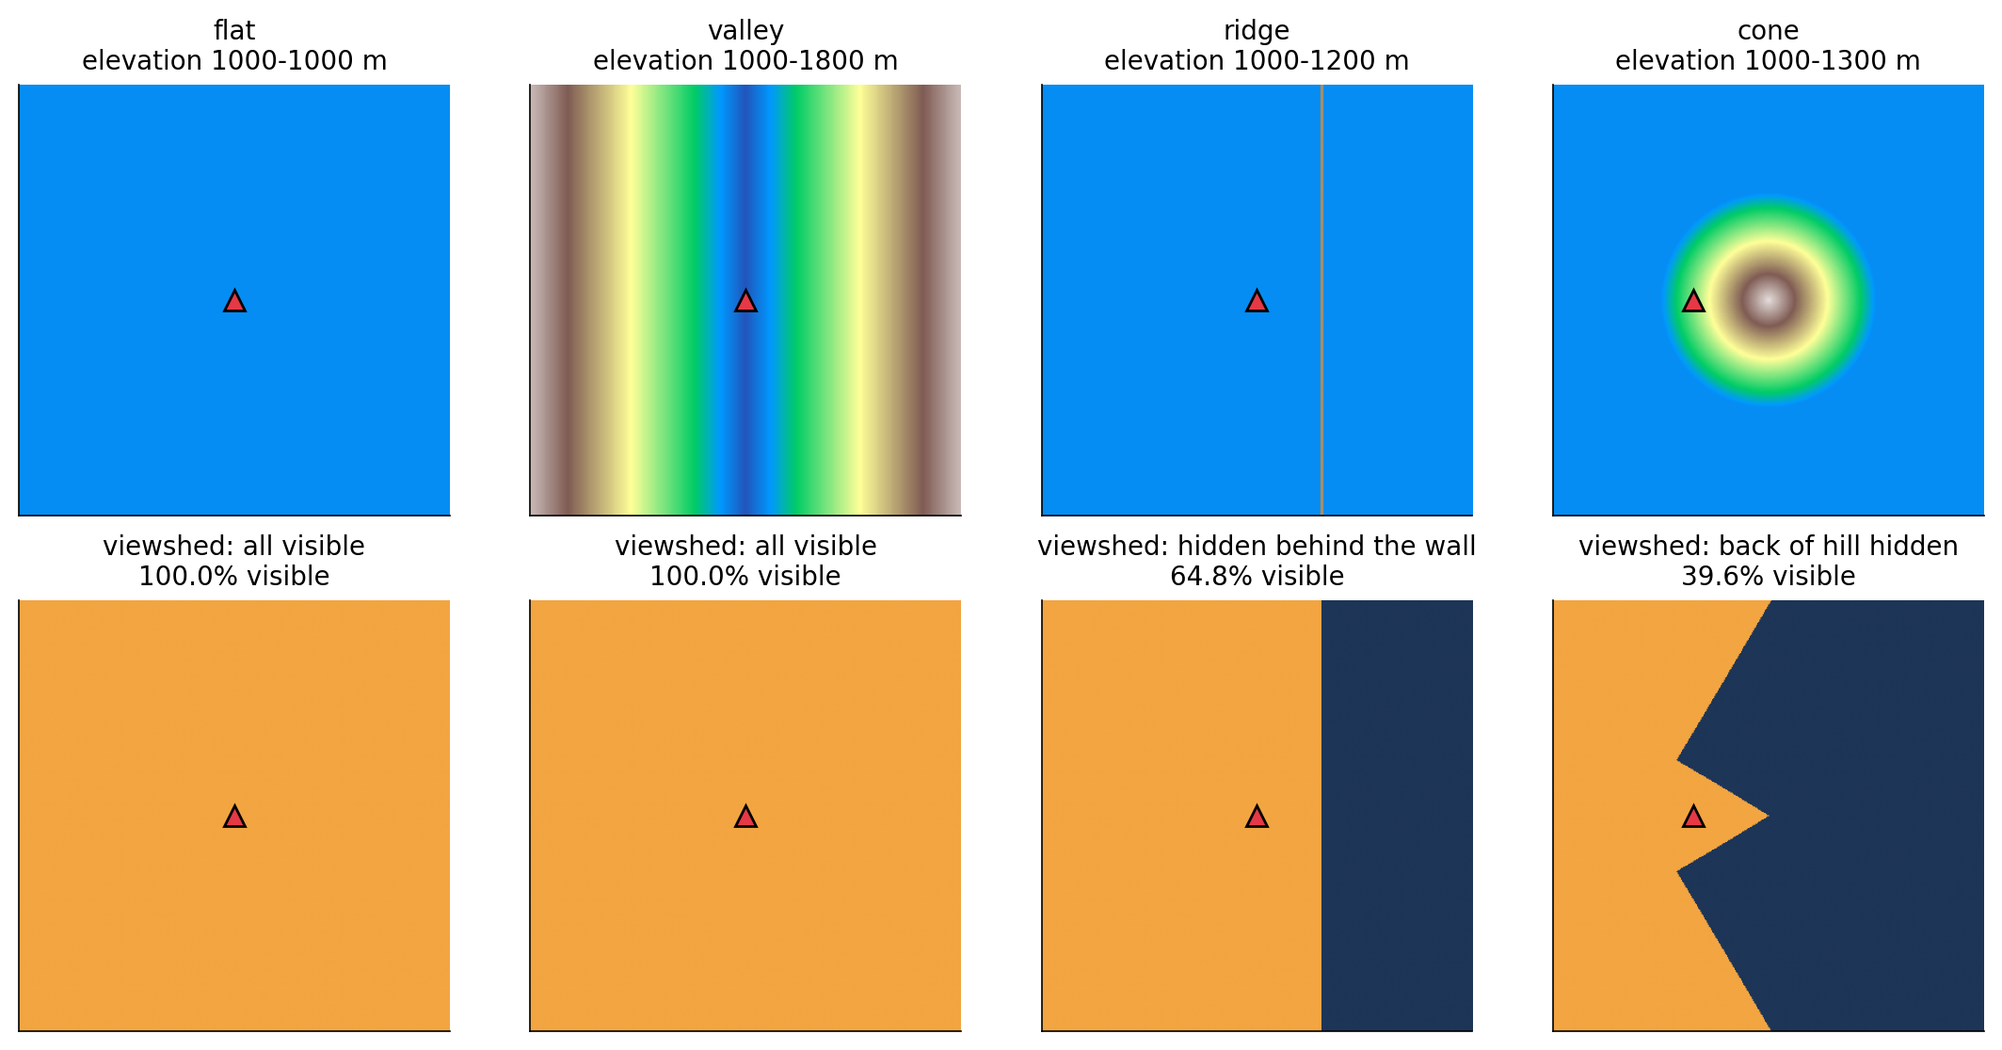
Validation 1: terrains with known answers
100%
correct on flat, valley and ridge, for all three algorithms
Cone: no simple answer
Against the exact method, GDAL agrees on 99.96% of cells and R2 on 99.90%.
Top: elevation. Bottom: computed viewshed, orange visible and blue blocked. The triangle is the radar.
Radar visibility assessment
7
Notes:
Before trusting any result I checked correctness. These four terrains are not real; they are generated by formulas, so the right answer is obvious. On a flat plain and in a V-shaped valley everything must be visible. With a 200 metre wall, everything behind the wall must be hidden. All three algorithms get these three exactly right. The cone has no simple answer, so there I compare the two fast methods with the exact one.

Slide 8
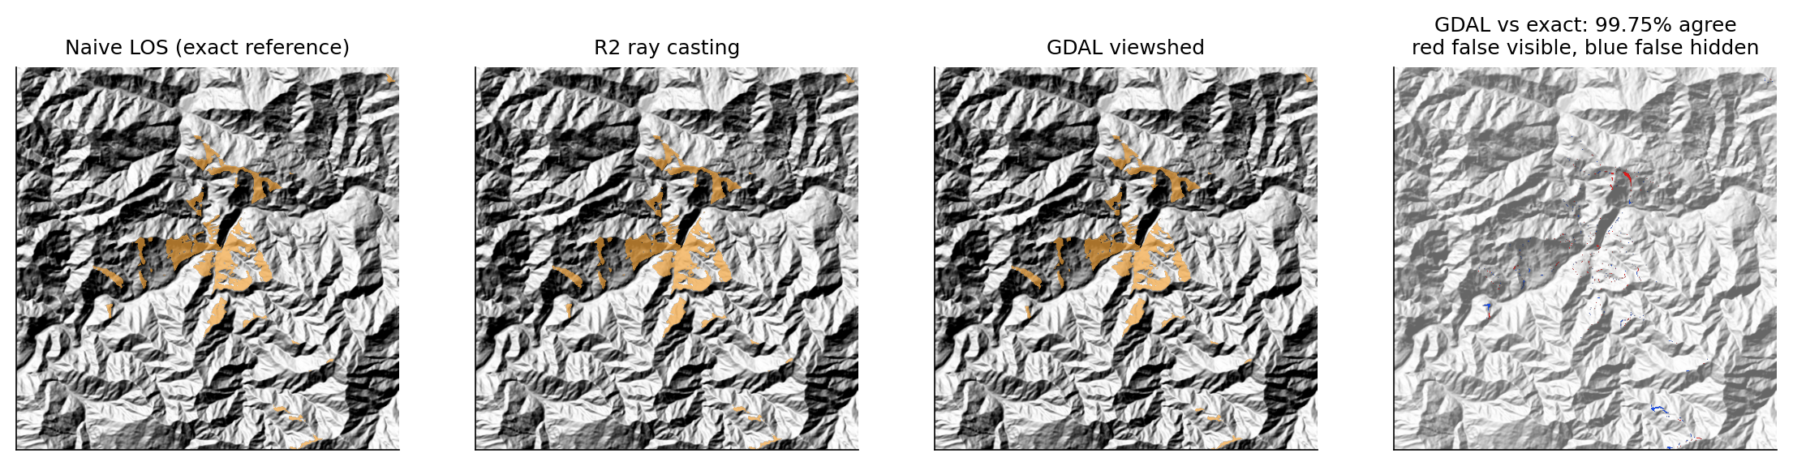
Validation 2: real terrain against exact
Test
GDAL
R2
Why kappa only about 3% of cells are visible, so calling everything hidden would already score 97%.
Error type R2 leans towards false-visible; GDAL's errors are balanced.
500 × 500, unlimited range
99.75% (kappa 0.965)
99.69% (kappa 0.957)
1000 × 1000, 10 km range
99.82% (kappa 0.964)
99.76% (kappa 0.954)
Radar visibility assessment
8
Notes:
On real terrain nobody knows the true answer, so the exact naive method becomes the reference and I compare the two fast methods with it cell by cell. Both agree on about 99.7 to 99.8 percent of cells. I also report kappa, because only about three percent of cells are visible: an algorithm that said 'everything is hidden' would already score 97 percent. Kappa removes that chance agreement, and it is still about 0.96. The last panel shows where GDAL differs from exact: only thin edges of the visible patches.

Slide 9
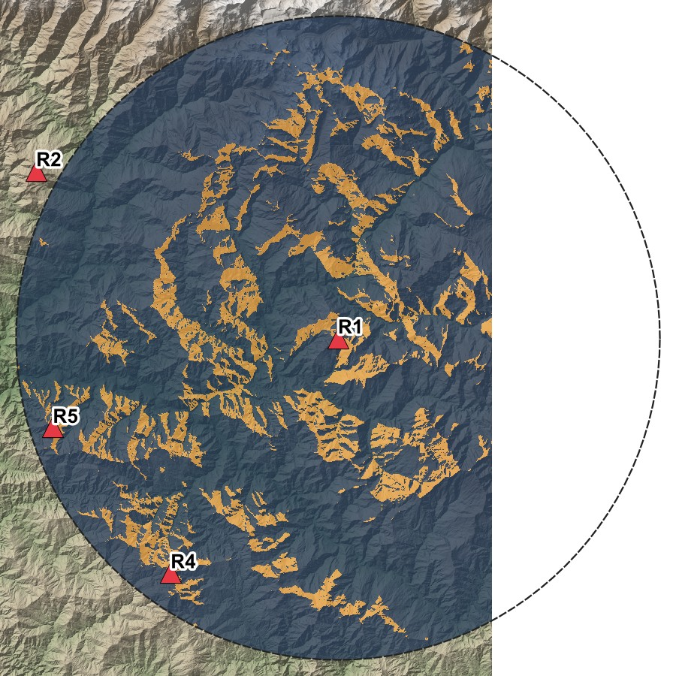
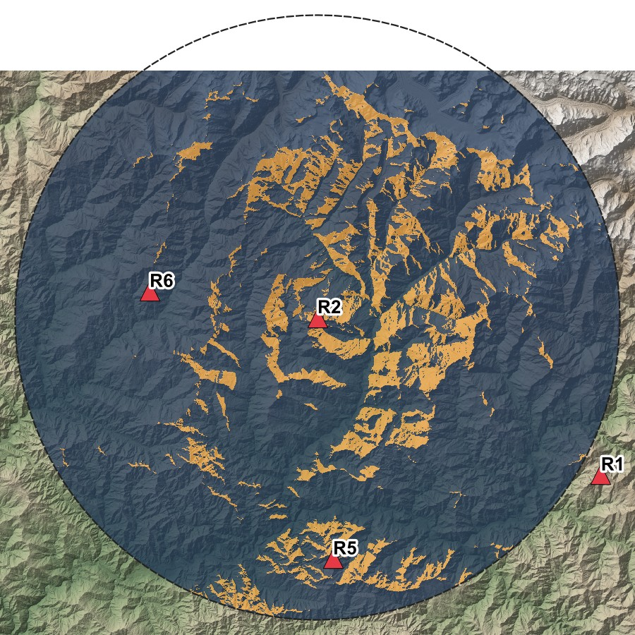
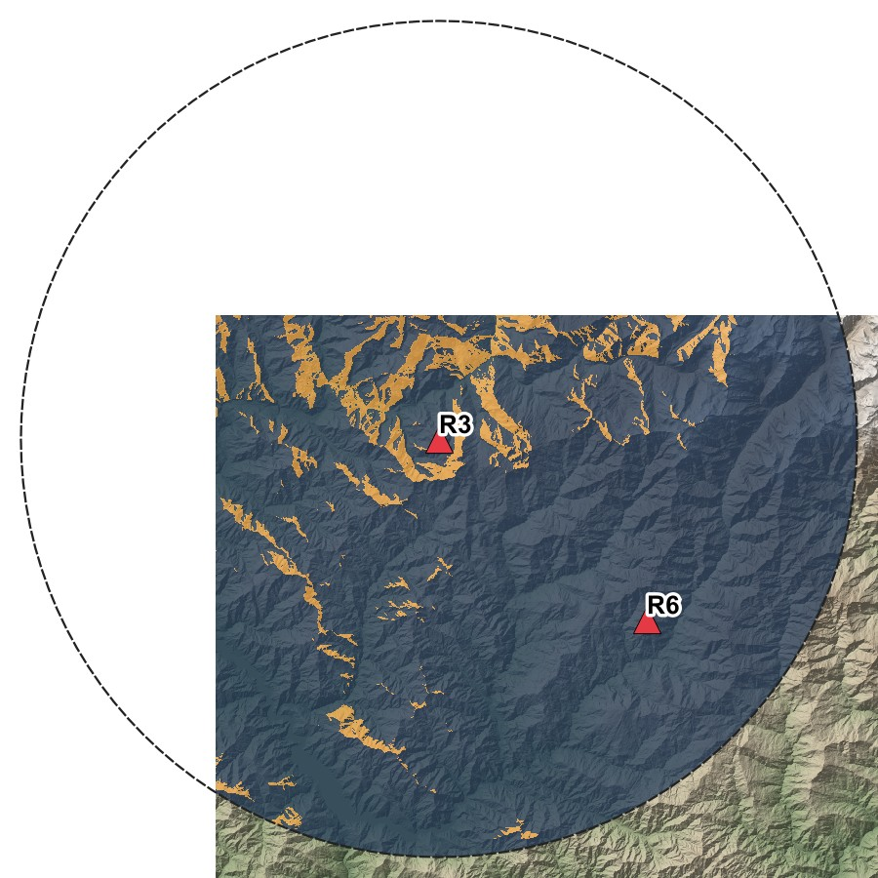
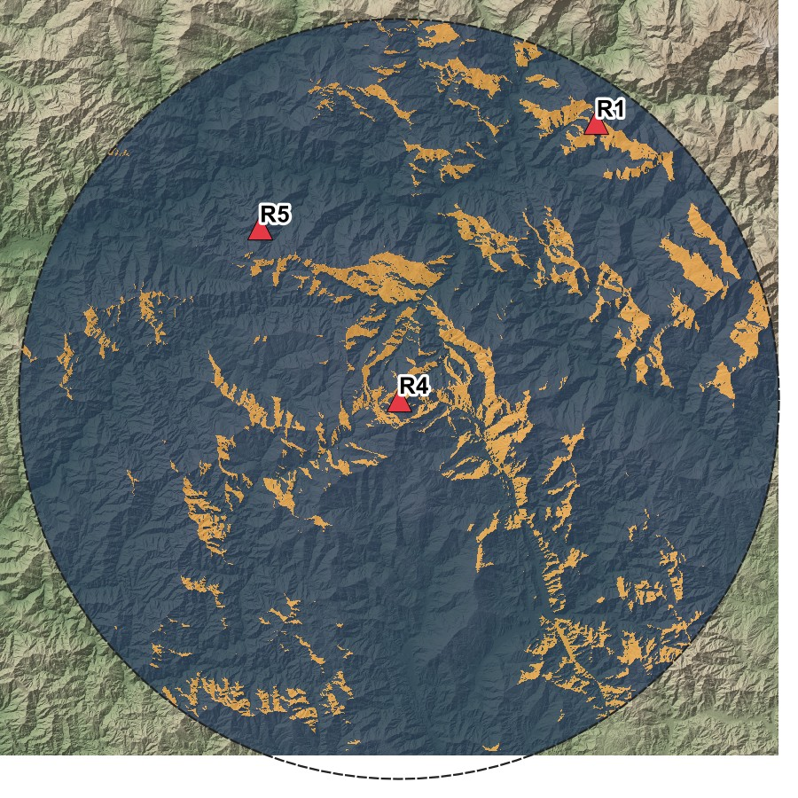
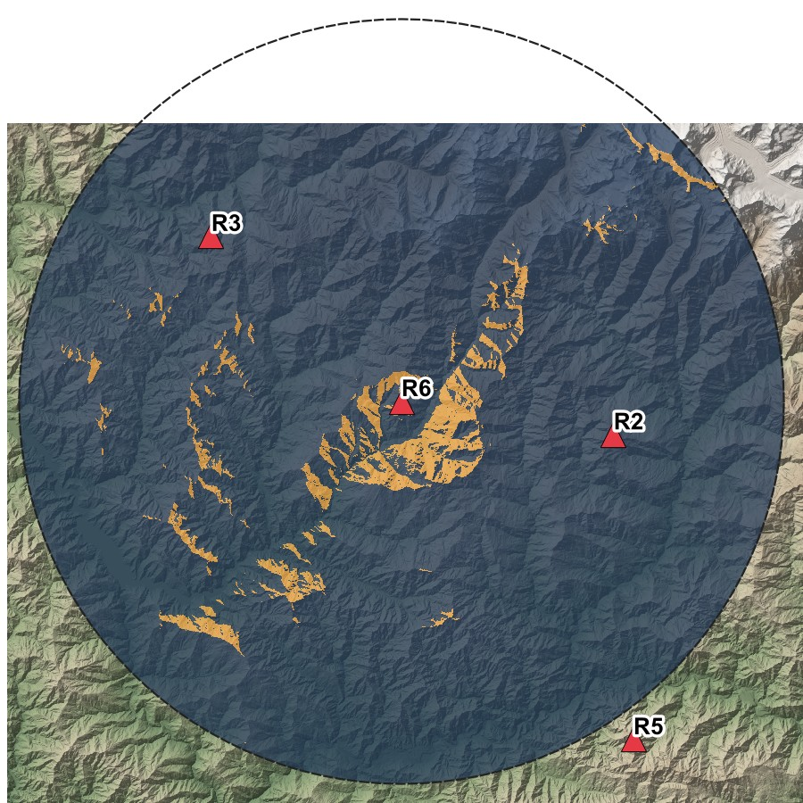
Scenario: six radars, one viewshed each
R1
R2
R3
Radar
Ground
Aircraft 150 m
R1
14.4%
32.2%
R2
12.3%
27.4%
R3
7.1%
17.7%
R4
9.9%
27.7%
R5
13.2%
34.5%
R6
3.8%
9.6%
R4
R5
R6
visible
blocked
Share of the area inside each 40 km range circle that the radar sees. Maps rendered in QGIS from the output GeoTIFFs.
Radar visibility assessment
9
Notes:
Now the realistic scenario. Six radars are placed on ridge tops by a fixed rule: the highest points between 1500 and 3200 metres, at least 22 kilometres apart. Each has a 30 metre mast and a 40 kilometre range. These are the six output rasters, drawn in QGIS. Orange is visible ground, blue is blocked. Even from a ridge top a radar sees only 4 to 14 percent of the ground inside its range circle, because the mountains hide the valleys.

Slide 10
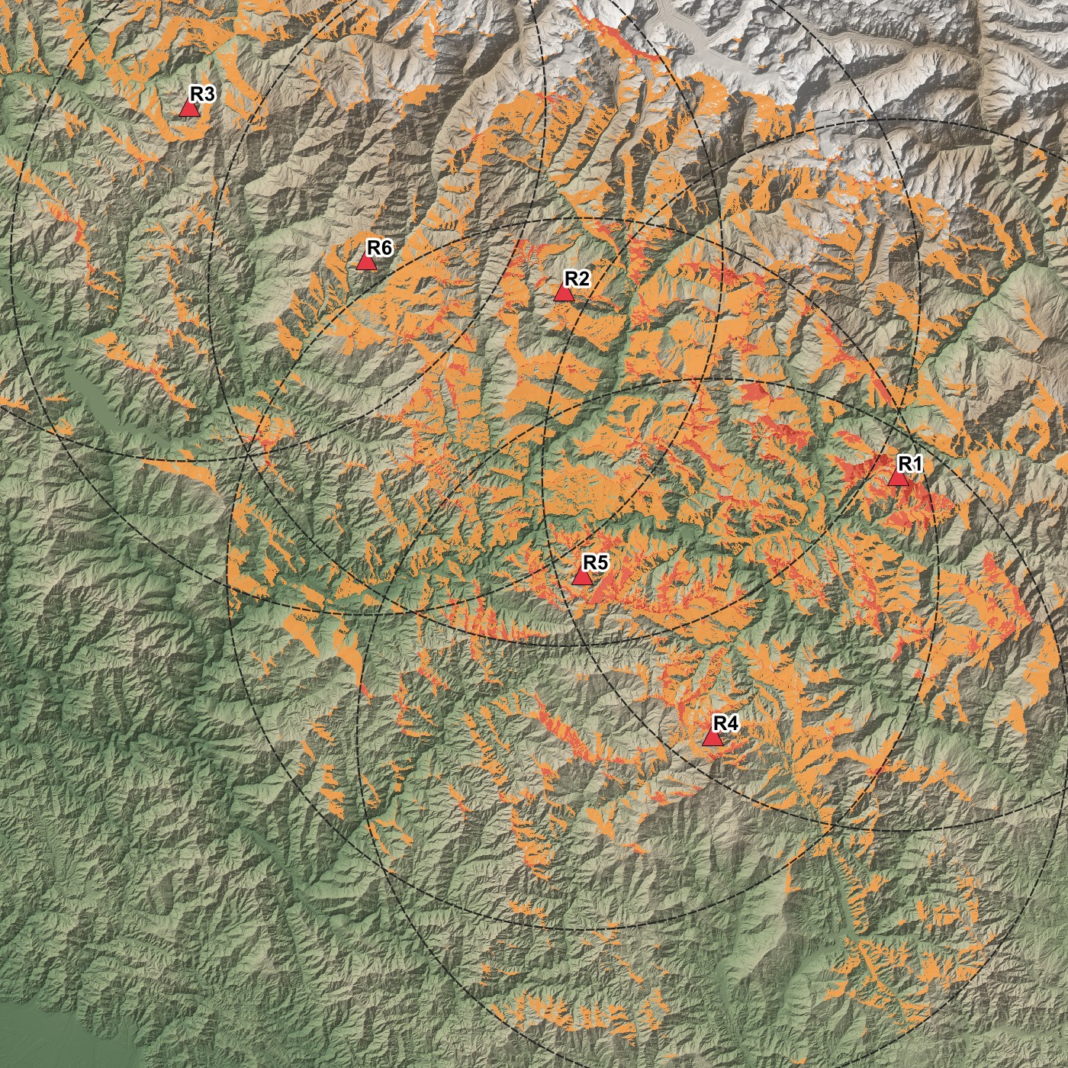
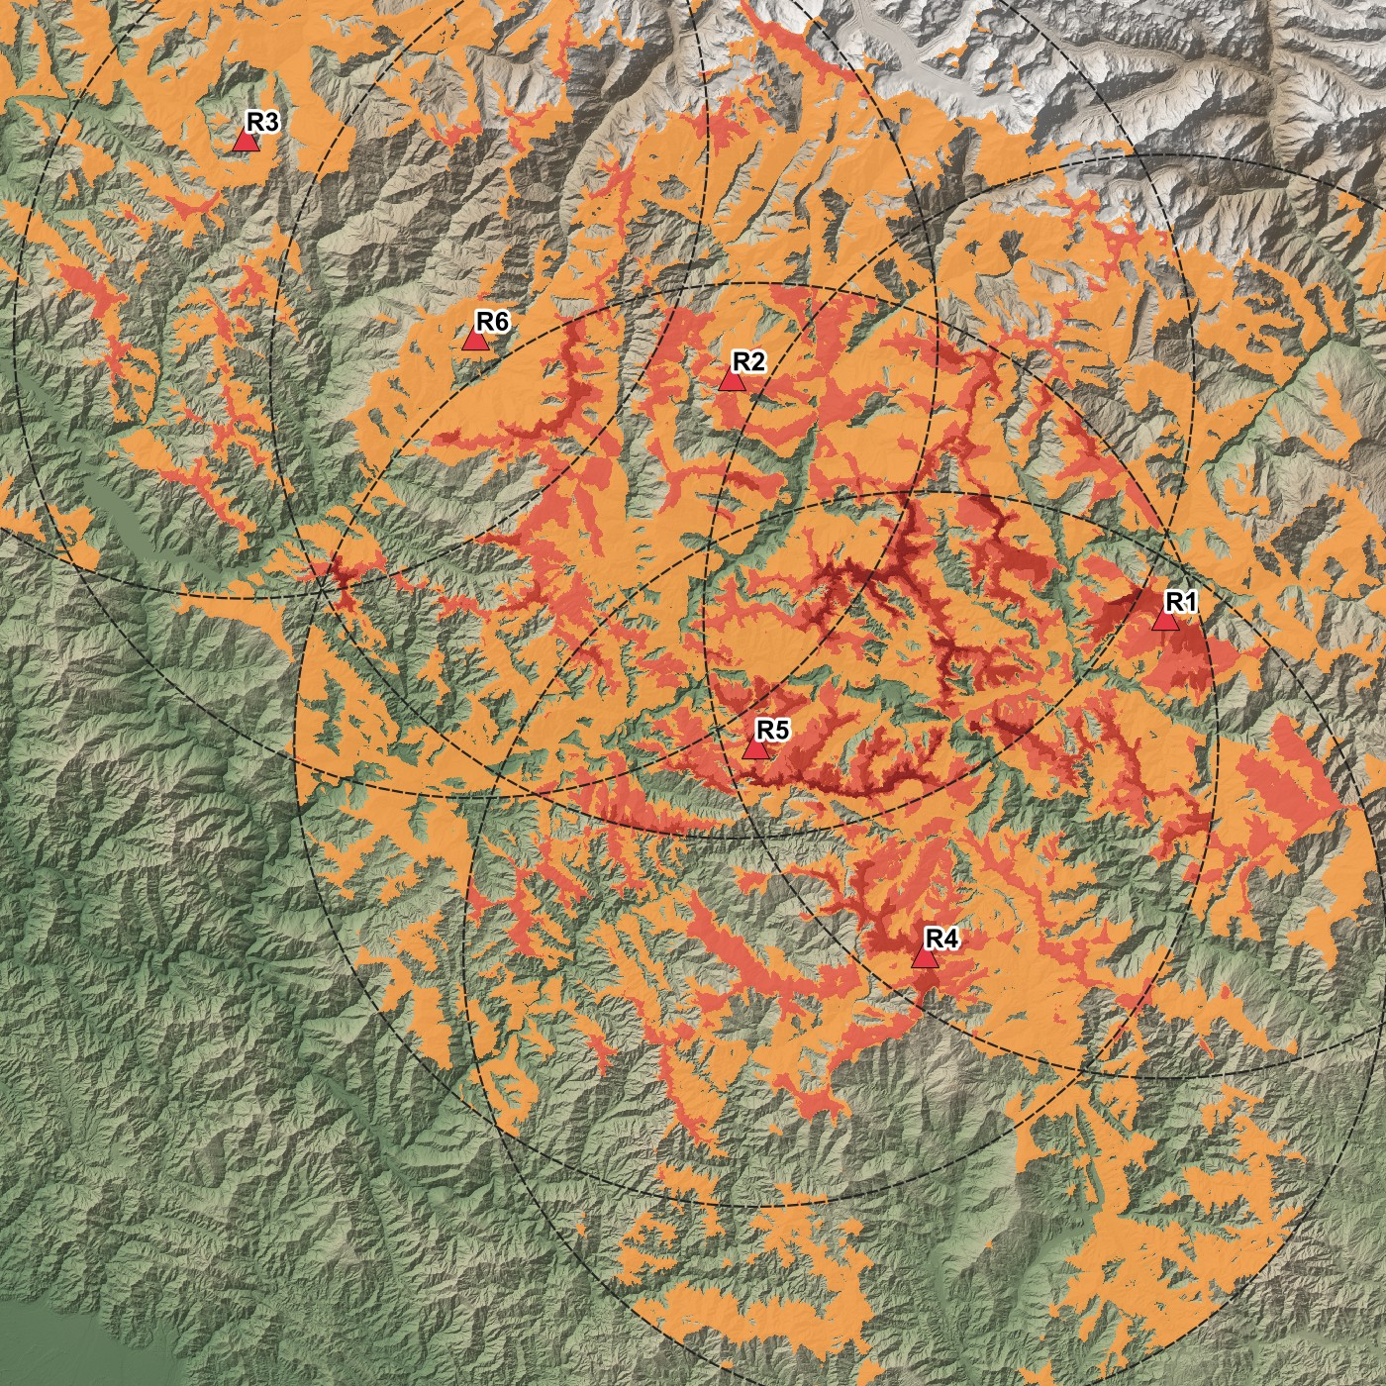
Scenario: combined coverage
Ground
Aircraft 150 m above ground
16.7%
of the ground seen by at least one radar
35.6%
of the airspace at 150 m
1.8%
of the ground seen by two or more
1 radar
2
3
4 or more
Radar visibility assessment
10
Notes:
Adding the six viewsheds gives a count raster: for every cell, how many radars see it. On the left is the ground, on the right an aircraft flying 150 metres above the ground. Together the radars see about one sixth of the ground. Raising the target by only 150 metres roughly doubles coverage to 36 percent, because the aircraft clears the nearby ridges. And the radars hardly overlap: under 2 percent of the ground is seen twice.

Slide 11
How the benchmarks were run
Fresh process per run
What varies
Algorithms
Peak memory is not polluted by earlier runs.
E1
DEM size, 0.25M to 16M cells
all three
E2
Radar range, 5 to 60 km
GDAL, R2
5 repeats, median reported
3 for the slowest cases; every raw run is kept in a CSV.
E3
Mast height, 10 to 300 m
GDAL
E4
Number of radars, 1 to 16
GDAL, 3 modes
Three numbers per run
E5
Full DEM or range window
GDAL, R2
Runtime with DEM read, compute time only, peak memory.
E6
Cell size, 30 to 120 m
GDAL
Machine 1: Intel i5-6300U, 2 cores / 4 threads, 15.9 GB RAM, Windows 11, GDAL 3.13.1, Python 3.12.
Radar visibility assessment
11
Notes:
For the evaluation, every single measurement runs in its own fresh Python process, so the memory peak is not affected by earlier runs. Each configuration is repeated five times and I report the median. For each run I record total runtime including reading the DEM, compute time of the algorithm alone, and peak memory. There are six experiments: three vary a parameter and three test an optimisation. All numbers on the next slides are from Machine 1, a 2-core machine.

Slide 12
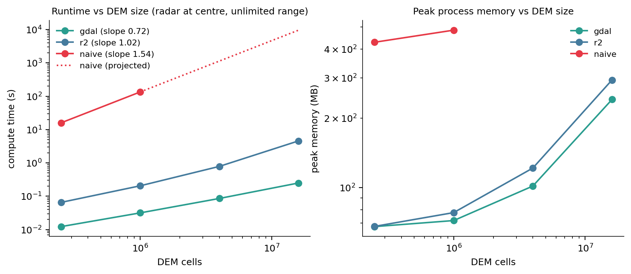
E1: cost against DEM size
Compute time at 16M cells
0.25 s
GDAL
4.6 s
R2 ray casting
160 min
naive, projected from 1M cells
Fitted exponents naive 1.54 (expected 1.5), R2 1.02 (expected 1), GDAL 0.72 (expected 1).
Peak memory at 16M cells GDAL 241 MB, R2 294 MB.
Radar visibility assessment
12
Notes:
This is the main complexity result. Both axes are logarithmic, so the slope of each line is the exponent of growth. Naive has slope 1.54, matching the expected N to the 1.5. R2 has slope 1.02, matching linear. GDAL measures 0.72, a little below linear, most likely because fixed start-up costs weigh more at the small sizes. In absolute terms: for 16 million cells GDAL needs a quarter of a second, R2 about four and a half seconds, and naive would need about 160 minutes, which is why naive was only run up to 1 million cells and projected beyond. Memory grows with the DEM held in RAM.

Slide 13
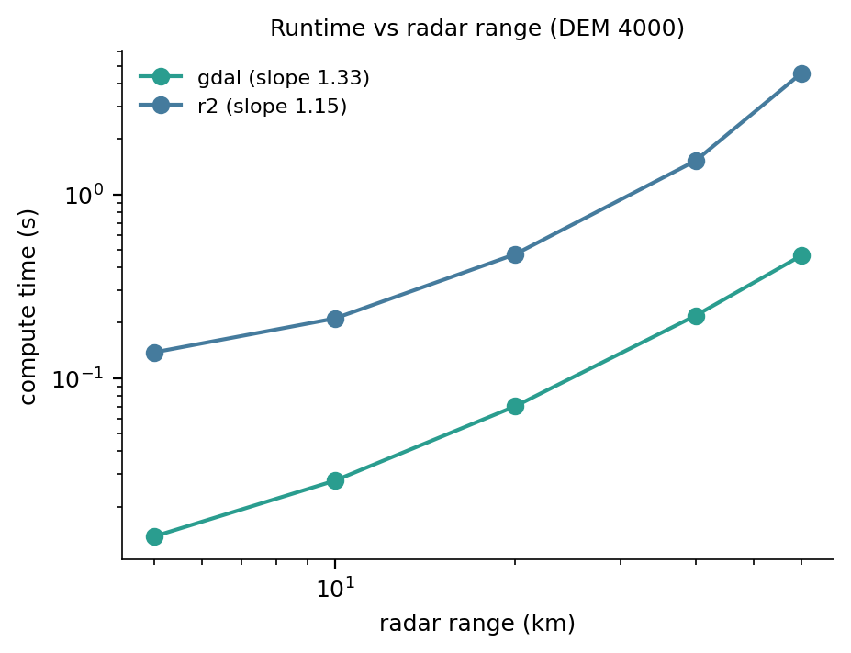
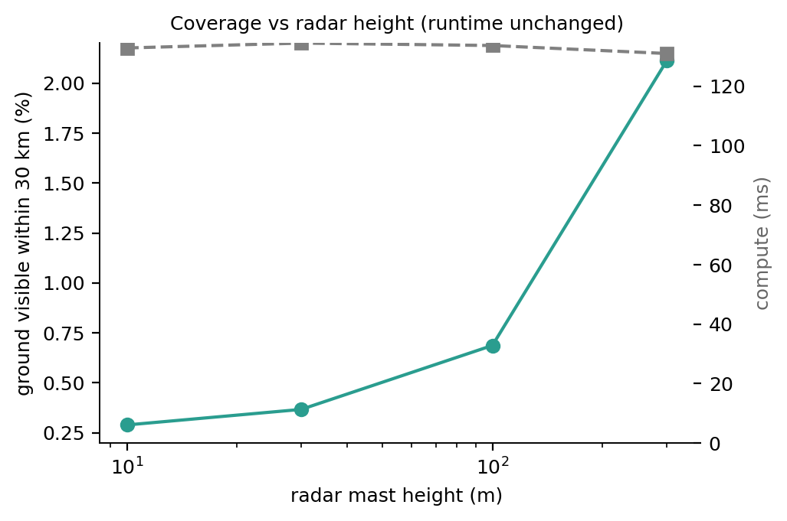
E2 and E3: range and mast height
Range GDAL goes from 0.014 s at 5 km to 0.46 s at 60 km; R2 from 0.14 s to 4.5 s. Cost follows the area in range.
Mast height visible ground rises from 0.29% at 10 m to 2.1% at 300 m, while compute stays at 0.13 s. Height changes the answer, not the cost.
Radar visibility assessment
13
Notes:
Two parameter studies. Left: increasing the radar range increases the number of cells inside the range circle, so cost rises. Right: raising the mast from 10 to 300 metres increases the visible ground about seven times, but the compute time does not move at all. So height changes the answer, not the cost, while range changes the cost.

Slide 14
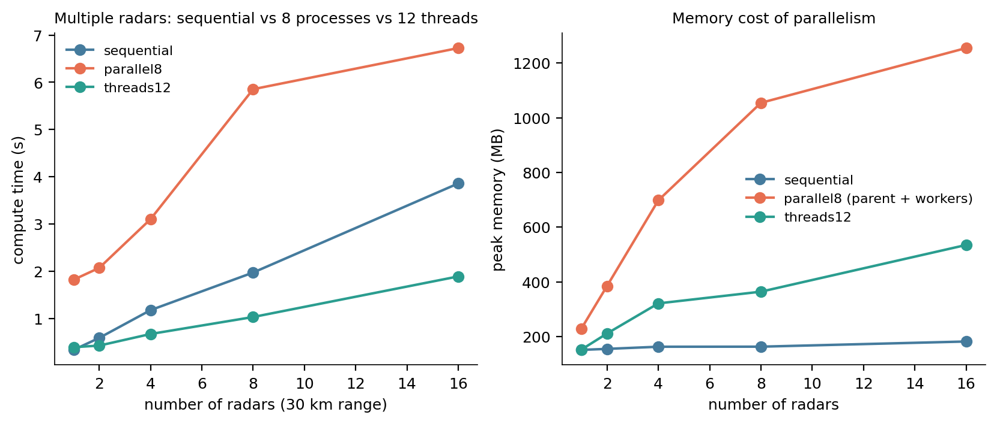
E4: many radars, threads or processes
16 radars, against sequential
2.0×
faster with threads
0.57×
with processes: slower than sequential
1.23 GB
GDAL releases Python's lock, so threads run side by side with no start-up cost. Each process starts its own Python and holds its own copy of the data. Machine 1 has 2 cores, so the gain caps near 2×.
memory with processes; threads use 0.52 GB
Radar visibility assessment
14
Notes:
With many radars the viewsheds are independent, so they can run in parallel. I compared one after another, a pool of threads, and a pool of separate processes. Threads win: GDAL releases Python's global lock while it computes, so threads really run side by side. Processes lose on this machine: each one has to start a new Python and gets its own copy of the data, which costs time and more than a gigabyte of memory. Machine 1 has only two cores, so the best possible gain is about two times; on Machine 2, with 12 cores, the same code reached 4.2 times.

Slide 15
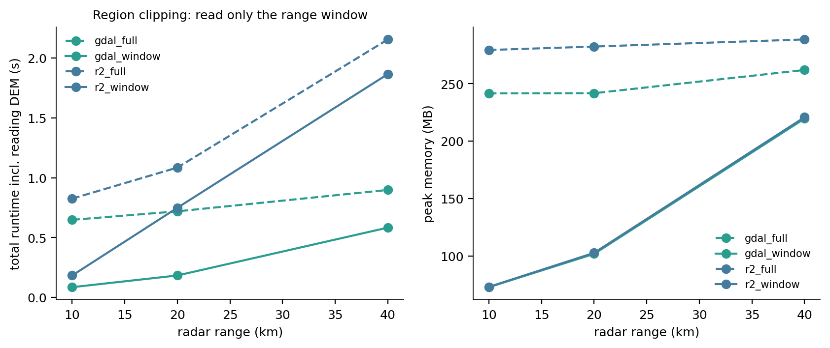
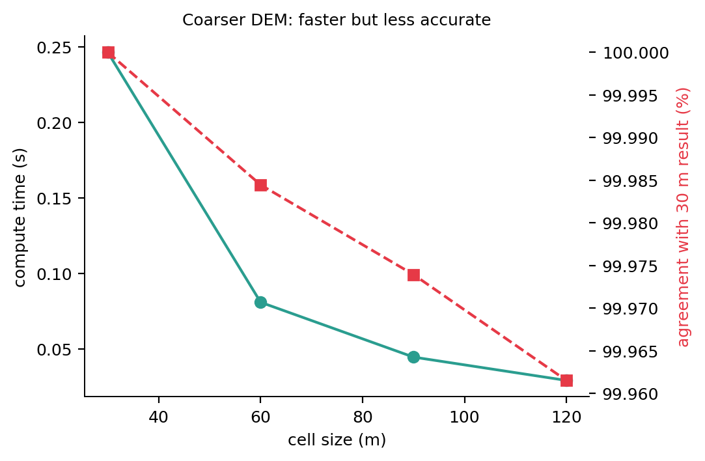
E5 and E6: clipping and a coarser DEM
Region clipping reading only the range window at 10 km cuts total runtime from 0.65 s to 0.09 s and memory from 242 MB to 73 MB. The gain shrinks as the window nears the whole DEM.
Coarser DEM 120 m cells compute 8.5× faster, but kappa against the 30 m result falls to 0.78.
Radar visibility assessment
15
Notes:
Two more optimisations. Left: a radar with a 10 kilometre range does not need the whole 120 kilometre DEM, so I read only the window that covers its range. That cuts total time about seven times and memory from 242 to 73 megabytes. The benefit shrinks as the range grows. Right: using coarser cells makes the computation faster, but accuracy drops. Plain agreement still looks like 99.96 percent, but kappa falls to 0.78, which shows that a real share of the visible cells is being lost.

Slide 16
Machine 1 against Machine 2
Machine 1
Intel Core i5-6300U
2 cores / 4 threads
15.9 GB RAM
Compute time
Machine 1
Machine 2
M1 slower by
GDAL, 16M cells
0.25 s
0.10 s
2.5×
R2, 16M cells
4.57 s
1.58 s
2.9×
Naive, 1M cells
134 s
56 s
2.4×
GDAL, 60 km range
0.46 s
0.19 s
2.4×
Machine 2
AMD Ryzen 9 7900X
12 cores / 24 threads
31.1 GB RAM
16 radars, one after another
3.86 s
1.68 s
2.3×
16 radars, in parallel threads
1.89 s
0.40 s
4.7×
Thread speedup, 16 radars
2.0×
4.2×
fewer cores
Identical on both coverage, accuracy and peak memory (GDAL at 16M cells: 241 MB against 242 MB).
Why Machine 1 is slower single-core work is 2.3–2.9× slower on an older, slower CPU; parallel work is 4.7× slower because it has 2 cores instead of 12.
Same on both: Windows 11, QGIS 3.44.12, GDAL 3.13.1, Python 3.12.13, NumPy 2.4.6
Radar visibility assessment
16
Notes:
The same code ran on the same data on two machines, with the same software versions: QGIS, GDAL, Python and NumPy are identical, and both run Windows 11. Only the hardware differs. Machine 1 has a 2-core Intel i5-6300U with 16 gigabytes; Machine 2 has a 12-core AMD Ryzen 9 7900X with 31 gigabytes. Everything that is about the answer is identical: coverage, accuracy, even peak memory. Only time differs. Work that runs on one core is about 2.3 to 2.9 times slower on Machine 1, because each core is older and slower. Work that runs in parallel is 4.7 times slower, because Machine 1 has 2 cores against 12; that is also why its thread speedup stops at 2.0 times while Machine 2 reached 4.2. So the conclusions hold on both machines; only the absolute times move.

Slide 17
Visualization in QGIS
Same Python all code runs on the Python that ships with QGIS 3.44, with the same GDAL.
Standard outputs viewsheds and coverage as GeoTIFF, radar sites and range rings as GeoJSON, all in UTM 44N.
PyQGIS scripts build the styled project file and render the maps without opening the window.
QGIS render time
Full extent
Zoomed
DEM, 16M cells (input)
1.21 s
0.31 s
Viewshed R1
0.27 s
0.18 s
Coverage count, ground
0.25 s
0.19 s
1600 × 1600 px, median of 5 renders on Machine 1; values vary between sessions.
Ground coverage layer over the hillshade, rendered by PyQGIS
Radar visibility assessment
17
Notes:
How the code connects to QGIS. All the code runs on the Python that ships with QGIS, so it uses the same GDAL library. The results are written as standard GeoTIFF and GeoJSON files in the same coordinate system as the DEM, so they overlay correctly. A PyQGIS script then builds a styled project and renders the maps you have seen. For visualization performance I timed QGIS drawing each radar raster: they draw about four to five times faster than the DEM itself. They are small one-byte rasters, well under a megabyte each, against 38 megabytes for the DEM. The exact times vary between sessions on Machine 1, so the ratio is the number to quote.

Slide 18
Conclusions
1
GDAL is the practical choice: linear cost, 0.25 s for 16M cells, about 0.2% error.
2
The exact method is a reference only: its N^1.5 cost means hours at 16M cells.
3
Memory follows the DEM held in RAM: clipping to the range window is the best saving.
4
Use threads for many radars: processes cost start-up time and memory.
5
A coarser DEM trades accuracy for speed: and only kappa reveals the loss.
Limits: geometric line of sight only, with no beam or signal model; the surface model includes trees and buildings; the naive exponent rests on two DEM sizes.
Notes:
To summarise. GDAL is the method to use: linear cost and about 0.2 percent error. The exact method is only useful as a reference. Memory is governed by how much DEM is loaded, so clipping is the most effective saving. For many radars, use threads. Coarser data is faster but loses accuracy, and only kappa shows it. The limits: this is purely geometric line of sight, with no radar beam or signal model, and the elevation data is a surface model that includes trees and buildings.

