Slide 1
Large-Scale Terrain Data Analysis 2
SPATIAL INFORMATICS · FINAL PRESENTATION
Radar visibility, flight-route visibility and radar-hidden corridors over the Garhwal Himalaya: one dataset, one pipeline, one QGIS plugin
Track 1 Sravani Track 2 Saloni Track 3 Akshat
Notes:
Three visibility problems on one shared terrain. Since the mid evaluation: every track finished its parameter studies and optimisations, the three tracks now run as one integrated pipeline on one machine, the tracks are cross-checked against each other, and Track 3 became an installable QGIS plugin, which we demo at the end.

Slide 2
One terrain, three visibility problems
1
2
3
TRACK 1 · SRAVANI
TRACK 2 · SALONI
TRACK 3 · AKSHAT
Radar visibility
Flight-route visibility
Radar-hidden corridor
Which terrain, and which low-flying aircraft, can a ground radar see?
What does an aircraft see along its route, and what does it miss?
Which route keeps the aircraft hidden from the radars, interactively?
Naive line of sight, R2 ray casting, GDAL; range, height, many radars
Viewsheds along a route, aggregation, sampling, altitude, threads
Graph search on 16 M cells, precompute vs on the fly, QGIS plugin
Shared: DEMs, visibility model and radar sites (Track 1 → 3), route endpoints (Track 2 → 3); Track 3 scores every track's routes with one detection model.
Notes:
Track 2 is many Track 1 problems along a path; Track 3 puts a graph search on top of Track 1's radar viewsheds and uses Track 2's endpoints.

Slide 3
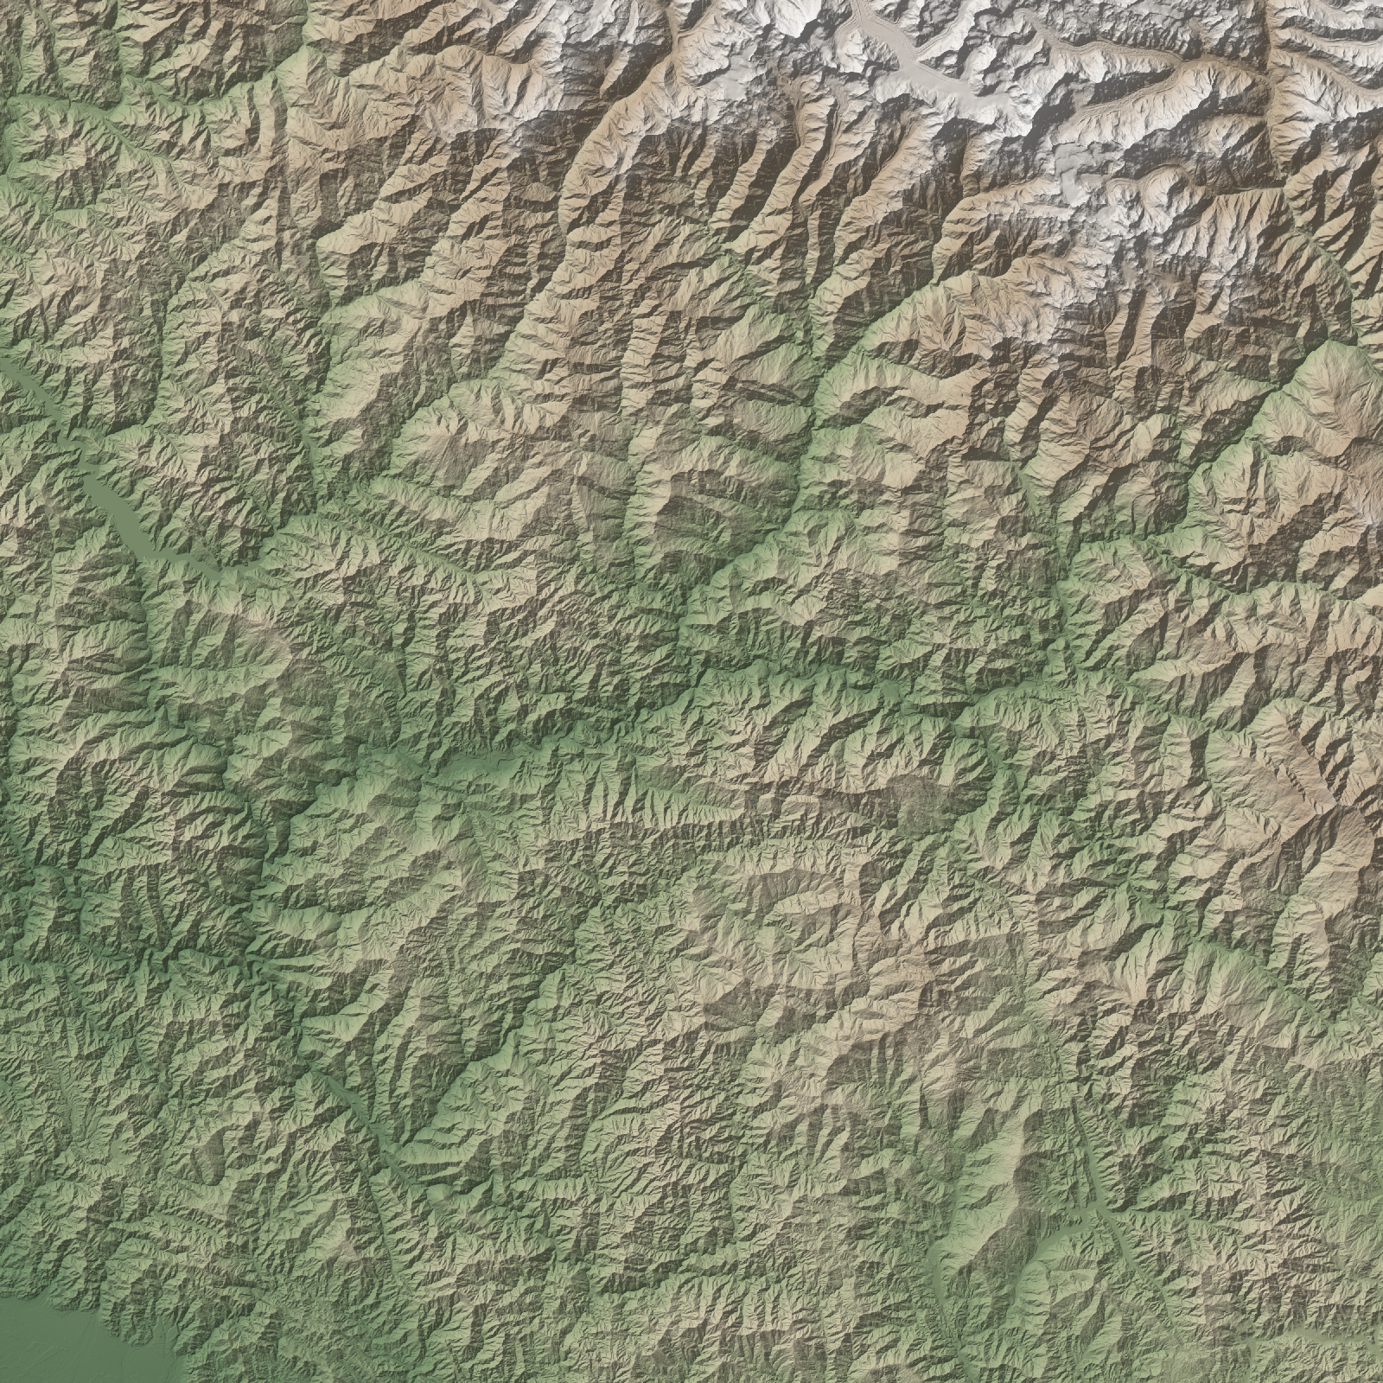
Shared data and model: Garhwal Himalaya
Copernicus GLO-30 DSM, UTM 44N (EPSG:32644), 30 m cells. Four square DEMs centred on Rudraprayag: coverage grows, resolution stays fixed.
DEM | cells | extent | elevation
500 × 500 | 0.25 M | 15 km | 594–2,856 m
1000 × 1000 | 1 M | 30 km | 547–3,022 m
2000 × 2000 | 4 M | 60 km | 485–4,480 m
4000 × 4000 | 16 M | 120 km | 315–7,074 m
One visibility model for all tracks
Radar masts 30 m · aircraft 150 m above ground · 40 km range · Earth curvature with refraction k = 1/7 · six ridge-top radar sites
Notes:
Growing the extent at fixed 30 m resolution is a clean size-scaling experiment; bigger DEMs also reach the high Himalaya, so the terrain gets more rugged with size.

Slide 4
One pipeline, one dataset, one machine
Part | Steps (validation, scenario, every benchmark, analysis) | time | status
Track 1 | validate, run_radar, benchmark, analysis | 7.3 min | ok
Track 2 | run_flight, benchmark, spacing_study, analysis | 12.7 min | ok
Track 3 | run_corridor, benchmark, analysis, interactive_bench, extensions_bench, efficiency_bench, panzoom_bench | 48.0 min | ok
Cross-track + QGIS | cross_track, build_project, render_bench | 1.0 min | ok*
run.bat -m integration.pipeline runs everything one step at a time in fresh processes, clears every benchmark CSV first and records commit 3074fca, the machine and each step's time.
How we measure: median of 5 runs, each in a fresh process (compute kept apart from I/O) · peak working set · complexity = slope of log(time) vs log(cells) · accuracy against synthetic terrains and exact references (agreement, kappa, Jaccard, cost gap).
AMD Ryzen 9 7900X, 12 cores / 24 threads, 31.1 GB · Python 3.12.13, GDAL 3.13.1, NumPy 2.4.6 · whole pipeline 69 min · *QGIS crashed on exit after writing all render results
Notes:
At the mid evaluation each track had benchmarked on its own laptop, so runtimes could not be compared across tracks. Now one command reruns all three tracks, all algorithms and all benchmarks on the same data and machine.

Slide 5
Radar visibility
TRACK 1 · SRAVANI
Which terrain, and which low-flying aircraft, can six ridge-top radars see? Three viewshed algorithms, validated and benchmarked.

Slide 6
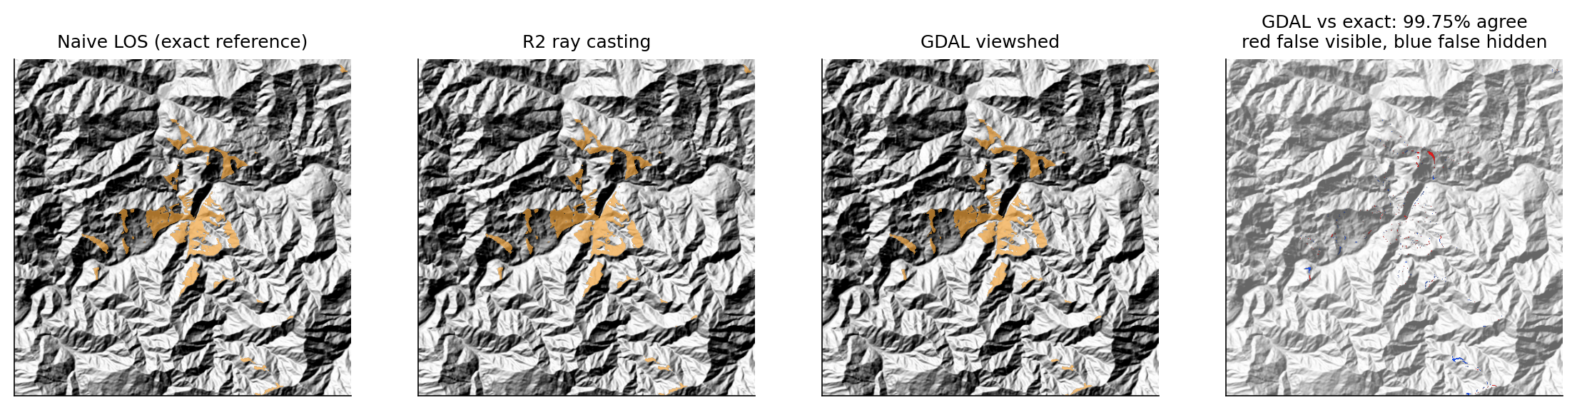
Three viewshed algorithms that agree with the exact answer
TRACK 1 · ALGORITHMS AND VALIDATION
Algorithm | Idea | Cost
Naive line of sight | sample the profile to every cell; exact reference | O(N·√N)
R2 ray casting | one ray per boundary cell with a running horizon (own NumPy code) | O(N)
GDAL viewshed | C++ reference-plane algorithm | O(N)
Real DEM vs exact | R2 | GDAL
agreement | 99.9% | 99.8%
kappa | 0.98 | 0.96
Synthetic flat, valley, wall and cone terrains: all three 100% correct. R2 now takes each cell from the ray closest to its centre: removes a +8% visible-area bias, at ~1.6× the time.
Notes:
All three share one interface so the benchmark swaps them. Mismatches sit on grazing ridge edges. Kappa corrects agreement for chance; most cells are hidden.

Slide 7
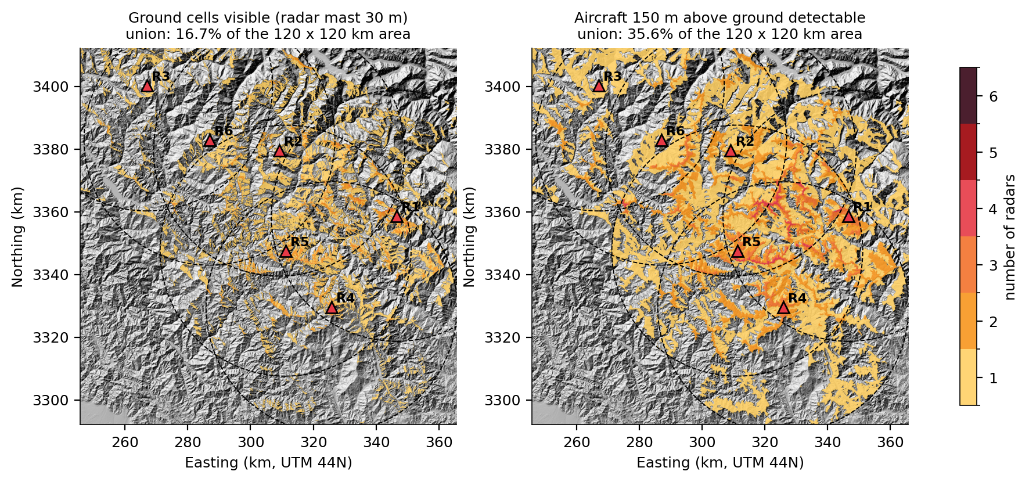
Six radars see 16.7% of the ground
TRACK 1 · SCENARIO
16.7%
of the ground seen by at least one radar
35.6%
where an aircraft 150 m up is seen: Track 3's threat
Each radar sees 4%–14% of the ground within 40 km.
Sites: highest point within 3 km, 1,500–3,200 m, ≥ 22 km apart · 30 m masts · 40 km range
Notes:
Deep valleys hide most terrain even from ridge tops. The aircraft layer is what Track 3 avoids.

Slide 8
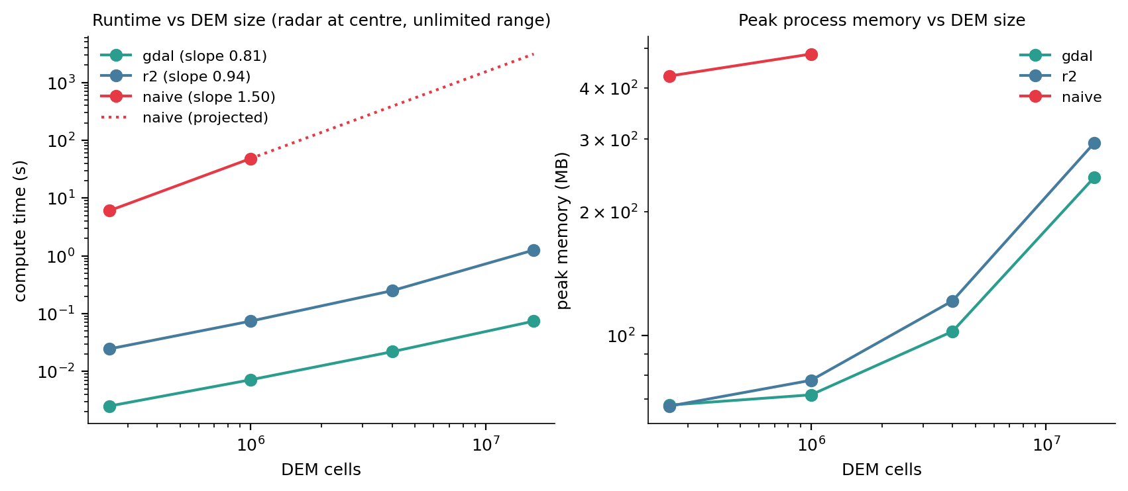
Exact costs N^1.5; the fast methods stay linear
TRACK 1 · SCALING (E1)
51.6 min
exact method, 16 M cells (projected)
74 ms
GDAL, same DEM
Fitted slopes: naive 1.50, R2 0.94, GDAL 0.81 (theory 1.5, 1, 1).
R2 timings: original R2 on the team PC; the fixed R2 is 1.5–1.9× slower (laptop, results/linux64) · GDAL peak memory 68 → 242 MB
Notes:
Naive is measured on 0.25 M and 1 M cells and extrapolated with its slope. GDAL's slope is under 1 because fixed overheads dominate small DEMs.

Slide 9
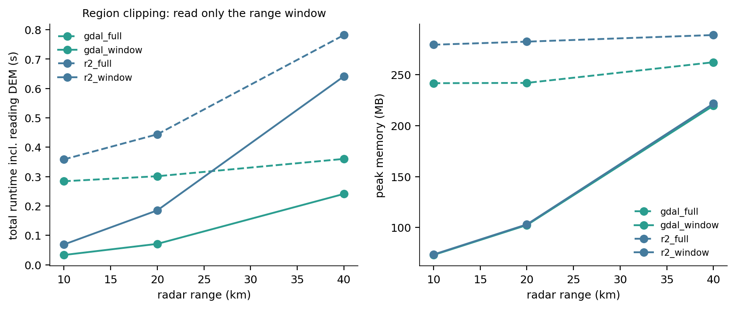
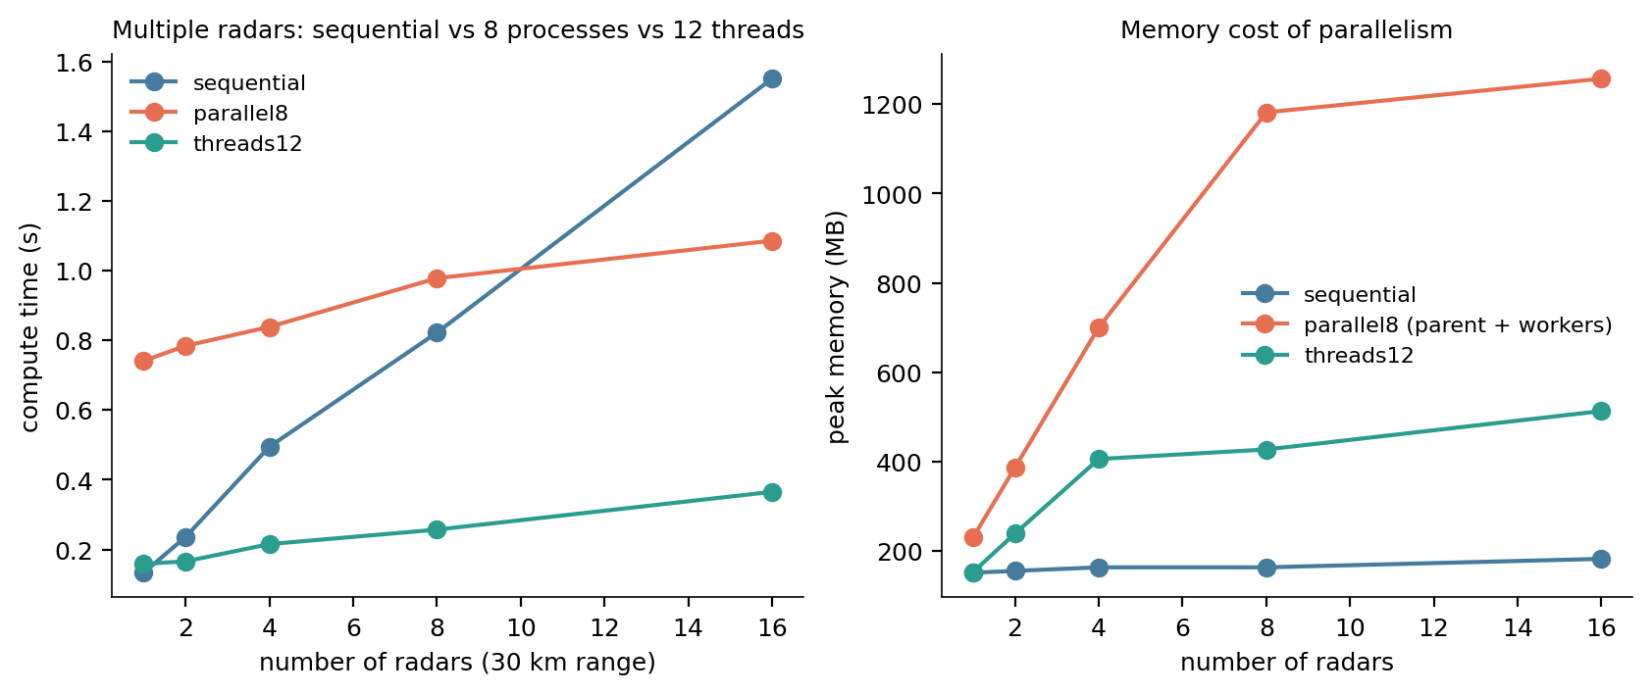
Read less, use threads, coarsen with care
TRACK 1 · PARAMETERS AND OPTIMISATIONS (E2–E6)
Study (16 M cells) | Result
E2 range 5 → 60 km | GDAL time grows as range^1.46 (area ~ range²)
E3 mast height | changes coverage, not cost
E4 many radars | 12 threads: 4.2× faster at 16 radars; processes lose up to 8 radars (start-up)
E5 read only the range window | same output, a fraction of the time and memory
E6 coarser DEM 60 / 90 / 120 m | kappa 0.90 / 0.83 / 0.78 vs 30 m
Notes:
GDAL releases Python's lock inside the viewshed, so threads run in parallel without process start-up (about 0.8 s on Windows) or copying results back.

Slide 10
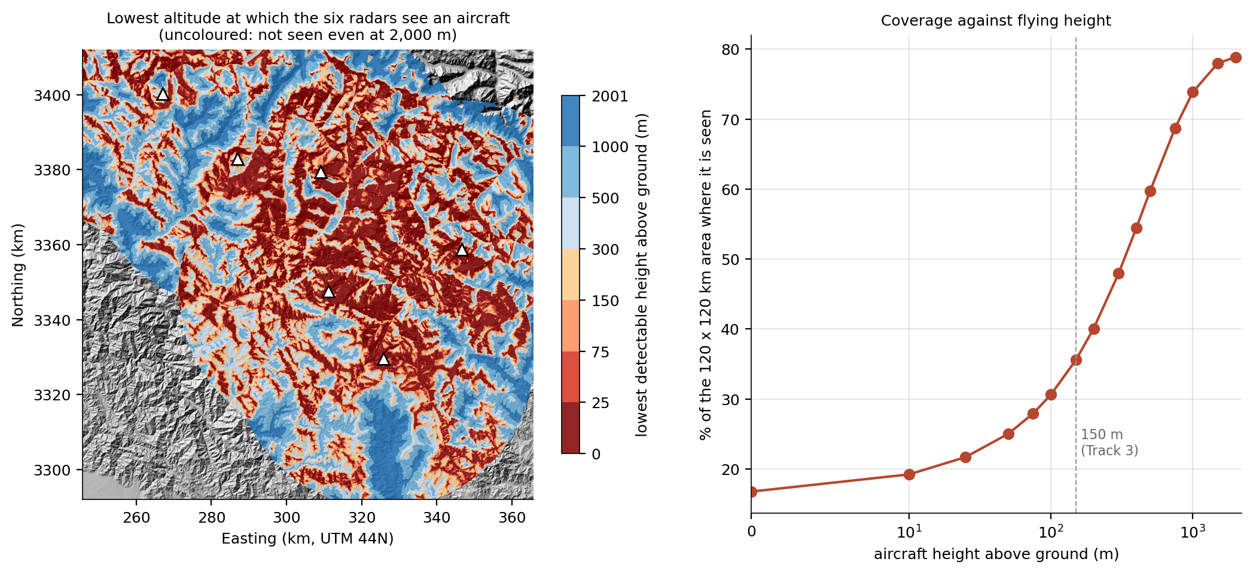
Fly 25 m above ground and the radars see you over 22% of the area
TRACK 1 · EXTENSION: LOWEST DETECTABLE ALTITUDE
36%
seen at 150 m (Track 3's threat height)
79%
seen at 2,000 m: the rest is out of range
15 target heights × 6 radars = 90 viewsheds in 7.6 s. A 5-level sweep over-estimates by 160 m on average.
Linux laptop · 4000 × 4000 DEM (16 M cells), GDAL viewshed, 40 km range · results/linux/radar_ext
Notes:
GDAL 3.4 has no direct minimum-height output, so the map is a sweep over target heights; the answer is exact at each level. Dark red valleys are the ones Track 3's corridors should use.

Slide 11
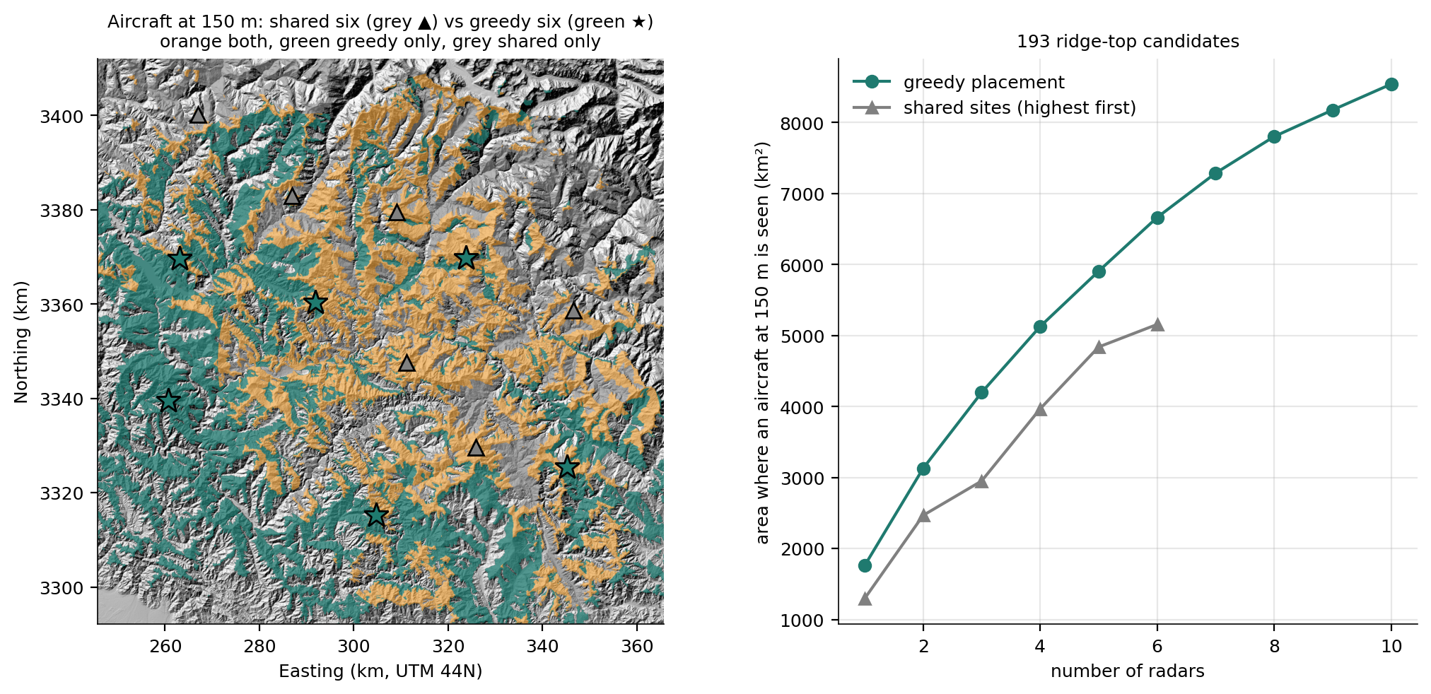
Greedy placement: 6,624 km² instead of 5,122 km² with the same six radars
TRACK 1 · EXTENSION: WHERE TO PUT THE RADARS
+29%
area where an aircraft at 150 m is seen
5
greedy radars to match the shared six
193 ridge-top candidates, one viewshed each (22 s), greedy pick on a 120 m grid (1.5 s). Highest-first picks peaks that look at each other; greedy spreads them (≥ 30 km apart).
Linux laptop · 4000 × 4000 DEM (16 M cells), GDAL viewshed, 40 km range · results/linux/radar_ext
Notes:
Greedy max-coverage is within 63% of the optimum by theory and usually much closer. The six shared sites stay as the team's common input; this shows what placement is worth.

Slide 12
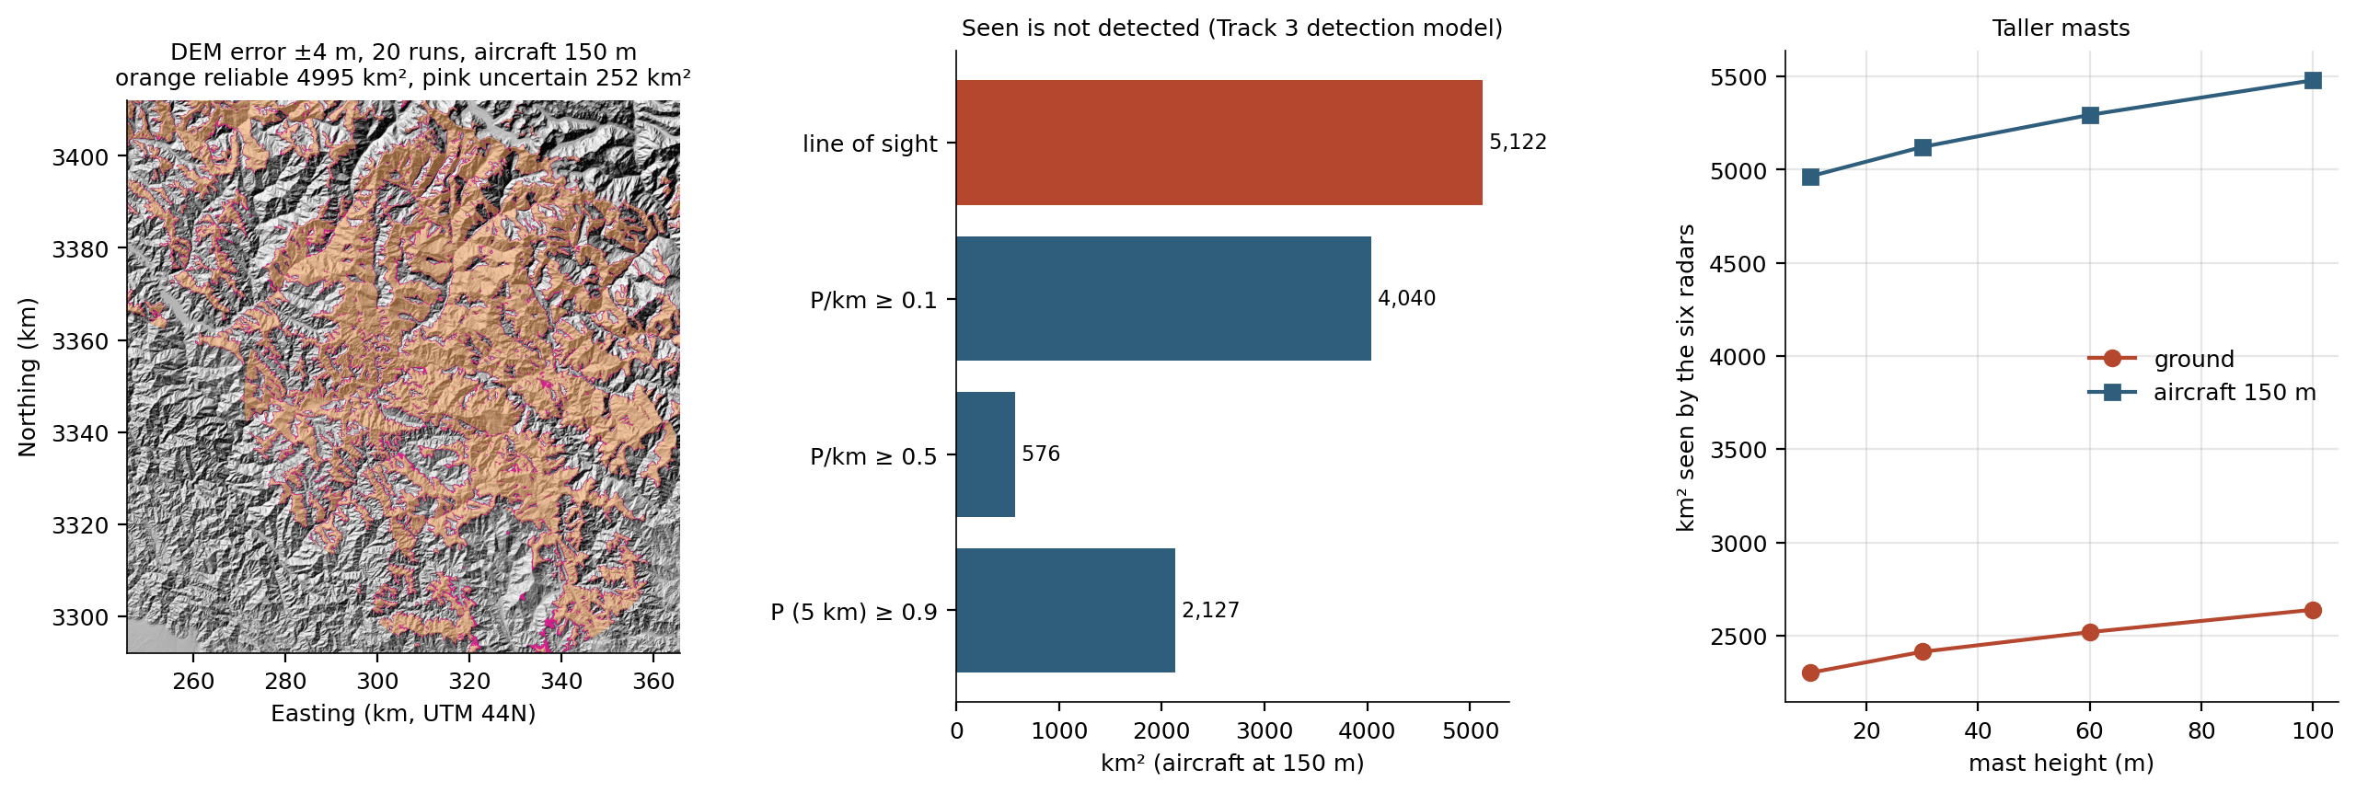
Seen is not detected; a few metres of DEM error matter little
TRACK 1 · EXTENSION: DETECTION, DEM ERROR, MAST HEIGHT
Study (aircraft at 150 m unless stated) | Result
Detection model of Track 3 | line of sight 5,122 km² → P(detect per km) ≥ 0.5 on only 576 km²; ≥ 0.9 over 5 km on 2,127 km²
DEM error ±4 m, 20 runs | reliable 4,995 km², uncertain 252 km² (5%); ground 8%
Mast 10 → 100 m | ground 2,301 → 2,639 km², aircraft 4,965 → 5,480 km²: placement matters more
Notes:
Track 3's detection model: p(d) = 0.5 / (1 + (d / 20 km)^4) per km flown, combined over radars. DEM noise is spatially correlated over 300 m, as in Track 2. Uncertain cells sit on ridge edges.

Slide 13
Flight-route visibility
TRACK 2 · SALONI
A moving observer = many viewsheds, aggregated: what the aircraft sees, when it first sees it, and what it never sees.

Slide 14
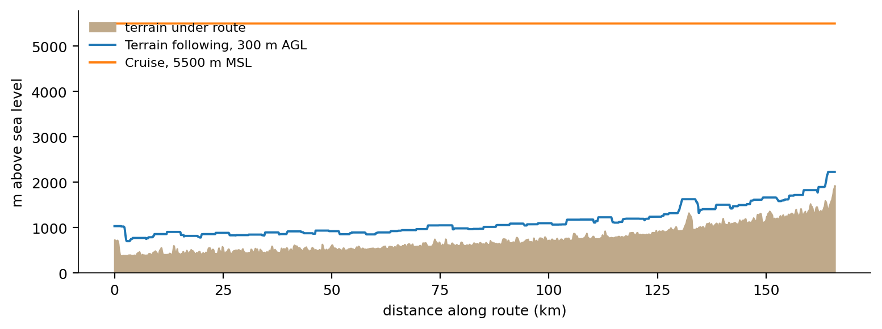
Route, altitude, sample, aggregate
TRACK 2 · METHOD
1 · Route
2 · Altitude
3 · Sample
4 · Aggregate
166 km up the Alaknanda valley, Devprayag → Joshimath (least-elevation path between towns)
terrain following 300 m above smoothed ground, or a 5,500 m cruise
a position every 1,000 m (167), a viewshed within 20 km at each
times seen per cell, first position that sees it, new area per position, blind spots
Notes:
The altitude profile is computed once at 100 m and interpolated, so coarse and dense sampling fly the same path: a fair comparison of sampling densities.

Slide 15
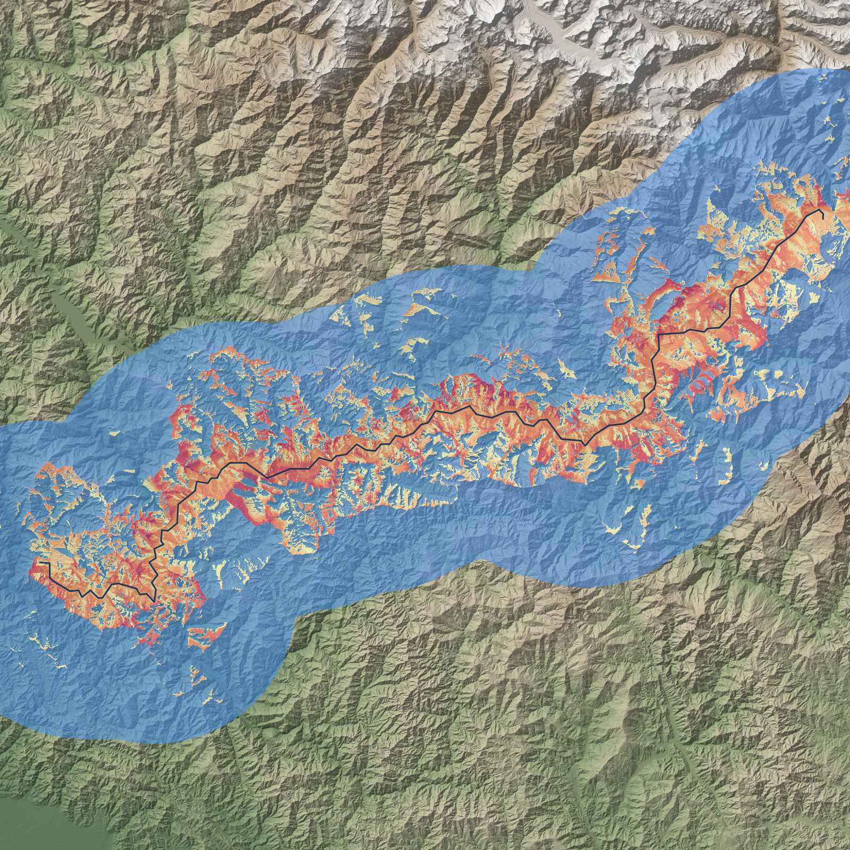
Valley flying sees 26% of the corridor
TRACK 2 · SCENARIO
1,537
km² seen at 300 m AGL (26% of the corridor)
4,732
km² seen cruising at 5,500 m (79%)
167 viewsheds in 2.9 s.
Corridor = 6,024 km² within 20 km of the route · blind spots = corridor cells never seen
Notes:
The valley walls hide almost everything beyond the first ridge from a low aircraft: good for staying hidden, bad for surveillance. That trade-off is what Track 3 optimises.

Slide 16
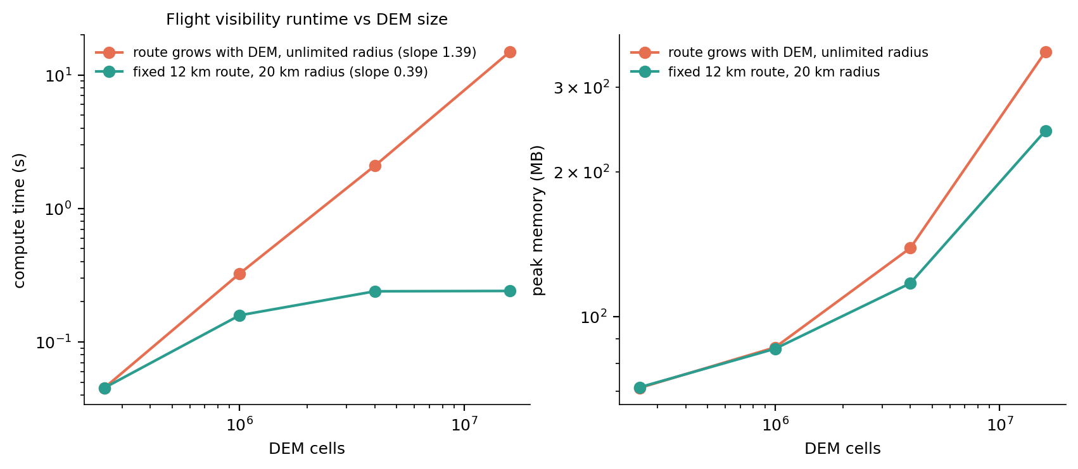
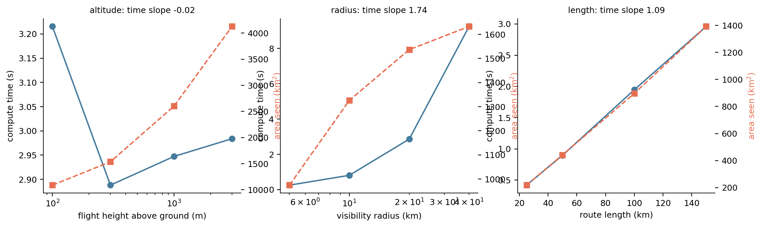
Cost = positions × cells per viewshed
TRACK 2 · SCALING AND PARAMETERS (F1–F5)
Study | Result
F1 DEM + route grow | 45 ms → 15.0 s, slope 1.39 (theory 1.5)
F1b fixed 12 km route | flat once the DEM is larger than the radius (slope 0.39)
F2 / F4 / F5 | linear in positions (0.98), ~radius² (1.74), linear in length (1.09)
F3 altitude | no cost change (-0.02); coverage grows with height
Notes:
DEM size alone does not drive the cost; the number of positions and the area each viewshed covers do.

Slide 17
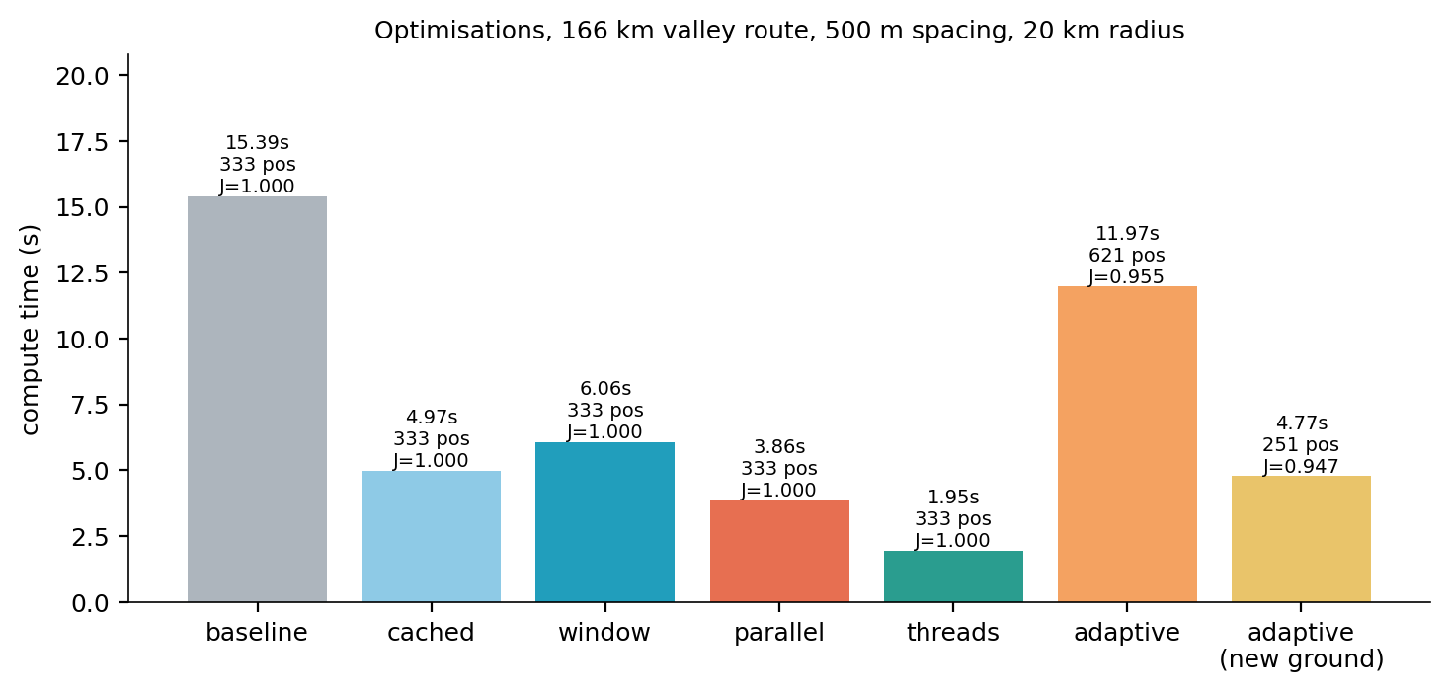
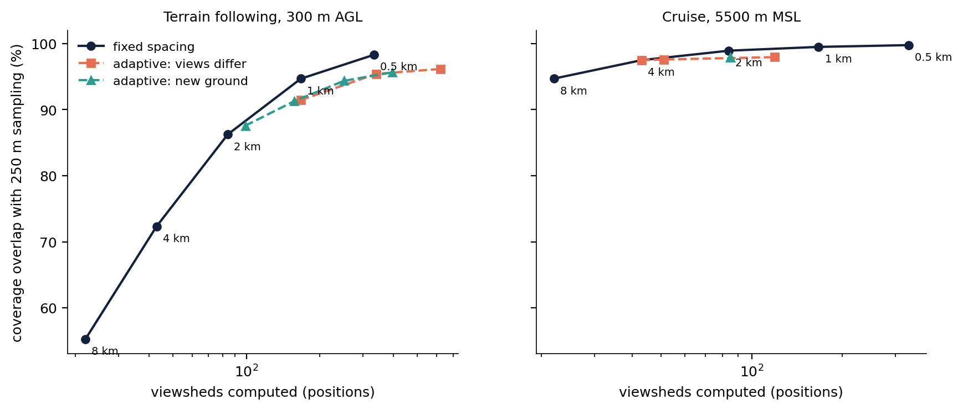
7.0× faster with threads; spacing should follow altitude
TRACK 2 · OPTIMISATIONS (F6) AND SAMPLING
Speed: 333 viewsheds take 15.7 s re-reading the DEM, 5.3 s cached, 4.2 s with processes and 2.2 s with threads (identical result).
Sampling: adaptive refinement never beat fixed spacing. The lever is altitude: at cruise 4 km spacing keeps ~97% of coverage; valley flying needs ~500 m.
Notes:
Coverage grows smoothly along the route, so uniform spacing is already efficient.

Slide 18
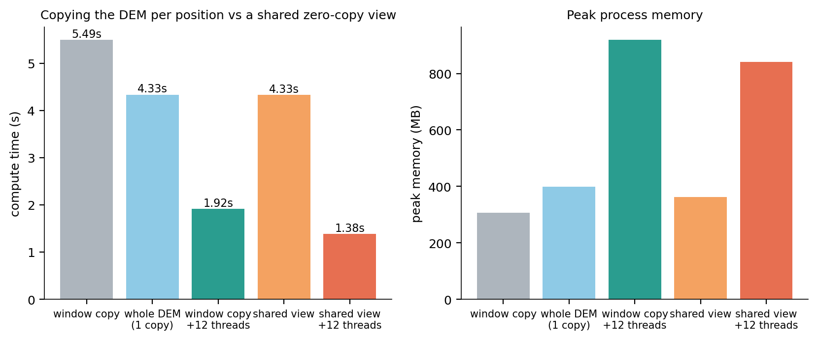
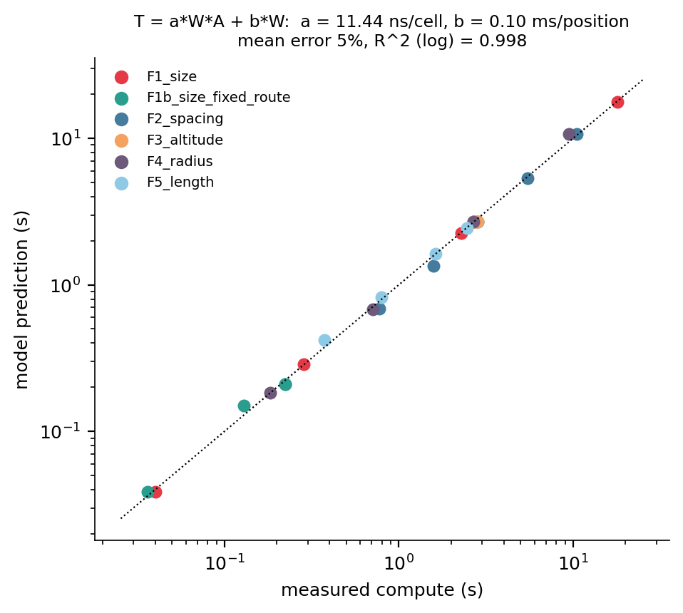
Shared DEM: 1.38 s instead of 1.92 s, same answer
TRACK 2 · EXTENSION 1: CHEAPER COMPUTATION (F7–F10)
Idea | Result
F7 shared view + threads | 1.38 s, 841 MB; identical result
F8 30 m near, coarse far | viewshed 2.3× faster, route ~10%; 86–97% overlap
F9 tiled accumulator | 12 km route, 16 M cells: 92 → 10 MB of rasters
F10 T = a·W·min(πr², N) + b·W | a 11.4 ns/cell, b 0.10 ms/pos, error 4.9%
Linux laptop: 10 cores / 12 threads, 15.3 GB, GDAL 3.4.1 · results/linux/flight
Notes:
Copying a 40 km window per position cost more than the smaller search saved. The model says cost is positions × min(radius², map): linear in route length, quadratic in radius, independent of altitude.

Slide 19
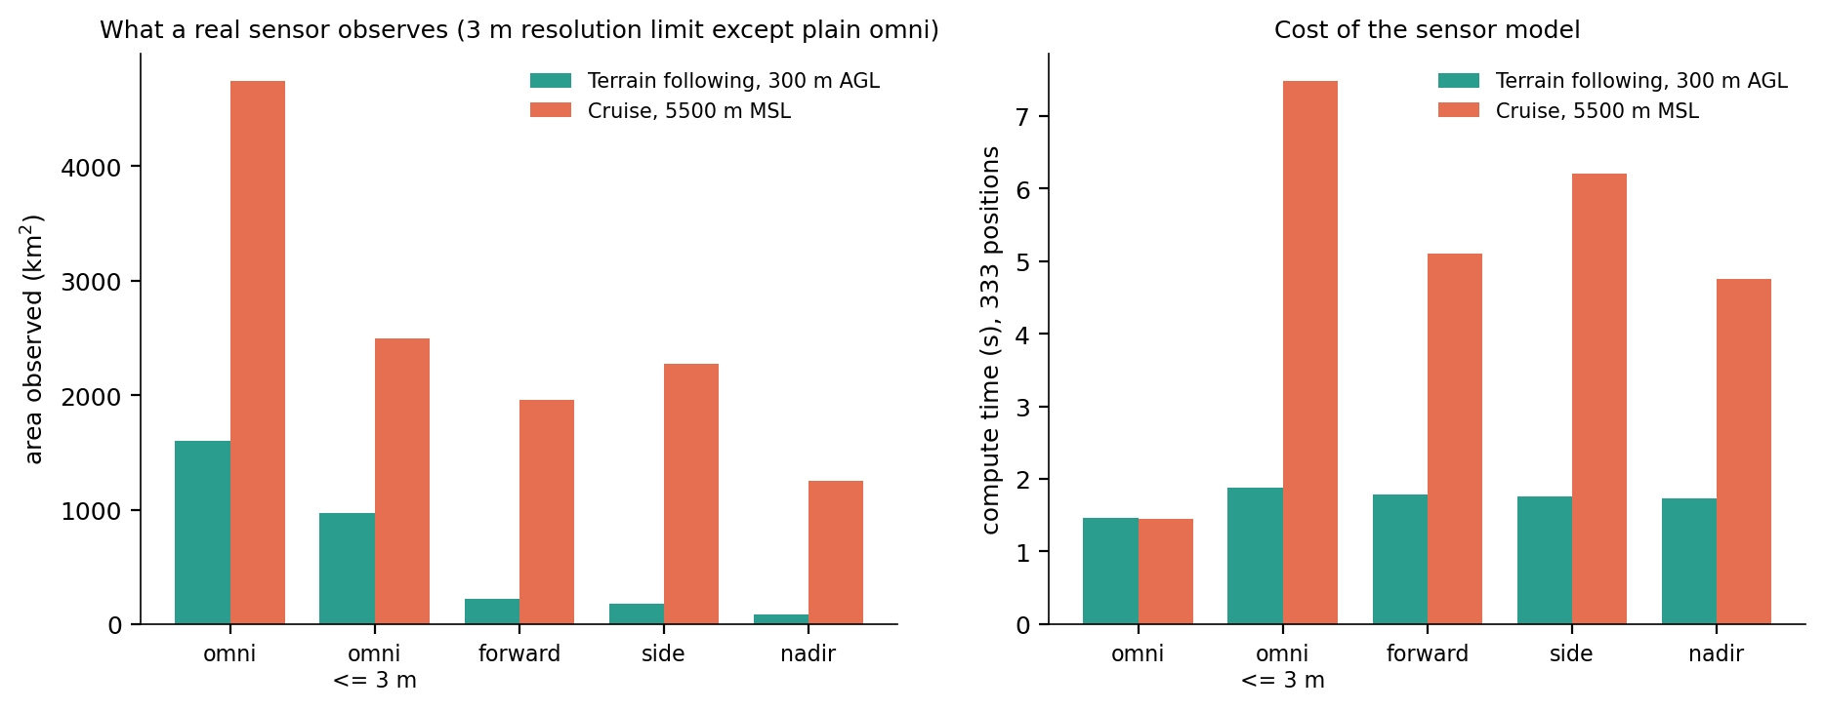
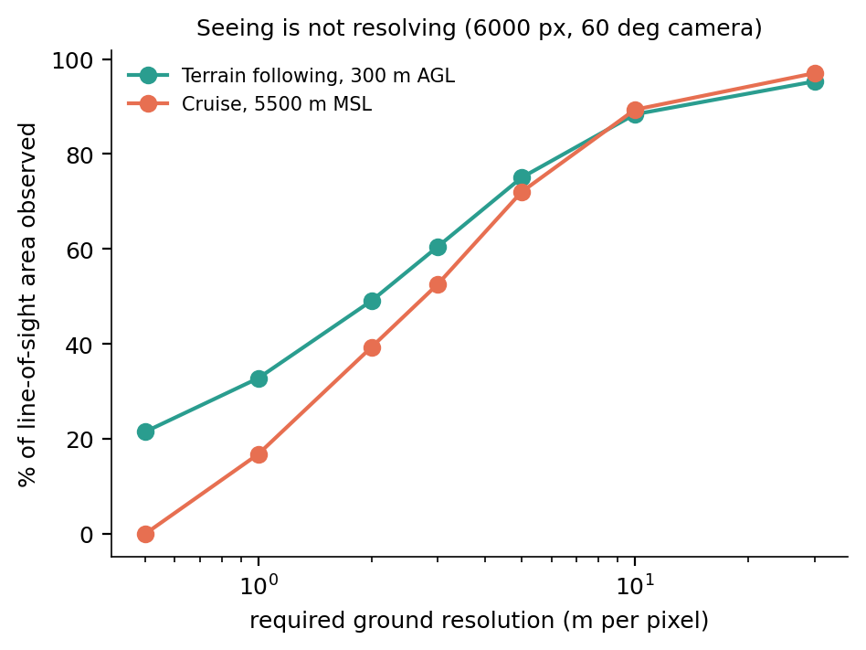
A forward camera observes 220 of 1,600 km² seen
TRACK 2 · EXTENSION 2: A REAL SENSOR
Sensor (3 m per pixel) | Valley 300 m | Cruise 5,500 m
line of sight only | 1,600 km² | 4,747 km²
forward camera 90° | 220 km², 25 s | 1,963 km², 50 s
side cameras 2 × 60° | 175 km², 8 s | 2,272 km², 67 s
nadir ≥ 45° down | 87 km², 8 s | 1,249 km², 125 s
Field of view from the heading, depression limits, ground sample distance = slant × IFOV / cos(incidence), dwell = seconds observed at 60 m/s (median shown). Valley: forward is best (walls block the sides); cruise: side-looking.
Linux laptop: 10 cores / 12 threads, 15.3 GB, GDAL 3.4.1 · results/linux/flight
Notes:
6000-pixel, 60 degree camera. At 5,500 m nothing is resolved at 0.5 m: the closest slant range is about 3.5 km.

Slide 20
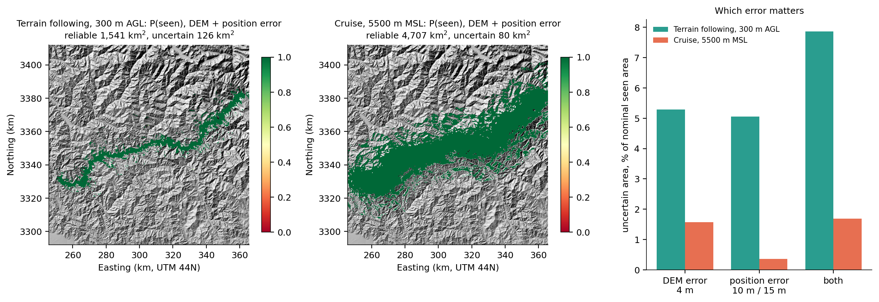
"Seen" is uncertain on 7.9% (valley), 1.7% (cruise)
TRACK 2 · EXTENSION 2: UNCERTAINTY (MONTE CARLO)
20 runs per source: DEM error 4 m (correlated over 300 m), aircraft position error 10 m horizontal / 15 m vertical. The total area barely moves (valley 1,604 ± 3 km²) but which cells are seen does, at the edges of visibility. Valley: DEM and position errors matter equally (85 / 81 km²); cruise: almost only the DEM.
Notes:
Report a reliable-coverage map (seen in at least 95% of runs) rather than a single nominal answer.

Slide 21
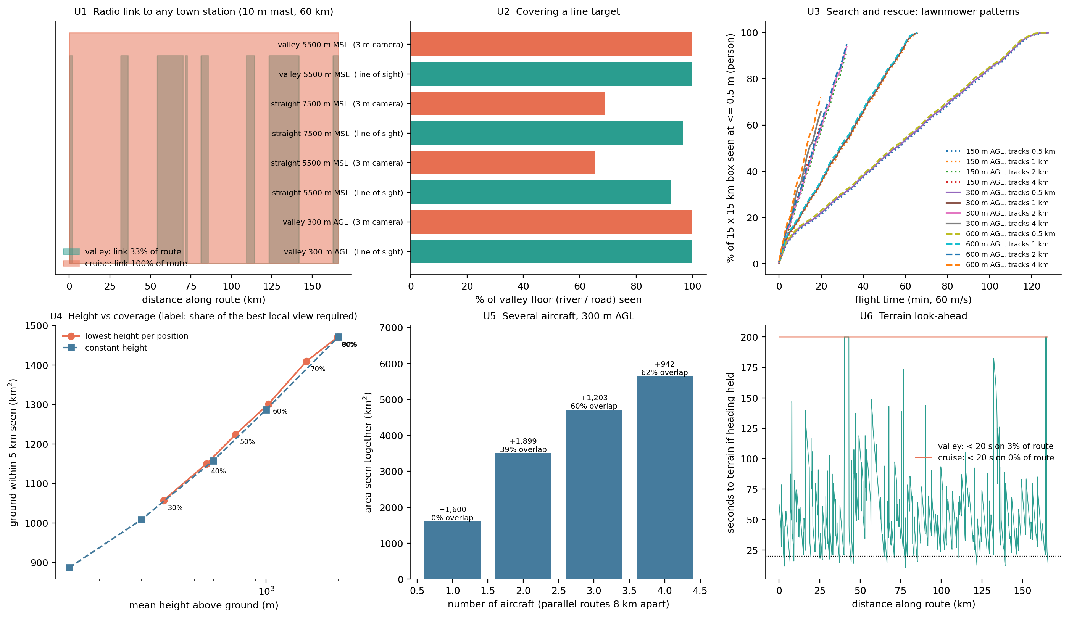
Six applications of the same engine
TRACK 2 · EXTENSION 3: SIX APPLICATIONS
Radio link: valley flight reaches a town station on 33% of the route (longest gap 30 km); cruise 100%.
River / road: following the valley sees all of it; a straight 5,500 m line only 65% with a 3 m camera.
Search & rescue: 0.5 m camera, 15 × 15 km: 1 km tracks cover 99.98% in 66 min, 4 km tracks 66% in 20 min.
Height: 80% of the local view needs ~2 km above ground; per-position height gains only ~2%.
Several aircraft: 1,600 → 3,499 → 4,702 → 5,644 km²; the 4th overlaps 62%.
Look-ahead: < 20 s to terrain on 3.4% of the valley route if heading is held.
Notes:
All six reuse the same viewshed engine; each is one function in flight/usecases.py.

Slide 22
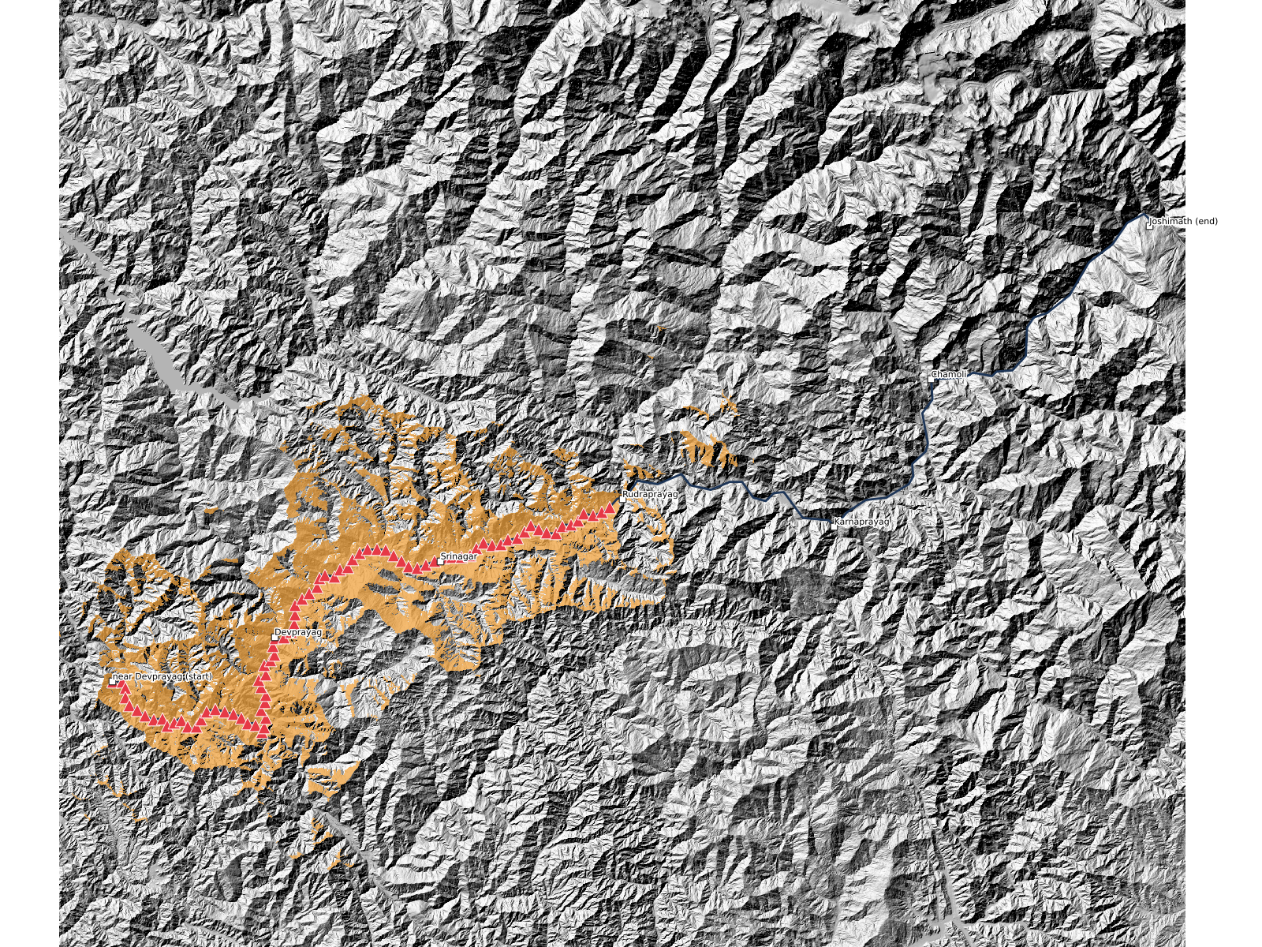
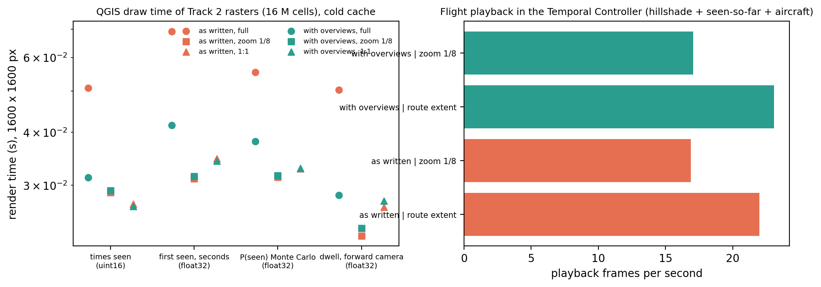
QGIS playback at 17–23 frames per second
TRACK 2 · EXTENSION 4: FLIGHT PLAYBACK IN QGIS
How: the first-seen raster stores the flight time at which each cell is first seen (raster temporal mode 'represents temporal values'); the aircraft layer has a time per position; a cumulative range makes seen ground accumulate.
Draw time: Track 2 rasters (16 M cells) draw in 23–69 ms; overviews make full-extent ~1.6× faster and change nothing zoomed in.
Files: qgis/track2_extensions.qgz, qgis/track2_layers.py
Notes:
Open View > Panels > Temporal Controller and press play: 163 frames of 17 s cover the 46-minute flight.

Slide 23
Radar-hidden corridor, interactively
TRACK 3 · AKSHAT
Exact routing on 16 M cells, what to precompute and what to compute on the fly, a certified risk budget, and the whole thing as a QGIS plugin (live demo at the end).

Slide 24
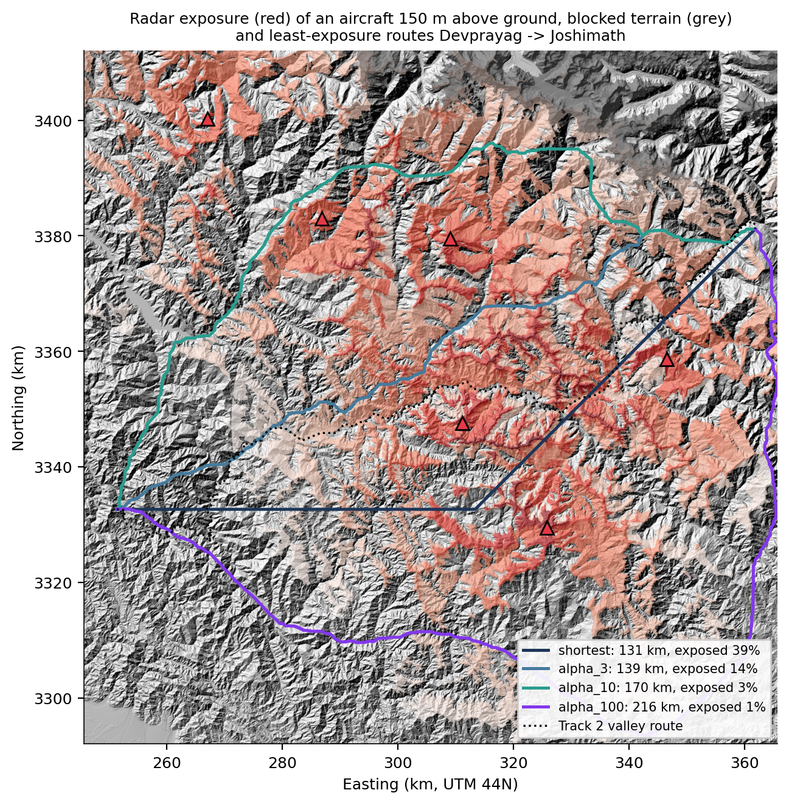
Stay hidden from the radars without a big detour
TRACK 3 · PROBLEM
c(u,v) = L · (1 + α · threat) + β · climb
Grid graph: 16 M cells, 8 neighbours, 128 M edges; aircraft 150 m above ground; above a 5,000 m ceiling is blocked.
Threat: from Track 1's radar viewsheds: exposure (visible, closer = worse) or detection hazard −ln(1 − p) per km.
Detection: P(detect) = 1 − exp(−Σ length · hazard): additive, so every shortest-path method applies.
Notes:
α trades exposure against distance; α = β = 0 is the shortest path. We chose visibility OF the aircraft FROM ground radars, so Track 3 reuses Track 1's sites and engine.

Slide 25
30% longer, 93% less exposure
TRACK 3 · SCENARIO AND EXACT SOLVERS
Devprayag → Joshimath | length | exposed | exposure
Shortest (α = 0) | 131 km | 39% | 31.5
Track 2 valley route | 178 km | 26% | 26.5
α = 3 | 139 km | 14% | 8.1
α = 10 | 170 km | 3% | 2.2
α = 100 | 216 km | 1% | 0.5
16 M nodes, one route | time | peak memory | gap
Dijkstra (Python) | 37.7 s | 682 MB | 0
A* (Python) | 28.2 s | 1,031 MB | 0
Dijkstra (SciPy) | 6.4 s | 6,025 MB | 0
Multi-resolution ×4 | 2.1 s | 1,217 MB | 1.4%
Our C Dijkstra (implicit grid) | 2.5 s | 635 MB | 0
All exact solvers return the same optimum. Fitted slopes 0.97–1.04 (theory N log N). The C search on the implicit grid needs no edge list: SciPy's 128 M-edge matrix costs 5.9 GB.
Exposure = km of route weighted by threat · ALT (landmark A*) returns the same cost and searches a fraction of the nodes
Notes:
Beyond α ≈ 30 the route only gets longer: diminishing returns. Exposed = share of the route visible to at least one radar.

Slide 26
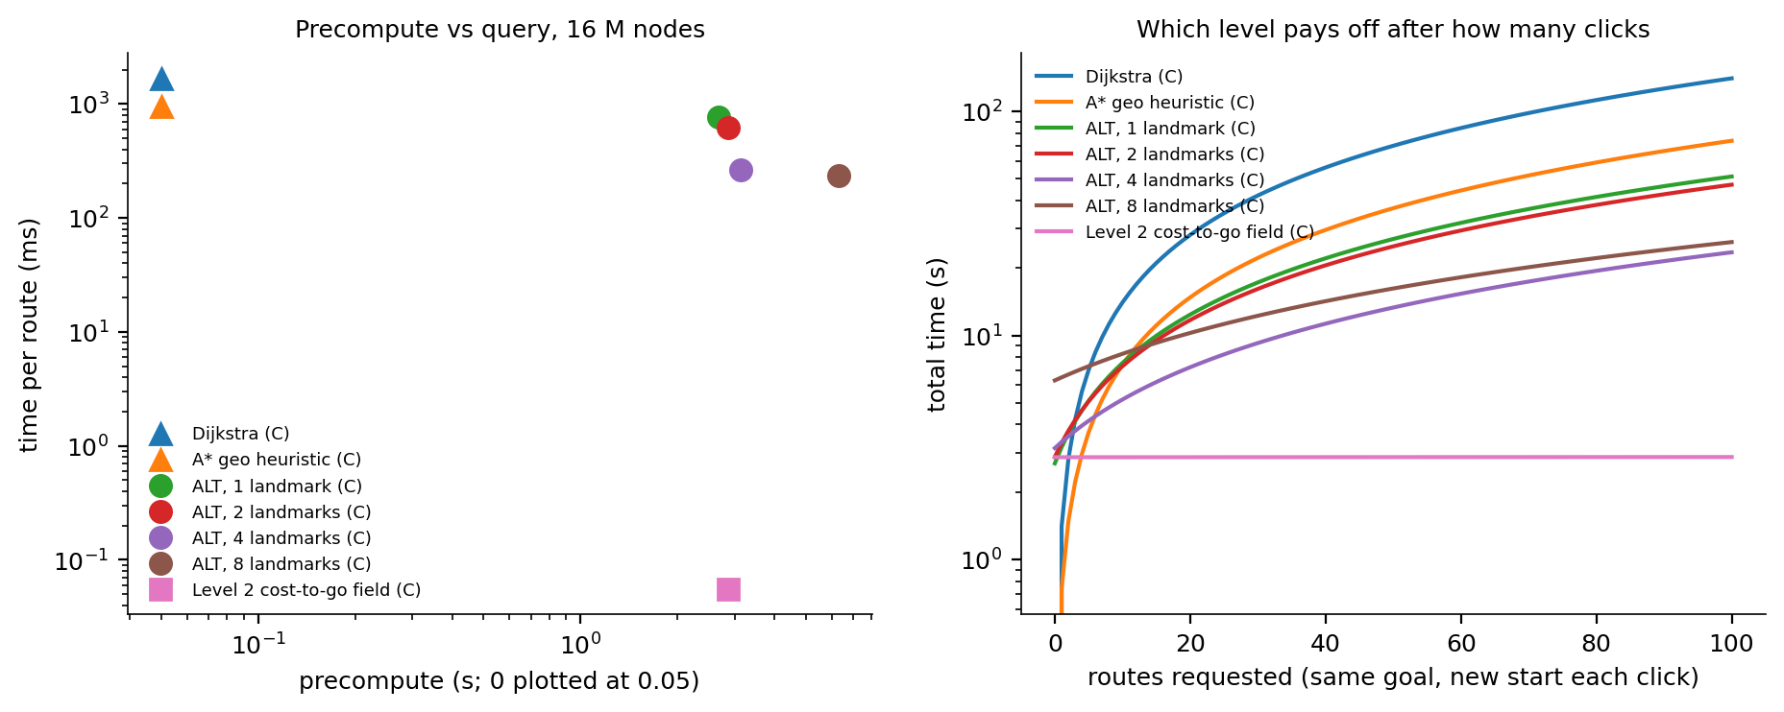
Precompute the field for the goal; every start is a lookup
TRACK 3 · WHAT TO PRECOMPUTE
Cost-to-go field
For every cell: cost of the best route to the goal and the next step. One backward search builds it; a route from any start is then a lookup: exact, no search.
Level (16 M cells) | Precompute | New start | New goal
0 · C Dijkstra | – | 1,404 ms | 1,678 ms
1 · 4 landmarks (ALT) | 3.1 s · 488 MB | 203 ms | 264 ms
2 · cost-to-go field | 0.28 s · 183 MB | 0.06 ms | new field
12 cores: 2.85 → 0.28 s
Delta-stepping with a lock-free atomic minimum, exact. 10.2× on 16 threads; a spin barrier fixed MinGW's sleeping one.
Notes:
Level 0 = no precompute; Level 1 = landmarks, any start and goal; Level 2 = one field per goal, pays off from the second click. With 12 cores a full rebuild beats incremental repair after a radar edit.

Slide 27
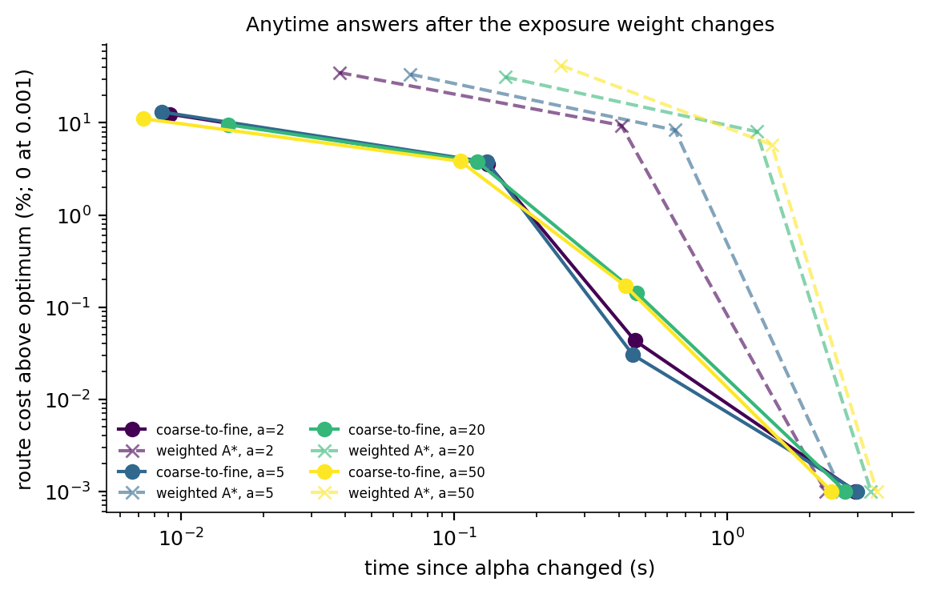
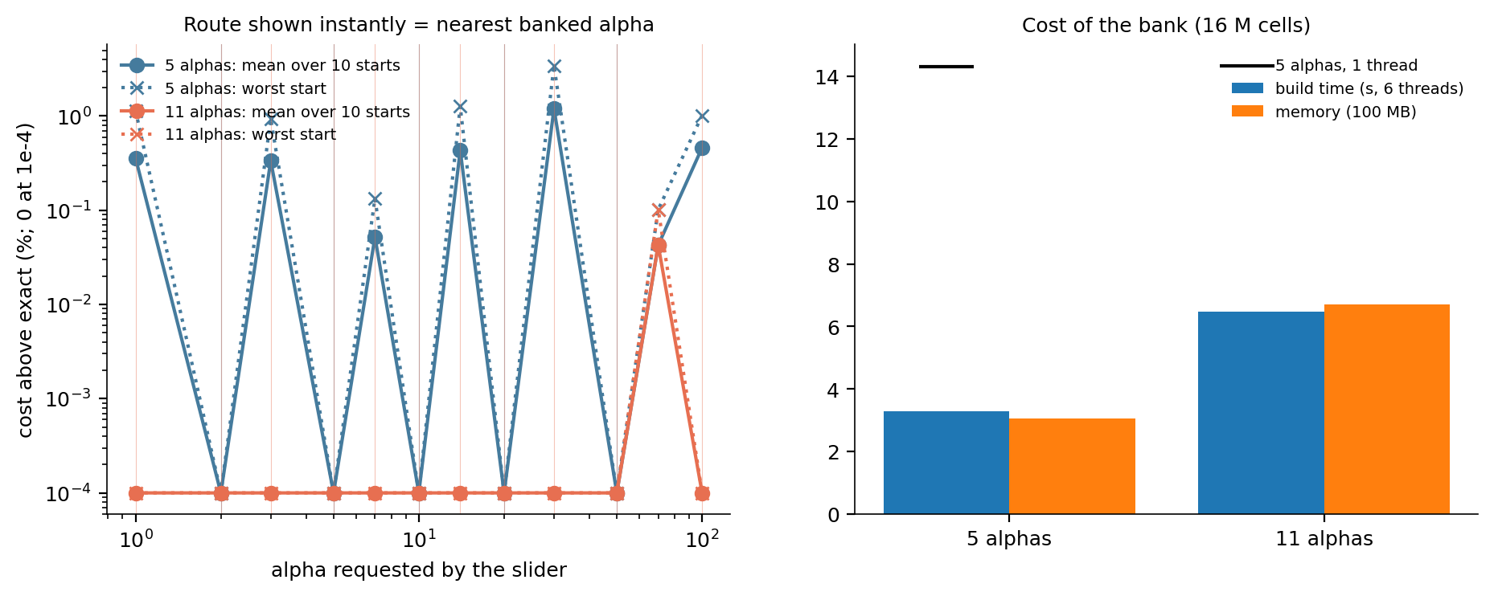
Answer at once, exact soon after
TRACK 3 · WHEN PRECOMPUTE STOPS BEING VALID
Interaction (16 M cells) | Strategy | Latency
Click a new start | Level 2 lookup | 0.09 ms
Change α | α bank lookup → exact field in background | ~1 ms → ~0.4 s
Drag / add a radar | that radar's viewshed + parallel field rebuild | ~0.6–0.9 s
New goal | coarse-to-fine route now, field in background | ~0.3–0.6 s
Pan / zoom | draw the known route (never re-search) | < 0.1 ms
The pyramid stores threat and height, not costs, so it survives an α change; the field and landmarks do not. Weighted A* lost to coarse-to-fine at every quality level.
Notes:
α bank: next-step fields for a ladder of α values; banked α → exact route in about a millisecond, in-between α → nearest banked route (within about 1%) while the exact field is rebuilt. Re-solving the visible window on pan/zoom was measured and rejected: slower, and often a different valley.

Slide 28
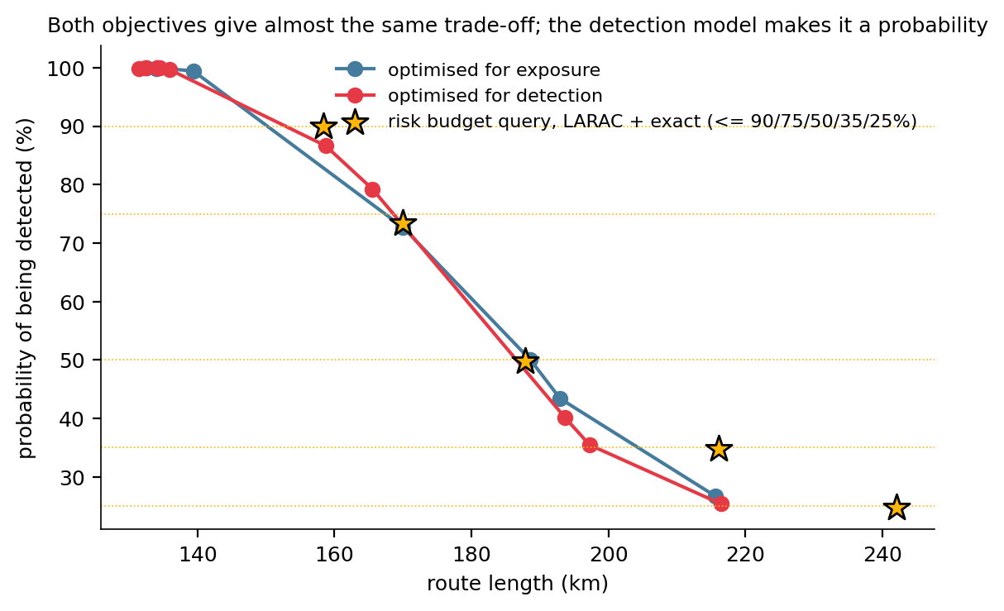
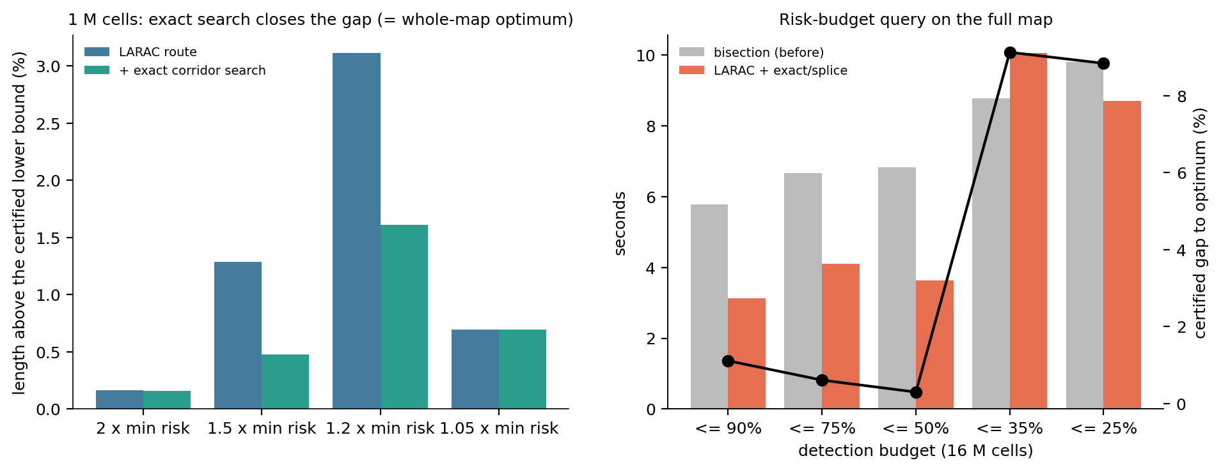
Shortest route under a detection budget, with a certificate
TRACK 3 · DETECTION RISK BUDGET
Resource-constrained shortest path (NP-hard): LARAC Lagrangian relaxation on parallel fields (2.7–4.7 s), then an exact label-setting search in a corridor with Lagrangian pruning and dominance. The lower bound certifies how far the answer can be from the best possible length.
Exact on 1 M cells (corridor answer = whole-map optimum) · 16 M cells, P(detect) ≤ 50%: 188 km at 49.8% (plugin scenario: 145 km, within 0.4% of optimal) · Monte Carlo = formula
Notes:
Carlyle, Royset and Wood 2008 for the Lagrangian pruning. In the plugin this is the B key.

Slide 29
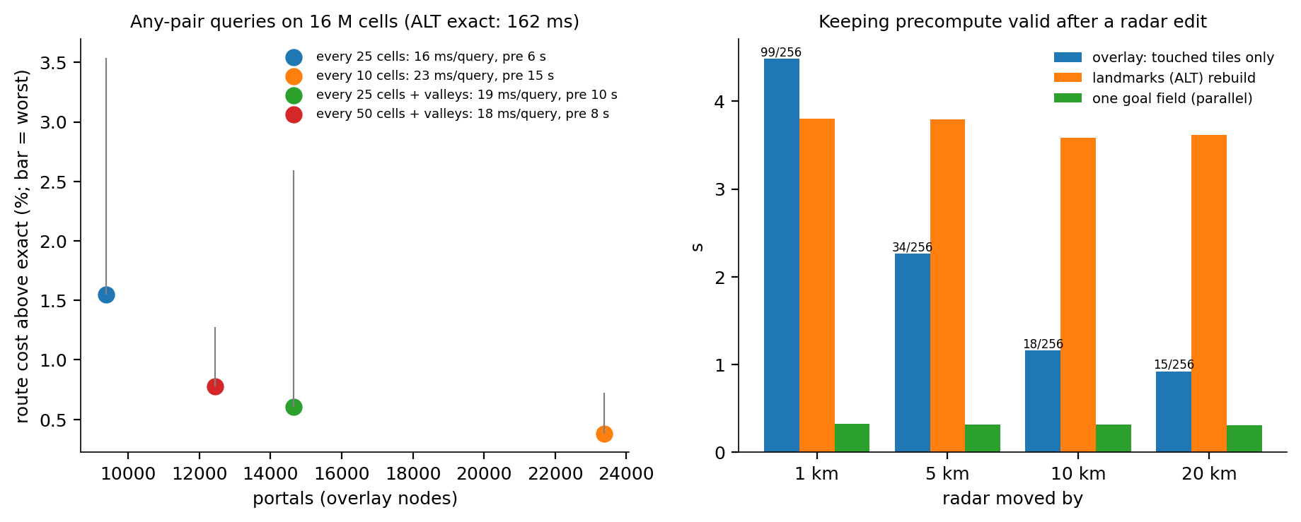
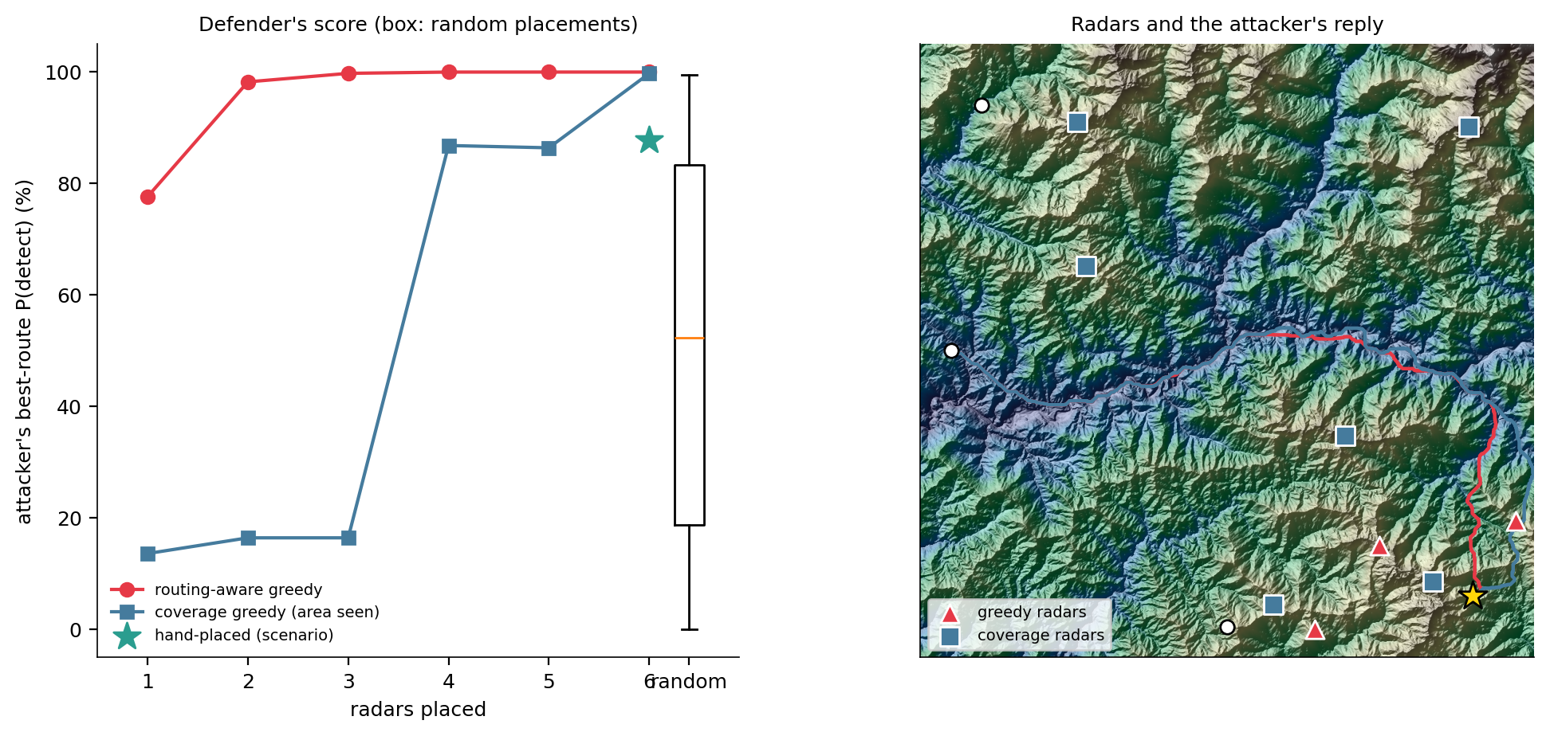
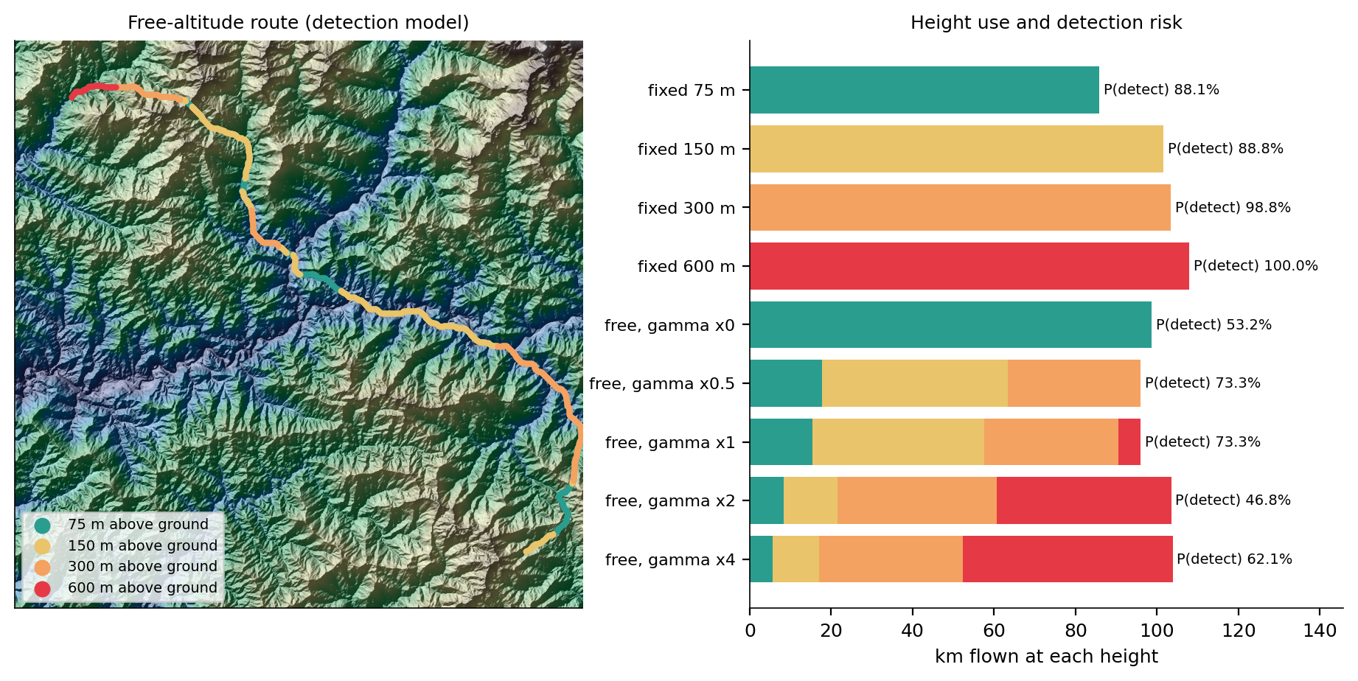
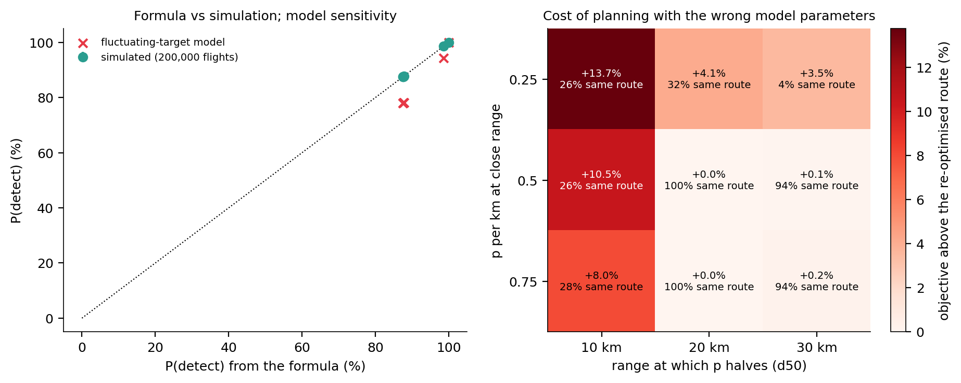
Tiles, radar placement, altitude, robustness
TRACK 3 · EXTENSIONS
Tiles (CRP idea): any pair in ~19 ms, 0.6% above exact · placement for routes beats placement for coverage (2 radars: 98% vs 16% detection) · free altitude: P(detect) 89% → 53%
Notes:
Tile overlay: costs between border portals of 250 × 250 tiles (Delling et al. 2011); a radar edit recomputes only the touched tiles. Placement game: defender places radars, attacker flies the safest route. 3-D search over 4 heights. Also uncertain radar positions and alternative corridors.

Slide 30
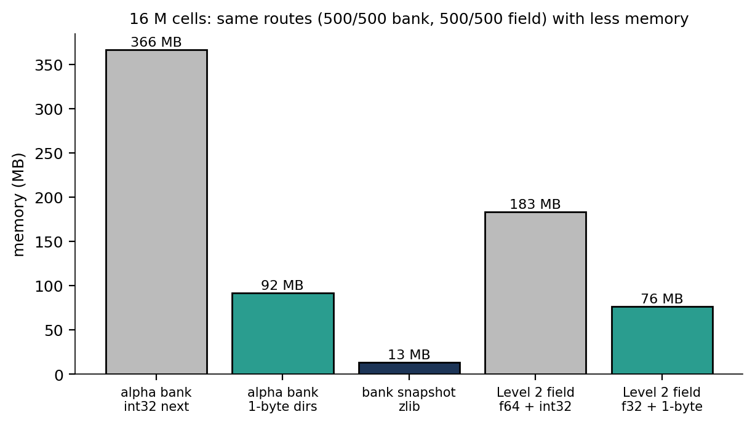
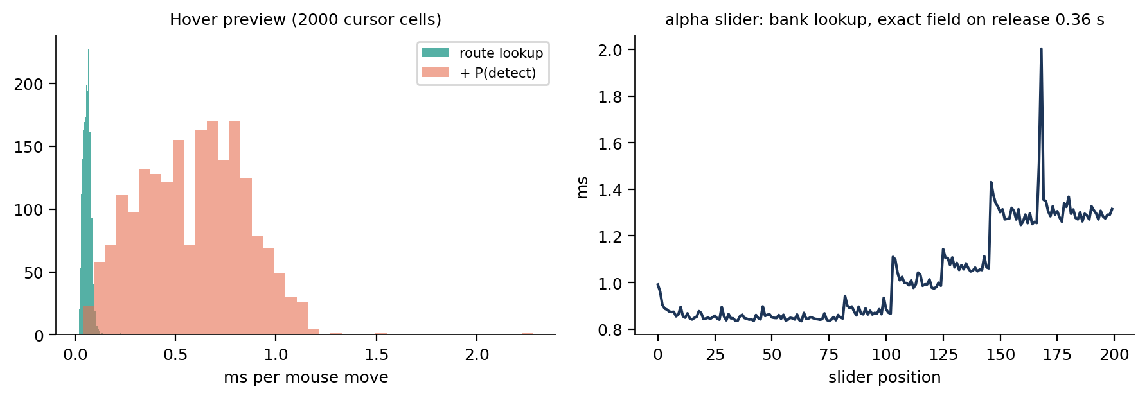
Same routes, a quarter of the memory; live previews
TRACK 3 · MEMORY EFFICIENCY AND ON-THE-FLY (NEW)
On the fly (plugin) | latency
Hover: route from the cursor | 0.06 ms (p99 0.11)
… + P(detect) of that route | 0.6 ms
α slider while dragging (bank) | 0.94 ms
α slider released (exact field) | 358 ms
Memory (16 M cells) | before | after | routes
α bank, 6 fields: next → 1-byte direction | 366 MB | 92 MB | 500/500
Field: f64 cost + int32 → f32 + 1 byte | 183 MB | 76 MB | 500/500
Bank snapshot on disk (zlib) | 92 MB | 13.4 MB | lossless
Notes:
A next step always points to one of 8 neighbours, so a 1-byte direction code replaces a 4-byte pointer with identical routes. Costs in float32 have a negligible relative error. Direction fields compress well, so banks for several goals can be stored and restored in milliseconds.

Slide 31
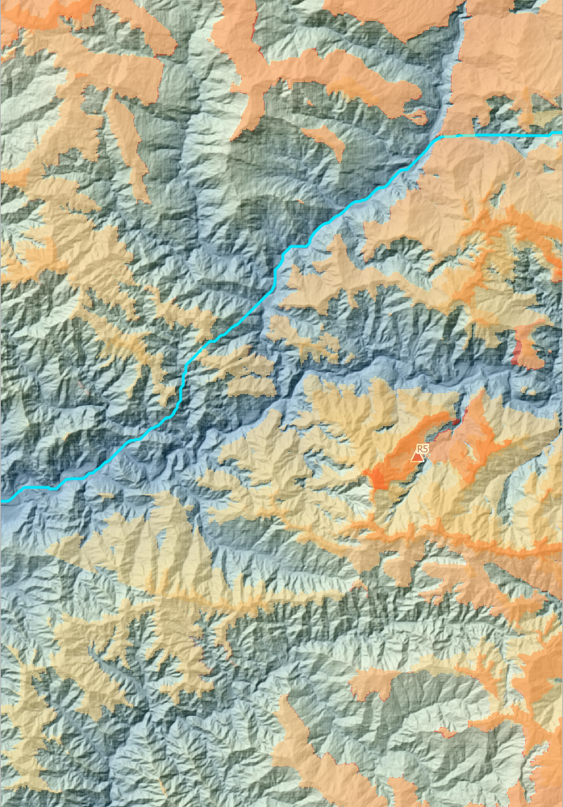
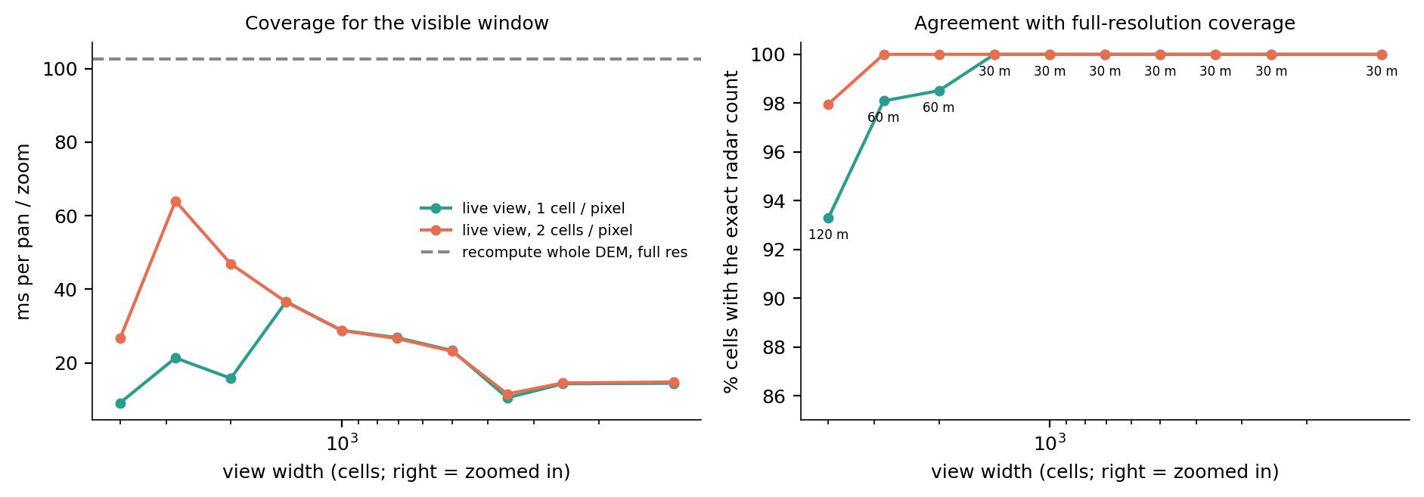
Every pan and zoom recomputes only what is on screen
TRACK 3 · PAN AND ZOOM ON THE FLY (NEW)
Per pan / zoom (canvas 1600 × 1000 px, 16 M cells) | time | exact cells
Recompute the whole DEM at 30 m | 103 ms | 100%
Live, zoomed out: 120 m level | 9 ms | 93.3%
Live, zoomed in (1414 cells wide or less): 30 m | 23 ms | 100%
All 73 views (zoom × pan) | median 20, max 40 ms | –
48 radars: whole DEM vs live, full extent | 541 vs 51 ms | –
Level of detail: DEM pyramid 30 m → 1.9 km (built at load in 0.20 s, +20 MB) · one GDAL viewshed per radar, only on the box between radar and view, on 12 threads · stale views dropped while panning
Notes:
Saloni's item 5. When the map moves, the plugin works out which DEM cells are visible and how many screen pixels they cover, picks the pyramid level with about one cell per pixel and recomputes the six-radar coverage (Track 1's cumulative viewshed for a 150 m aircraft) for that window only. Zoomed in it runs at 30 m and matches Track 1's coverage cell for cell; zoomed out it uses 60-120 m cells, which the screen cannot resolve anyway. The cost depends on the screen size, not the DEM: with 48 radars the whole-DEM recompute takes about half a second, the live view still about 50 ms. A moved radar redraws the current view in tens of ms. Wheel zooms, middle-drag or Space pans, even with the planner tool active.

Slide 32
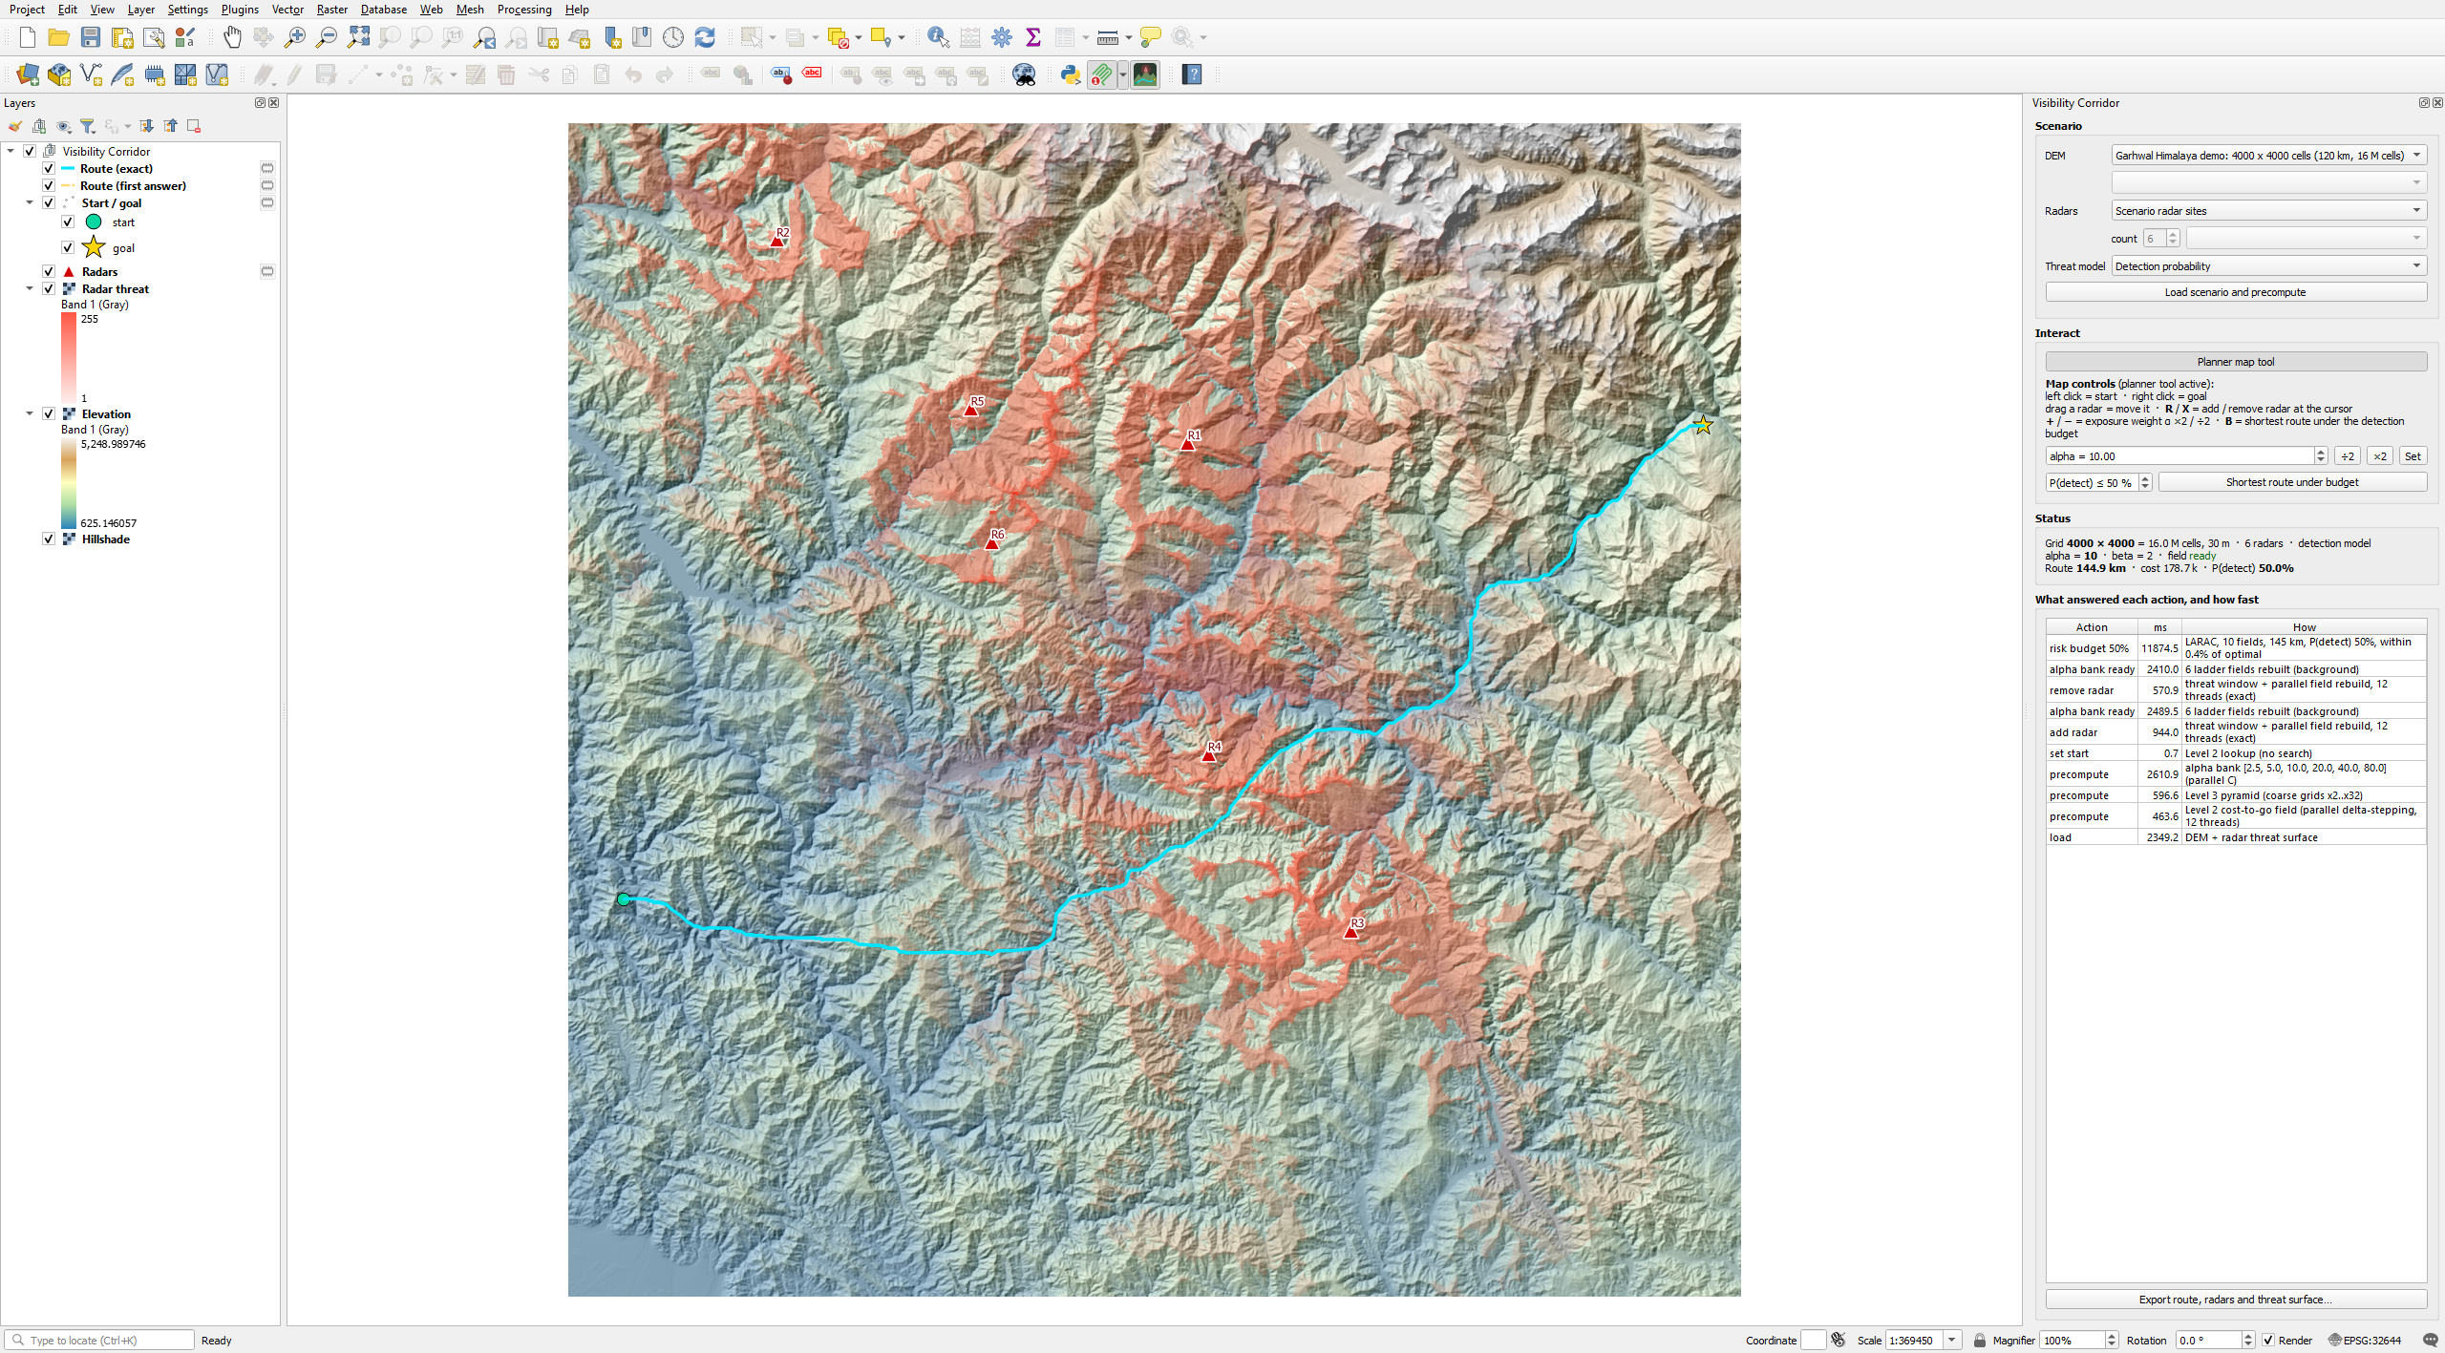
A QGIS plugin: the planner inside QGIS
TRACK 3 · DELIVERABLE
Install: Plugins → Install from ZIP (Windows; not open source).
Map: DEM, radar threat, radars, start/goal and routes are real QGIS layers.
Controls: left / right click start / goal, drag a radar, R / X add / remove, + / − α, B risk budget, live hover preview, α slider; wheel / middle-drag pan and zoom with live radar coverage of the view.
Panel: which level answered each action and how long it took.
Any DEM: bundled 1000 / 2000 / 4000 scenarios, or any DEM layer (lat/lon reprojected to UTM), radars from a point layer.
Export: route, radars and start/goal to GeoPackage, threat surface to GeoTIFF · the C solver ships as a DLL, without its source
Notes:
The matplotlib demo became a QGIS plugin: same engine, QGIS map canvas instead of a figure window. Every action is answered from precomputed structures or the parallel C solver in the background, so QGIS stays responsive.

Slide 33
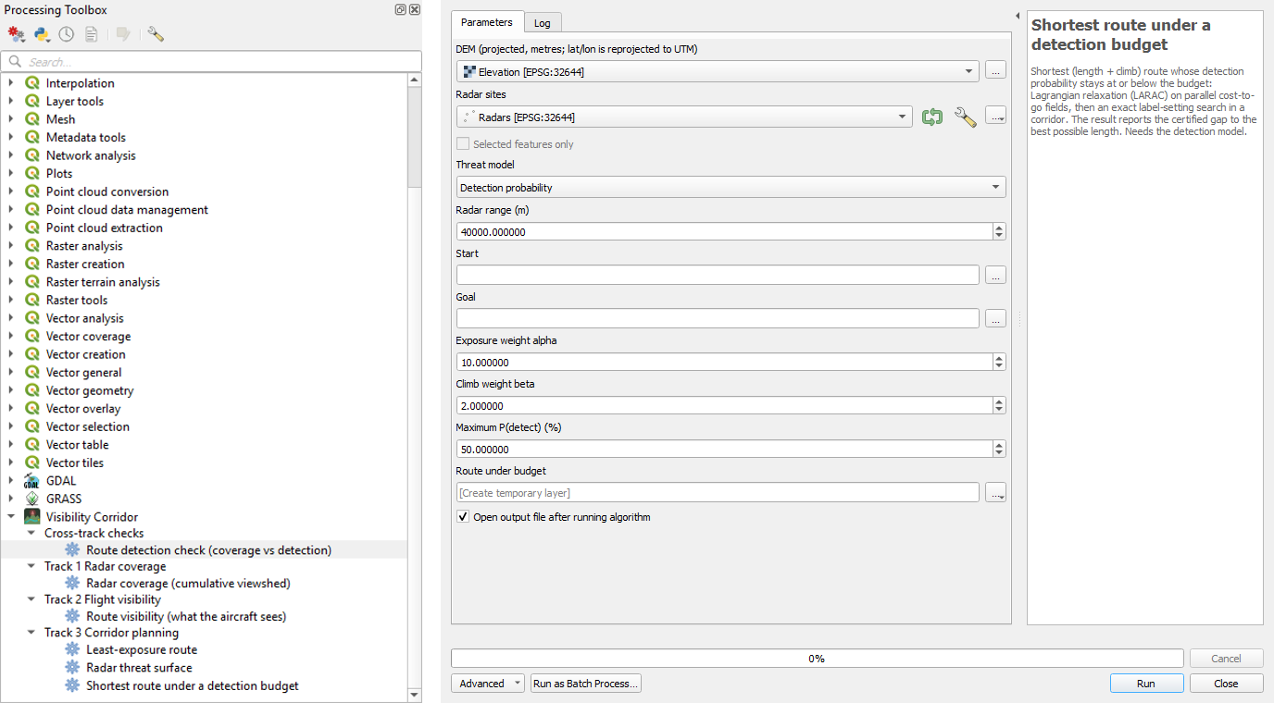
Our best algorithm per track as Processing tools
TRACK 3 · PROCESSING TOOLBOX
Tool | Track | Algorithm
Radar coverage | 1 | GDAL viewshed per radar, count
Route visibility | 2 | threaded window viewsheds (F6 best)
Radar threat surface | 3 | detection hazard or exposure
Least-exposure route | 3 | parallel C cost-to-go field, exact
Shortest route under a detection budget | 3 | LARAC + exact label search, certified
Route detection check | all | P(detect) + part outside coverage (= 0)
Usable in the Model Designer, batch mode and from Python, like any QGIS algorithm.
Notes:
These tools let anyone chain our algorithms with QGIS's own in a model, as in the Lecture 21 modelling activity.

Slide 34
Visibility Corridor in QGIS
LIVE DEMO
1 · Load the 120 km Garhwal scenario (~6 s) 2 · click starts, move the mouse: live preview 3 · right-click a goal 4 · drag a radar, R / X 5 · α slider, + / − 6 · B: route under 50% detection 7 · pan and zoom: live coverage 8 · Processing tool on another DEM
Notes:
Demo script. Fallback if anything fails: the screenshots on the previous slides and qgis_plugin/screenshots. Mention the timing panel after each action.

Slide 35
All three tracks on one dataset
INTEGRATION
Does every track agree with the others? Detection is checked against coverage, every route is scored by all tracks, and all benchmarks run on one machine.

Slide 36
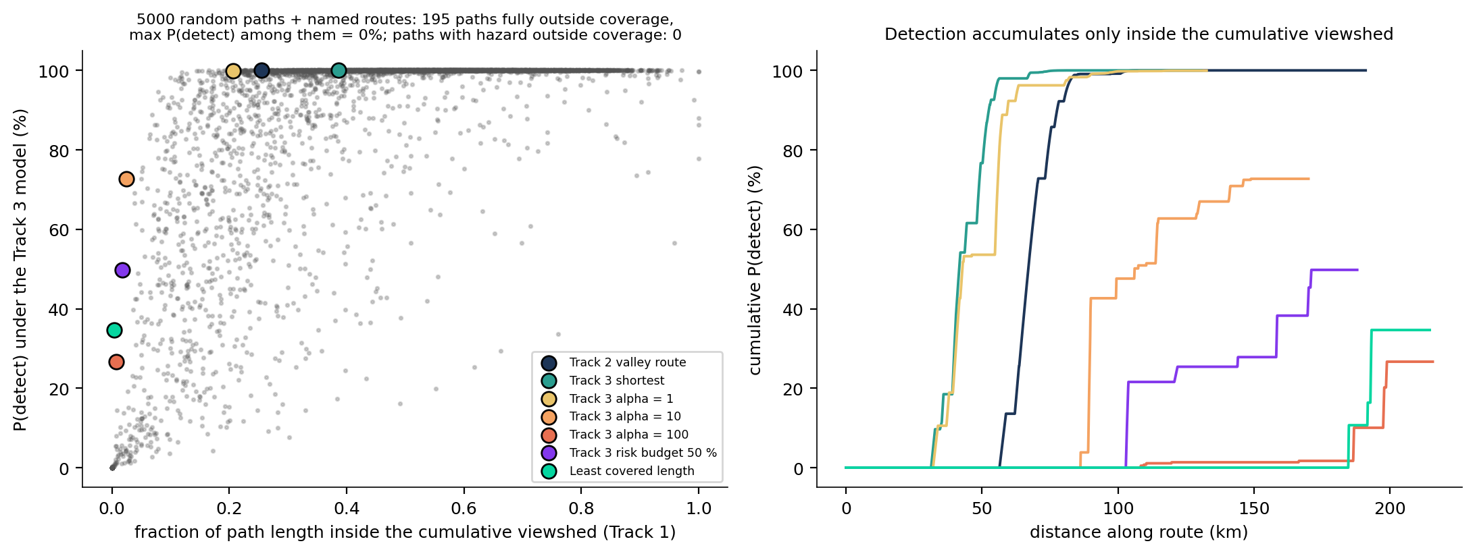
No detection outside the cumulative viewshed
CROSS-TRACK CHECK · TRACK 1 × TRACK 3
Check (16 M cells) | Result
Cells: Track 1 coverage = Track 3 hazard > 0 | 100.000% agree
Hazard outside coverage | 0 cells
Random paths fully outside (of 5,000) | 195, max P(detect) 0.00%
Paths with hazard outside coverage | 0
Fully hidden Devprayag → Joshimath route | none
A path the radars cannot see cannot be detected: the detection hazard is zero wherever Track 1's coverage of a 150 m aircraft is zero, checked cell by cell, on every named route and on thousands of random paths. The same check is a Processing tool.
Notes:
Both tracks use the same GDAL viewshed, mast and target heights and curvature; Track 1 also cuts coverage at exactly 40 km. Any disagreement would show at the range rim.

Slide 37
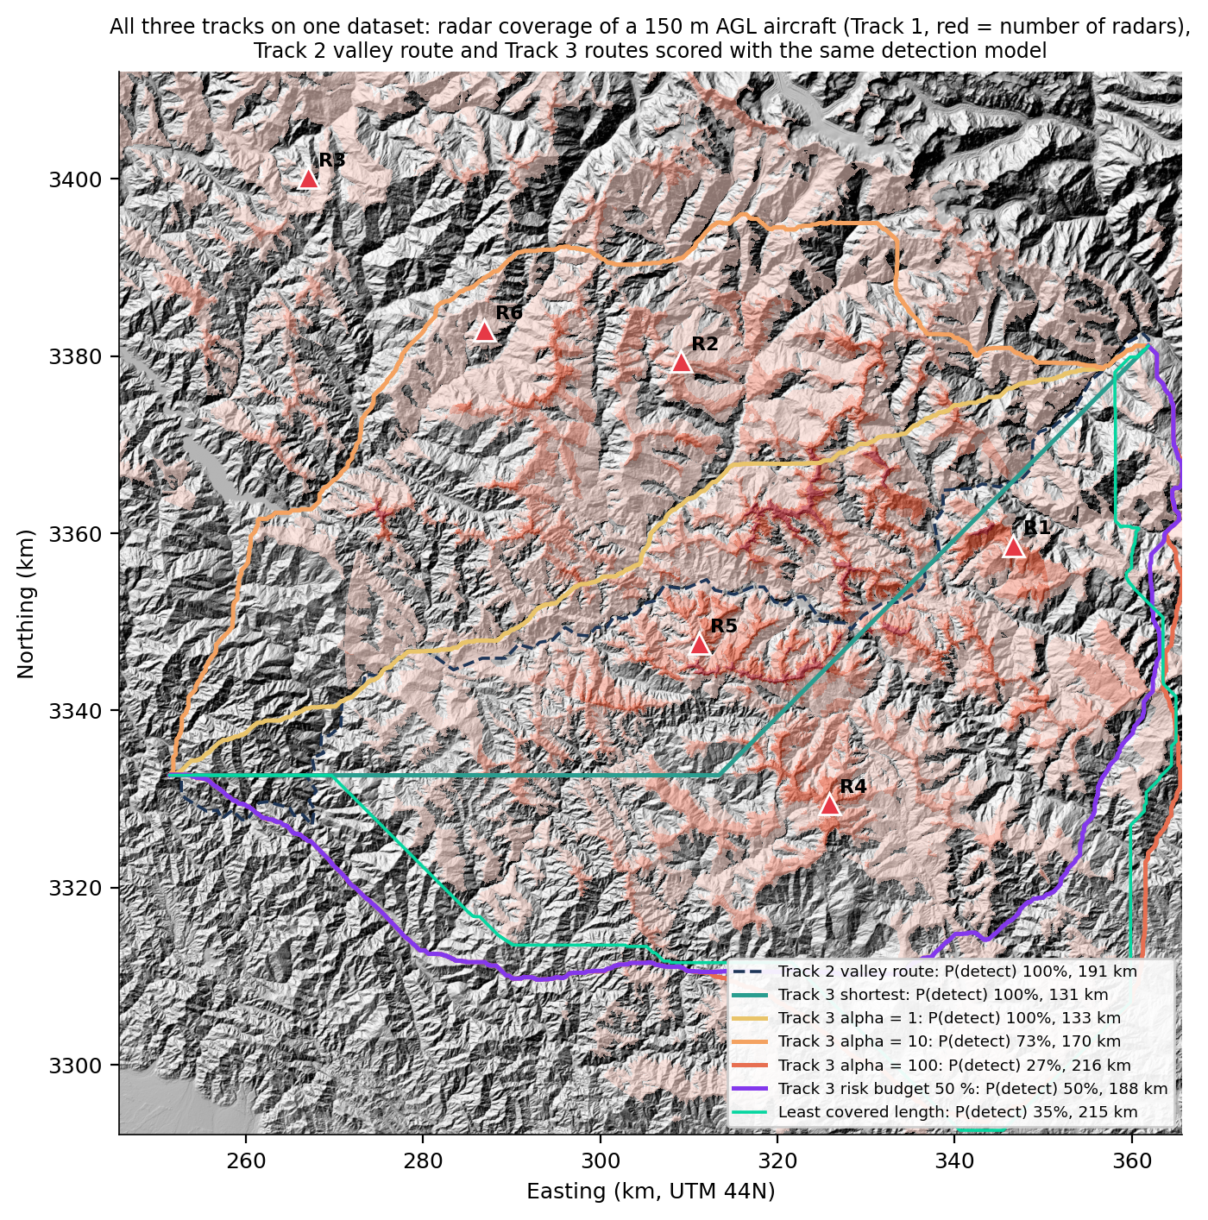
Hidden from the radars is not blind to the ground
CROSS-TRACK · EVERY ROUTE SCORED BY EVERY TRACK
Route | km | covered km | P(detect) | worst | aircraft sees km²
Track 2 valley | 191 | 49 | 100% | R1 | 1,205
Track 3 shortest | 131 | 50 | 100% | R1 | 2,169
Track 3 α = 10 | 170 | 4 | 73% | R2 | 2,456
Track 3 α = 100 | 216 | 2 | 27% | R1 | 2,320
Track 3 P ≤ 50% | 188 | 3 | 50% | R1 | 2,303
Least covered | 215 | 1 | 35% | R1 | 2,945
Track 1's radars and Track 3's detection model score each route; Track 2's engine measures the ground the aircraft itself sees (150 m AGL, 20 km). Hiding from six radar sites does not blind the aircraft: the least-covered route is detected with 35% probability yet sees 2,945 km², 2.4× the valley route.
Notes:
Worst = the radar contributing most detection. Covered km = length inside the cumulative viewshed.

Slide 38
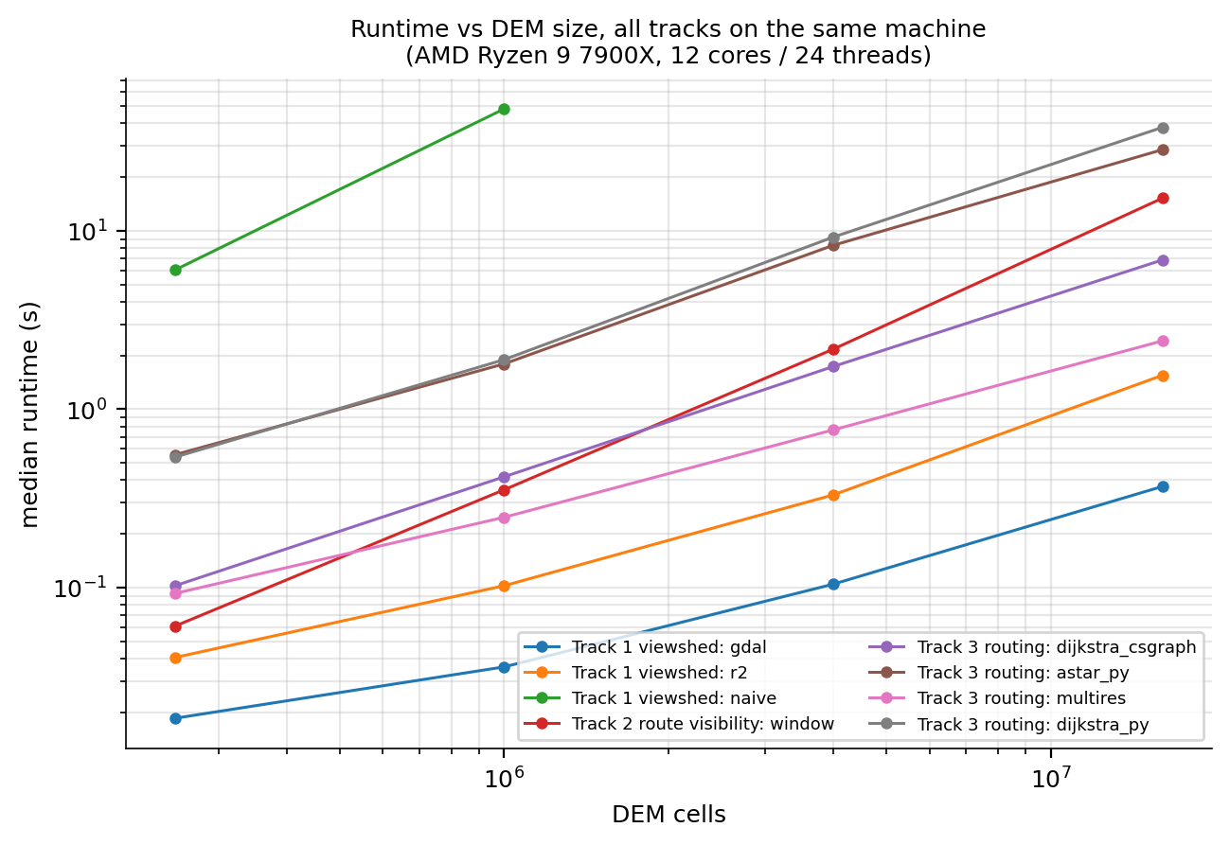
Three workloads, three cost drivers
CROSS-TRACK · SCALING ON ONE MACHINE
Track | Unit of work | Grows with | Exponent | Best lever
1 Radar | one viewshed | cells in range | 0.72 | range window, threads
2 Flight | viewshed per position | positions × radius² | 1.33 | threads, spacing per altitude
3 Corridor | graph search | nodes (N log N) | 1.01 | C on implicit grid, precompute
Raw runtimes across tracks are not a contest: they do different work. Comparisons that matter are within a track; across tracks we compare what drives the cost.
AMD Ryzen 9 7900X, 12 cores / 24 threads, 31.1 GB · Python 3.12.13, GDAL 3.13.1, NumPy 2.4.6
Notes:
Track 2 is many Track 1 problems; Track 3 adds a graph search on top of Track 1's viewsheds. Memory is set by the DEM in Tracks 1 and 2, by the graph representation in Track 3.

Slide 39
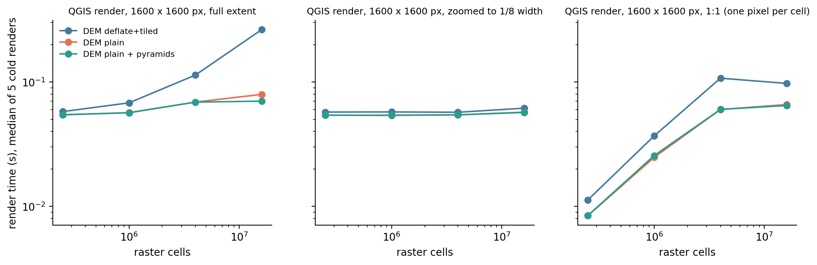
QGIS cost follows the screen, not the raster
VISUALISATION PERFORMANCE
Plain or pyramided rasters draw in tens of milliseconds at any size. Compressed tiled GeoTIFFs without pyramids grow with the raster at full extent (every tile is decompressed). Build pyramids for compressed outputs; the plugin keeps its threat layer in memory.
Notes:
Algorithm time and render time are measured separately; each render opens a fresh layer, so GDAL's block cache is cold.

Slide 40
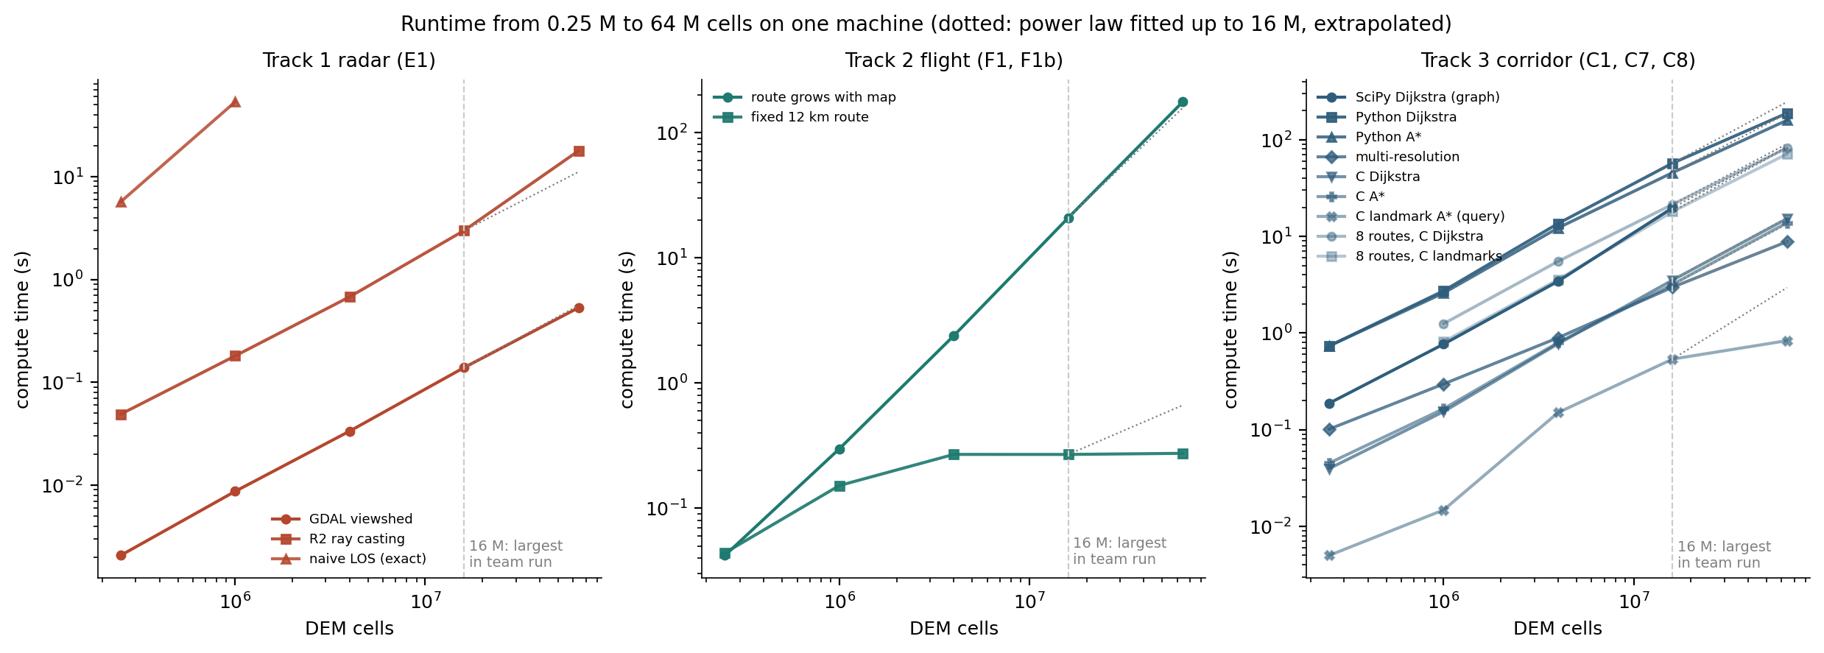
4× the largest map: the scaling laws hold, with two exceptions
SCALE TEST · 64 M CELLS, ALL THREE TRACKS
Method | 16 M → 64 M | 64 M measured | Predicted from ≤ 16 M
T1 GDAL viewshed | ×3.8 | 531 ms | 5%
T1 R2 ray casting | ×6.0 | 17.8 s | -38% (cache)
T2 route grows with map | ×8.4 | 2.9 min | -10%
T3 C Dijkstra / C A* | ×4.3 / ×4.3 | 15.2 s / 13.8 s | 2% / -3%
Notes:
Power law t = c·N^b fitted on 0.25–16 M cells, extrapolated to 64 M. R2's arrays stop fitting in cache; Track 2's route grows with the map, so its cost also picks up a map-size term.

Slide 41
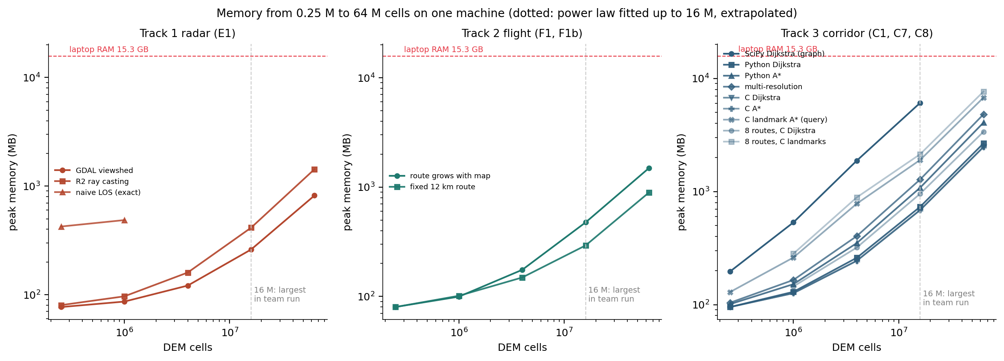
Memory, not time, decides what runs at 64 M cells
SCALE TEST · MEMORY
0–13%
~24 GB
2.4 GB
memory prediction error (base + bytes per cell)
SciPy graph at 64 M: not run on 15.3 GB
C Dijkstra: same job in 15.2 s
Notes:
Linux laptop, 15.3 GB · dem_8000: 8000 × 8000 cells, 240 × 240 km, same grid as the 500–4000 DEMs · results/linux64. Memory is a straight line in cells (a power law was 50% low). The explicit SciPy graph costs ~387 bytes per cell, the C solvers ~39.

Slide 42
What we learned
Track 1
Track 2
Track 3
Exact viewsheds cost N^1.5; R2 (bias fixed) and GDAL stay linear. Threads for many radars (4.2×). Greedy siting sees 29% more with the same six radars; seen is not detected.
Cost = positions × min(radius², map), fitted within 5%. Sharing the DEM across threads is fastest (exact); spacing should follow altitude. A real camera sees 5–18% of line of sight in the valley; ~8% of a low-flight coverage map is uncertain.
Precompute per goal and every start is a lookup; parallel C makes rebuilds sub-second; a certified risk budget; 4× less memory with direction codes; shipped as a QGIS plugin with Processing tools.
Across tracks: one pipeline on one machine, detection consistent with coverage, and every route scored by all three tracks.
Notes:
Limitations: one region and one DEM source; radar model is line of sight with a distance-based detection probability; the plugin is Windows-only because the solver ships as a DLL.

Slide 43
Questions?
THANK YOU
Code, results and the plugin ZIP in the team repository · run.bat -m integration.pipeline reproduces every number

Slide 44
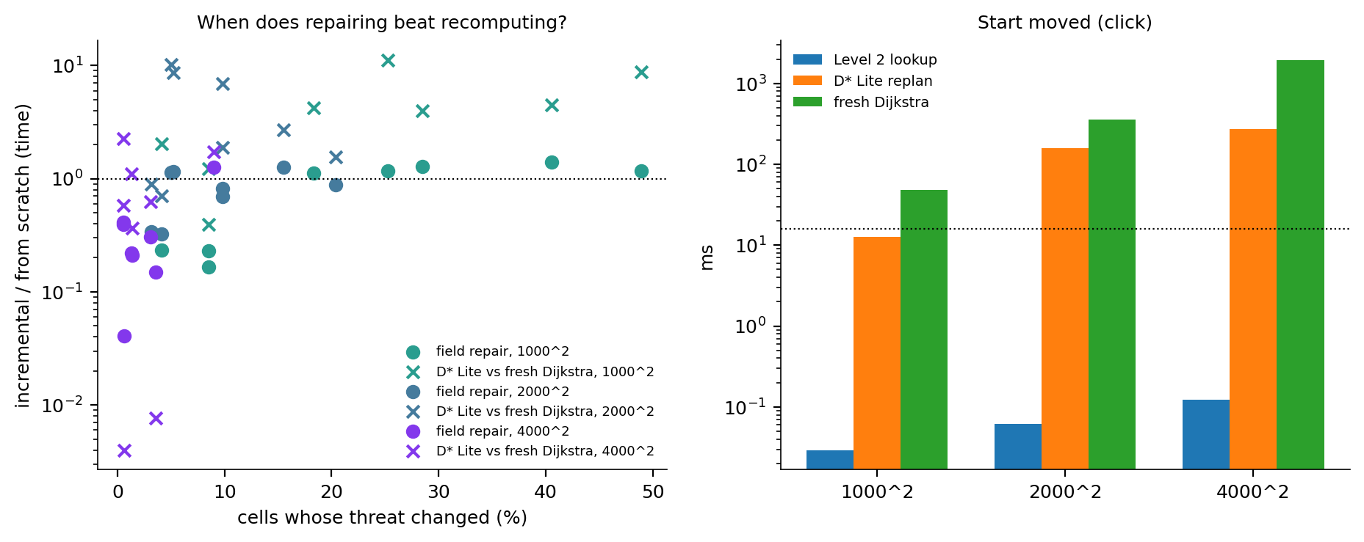
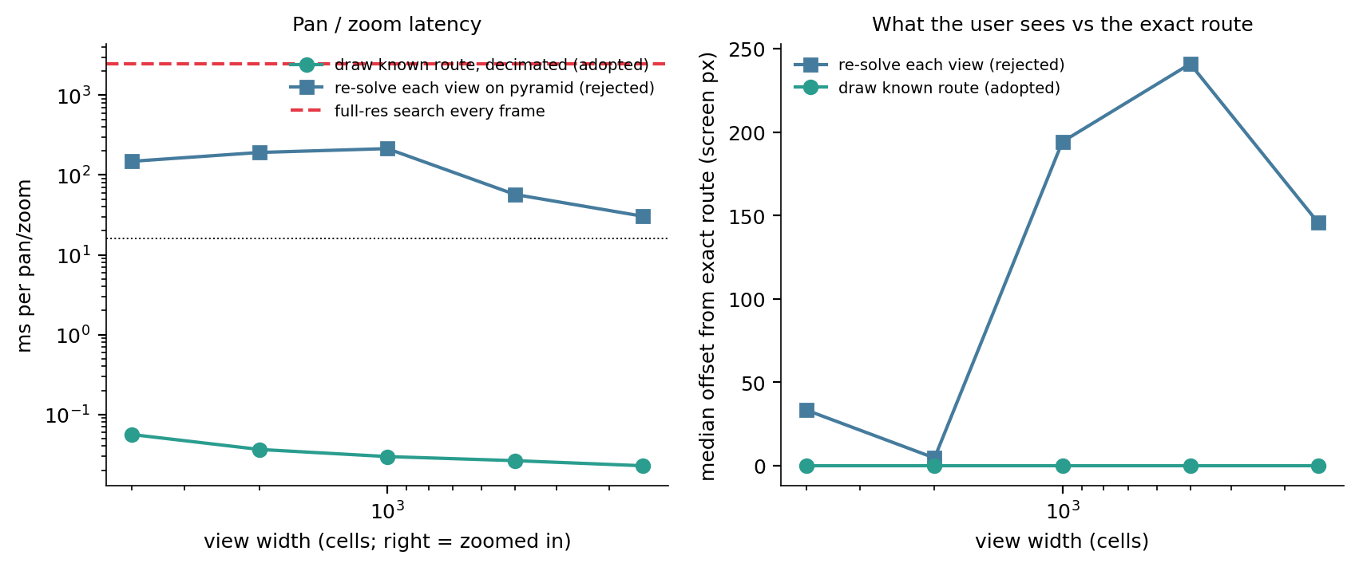
Recompute only what an edit invalidates
BACKUP · TRACK 3 EDITS AND PAN / ZOOM
Start moved
Field lookup ~0.1 ms vs 2.7 s Dijkstra; D* Lite often needs no work, but the lookup is simpler.
Radar dragged
Recompute that radar's viewshed window (~0.2 s), then rebuild the field in parallel (~0.4 s). Exact.
Pan / zoom
Never search: draw the known route. Re-solving each view: 30–240 ms and often the wrong valley.

Slide 45
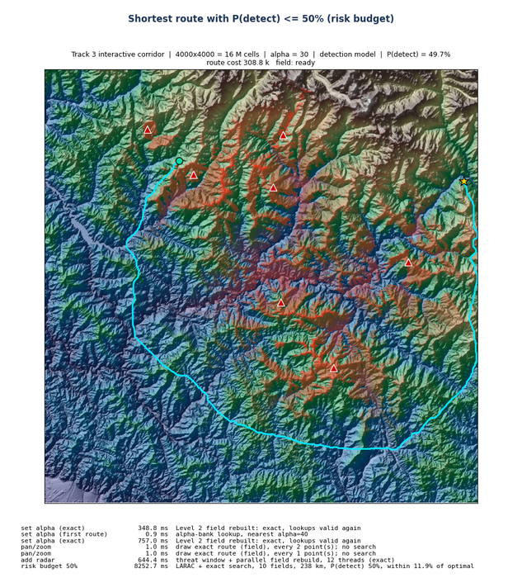
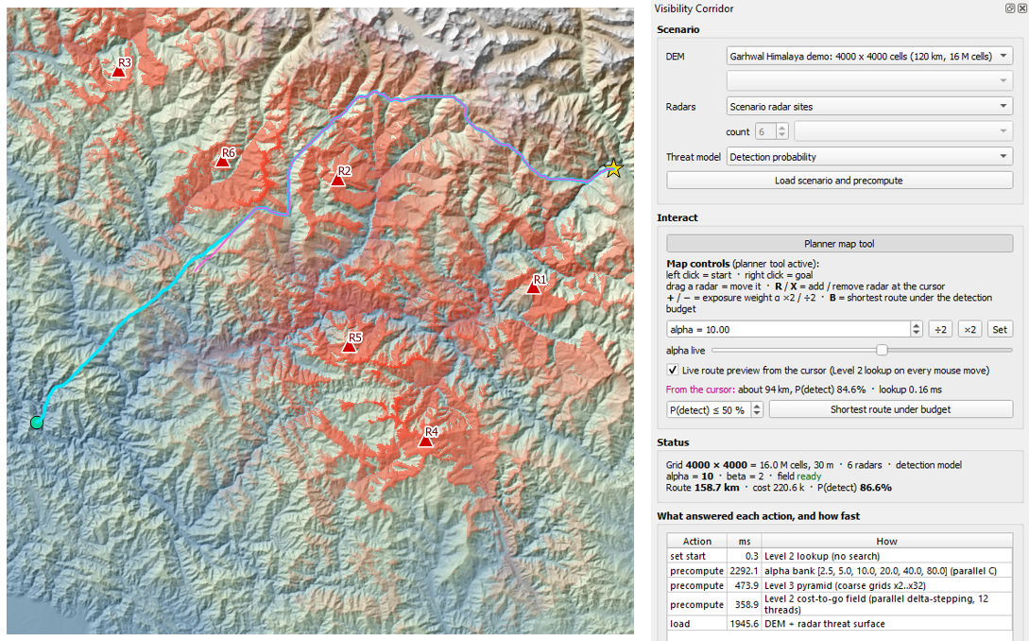
From the matplotlib viewer to the plugin with live preview
BACKUP · TRACK 3 INTERACTIVE VIEWER (BEFORE THE PLUGIN)

