Slide 1
Large-Scale Terrain Data Analysis 2
SPATIAL INFORMATICS · MID EVALUATION
Radar visibility, flight-route visibility and optimal visibility corridors over the Garhwal Himalaya
Track 1 Person 1 Track 2 Person 2 Track 3 Person 3
Notes:
Three team members, three terrain-visibility applications on one shared set of DEMs. The question across all three: how does the computational cost grow with terrain size and problem parameters, and which implementation choices help.

Slide 2
One terrain, three visibility problems
1
2
3
TRACK 1 · PERSON 1
TRACK 2 · PERSON 2
TRACK 3 · PERSON 3
Radar visibility
Flight-route visibility
Visibility corridor
Which terrain can a stationary radar see?
What does an aircraft see along its route, and what does it miss?
Which route keeps an aircraft hidden from the radars without a big detour?
Varies: DEM size, range, mast height, number of radars
Varies: DEM size, sample spacing, altitude, radius, route length
Varies: graph size, exposure weight, solver, trip length
Each track runs on its own; they share data and conventions, the radar sites (Track 1 → 3) and the route endpoints (Track 2 → 3).
Notes:
Each person owns all six phases for their track. Comparisons are made within a track; the three tracks do different work, so raw runtimes across tracks are not an algorithm contest.

Slide 3
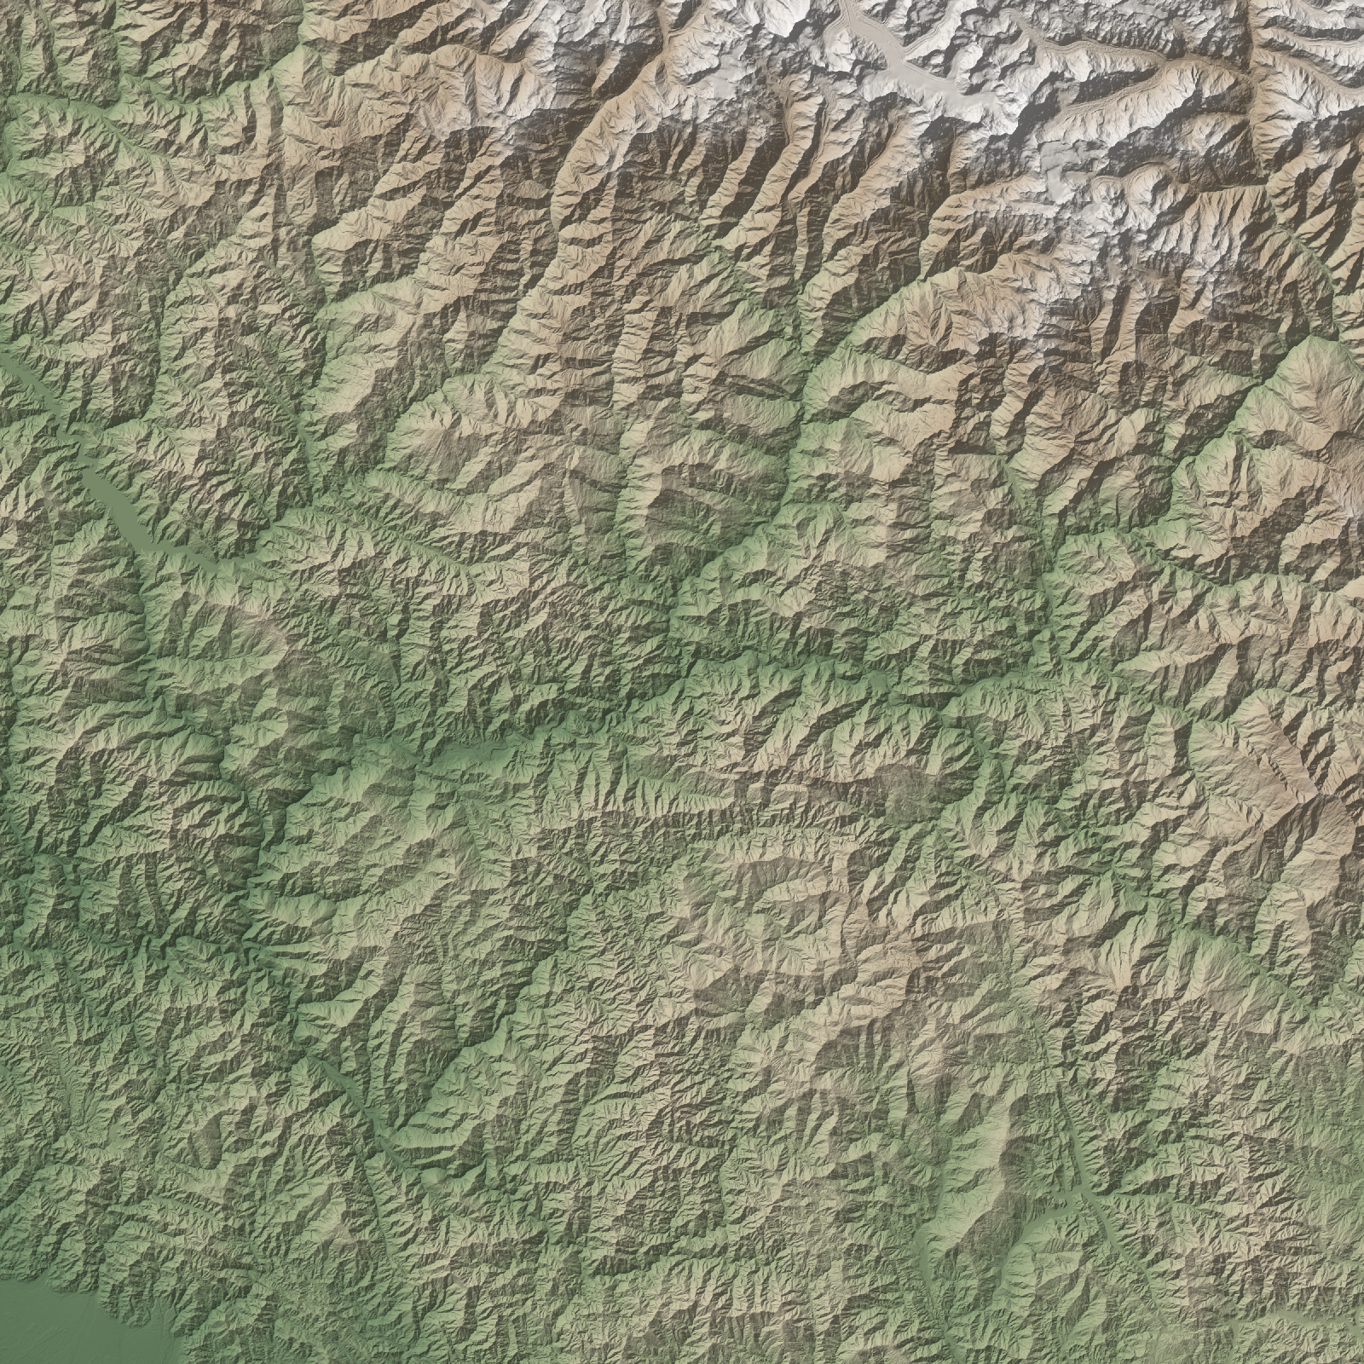
Shared data: Garhwal Himalaya
Copernicus GLO-30 DSM, UTM 44N (EPSG:32644), 30 m cells. Four square DEMs centred on Rudraprayag: coverage grows, resolution stays fixed.
DEM | cells | extent | elevation range
500 × 500 | 0.25 M | 15 km | 594–2,856 m
1000 × 1000 | 1 M | 30 km | 547–3,022 m
2000 × 2000 | 4 M | 60 km | 485–4,480 m
4000 × 4000 | 16 M | 120 km | 315–7,074 m
Plus flat, ridge, valley and cone synthetic terrains with known answers.
Notes:
Growing the extent at a fixed 30 m resolution is a clean size-scaling experiment, but bigger DEMs also reach the high Himalaya, so terrain gets more rugged with size.

Slide 4
How we measure
Dimension | Method
Execution time | Median of 5 runs, each in a fresh process; compute (algorithm only) kept apart from DEM reading
Peak memory | Peak working set of the process (Python + NumPy + GDAL alone is about 60 MB)
Scalability | DEM 500 → 4000 cells per side (0.25 M → 16 M cells), same 30 m cells, plus track parameters
Complexity | Slope of log(time) vs log(size), compared with the theoretical big-O
Visualisation | QGIS load and render time at 1600 × 1600 px, full extent and zoomed, with and without pyramids
Accuracy | Synthetic terrains with known answers, an exact reference, and agreement / kappa / Jaccard / cost gap
AMD Ryzen 9 7900X (12 cores), 31 GB RAM, Windows 11 · QGIS 3.44.12, GDAL 3.13.1, Python 3.12, NumPy 2.4 · every raw run kept in CSV
Notes:
Each benchmark run is a new Python process so memory from an earlier run does not leak into the next. Slowest baselines run 1 to 3 times and are extrapolated with the fitted exponent.

Slide 5
Three ways to compute a viewshed
TRACK 1 · RADAR VISIBILITY
Algorithm | Idea | Cost | Role
Naive line of sight | Sample the profile to every cell every half cell; blocked if anything rises above the sight line | O(N·√N) | exact reference
R2 ray casting | One ray to each boundary cell, each keeps a running horizon (our NumPy code) | O(N) | own fast method
GDAL viewshed | C++ reference-plane algorithm (Wang et al.) | O(N) | production engine
Same model for all three
Radar on a 30 m mast; a cell is visible if its surface (or an aircraft 150 m above it) is in line of sight; Earth curvature with refraction k = 1/7; output 1 visible / 0 blocked / 255 out of range.
Notes:
All three share one interface (radar/viewshed.py) so the benchmark can swap them. The naive method is slow but exact, so it is our truth for accuracy.

Slide 6
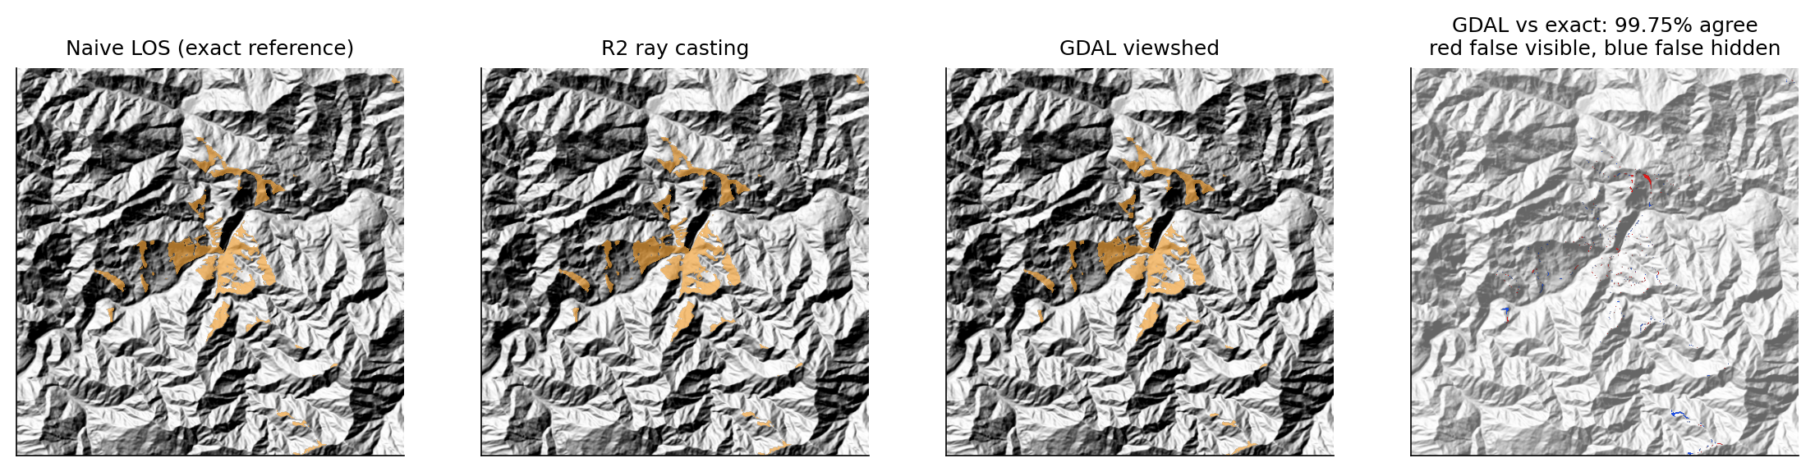
All three agree with the exact answer
TRACK 1 · VALIDATION
Test | Naive | R2 | GDAL
Flat plane: all visible | 100% | 100% | 100%
V valley: all visible | 100% | 100% | 100%
200 m wall: hidden behind | 100% | 100% | 100%
Real DEM, agreement with exact | ref. | 99.7% | 99.8%
Kappa vs exact | ref. | 0.957 | 0.965
The few mismatches sit on grazing ridge edges. A bug caught by the valley test: the first R2 scored 84.7% because it tested the cell centre against a horizon built from interpolated ray points; testing the ray point itself fixed it.
Notes:
Synthetic terrains have analytical answers; on the real 500 x 500 DEM the exact line-of-sight method is the reference. Kappa corrects agreement for chance, which matters because most cells are hidden.

Slide 7
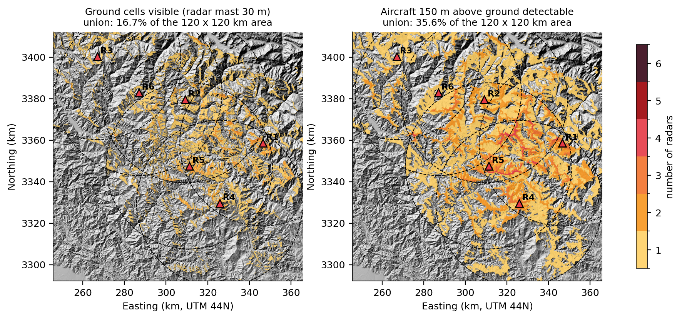
Six ridge-top radars see one sixth of the ground
TRACK 1 · SCENARIO
16.7%
of the ground visible to at least one radar
35.6%
where an aircraft 150 m up would be seen
Each radar sees 4–14% of the ground within its 40 km range.
Sites: highest point within 3 km, 1,500–3,200 m, at least 22 km apart · 30 m masts · 40 km range
Notes:
Deep valleys hide most of the terrain even from ridge tops. The aircraft layer is what Track 3 tries to avoid.

Slide 8
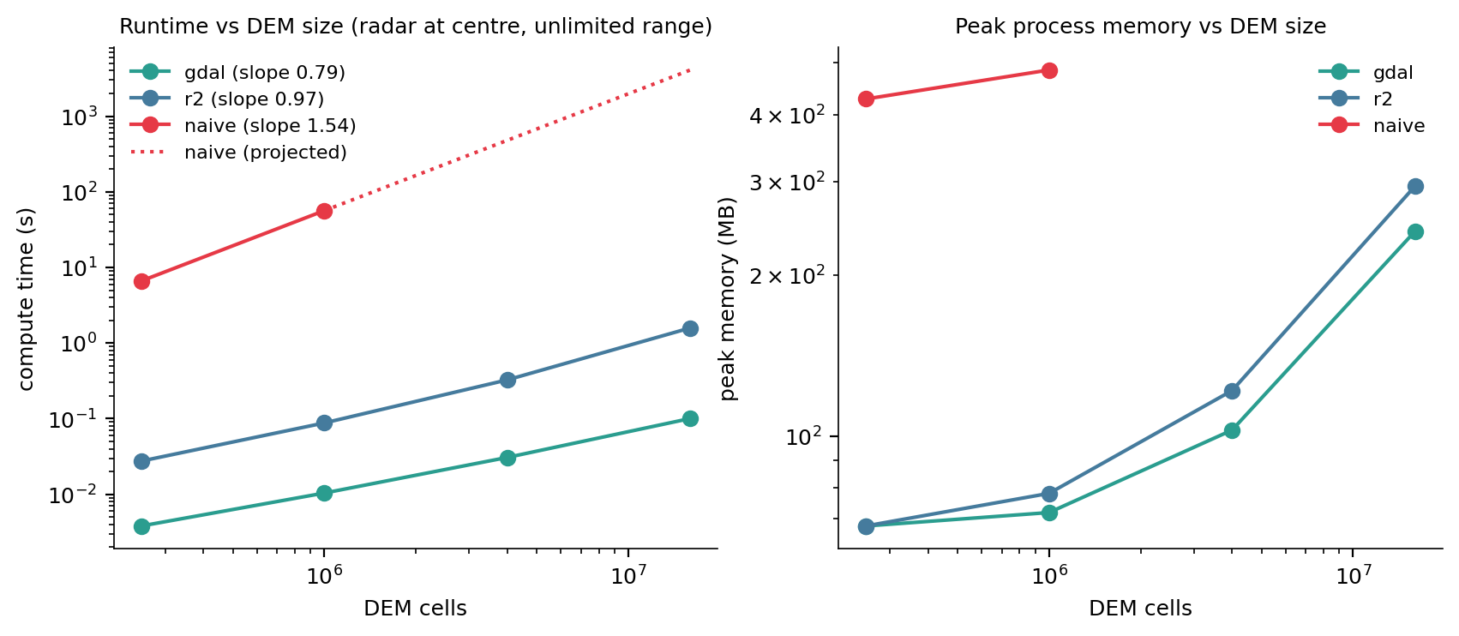
Exact costs N^1.5; the fast methods stay linear
TRACK 1 · SCALING (E1)
~68 min
exact method, 16 M cells (projected)
0.10 s
GDAL, same DEM, 99.8% agreement
Fitted slopes: naive 1.54, R2 0.97, GDAL 0.79 (theory 1.5, 1, 1).
Radar at the DEM centre, unlimited range · median of 5 runs (naive: 3) · GDAL peak memory 68 → 242 MB
Notes:
Naive ran on 0.25 M and 1 M cells (6.6 s and 56 s); beyond that we extrapolate with its fitted slope. GDAL's slope is under 1 because fixed overheads dominate the smallest DEMs.

Slide 9
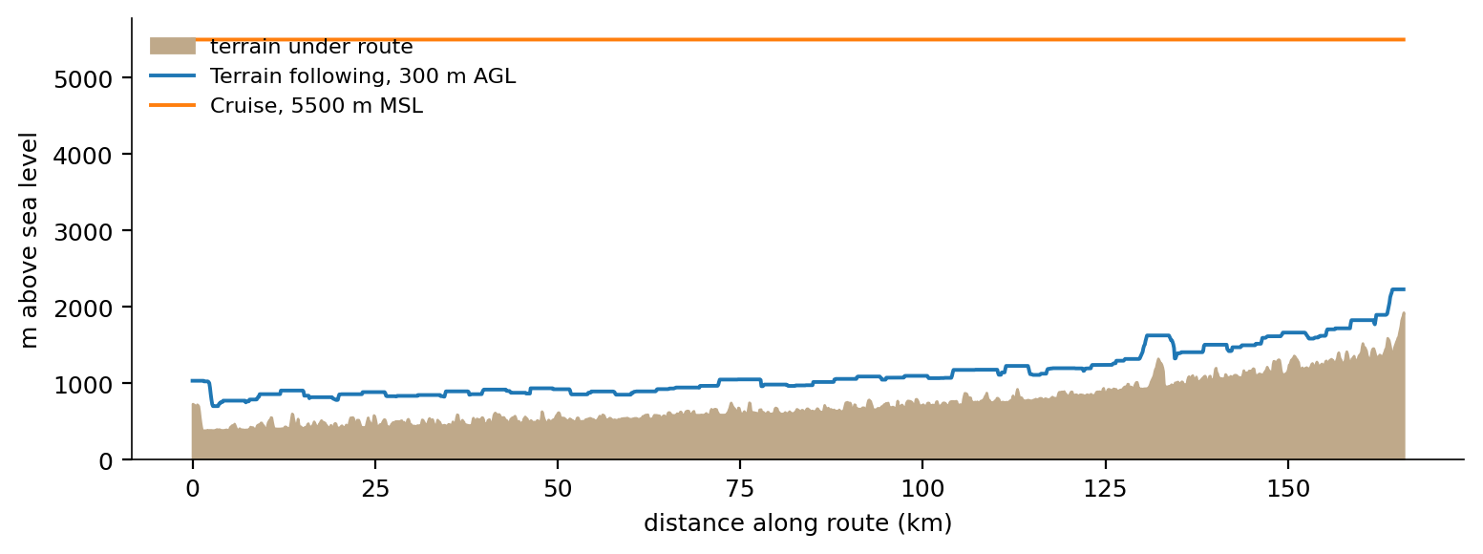
A moving observer = many viewsheds, aggregated
TRACK 2 · FLIGHT-ROUTE VISIBILITY
1 · Route
2 · Altitude
3 · Sample
4 · Aggregate
166 km up the Alaknanda valley, Devprayag → Joshimath: least-elevation path between the towns
Terrain following 300 m above a smoothed ground, or a constant 5,500 m cruise
A position every 1 km (167), a viewshed within a 20 km sensor radius at each
Times seen per cell, first position that sees it, new area per position, blind spots
Notes:
The altitude profile is computed once at 100 m spacing and interpolated, so coarse and dense sampling fly exactly the same path; that makes the comparison of sampling densities fair. Same GDAL engine and curvature model as Track 1.

Slide 10
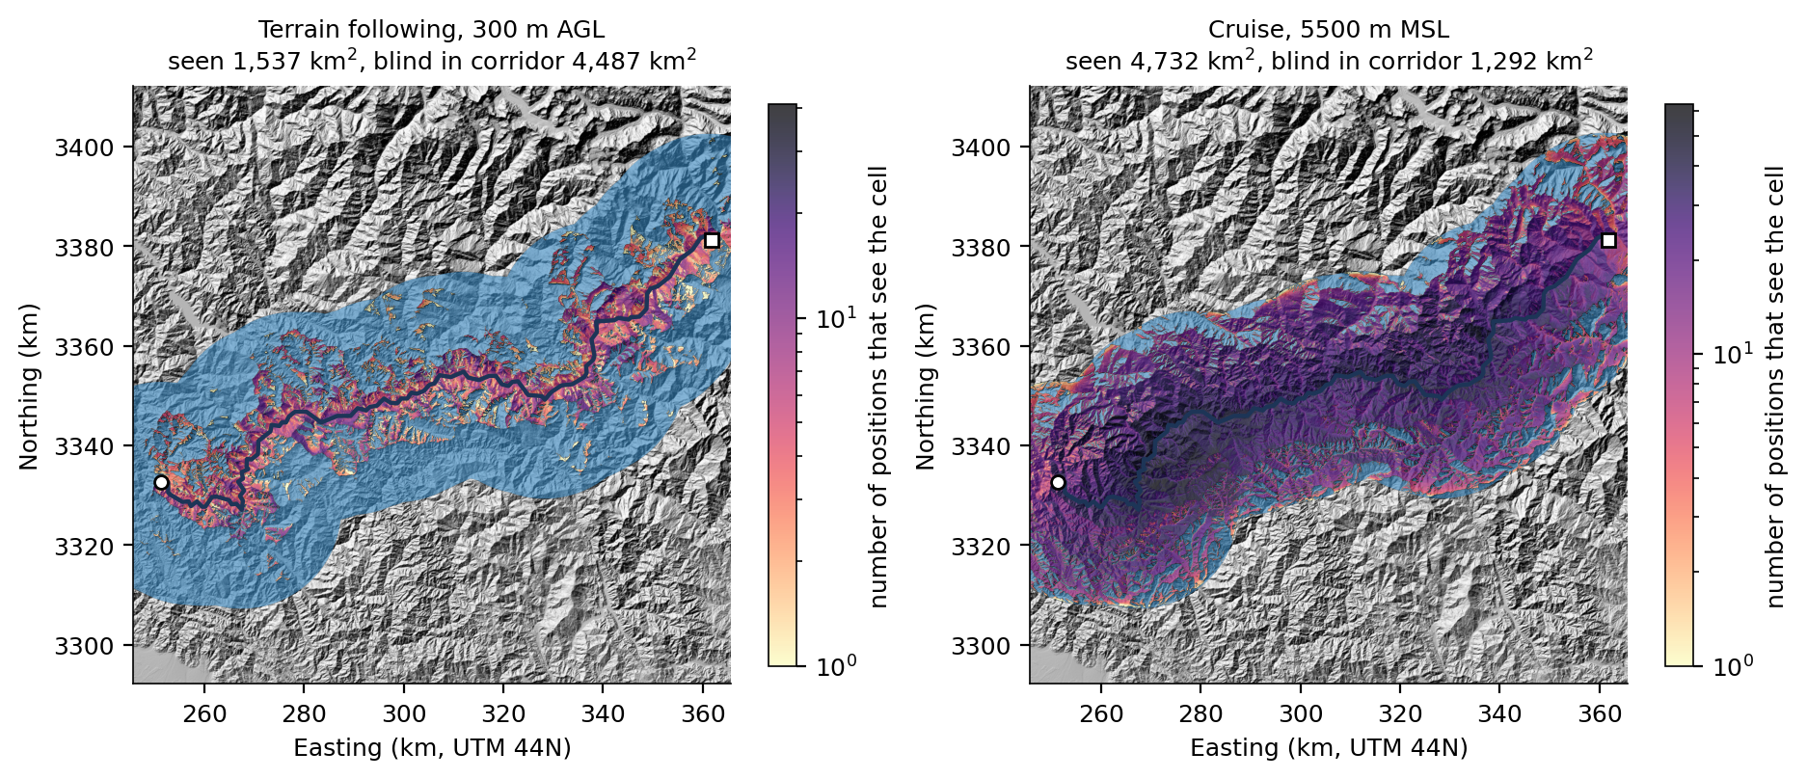
Valley flying sees a quarter of the corridor
TRACK 2 · SCENARIO
26%
of the corridor seen at 300 m above ground (1,537 km²)
79%
seen cruising at 5,500 m (4,732 km²)
167 viewsheds in about 4.5 s.
Corridor = 6,024 km² within 20 km of the route · blue = blind spots (in the corridor, never seen)
Notes:
The valley walls hide almost everything beyond the first ridge from a low aircraft: good for staying hidden, bad for surveillance. That trade-off is what Track 3 optimises.

Slide 11
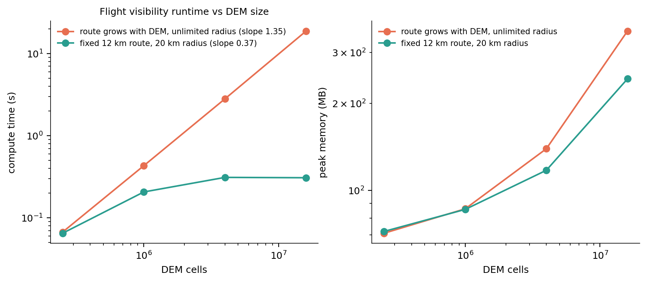
Cost = positions × cells per viewshed
TRACK 2 · SCALING (F1)
Route and radius grow with the DEM: 13 → 97 positions, each covering the whole DEM; 0.07 → 18.8 s, slope 1.35 (theory 1.5).
Fixed 12 km route, 20 km radius: 0.07 → 0.31 s, flat once the DEM is bigger than the radius.
Median of 5 runs (3 at 16 M cells) · 1 km spacing · peak memory 71 → 356 MB
Notes:
DEM size alone does not drive the cost; the number of positions and the area each viewshed covers do.

Slide 12
Stay hidden from the radars, without a big detour
TRACK 3 · OPTIMAL VISIBILITY CORRIDOR
Exposure of an aircraft 150 m above each cell: sum over the six Track 1 radars that can see it of (1 − distance / 40 km).
Solver | Notes
Dijkstra (Python) | binary heap, stops at goal; baseline
A* (Python) | straight-line distance + β·height still to climb: admissible and consistent
Dijkstra (SciPy, C) | explicit sparse graph, build timed
Multi-resolution | 4× coarser search, then A* in a buffer around it; approximate
c(u,v) = L · (1 + α · mean exposure) + β · climb
8-connected 30 m grid. α trades exposure for distance; β = 2 penalises climbing; ground + 150 m above a 5,000 m ceiling is blocked. α = β = 0 is the shortest path.
Notes:
We chose visibility OF the aircraft FROM ground radars, so Track 3 reuses Track 1's radar sites and engine. All exact solvers return identical costs at every size.

Slide 13
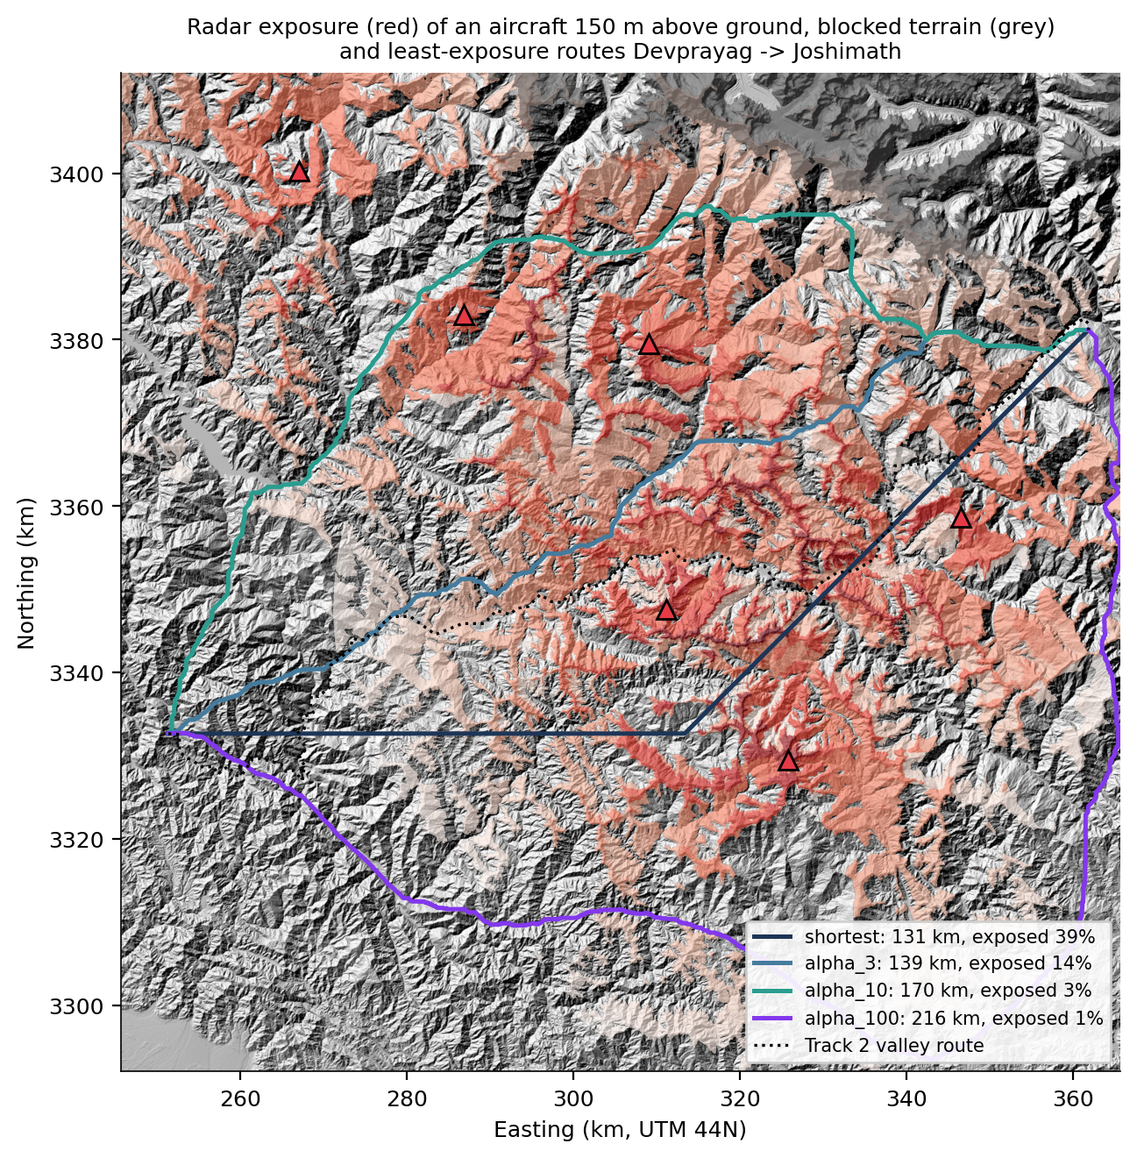
30% longer, 93% less exposure
TRACK 3 · SCENARIO
Devprayag → Joshimath | length | exposed | exposure
Shortest (α = 0) | 131 km | 39% | 31.5
Track 2 valley route | 178 km | 26% | 26.5
α = 3 | 139 km | 14% | 8.1
α = 10 | 170 km | 3% | 2.2
α = 100 | 216 km | 1% | 0.5
A* and Dijkstra return the identical optimum (234,906 cost units). Exposed = share of the route visible to at least one radar.
Notes:
Exposure = segment length times weighted exposure, in km. The shortest route is an L because on an 8-connected grid many paths tie on length. Beyond alpha 30 the route only gets longer: diminishing returns.

Slide 14
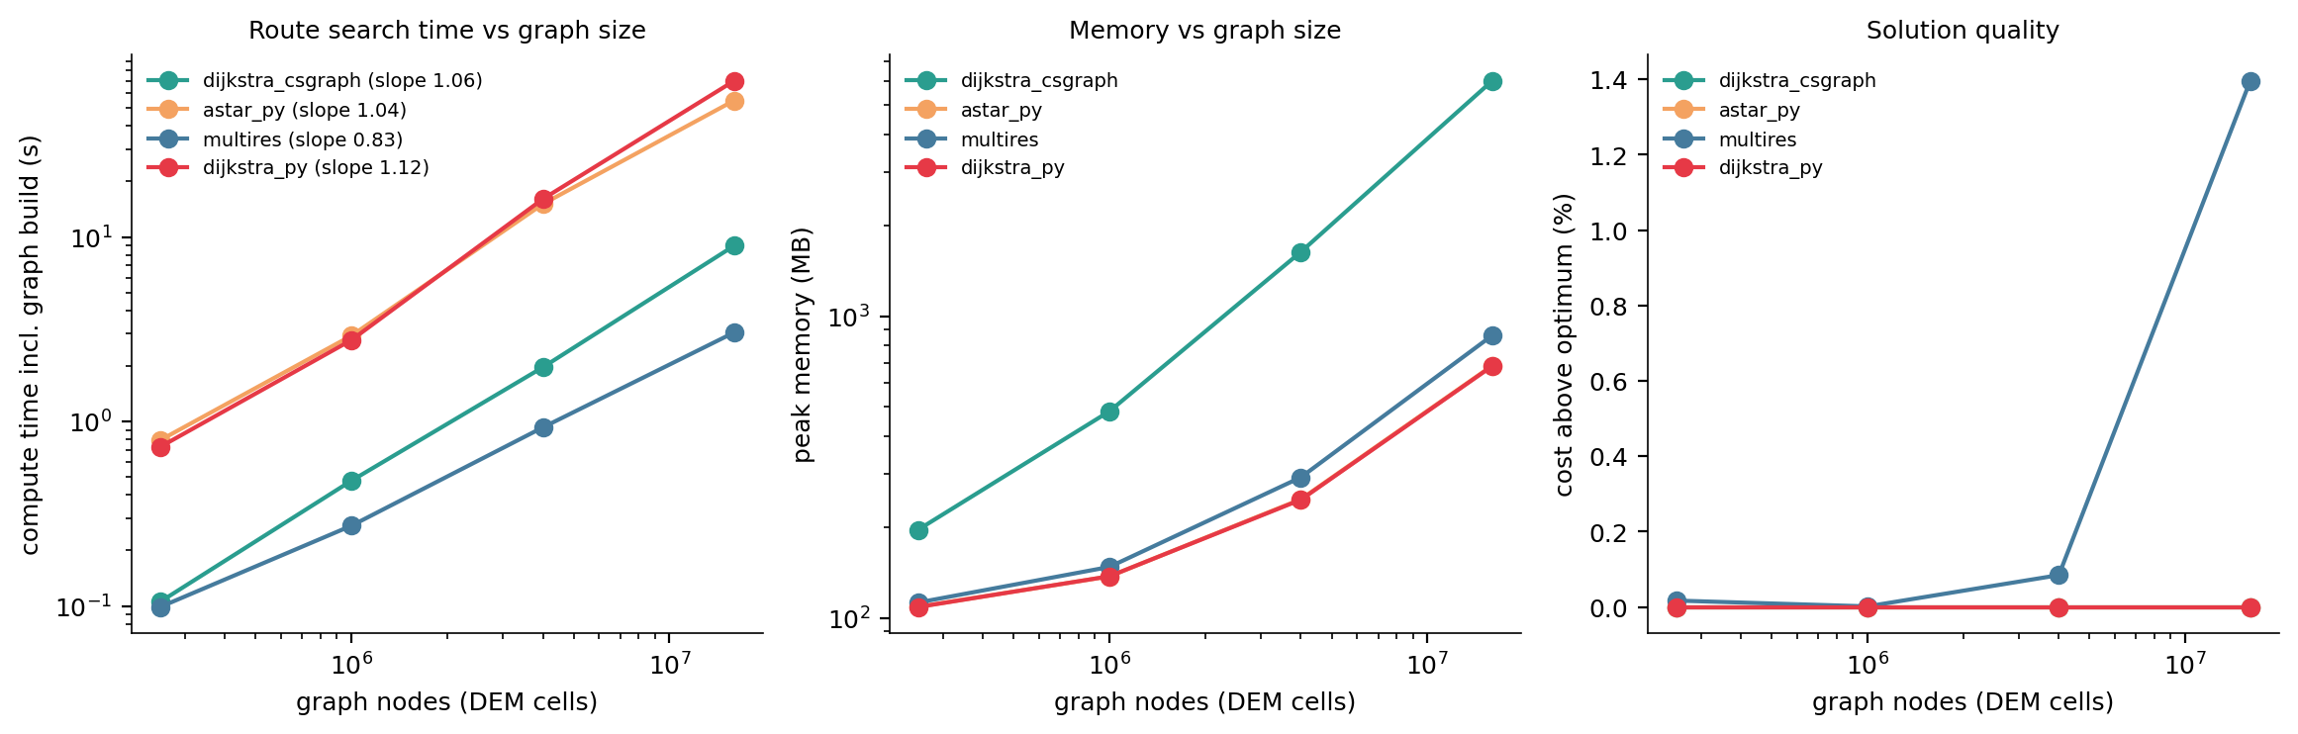
C is 8× faster, but needs 9× the memory
TRACK 3 · SCALING (C1)
16 M nodes | Dijkstra (Python) | A* (Python) | SciPy (C) | Multi-resolution
Time · peak memory | 70.2 s · 683 MB | 55.0 s · 685 MB | 9.0 s · 6.0 GB | 3.0 s · 863 MB
Cost above optimum | 0 | 0 | 0 | 1.4%
Notes:
All exact solvers scale close to linearly (slopes 1.04 to 1.12, theory N log N). The C solver needs the whole graph as a sparse matrix: 128 M edges.

Slide 15
Where we are
Phase | Track 1 | Track 2 | Track 3
0 · Shared data and protocol | done | done | done
1 · Research and design | done | done | done
2 · Implementation + checks | done | done | done
3 · Visualisation (maps, QGIS) | done | done | done
4a · Scaling vs DEM size | E1 done | F1 done | C1 done
4b · Parameter studies | range, height, radars | spacing, altitude, radius | α, trip length
5 · Optimisations | clipping, threads, resolution | caching, threads, sampling | landmark A*, C, multi-res
6 · Analysis, rendering, report | final | final | final
Green rows = this mid-submission (about 50%). The rest is planned for the final; first results are in the backup slides.
Notes:
Mid-submission scope: phases 0 to 3 and the first scaling benchmark for every track. Phases 4b, 5 and 6 are the second half.

Slide 16
Parameter studies, optimisations and rendering
BACKUP · BEYOND THE MID-SUBMISSION
Already run; shown only if asked. These belong to the final submission.
Notes:
Skip these in the mid presentation unless the evaluators ask what comes next.

Slide 17
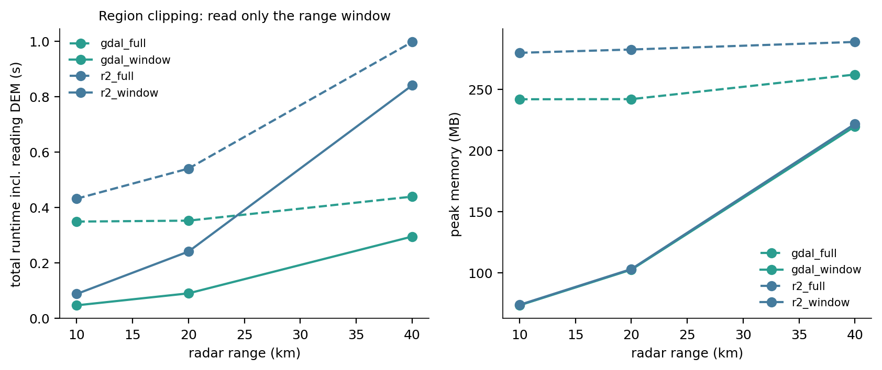
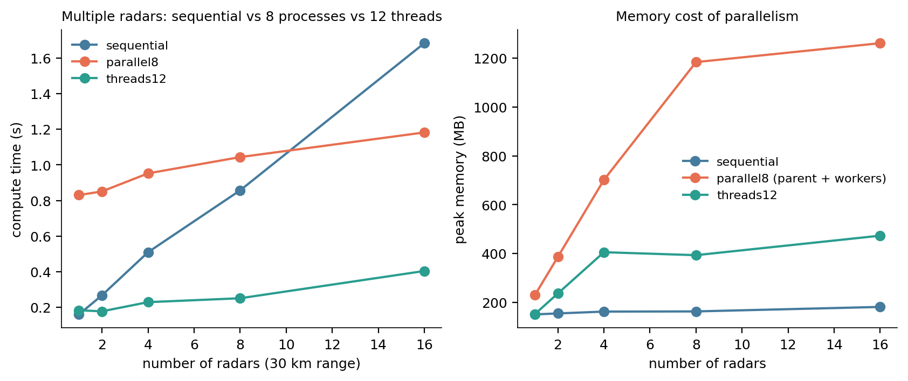
Read less, and use threads, not processes
BACKUP · TRACK 1 OPTIMISATIONS
Optimisation (DEM 4000) | Result | Cost
Read only the range window | 10 km: 0.35 → 0.05 s, 242 → 73 MB | none; identical output
12 threads, many radars | 16 radars: 1.68 → 0.40 s (4.2×); wins from 2 radars | ~0.5 GB, windows held together
8 processes (first try) | slower up to 8 radars; 1.4× at 16 | ~0.8 s start-up, 1.2 GB
Coarser DEM (60/90/120 m) | compute 0.10 → 0.03 / 0.016 / 0.010 s | kappa 0.90 / 0.83 / 0.78
Notes:
On Windows each worker process starts from scratch and re-imports NumPy and GDAL (about 0.8 s) and copies results back. GDAL releases Python's lock inside the viewshed, so threads run in parallel with neither cost. Range: compute time slope 1.38 (GDAL) and 1.12 (R2). Mast height changes coverage, not cost.

Slide 18
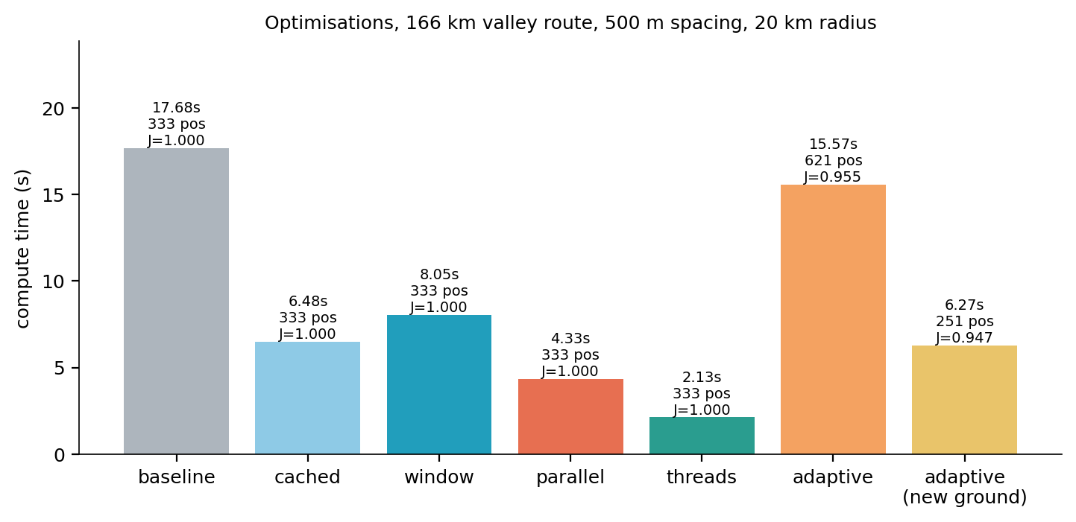
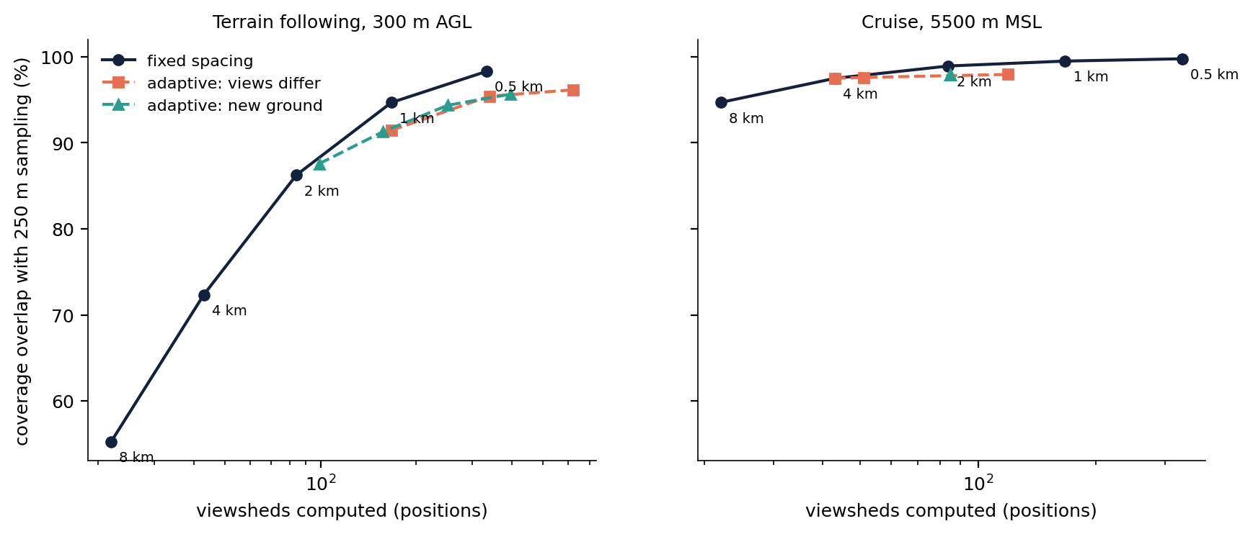
8× faster with threads; spacing should follow altitude
BACKUP · TRACK 2 OPTIMISATIONS
Speed: 333 viewsheds on the 166 km route take 17.7 s re-reading the DEM, 6.5 s cached, 4.3 s with 8 processes and 2.1 s with 12 threads (identical result).
Sampling: adaptive refinement never beat fixed spacing. The real lever is altitude: at cruise, 4 km spacing keeps 97.5% of the coverage with 43 viewsheds; valley flying needs 500 m (333).
Notes:
Adaptive v1 refined where neighbouring viewsheds look different; in a winding valley they always do (621 positions). v2 refines only where the midpoint sees new ground: 251 positions at 94.7% overlap, still on or below the fixed-spacing curve. Coverage grows smoothly along the route, so uniform spacing is already efficient.

Slide 19
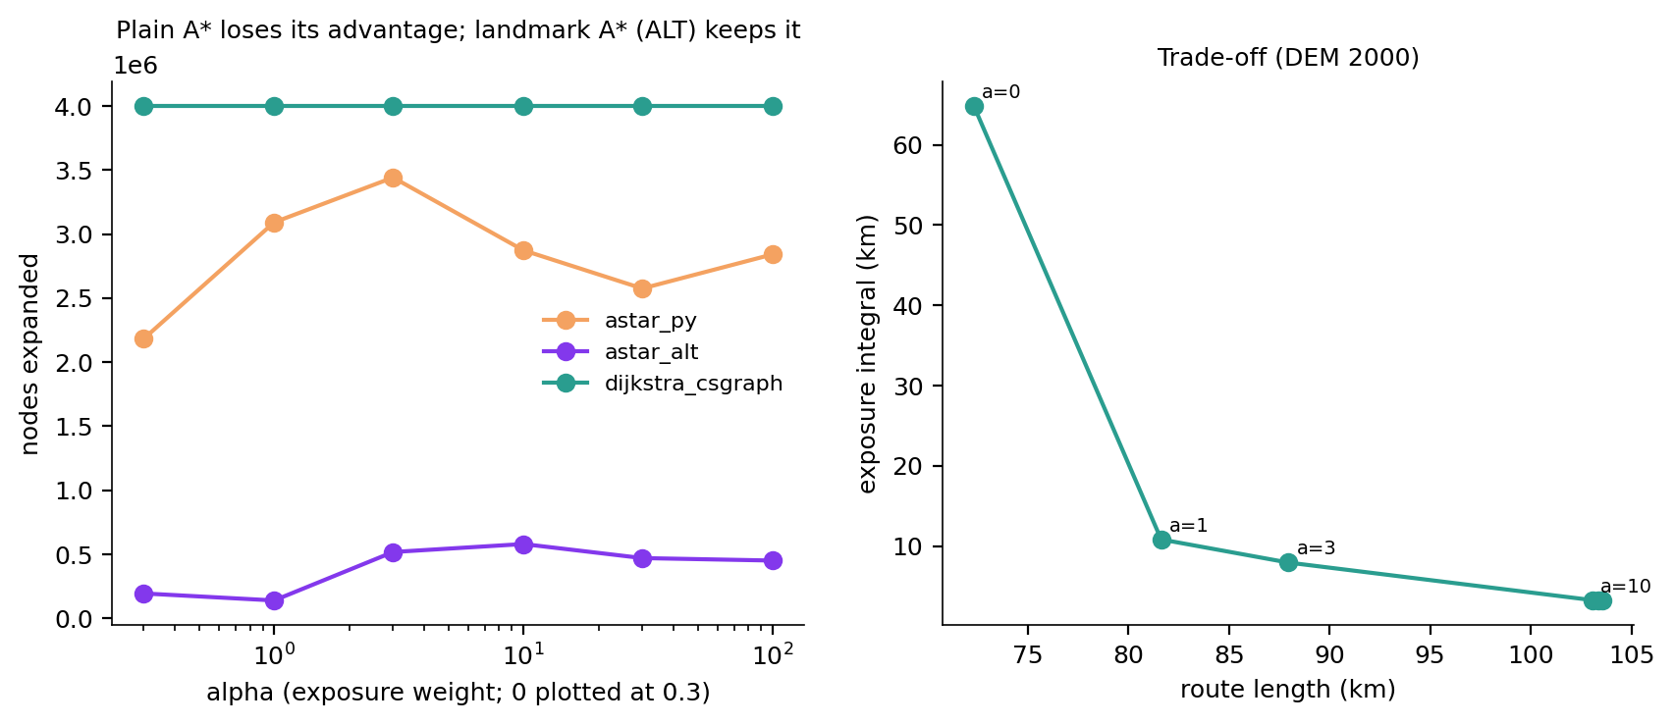
Fixing A*: a heuristic that knows about the radars
BACKUP · TRACK 3 OPTIMISATIONS
Problem: straight-line distance assumes 1 cost unit per metre; exposed metres cost 5–17. The guess is far too low, so A* searched 64–86% of the map.
Fix (ALT): exact costs to 4 landmarks, precomputed once; the triangle inequality gives a much tighter guess that is still admissible.
Same optimal route | Plain A* | Landmark A* | C Dijkstra
4 M nodes, α = 1–100 | 2.6–3.4 M nodes, 8–12 s | 0.14–0.58 M, 0.8–2.0 s | all 4 M, 1.7–1.9 s
16 M nodes, scenario | 14.3 M nodes, 67 s | 4.6 M, 22 s (+37 s once) | all, 9 s · 6 GB
Notes:
Landmark A* returns the same cost as Dijkstra in every case and searches 3.5 to 15% of the nodes, yet in Python it only matches the C Dijkstra per route (8 routes on 16 M nodes: 6.1 s vs 4.4 s each) because Python costs far more per node. Next step: the same algorithm in compiled code. Multi-resolution stays the fastest approximate option (16 M nodes: k = 4, 2.1 s, 1.4% above optimum).

Slide 20
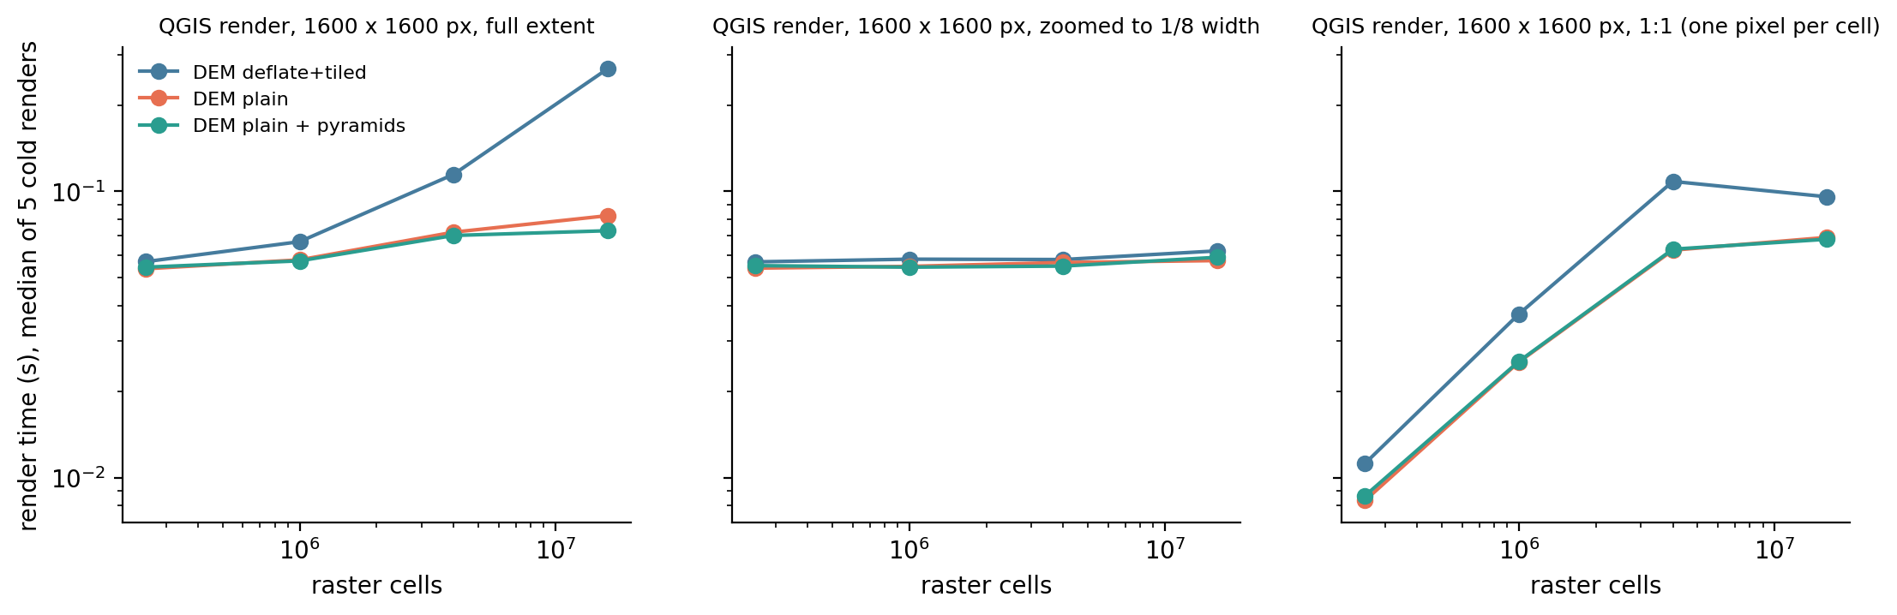
QGIS cost follows the screen, not the raster
BACKUP · VISUALISATION PERFORMANCE
Plain or pyramided rasters draw in 55–80 ms at any size. Compressed, tiled GeoTIFFs without pyramids grow to 0.27 s at full extent (every tile is decompressed), and to 20 s if GDAL's cache is starved to 1 MB. Build pyramids for compressed outputs.
Notes:
Each render opens a fresh layer, so GDAL's block cache is cold; the operating-system file cache stays warm. Algorithm time and render time are measured separately.

Slide 21
Three workloads, three different cost drivers
BACKUP · ACROSS THE TRACKS
Track | Unit of work | Grows with | 16 M cells | Best lever
1 Radar | one viewshed | cells in range (~R²) | 0.10 s, 242 MB | read only the window; threads
2 Flight | one viewshed per position | positions × radius² | 18.8 s (97 positions) | threads; spacing per altitude
3 Corridor | graph search + exposure | nodes (N log N) | 9–70 s, 0.7–6 GB | C code, landmark A*, multi-res
Raw runtimes across tracks are not a fair contest: the tracks do different amounts of work. The comparisons that matter are within a track (sizes, baselines, optimisations); across tracks we compare what drives the cost.
Notes:
Track 2 is many Track 1 problems; Track 3 adds a graph search on top of Track 1's viewsheds. Memory is set by the DEM in Tracks 1 and 2, but by the explicit graph in Track 3's C solver.

