Slide 1
Non-Traditional Machining (NTM)
Limitations in conventional machining:
The tool needs to be harder than the job/workpiece. In that case how do you machine very hard materials ?
Intricate dimensional and accuracy requirements.
Difficult to achieve higher production rates.
Non-Traditional Machining can overcome these limitations

Slide 2
Non-Traditional Machining
Some non-traditional machining techniques:
Electric Discharge Machining (EDM)
Electrochemical Machining (ECM)
Abrasive Jet Machining (AJM)
Laser Beam Machining (LBM)

Slide 3
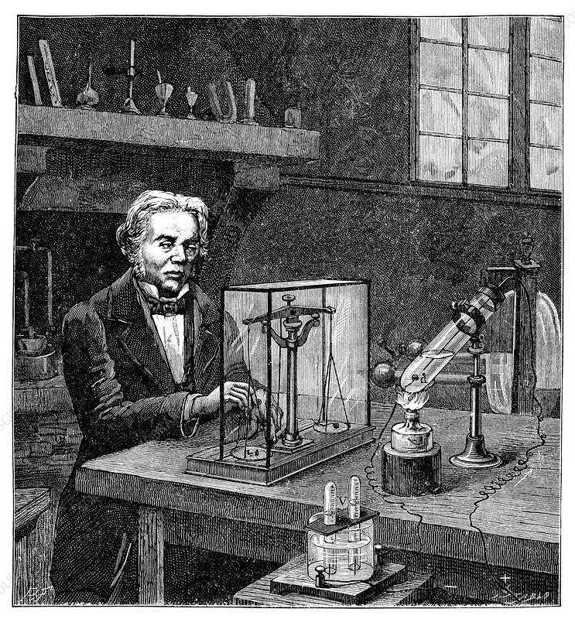
ECM
Die sinking process.
Principles of electrolysis and Reverse of electroplating
The shape or size of the electrode it would create just a negative map of itself on the on the surface.
The workpiece is generally connected to the positive terminal (anode).
When current is passed, a controlled anodic dissolution the work piece occurs with almost no deposition or dissolution of the cathode (tool). This is possible due to suitable choices of the electrodes and the electrolyte.
Physique Populaire
Description
Faraday's electrolysis experiment. Historical artwork of British chemist and physicist Michael Faraday (1791-1867) experimenting on electrolysis in 1833. The test tube (lower right) contains two platinum electrodes dipped in molten tin chloride heated by a spirit lamp. The electrodes are connected to a battery (not seen) and a voltmeter (bottom centre). The amount of hydrogen and oxygen gas produced in the voltmeter is a measure of the amount of electricity used. Chlorine is produced at the positive electrode (wire) and tin at the negative electrode (round coil). Weighing the coil showed that the amount of tin deposited was proportional to the amount of electricity. From Physique Populaire (E. Desbeaux, 1891).

Slide 4
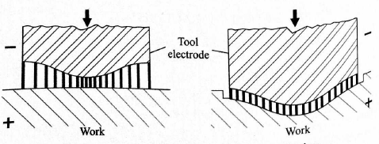
ECM-Mechanism
In metal, electricity is conducted by free electrons but in the solution the conduction of the electricity is attained by the movement of ions.
The gap between the suitably-shaped tool and the workpiece is filled by electrolyte.
The rate of anodic dissolution is inversely proportional to this gap.
When tool is given downward motion, the work surface tends to take the same shape as that of the tool.
At steady state the gap is uniform, and the shape of the tool is reproduced in the job.

Slide 5
ECM-Mechanism
The electrolyte is pumped at a high pressure through the tool and a small gap between the tool in the work piece.
The electrolyte is so chosen that the anode is dissolved but there is no deposit back on the cathode.
The order of the current and voltages are about 1000 amps and 8-20 volts.
The gap is of the order of about close to 100 to 200 microns.
The metal removal is about 1600 mm^3 /s for each one kilo ampere current.

Slide 6
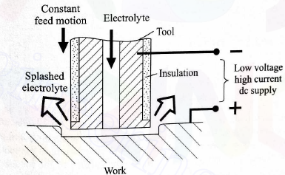
ECM- Schematic of the Setup and Capability
Metal removal is independent of the work piece hardness.
In case of mechanical removal ECM becomes advantageous when either the work material process is a very low machinability or the shape of the machined item is very complex.
No tool wear.
Tool experience no force.
Tool and workpiece subjected to large force exerted by the high pressure fluid in the gap.

Slide 7
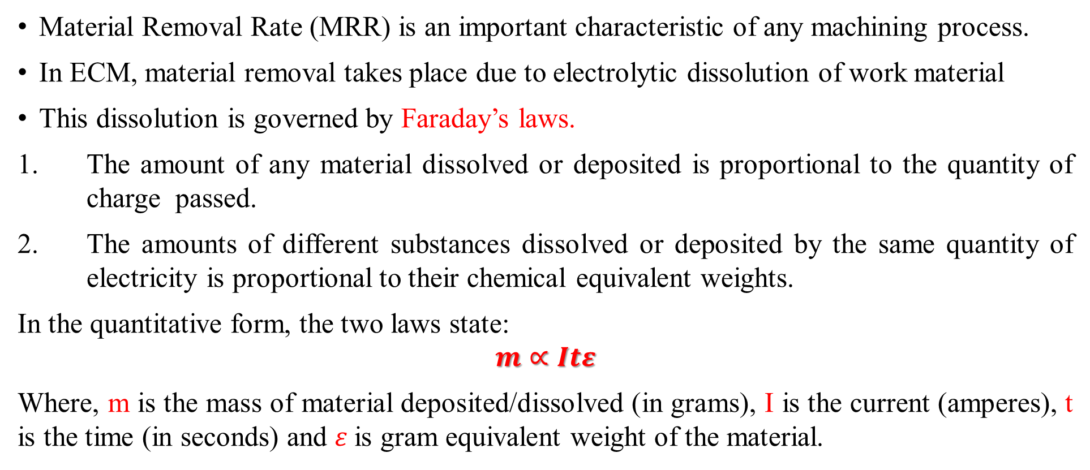
Faraday's Laws:
Material Removal Rate (MRR) is an important characteristic of any machining process.
In ECM, material removal takes place due to electrolytic dissolution of work material
This dissolution is governed by Faraday’s laws.
The amount of any material dissolved or deposited is proportional to the quantity of charge passed.
The amounts of different substances dissolved or deposited by the same quantity of electricity is proportional to their chemical equivalent weights.
In the quantitative form, the two laws state:
$$m∝Itε$$
Where, m is the mass of material deposited/dissolved (in grams), I is the current (amperes), t is the time (in seconds) and $ε$is gram equivalent weight of the material.

Slide 8
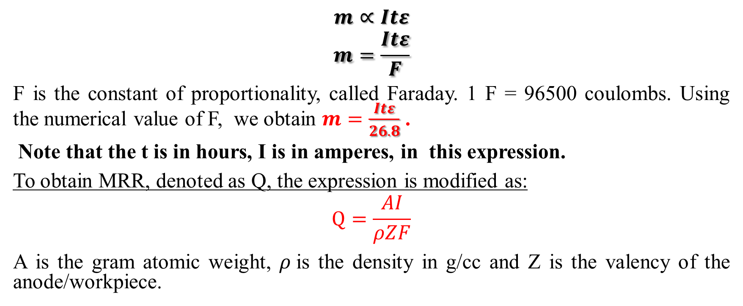
Faraday's Laws for a metal
$$m∝Itε$$
$$m=\frac{Itε}{F}$$
F is the constant of proportionality, called Faraday. 1 F = 96500 coulombs. Using the numerical value of F, we obtain $m=\frac{Itε}{26.8}$ .
Note that the t is in hours, I is in amperes, in this expression.
To obtain MRR, denoted as Q, the expression is modified as:
$$Q=\frac{AI}{ρZF}$$
A is the gram atomic weight, $ρ$is the density in g/cc and Z is the valency of the anode/workpiece.

Slide 9
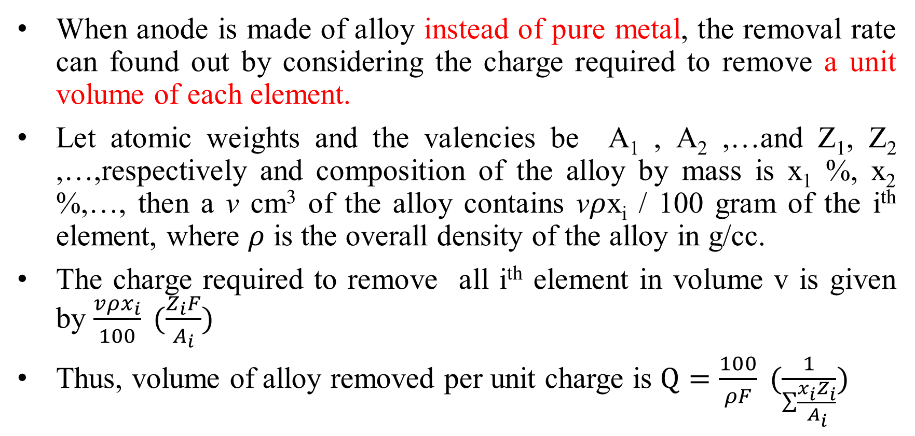
Faraday's Laws as applied to an alloy
When anode is made of alloy instead of pure metal, the removal rate can found out by considering the charge required to remove a unit volume of each element.
Let atomic weights and the valencies be A₁ , A₂ ,…and Z₁, Z₂ ,…,respectively and composition of the alloy by mass is x₁ %, x₂ %,…, then a v cm³ of the alloy contains v$ρ$x_{i} / 100 gram of the i^{th} element, where $ρ$ is the overall density of the alloy in g/cc.
The charge required to remove all i^{th} element in volume v is given by $\frac{vρx_{i}}{100} (\frac{Z_{i}F}{A_{i}})$
Thus, volume of alloy removed per unit charge is $Q=\frac{100}{ρF} (\frac{1}{\sum{\frac{x_{i}Z_{i}}{A_{i}}}})$

Slide 10
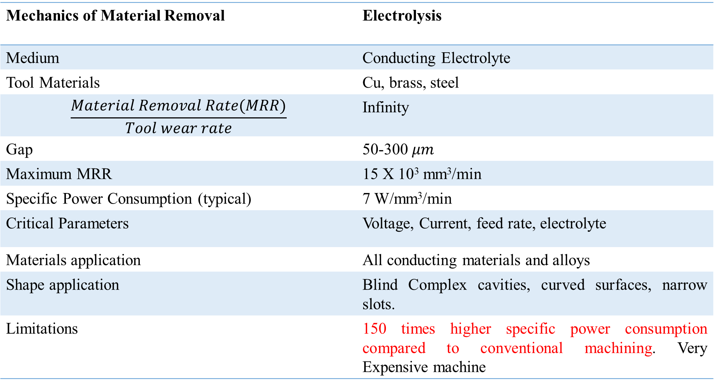
ECM-Process Summary
Mechanics of Material Removal | Electrolysis
Medium | Conducting Electrolyte
Tool Materials | Cu, brass, steel
$$\frac{Material Removal Rate(MRR)}{Tool wear rate}$$ | Infinity
Gap | 50-300 $μm$
Maximum MRR | 15 X 10³ mm³/min
Specific Power Consumption (typical) | 7 W/mm³/min
Critical Parameters | Voltage, Current, feed rate, electrolyte
Materials application | All conducting materials and alloys
Shape application | Blind Complex cavities, curved surfaces, narrow slots.
Limitations | 150 times higher specific power consumption compared to conventional machining. Very Expensive machine

Slide 11
Problem 1
In electrochemical machining of pure iron a material removal rate of 5 cm³/min is required. Estimate current requirement.

Slide 12
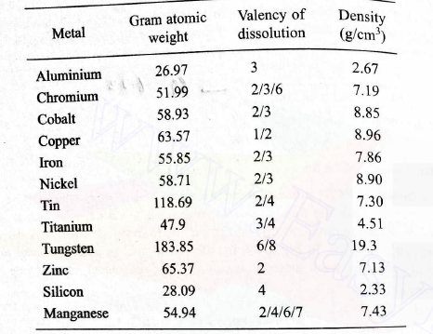
Problem 2
The composition by % weight of the Nimonic 75 alloy is given as:
Ni 72.5, Cr 19.5, Fe 5.0, Ti 0.4, S 1.0, Mn 1.0, Cu 0.6. Calculate the removal rate in cc/min when 1000 A current is passed. Use the lowest valency of each element

Slide 13
Electric Discharge Machining (EDM)
Definition-Electro Discharge Machining (EDM) is an electro-thermal non-traditional machining process, where electrical energy is used to generate electrical spark and material removal mainly occurs due to thermal energy of the spark.
Why EDM? EDM is mainly used to machine difficult-to-machine materials and high strength temperature resistant alloys. EDM can be used to machine difficult geometries in small batches. Work material to be machined by EDM has to be electrically conductive.

Slide 14
Electric Discharge Machining (EDM)
EDM is the process of material removal by a controlled erosion through a series of electric sparks.
Developed in USSR around 1943.
When a discharge takes place between two points of the anode and cathode the intense heat generated near the zone melts and evaporates the materials in the sparking zone.
For improving the effectiveness the workpiece and tool are submerged in a dielectric fluid (Mineral oils or hydrocarbons)

Slide 15
Schematic of EDM
Servo-control
Spark Generating Source
Tool
Dielectric Fluid
Spark gap
Work-piece
Schematic of EDM

Slide 16
Electric Discharge Machining (EDM)
The workpiece is generally made the anode.
In an EDM process electrons emanating from the cathode first strike the neutral molecules of the electrolyte and these undergo electrolytic dissociation producing cations and more electrons.
The electrons are accelerated due to the electric field and may ultimately dislodge other electrons and ions.
A suitable gap, known as the spark gap, is maintained between the tool and the workpiece surfaces.
The sparks are made to discharge at a high frequency with a suitable source.
Since, the spark occurs at a spot where the tool and the workpiece surfaces are the closest and since the spot changes after each spark , the spark travel all over the surface.
This results in an uniform material removal all over the surface, and finally the workpiece conforms to the tool surface.
Thus the tool produces the required impression in the workpiece.

Slide 17
Electric Discharge Machining (EDM)
For maintaining the predetermined spark gap, servo control unit is generally used.
The gap is sensed through an average voltage across it and this is compared with preset value.
The difference is used to control a servomotor.
A solenoid control is also possible for maintaining the gap voltage.
The spark frequency is normally in the range of 200-50000 Hz. The spark gap is around 0.025-0.05 mm.
The peak voltage across the gap is kept in the range of 30-250 volts.
A material removal rate up to 300 mm^3/min can be obtained with this process.
The specific power is around 10W/mm^3/min.
The efficiency of performance increases if a forced circulation of dielectric fluid is provided.
The most commonly used dielectric fluid is kerosene.
The tool is generally made of brass or a copper alloy.

Slide 18
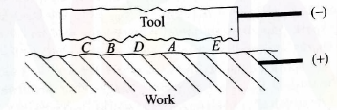
Mechanics of EDM- Spark Propagation
The spark produces a compression shock wave which results in the development of a very high temperature near the region hit by the spark and this melts and vaporizes the anodic material.
The melt or vapors are further removed by the mechanical blast and results in pitting on the electrode surface.
The temperature in the melting zone is in the range of 10000 -12000 deg.C
This results in small craters in both electrode surfaces.
The surface irregularities causes the local spark gap to vary. At the point of minimum gap (say at ‘A’) the spark first occurs. As soon as this happens, the gap between the electrodes at A increases, the next location of the shortest gap is somewhere else (say at ‘B’). In this way, the spark wanders all over the electrode and, ultimately, the process results in a uniform gap. So, depending on the negative electrode shape, an impression is created on the other electrode.

Slide 19
Mechanics of EDM- Spark Propagation
Therefore, a negative of the electrode shape is created over the workpiece electrode.
Generally, the MRR from the cathode is comparatively less than that from the anode due to the following reason:
1. The momentum with which the stream of electrons strike the anode is much more that due to the stream of positive ions impinging on the cathode through the mass of individual electron is less than that of the positive ions.
2. The compressive force is developed on the cathode surface primarily due to cations.
Therefore, normally, the tool is connected to negative terminal of the dc source.

Slide 20
EDM-Role of Dielectric
Material removal occurs due to intense heating, resulting in vaporization and melting of workpiece. This needs to be executed in absence of oxygen so that oxidation is avoided. Oxidation often leads to poor surface conductivity (electrical) of the workpiece hindering further machining. Dielectric fluid should provide an oxygen free machining environment. Dielectric medium is generally flushed around the spark zone to achieve efficient removal of molten material.
Basic requirements of an ideal dielectric fluid:
Low viscosity
Absence of toxic vapors
Chemical neutrality
Readily available /low cost
Kerosene, Parrafin Oil, Deionised water are used as dielectric fluids in EDM

Slide 21
EDM- Choice of Tool materials
Basic requirements of the Tool material:
1. It should not undergo much wear when impinged by positive ions.
Also, it should be easily machinable, that is, it should have high machinability. This feature allows us to machine complicated shapes using conventional machining processes.
Therefore, the Tool material should exhibit:
1. High electrical conductivity – electrons are cold emitted more easily and there is less bulk electrical heating.
2. High thermal conductivity – for the same heat load, the local temperature rise would be less due to faster heat conducted to the bulk of the tool, and therefore, less tool wear.

Slide 22
EDM- Choice of Tool materials
3. Higher density – for the same tool wear by weight there would be less volume removal or tool wear and thus less dimensional inaccuracy.
4. High melting point – high melting point leads to less tool wear due to less tool material melting for the same heat load.
5. Low cost and readily available.
Brass, Oxygen-free Copper, Tellurium-Copper, Graphite are commonly used.
6. High machinability.

Slide 23
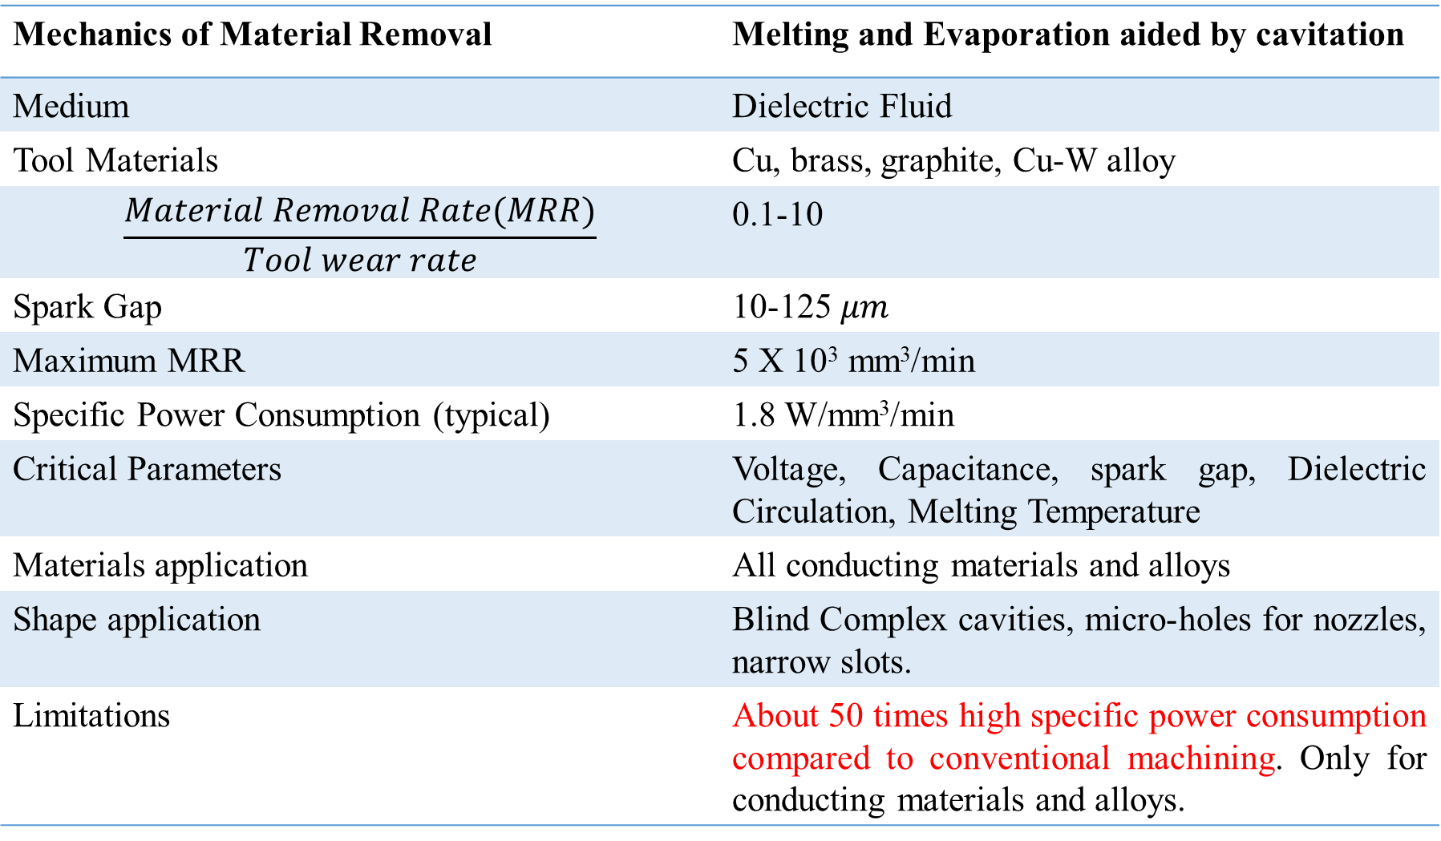
EDM-Process Summary
Mechanics of Material Removal | Melting and Evaporation aided by cavitation
Medium | Dielectric Fluid
Tool Materials | Cu, brass, graphite, Cu-W alloy
$$\frac{Material Removal Rate(MRR)}{Tool wear rate}$$ | 0.1-10
Spark Gap | 10-125 $μm$
Maximum MRR | 5 X 10³ mm³/min
Specific Power Consumption (typical) | 1.8 W/mm³/min
Critical Parameters | Voltage, Capacitance, spark gap, Dielectric Circulation, Melting Temperature
Materials application | All conducting materials and alloys
Shape application | Blind Complex cavities, micro-holes for nozzles, narrow slots.
Limitations | About 50 times high specific power consumption compared to conventional machining. Only for conducting materials and alloys.

