Slide 1
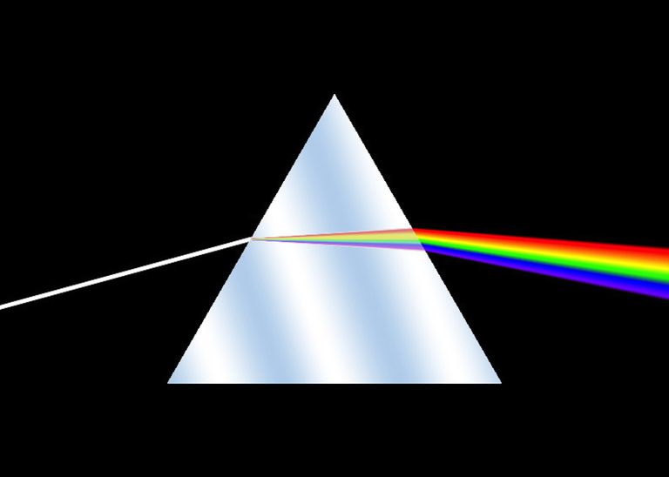
Introduction to Spectroscopy

Slide 2
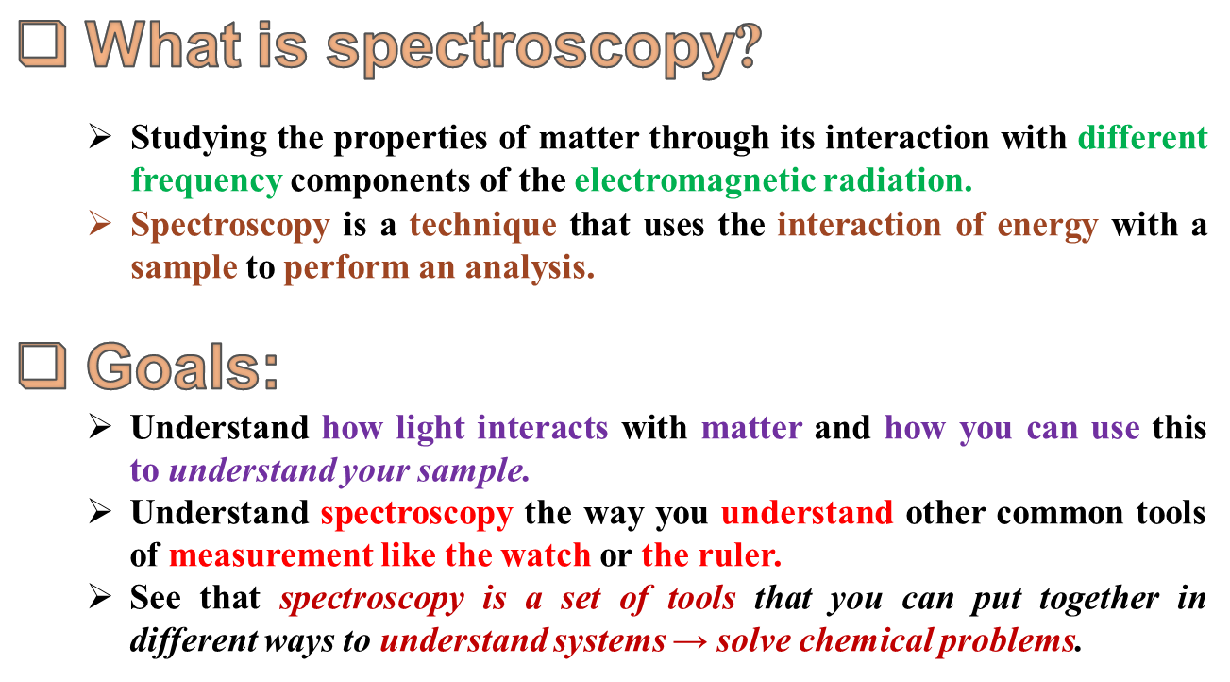

Slide 3
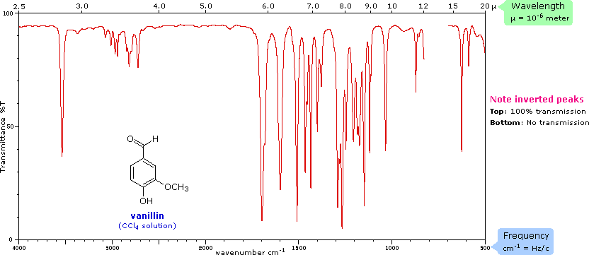
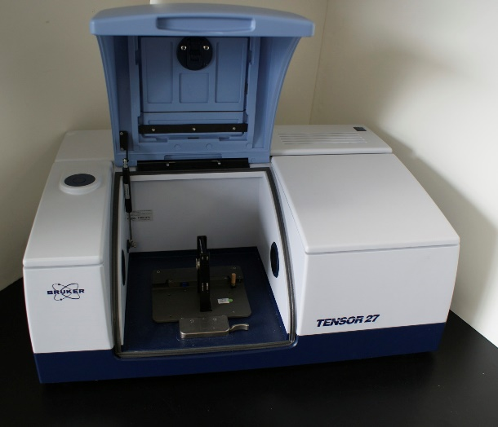
What is Spectrum?
A plot of the response as a function of wavelength or more commonly wavenumber is referred as a spectrum.
What is spectrometer?
An instrument which performs such measurement.
Reference Books
Introduction to Spectroscopy, 3rd Edn, Pavia & Lampman
Organic Spectroscopy – P S Kalsi

Slide 4
Common types?
Fluorescence Spectroscopy.
X-ray spectroscopy and crystallography
Flame spectroscopy
Atomic emission spectroscopy
Atomic absorption spectroscopy
Atomic fluorescence spectroscopy
Plasma emission spectroscopy
Spark or arc emission spectroscopy
IR spectroscopy
UV-Vis Spectroscopy
Raman Spectroscopy
NMR spectroscopy
EPR Spectroscopy
Photo thermal spectroscopy
Thermal infra-red spectroscopy
Mass Spectroscopy

Slide 5
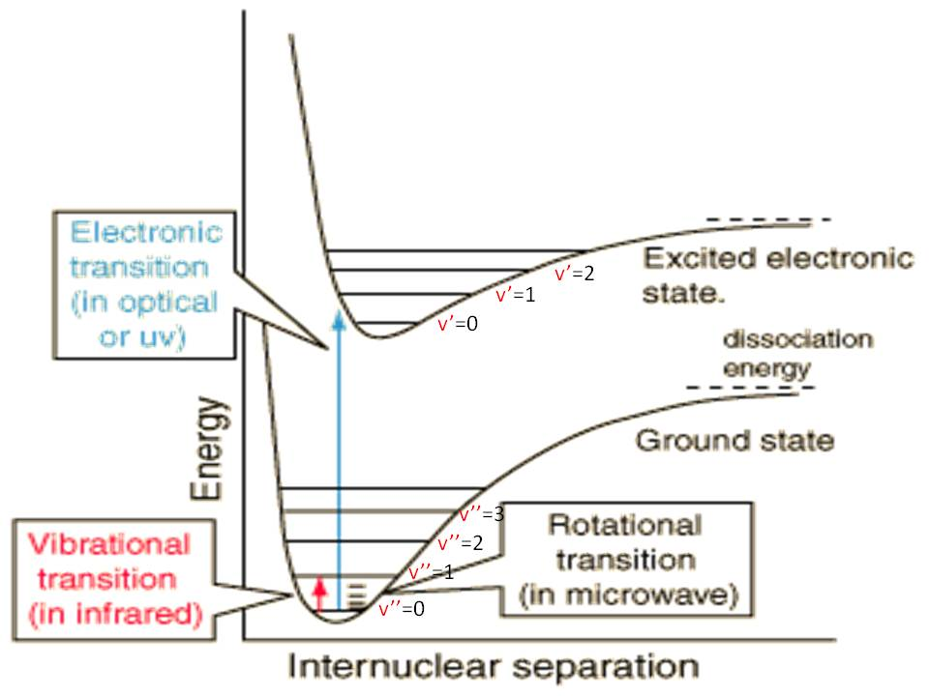
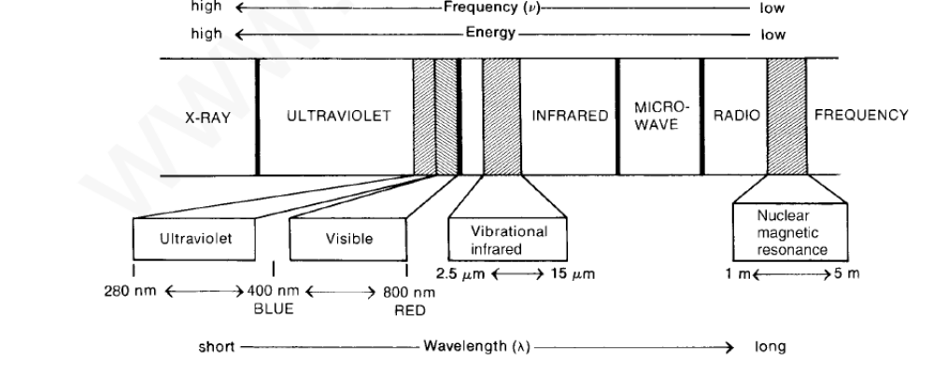
Infra-red spectroscopy

Slide 6
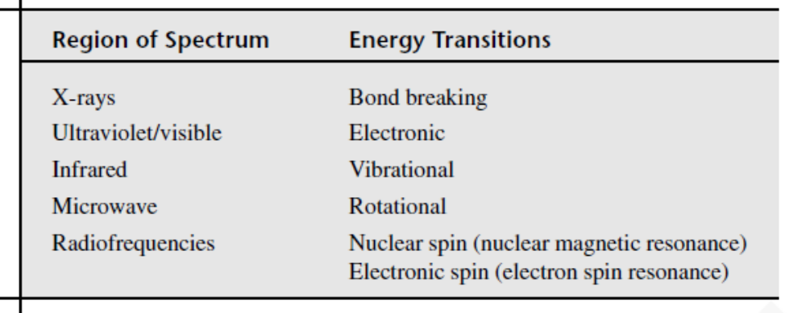
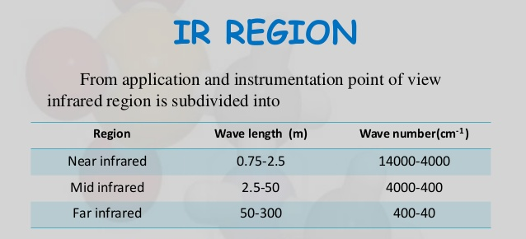
Infra-red spectroscopy
Chemists prefer to use wavenumber as unit. It directly proportional to energy.

Slide 7
Infra-red Absorption Process
Molecules are excited to a higher energy state when they absorb infrared radiation.
The absorption of infrared radiation is a quantized process.
A molecule absorbs only selected frequencies (energies) of infrared radiation.
The absorption of infrared radiation corresponds to energy changes on the order of 8 to 40 kJ/mole.
Radiation in this energy range corresponds to the range encompassing the stretching and bending vibrational frequencies of the bonds in most covalent molecules.
In the absorption process, those frequencies of infrared radiation that match the natural vibrational frequencies of the molecule in question are absorbed, and the energy absorbed serves to increase the amplitude of the vibrational motions of the bonds in the molecule.
Note, however, that not all bonds in a molecule are capable of absorbing infrared energy, even if the frequency of the radiation exactly matches that of the bond motion.
Only those bonds that have a dipole moment that changes are capable of absorbing infrared radiation.

Slide 8
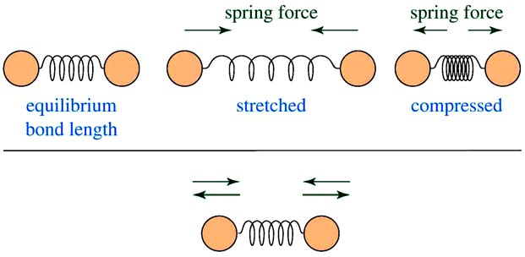
Infrared radiation is largely thermal energy.
It induces stronger molecular vibrations in covalent bonds, which can be viewed as springs holding together two masses, or atoms.
Specific bonds respond to (absorb) specific frequencies

Slide 9
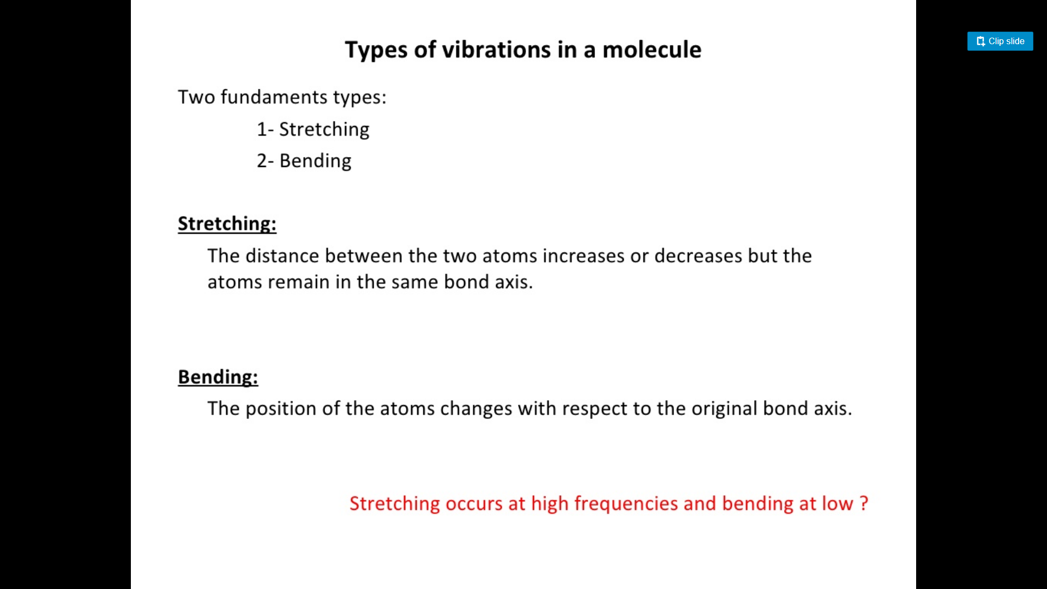
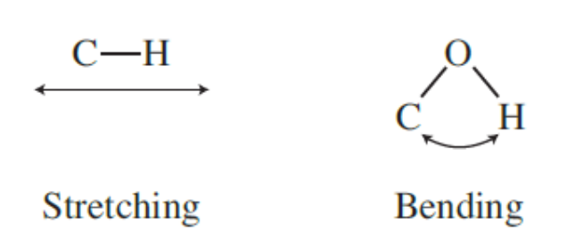
Essential criteria for a molecule to be IR active:
Only those vibration modes are IR active that involve a change in dipolemoment, during vibration.
H₂, N₂, O₂, Br₂, Cl₂, I₂ etc and IR inactive, while CO, NO, CO₂, etc are IR active

Slide 10
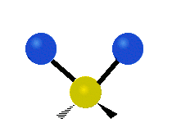
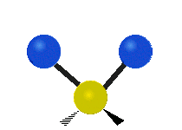
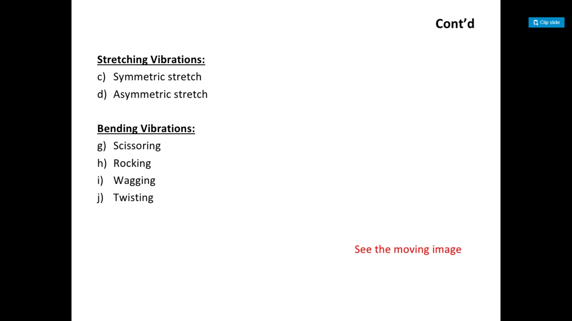



Symmetric stretching
Asymmetric stretching
Scissoring
Rocking
Twisting
Wagging

Slide 11
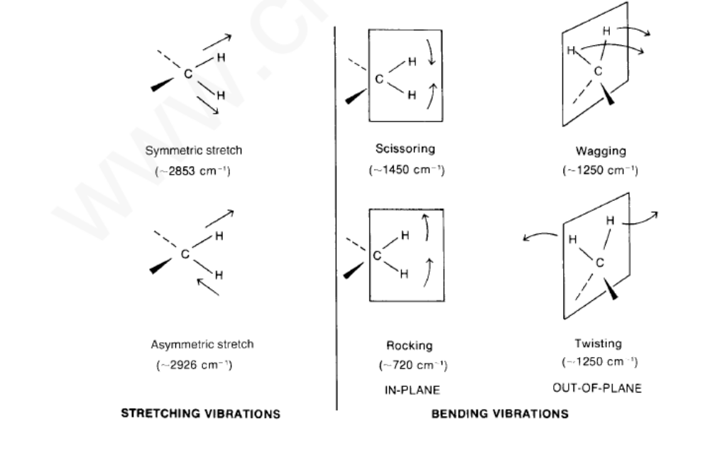

Slide 12
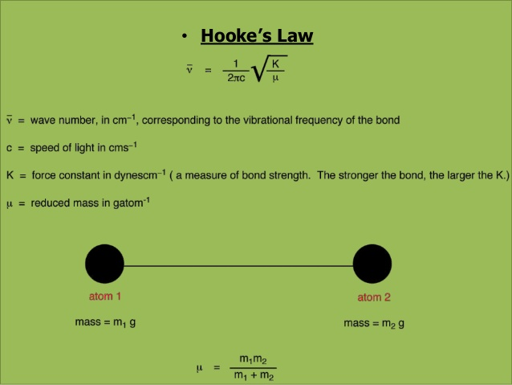

Slide 13
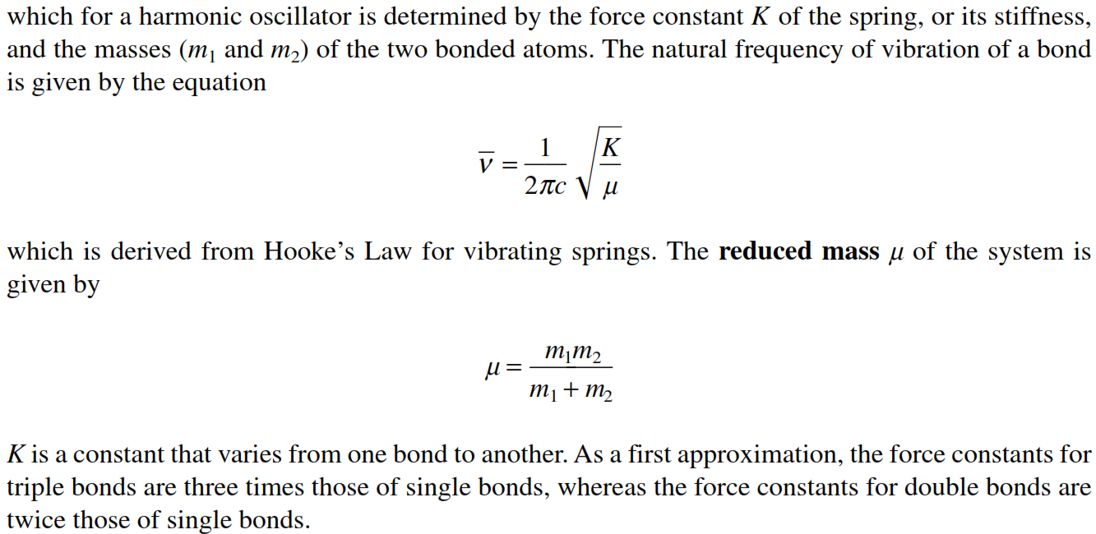
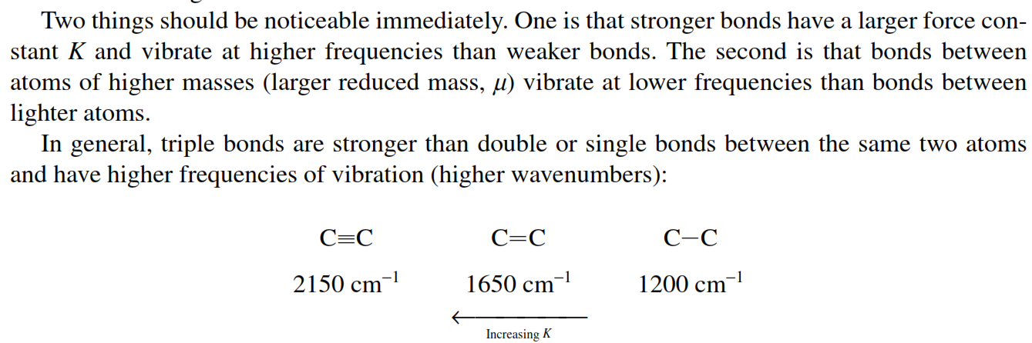
Department of Applied Chemistry, IIT(ISM) Dhanbad

Slide 14
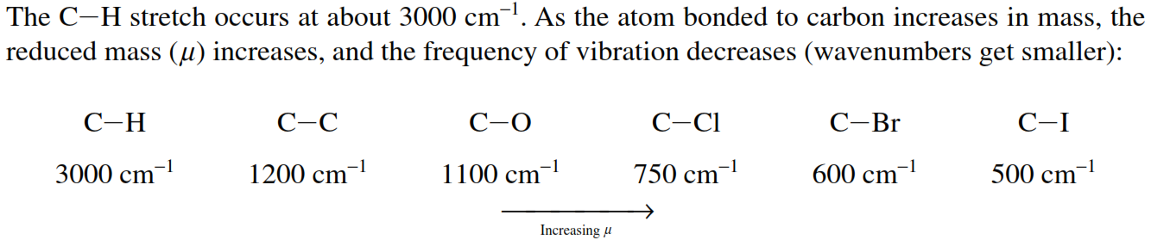
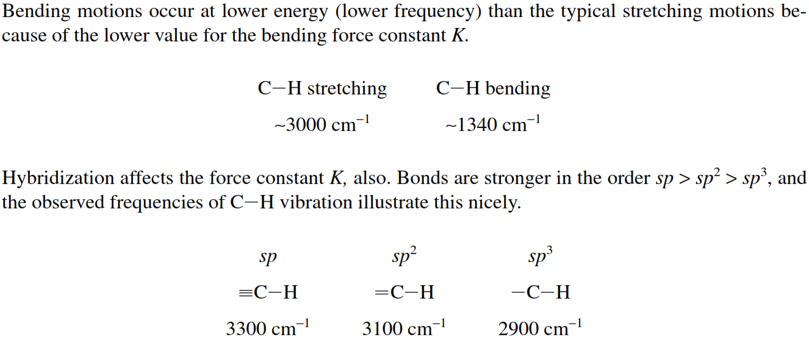

Slide 15
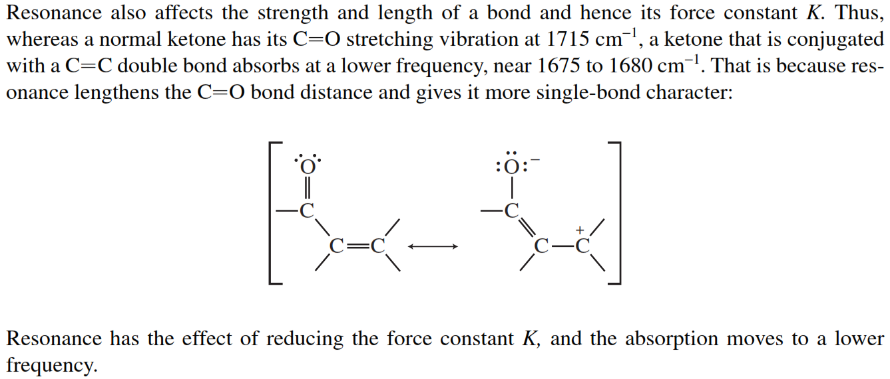

Slide 16
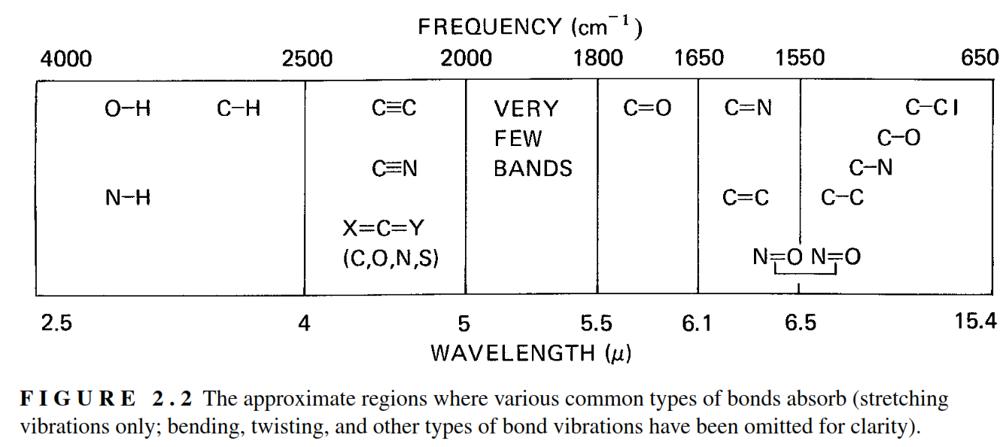

Slide 17
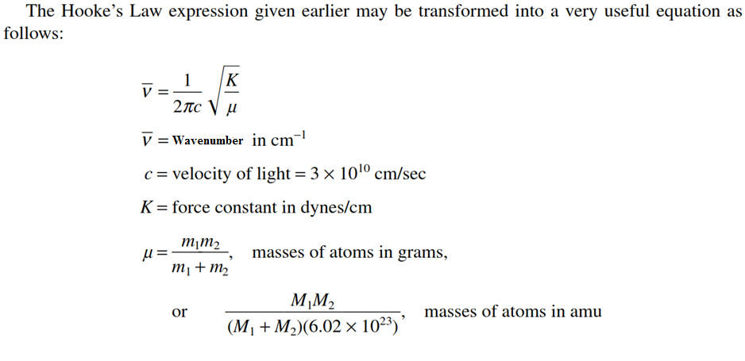
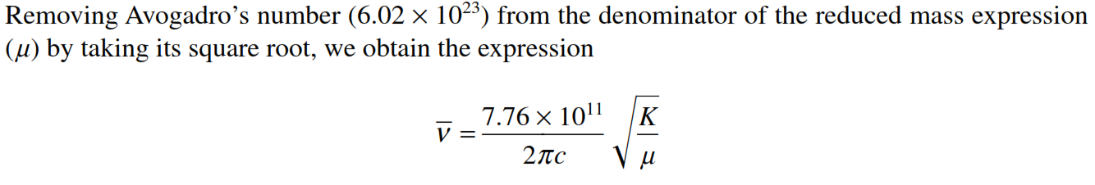

Slide 18
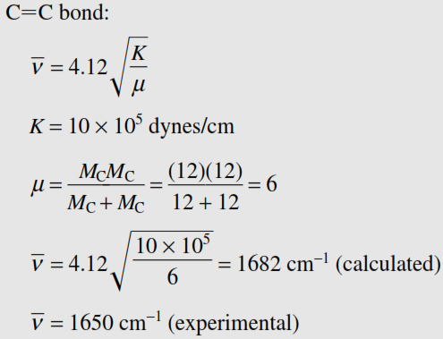
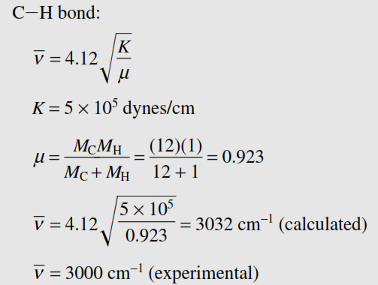
Solved Problems

Slide 19
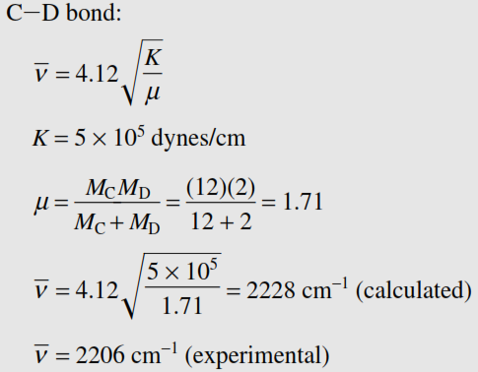
Solved Problems
Q: Why IR spectra is always reported in wavenumbers (cm⁻¹) and not in wavelength (μm)?
Ans: The reason is, if reported in wavelength (μm) the mid-IR range comes in the range 25 μm to 2.5 μm which is equivalent to 400 to 4000cm⁻¹ when reported in wavenumbers (cm⁻¹). The reporting in wavenumber gives better resolution and make identification of the spectral bands easier.

Slide 20
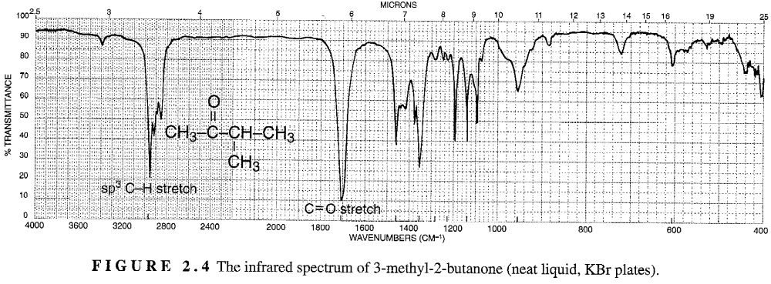
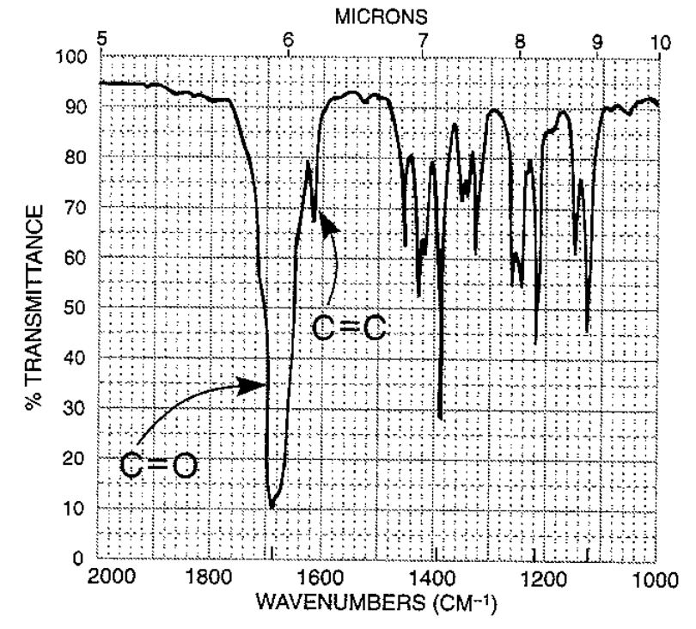
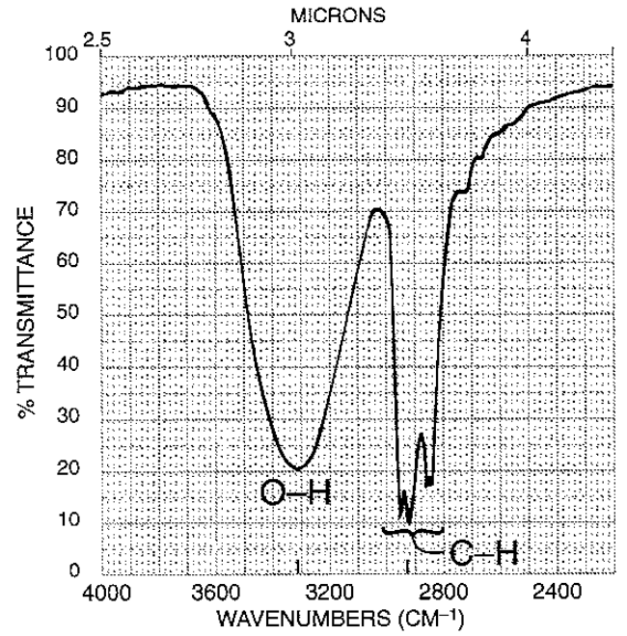
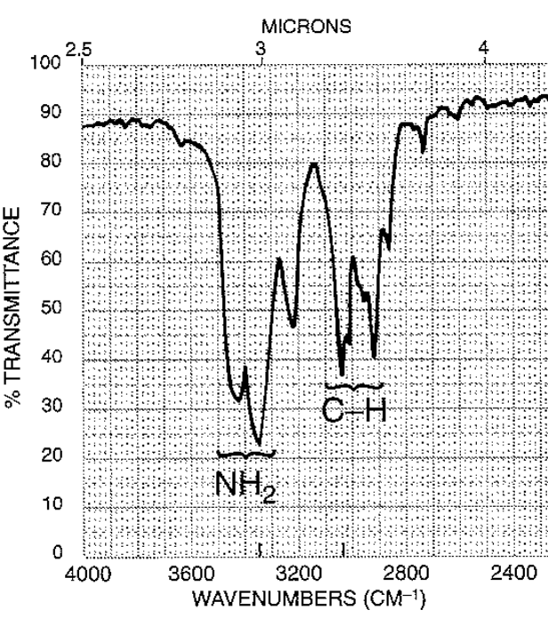

Slide 21
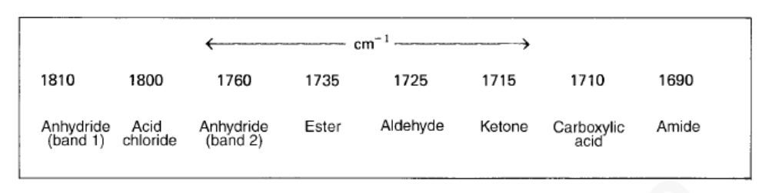
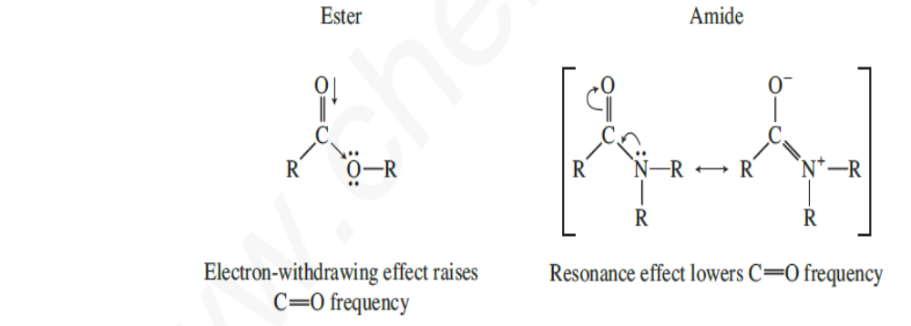
Carbonyl Compounds
Q: What is the fundamental requirement for a molecule to give IR spectrum (compound to be IR active)?
Ans: The molecule should under go a change in dipole moment during a vibration.
Q: Which of the following molecules will give IR spectrum? H₂, N₂, CO, N₂, NO.
Ans: (home work)

Slide 22
Q: Why there are so many small and medium bands in IR spectra of compounds with simple structures?
Ans: The reason is presence of Overtones, combination bands and difference bands.
Q: What are combination bands, Overtones and difference bands
Ans: Some times two vibrations of different values (ν₁ and ν₂) couple to give a new band whose frequency is ν₁+ ν₂. These bands are called combination bands.
During vibrational excitation from ground states to excited states some times excitation to higher energy states are also possible which are integral multiples of fundamental vibration, ν. Hence new hands may appear at 2ν, 3ν, etc. These bands are called Overtones
Some times coupling of two different bands leads to new bands which are difference between the frequencies of either bands. ν₃ = ν₁- ν₂. These bands are called difference bands.
Q: Why the bands are not sharp, but rather broad?
Ans: This is because, some times, rotational frequencies couple with vibrational frequency, creating additional fine structure due to small transitions.

