Slide 2

Learning Management System
Submitted to:
Department of Computer Science and Engineering

Slide 3
Supervised by: Prof.Narendra Pal Singh Rathore
Team Members
1.Yashika Solanki
2.Yogesh Patel
3.Saloni Nagpal
4.Yash Sharma

Slide 4
Project Presentation Outline
Introduction
Problem Statement
Survey of Existing Systems
Project Objectives
Requirement Analysis
Solution Proposed
Features
System architecture
User Interface
Testing Plan
The Outcome Discussion
Conclusions

Slide 5
Introduction
CogniPath is an innovative Learning Management System (LMS) project designed to enhance the learning experience for students and teachers. It leverages a user-friendly interface created with HTML, CSS, and JavaScript to provide an engaging and interactive front-end experience. At the core of the system lies Django, a robust Python web framework, and a SQLite database to manage and store educational content, user information, and course data efficiently.
CogniPath is an all-in-one solution for educational institutions, providing a seamless learning experience that promotes engagement, knowledge retention, and efficient learning management. It simplifies the teaching and learning process, making education accessible and interactive for all users.

Slide 6
The Problem Statement
In the digital age of education, educational institutions, instructors, and students face a significant challenge in managing, accessing, and delivering educational content efficiently. The problem is to address the limitations of traditional education delivery methods and provide a solution that overcomes these challenges. The specific problem to solve is to create an effective and user-friendly Learning Management System (LMS) that streamlines content management, user interaction, and assessment processes.

Slide 7
Survey of Existing Systems
Existing System/Application 1: Moodle
Problems Addressed: Moodle addresses the need for a versatile LMS that can accommodate various types of educational content and assessments.
Advantages: Open-source nature, customizable features, and extensive plugin ecosystem.
Disadvantages: Steeper learning curve for beginners, limited built-in multimedia features.
Gaps Identified: Potential improvements in user-friendliness, enhanced multimedia capabilities, and streamlined course creation.
Reference Link: Moodle
Existing System/Application 2: Canvas
Problems Addressed: Canvas aims to simplify course management and foster interactive learning environments.
Advantages: Intuitive user interface, responsive design, extensive integration capabilities.
Disadvantages: Limited customization for self-hosted instances, potential scalability concerns for larger institutions.
Gaps Identified: Opportunities for more streamlined assessment workflows and advanced student engagement tools.
Reference Link: Canvas

Slide 8
Survey of Existing Systems
Existing System/Application 3: Edmodo
Problems Addressed: Edmodo emphasizes ease of use and collaboration in a digital classroom.
Advantages: User-friendly interface, dedicated mobile app, strong focus on teacher-student interaction.
Disadvantages: Limited customization options, relatively simplified features compared to comprehensive LMS solutions.
Gaps Identified: Potential for expanding beyond K-12 education, offering more advanced assessment tools.
Reference Link: Edmodo
Existing System/Application 4: Google Classroom
Problems Addressed: Google Classroom streamlines assignment distribution and collaboration within the Google ecosystem.
Advantages: Seamlessly integrates with Google Drive and other Google tools, easy adoption for schools already using Google services.
Disadvantages: Less comprehensive than standalone LMS platforms, limited features for advanced educational needs.

Slide 9
Objectives
The specific objectives to be addressed while development work
Enhanced Instructor Control: Ensure that instructors have full control over the learning environment, enabling them to provide guidance, structure, and assessment without interference from student-to-student collaboration.
Personalized Learning: Facilitate a personalized learning experience, where students can progress through courses at their own pace and receive tailored feedback from instructors.
Customized Learning Paths: Enable instructors to tailor learning paths for each student's specific needs and goals without interference from group dynamics.
User Satisfaction: Ensure that both instructors and students have a clear understanding of the platform's goals and limitations, leading to greater user satisfaction and trust in the system.

Slide 10
Objectives
Focused Learning: Create an environment where students can concentrate on their individual learning journeys, promoting self-paced study and self-reliance.
Personalized Learning: Facilitate a personalized learning experience, where students can progress through courses at their own pace and receive tailored feedback from instructors.

Slide 11
Requirement Analysis
Functional Requirements:
User Role Management: Implement user role management within your system. Create different roles for students and teachers, where students have limited interaction capabilities.
Content Access Control: Ensure that access to course materials, assignments, and resources is strictly instructor-controlled. Students should not be able to share or collaborate on course content.
Privacy Settings: Implement privacy settings to restrict student profiles and course activities from being visible to other students.
Access Controls: Ensure that students can only access their own progress reports and not those of their peers.
Admin Controls: Give administrators and instructors the ability to monitor and control student interactions and activities.

Slide 12
Requirement Analysis
Non-Functional Requirements:
Performance:
Responsiveness: The system should respond quickly to user actions, ensuring a seamless experience.
Scalability: The platform should be able to handle a growing number of users and courses without performance degradation.
Usability:
User Interface: The user interface should be intuitive and user-friendly, even for users with limited technical skills.
Accessibility: Ensure that the platform is accessible to users with disabilities, adhering to accessibility standards.
Security:
Data Security: Implement robust data security measures to protect sensitive user information and course materials.
User Authentication: Ensure secure user authentication and authorization processes.
Reliability:
Availability: Maintain high system availability, with minimal downtime for maintenance or unexpected issues.
Error Handling: Implement effective error handling and reporting mechanisms to assist users and administrators
Technology:
Browser Compatibility: Ensure compatibility with a wide range of web browsers and devices.
Performance Testing:
Load Testing: Perform load testing to ensure the system can handle multiple concurrent users without performance degradation.

Slide 13
Solution Proposed
User Role Management: We have established three distinct user profiles within the system - students, teachers, and administrators. Each user type has a specific role and a set of associated permissions.
Front-End Development: Utilizing HTML, CSS, and JavaScript, we have crafted a responsive and user-friendly front-end interface. This interface is designed to cater to the unique requirements of each user role while maintaining a professional and aesthetically pleasing appearance.
Role-Based Permissions: Role management is at the core of our solution. Teachers are equipped with the capability to manage courses, including the creation, modification, and assessment of course materials and student performance. Students are granted access to course content and communication features, and administrators exercise comprehensive oversight over the entire user base, including user management.
Course Creation and Management: Instructors are empowered to efficiently create, manage, and maintain courses. They can upload course materials, define assignments, and evaluate student performance. This functionality supports effective educational delivery.
Security and Authentication: Security measures include robust user authentication to safeguard user accounts and data. Encryption protocols ensure data privacy and protection against unauthorized access.

Slide 14
Solution Proposed
Data Management: We have employed Django, complemented by a SQLite3 database, for efficient data storage and management. This combination optimally handles user data, course materials, and system configurations.
Individualized Learning Experiences: Our platform is engineered to provide students with personalized learning journeys.

Slide 15
Features
Main features and functionalities of the project.
User Authentication: The system provides a secure user authentication process. Teachers are added to the system by the admin, ensuring that only authorized individuals can access teacher privileges.
Student Registration: Students can register themselves by providing the necessary information, such as their name, email, and a secure password. Registration is a one-time process, and it creates a student profile.
Student Login: After registration, students can log in using their credentials. The login process is designed for security and convenience.
Homepage Overview: Upon login, students are directed to the homepage. Here, they can see a list of popular courses that have been highly rated or frequently accessed by other students.
Classroom Enrollment: In the "All Classroom" section, students can explore the available virtual classrooms created by teachers. Each classroom represents a collection of courses and educational materials offered by a specific teacher.

Slide 16
Features
Enrolling in a Classroom: Students have the option to enroll themselves in a classroom that aligns with their educational interests and goals. This enrolls them in all the courses offered within that classroom.
Viewing Classroom Courses: Once enrolled in a classroom, students can view all the courses and content uploaded by the teacher. They can access lecture materials, assignments, and resources.
My Learning Section: A dedicated "My Learning" section provides students with an overview of all the courses they have enrolled in. This section serves as a personalized learning dashboard.
Course Enrollment: In the "My Learning" section, students can see a list of all the courses they've enrolled in, including those from different classrooms. By selecting a course, they can access its content and begin their learning journey.

Slide 17
Features
Video Player Features
Quality Video Player: The platform includes a state-of-the-art video player for the seamless playback of video content, enhancing the learning experience.
Compatibility: The video player is compatible with various video formats commonly used for educational content, ensuring a wide range of content can be accessed and viewed.
Playback Controls: The video player offers essential playback controls, including play, pause, rewind, fast forward, volume adjustment, and

Slide 18
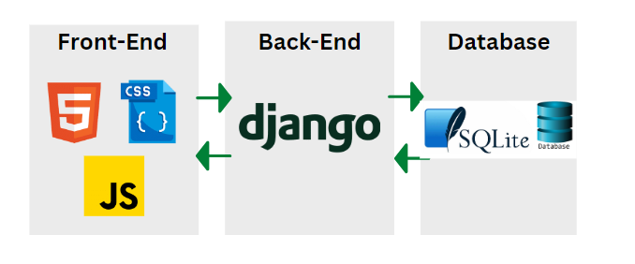
System Architecture

Slide 19
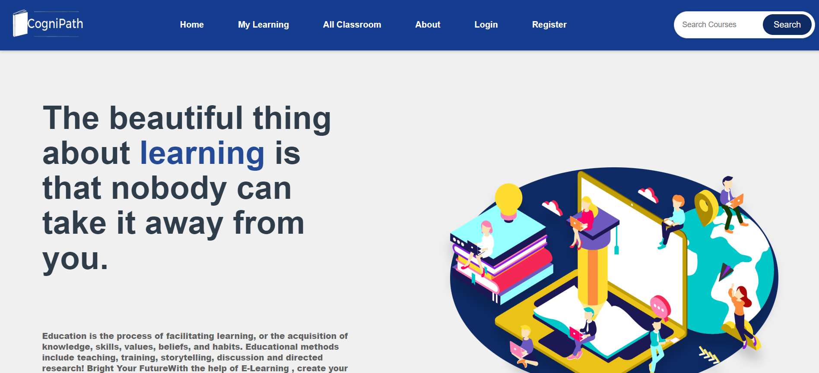
User Interface:

Slide 20
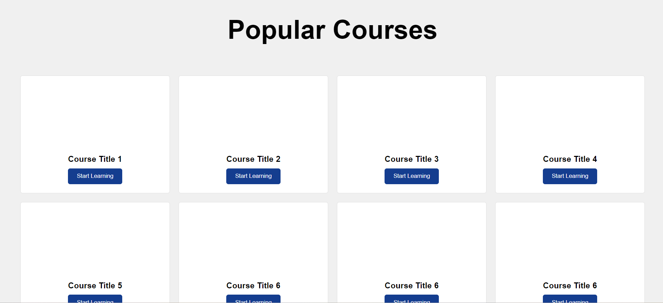

Slide 21
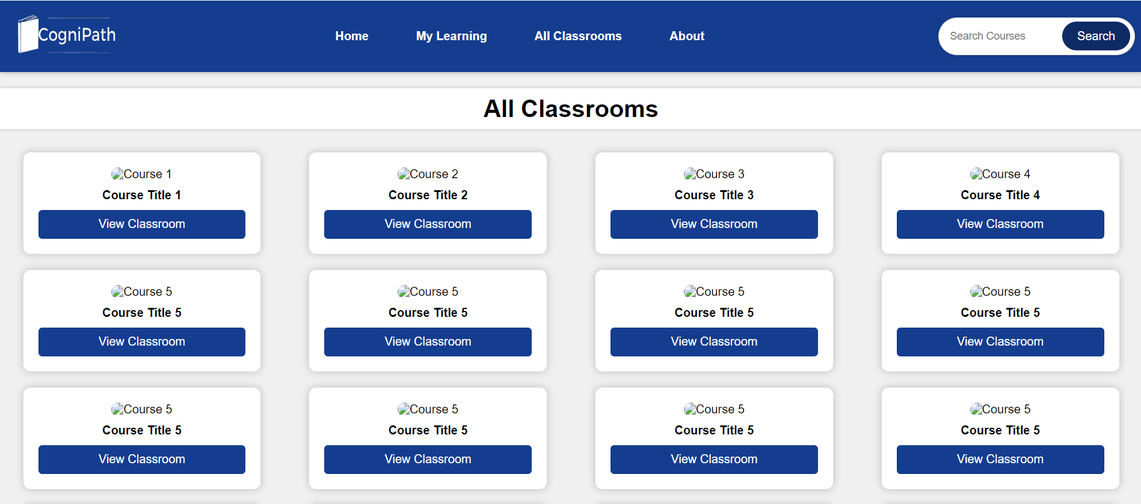

Slide 22
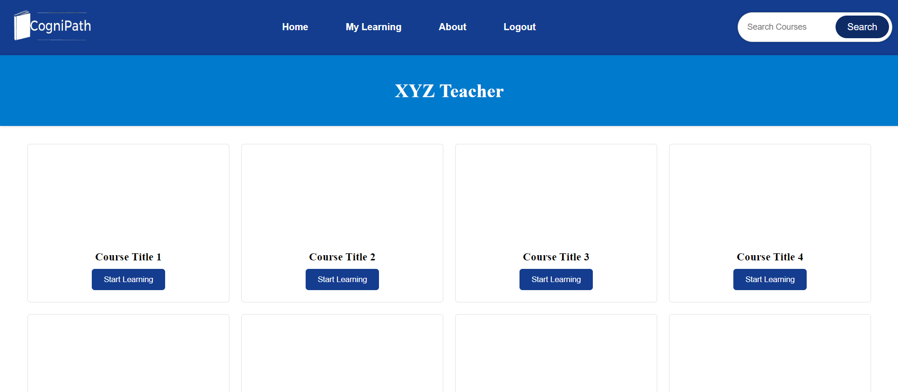

Slide 23
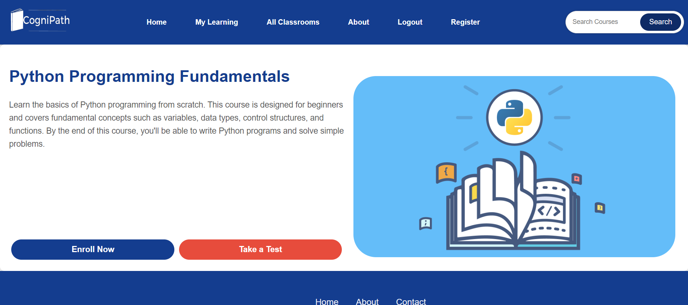

Slide 24
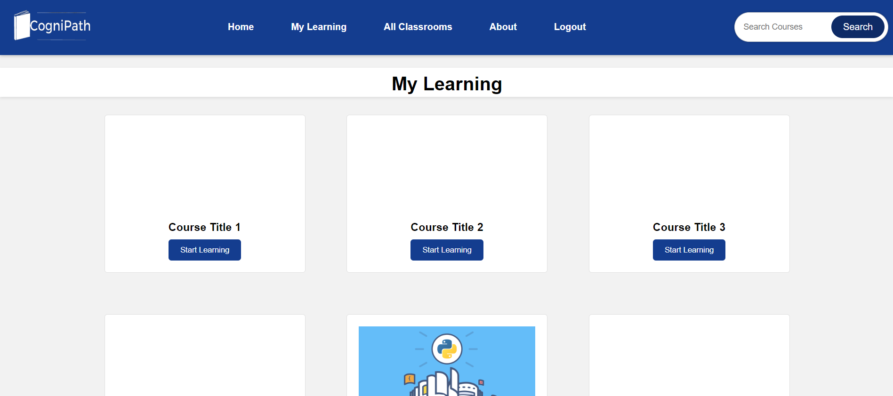

Slide 25
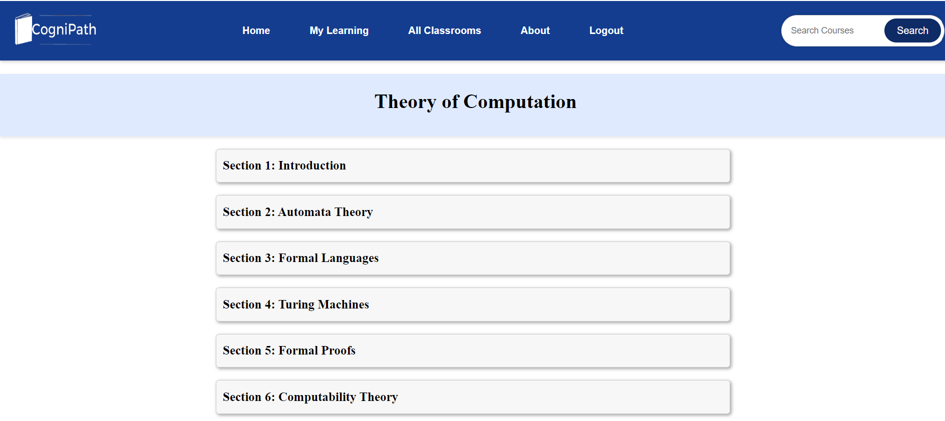

Slide 26
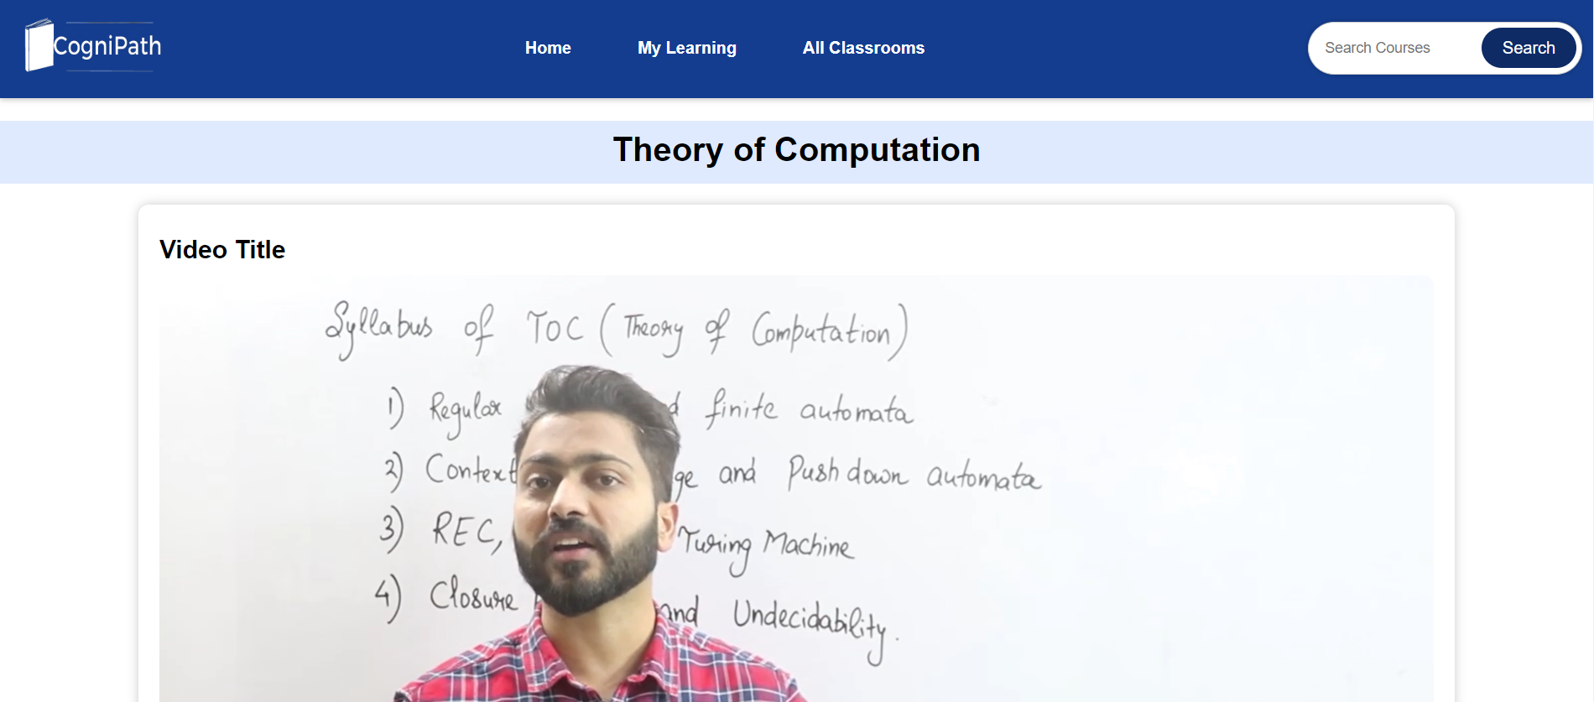

Slide 27
The Outcome
Expected outcome of the project development work
A Functional Learning Management System: The successful development of a fully functional LMS that allows for the creation, management, and delivery of educational content to students and provides user-friendly tools for teachers and administrators to oversee the platform.
User-Friendly Interface: An intuitive and user-friendly interface that makes it easy for students, teachers, and administrators to navigate the system, access courses, and interact with educational materials.
Secure User Authentication: A robust user authentication system that ensures the security of user accounts and sensitive data, preventing unauthorized access.
User Role Management: Effective role management that distinguishes between students, teachers, and administrators, granting each group appropriate permissions and capabilities.
Classroom Feature: A feature that allows teachers to create virtual classrooms, upload course materials, and organize educational resources, enhancing the learning experience.

Slide 28
The Outcome
Course Enrollment and Progress Tracking: The ability for students to enroll in courses, track their progress, and view completed courses in their personal learning dashboards.
Integrated Video Player: A high-quality video player integrated into the system for smooth playback of educational video content with features like bookmarking, note-taking, and discussion capabilities.

Slide 29
Conclusion
Conclude your project idea.
In conclusion, the development of the "CogniPath" Learning Management System is a significant step toward creating a versatile and user-centric platform for online education. With a user-friendly interface, role-based access, and a feature-rich system, "CogniPath" aims to provide students and teachers with a seamless and efficient learning experience. The inclusion of virtual classrooms, course enrollment, video playback capabilities, and user support channels enhances the educational process, making it accessible and engaging.

Slide 30
Q&A

Slide 31
THANKS

