Slide 1
BUSINESS ANALYTICS INTERNSHIP PROJECT • COGNIFYZ TECHNOLOGIES
Investment Behavior &
Preference Analysis
A survey-based study of demographic patterns, investment preferences, savings
objectives, and return expectations among 40 participants
40 Survey Participants
24 Data Variables
7 Investment Instruments

Slide 2
What We'll Cover
A structured walk through the survey findings
01
Data Overview
02
Demographics
Structure and scope of the survey dataset
Gender mix and participant age profile
03
Investment Preferences
04
Objectives & Sources
Preferred avenues and instrument rankings
Why participants save, and where they get advice
05
Duration & Correlation
06
Reasons & Expectations
Holding periods and relationships between variables
Motivations behind each instrument and return outlook
Investment Behavior & Preference Analysis
2

Slide 3
Data Overview
Understanding the dataset structure before diving into analysis
40
24
37
0
Total Entries
Columns
Active Investors
Missing Values
Survey respondents captured in the dataset
Demographic, behavioral, and preference variables
Participants who currently invest (92.5%)
Complete data across all recorded fields
Variables captured span demographics (gender, age), instrument-level preference ranks (Mutual Funds, Equity, Debentures, Government Bonds, Fixed Deposits, PPF, Gold), savings objectives, information sources, holding duration, and expected returns.
Investment Behavior & Preference Analysis
3

Slide 4
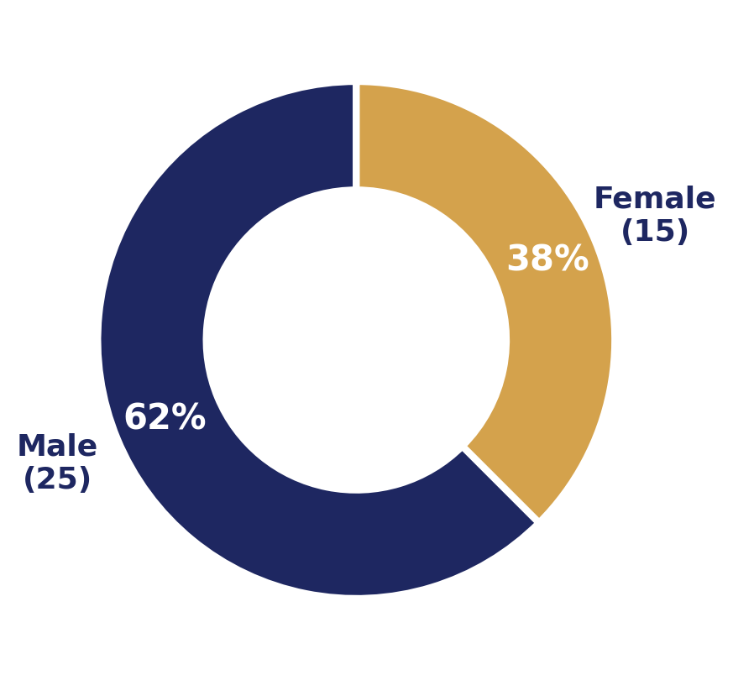
Gender Distribution
Composition of survey participants
The sample skews male, with 25 of 40 participants (62.5%) identifying as male and 15 (37.5%) as female.
This composition should be kept in mind when generalizing preference and behavior findings to a broader population.
Later slides (duration, correlation) treat the full sample together, since gender was not a strong differentiator in preference ranks.
Investment Behavior & Preference Analysis
4

Slide 5
Descriptive Statistics
Age and instrument preference ranks (1 = most preferred, 7 = least preferred)
Variable | Mean | Median | Std Dev | Min | Max
Age | 27.80 | 27.0 | 3.56 | 21 | 35
Mutual Funds | 2.55 | 2.0 | 1.20 | 1 | 7
Equity Market | 3.48 | 4.0 | 1.13 | 1 | 6
Debentures | 5.75 | 6.5 | 1.68 | 1 | 7
Government Bonds | 4.65 | 5.0 | 1.37 | 1 | 7
Fixed Deposits | 3.58 | 3.5 | 1.80 | 1 | 7
PPF | 2.02 | 1.0 | 1.61 | 1 | 6
Gold | 5.98 | 6.0 | 1.14 | 2 | 7
Reading the Ranks
PPF and Mutual Funds post the lowest average ranks (2.02 and 2.55), signaling the strongest overall preference. Gold and Debentures rank highest on average (near 6), making them the least preferred instruments in this sample.
Sample skews young and working-age, averaging 27.8 years.
Investment Behavior & Preference Analysis
5

Slide 6
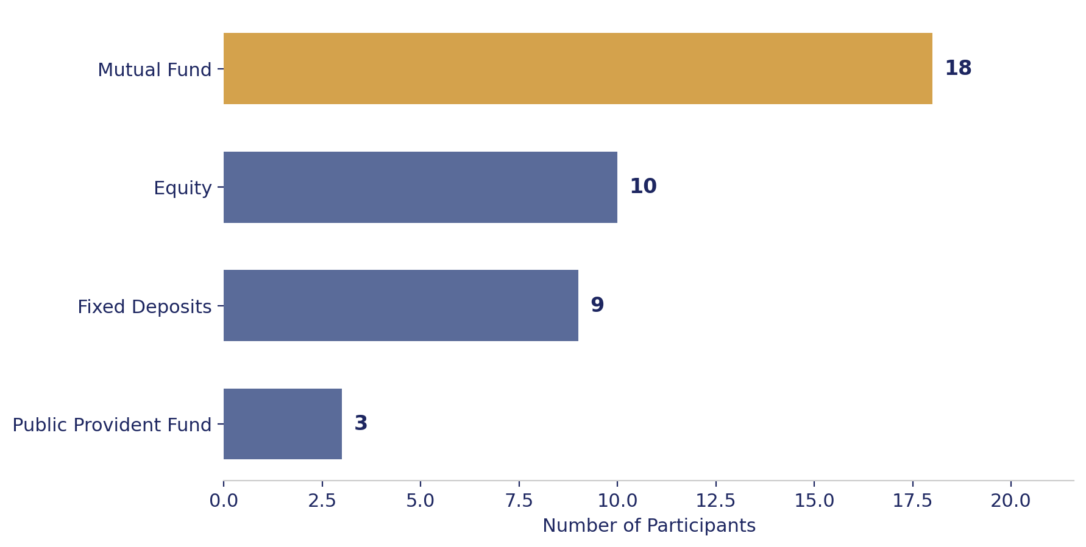
Most Preferred Investment Avenue
Which single avenue participants named as their top choice
45%
of participants named Mutual Funds as their most preferred investment avenue — the clear leader ahead of Equity (25%) and Fixed Deposits (22.5%).
Public Provident Fund trails as a top choice (7.5%) despite scoring well on average preference rank — suggesting it's a strong secondary pick rather than a first choice.
Investment Behavior & Preference Analysis
6

Slide 7
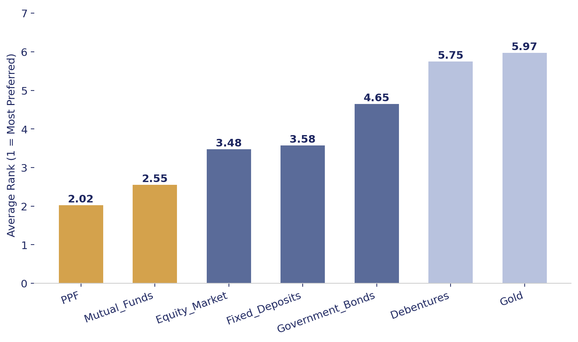
Average Preference Rank by Instrument
Cross-validating stated top choice against ranks across all 7 instruments
Investment Behavior & Preference Analysis
7

Slide 8
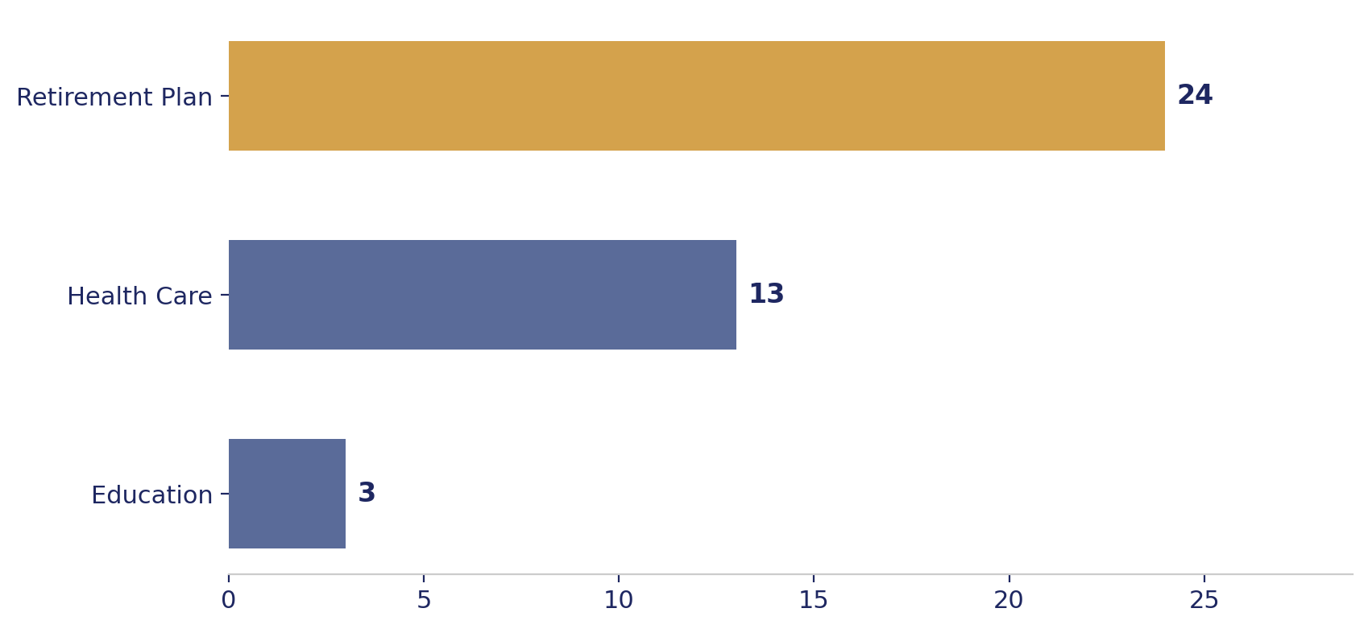
Savings Objectives
What participants are ultimately saving toward
Breakdown
Retirement Plan
24 participants • 60%
Health Care
13 participants • 32.5%
Education
3 participants • 7.5%
Investment Behavior & Preference Analysis
8

Slide 9
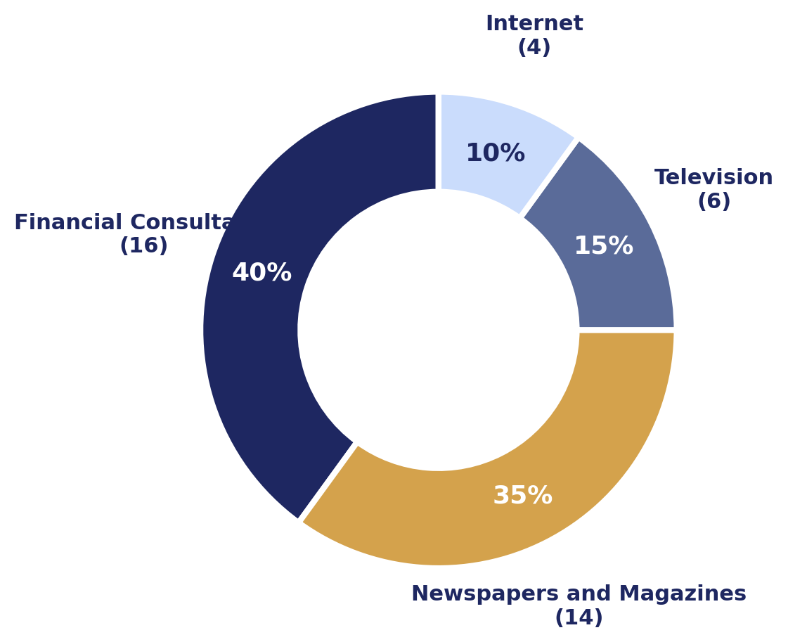
Sources of Investment Information
Where participants turn for advice and guidance
Financial Consultants
16 (40%)
Leading source — professional advice is the top touchpoint
Newspapers & Magazines
14 (35%)
Close second, showing print media still carries weight
Television
6 (15%)
Moderate reach as a supporting channel
Internet
4 (10%)
Smallest share — digital-first sources trail traditional ones
Investment Behavior & Preference Analysis
9

Slide 10
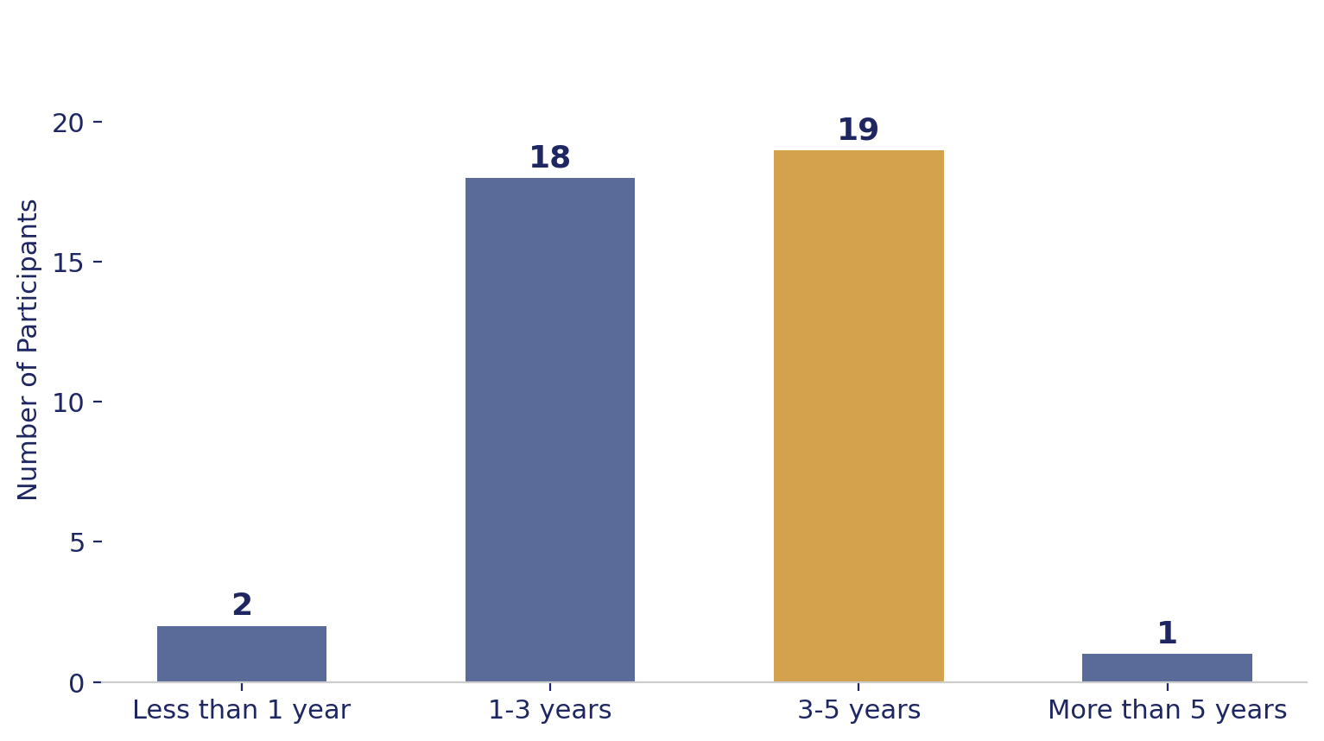
Investment Duration
How long participants typically hold their investments
3–5 years
is the most common holding period (19 of 40 participants), narrowly ahead of 1–3 years (18 participants).
Together, the 1–5 year range covers 92.5% of the sample — very few participants commit to less than a year or more than five, indicating a medium-term investment horizon is the norm.
Investment Behavior & Preference Analysis
10

Slide 11
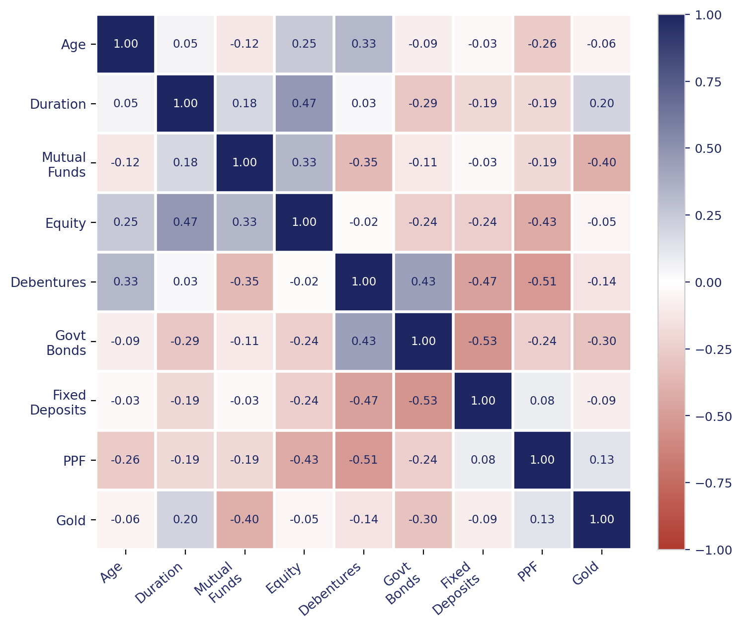
Correlation Analysis
Relationships between age, holding duration, and instrument preference ranks
A negative correlation between two instruments reflects a genuine preference trade-off (favoring one over the other), not reduced popularity overall — ranks are relative, not independent scores.
Age shows only a weak relationship with duration (r = 0.05) and with most preference ranks, suggesting instrument choice is driven more by individual risk appetite than by age alone.
Equity preference strengthens somewhat with longer holding duration (r = 0.47), consistent with equity being viewed as a longer-horizon instrument.
Investment Behavior & Preference Analysis
11

Slide 12
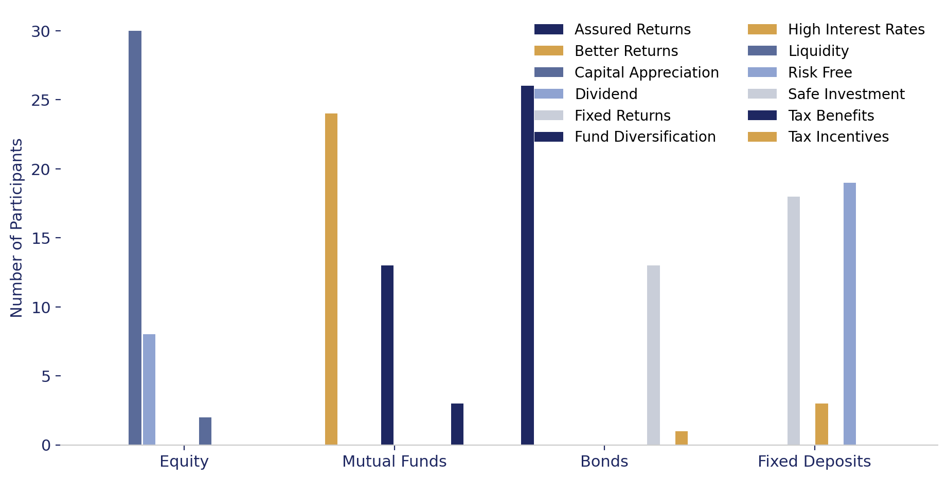
Reasons for Investment by Instrument
What drives the choice of each instrument type
Equity: Capital Appreciation (30)
Mutual Funds: Better Returns (24)
Bonds: Assured Returns (26)
Fixed Deposits: Risk Free (19)
Investment Behavior & Preference Analysis
12

Slide 13
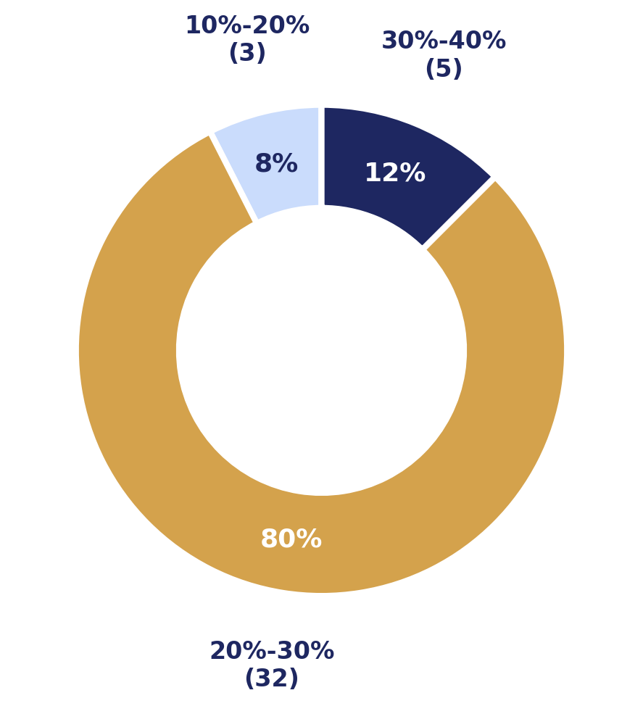
Expected Returns from Investments
What participants anticipate earning on their investments
80%
of participants (32 of 40) expect returns of 20–30% — a notably optimistic and fairly concentrated expectation across the sample.
Only 3 participants (7.5%) set more conservative expectations of 10–20%, while 5 (12.5%) expect an aggressive 30–40% — return expectations skew high relative to typical long-run market averages, which may warrant investor education on realistic benchmarks.
Investment Behavior & Preference Analysis
13

Slide 14
Key Findings
Summary of insights across the analysis
Demographics
Preferred Avenue
Sample skews male (62.5%) and young, averaging 27.8 years — a working-age, early-career profile.
Mutual Funds lead as the top choice (45%), reinforced by the lowest average preference ranks alongside PPF.
Savings Objective
Information Source
Retirement planning dominates (60%), followed by health care (32.5%) as the leading long-term priorities.
Financial consultants (40%) and print media (35%) are trusted more than TV or internet sources.
Holding Duration
Return Expectations
A medium-term horizon prevails — 92.5% hold investments for 1–5 years.
80% expect 20–30% returns, an optimistic outlook that exceeds typical long-run market averages.
Investment Behavior & Preference Analysis
14

Slide 15
Thank You
Investment Behavior & Preference Analysis — Business Analytics Internship Project, Cognifyz Technologies
Data source: Finance_data.csv (40 survey respondents)

