Slide 1
IBM University Engagement Project Submission
“Exploring the Power of Agentic AI with IBM Bob and IBM Watsonx”

Slide 2
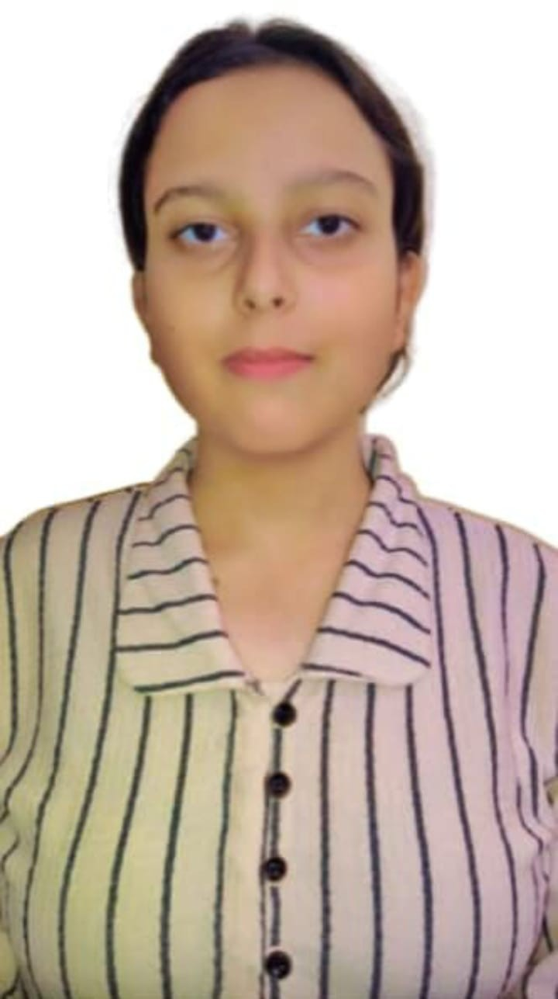
Project Tile – [NutriBot – AI-Powered Nutrition Agent]
Domain of Project – Healthcare & Nutrition
Student Name | Recent Passport Photo | Email ID | Mobile number [WhatsApp]
Saloni Sharma |  | sharma43saloni@gmail.com | 6396184166

Slide 3
Problem Statement -
Problem Statement : Nutrition Agent
The Challenge
Good nutrition is the foundation of health, but individuals often struggle with diet planning, portion control, and tracking nutritional intake. Information about healthy diets, disease-specific nutrition, and food composition is scattered across unreliable sources. Without personalized, real-time guidance, many fail to maintain balanced diets or make informed food choices.
The Objective
Build an AI-powered Nutrition Agent that delivers personalized dietary insights and guidance for individuals, families, and health professionals. The solution should:
Personalized Diet Plans – Recommend meals based on age, health conditions, allergies, cultural preferences, and fitness goals.
Calorie & Nutrition Analysis – Instantly break down calories, macros, and micronutrients for any meal or Indian food item.
BMI & Health Tracking – Calculate BMI using Asian (Indian) thresholds and deliver instant, personalized nutrition advice.
Preventive Health Focus – Suggest diets for chronic disease management (e.g., diabetes-friendly or heart-healthy plans).
Core Feature Modules –
Chat Assistant (conversational nutrition guidance)
7-Day Meal Planner (personalized meal plans)
BMI Calculator (BMI & personalized health advice)
Family Nutrition Planner (unified plans for the whole family)
Responsive Web Dashboard – Mobile-friendly Flask web app with dark mode, animated BMI gauge, and macro-nutrient bars.

Slide 4
Proposed Solution -
Proposed Solution: AI-Powered Nutrition Agent
NutriBot is a Flask-based intelligent nutrition assistant that leverages the capabilities of IBM watsonx.ai Foundation Models to provide personalized dietary recommendations in real time. Instead of following predefined rules, the application understands user inputs using Generative AI and responds with customized nutritional advice.
The system collects information such as age, gender, dietary preference, allergies, existing health conditions, physical activity level, and fitness goals before generating recommendations tailored to each individual. This enables users to receive practical guidance that aligns with their personal health objectives.
The application is organized into multiple integrated modules:
AI Chat Assistant for answering nutrition-related questions.
Meal Planner for generating personalized daily and weekly meal plans.
BMI Calculator with Indian BMI classification and health suggestions.
Nutrition Analyzer for calorie, protein, carbohydrate, fat, vitamin, and mineral estimation.
Family Nutrition Planner for creating balanced meal plans for multiple family members.
A responsive dashboard developed using Bootstrap provides an intuitive user experience with dark mode support, animated health indicators, and visually organized AI responses.

Slide 5
Technology Used
Flask (Python) -Lightweight backend web framework serving all pages, routes, and API calls
IBM watsonx.ai Foundation Model - Meta Llama 3.3 70B Instruct, served via watsonx.ai (IBM Granite models also supported on the platform) – for natural language understanding, reasoning, and personalization
IBM Cloud – It provides the infrastructure to build, deploy, and scale the Nutrition Agent efficiently. IBM Cloud enables a reliable, secure, and scalable environment for deploying the Nutrition Agent.
IBM BOB – IBM's AI-powered development assistant, used to help generate, debug, and refine parts of the NutriBot codebase during development.
Prompt Engineering– A carefully engineered system prompt (agent.py) encodes nutrition domain knowledge, persona, and safety rules, making the Nutrition Agent more trustworthy and effective.
IBM Watsonx.ai - For secure, IAM-authenticated foundation model deployment and inference
Bootstrap 5 & marked.js – For the responsive dark-mode UI and Markdown-rendered chat responses

Slide 6
Key components Used -
1) Chat Input – Web form on each page (Chat, Nutrition, Meal Plan, BMI, Family) where users enter queries, profile details, or meal data.
2) agent.py (Watsonx.ai client) - Builds the prompt from AGENT_INSTRUCTIONS + user input and calls the watsonx.ai foundation model API to generate personalized nutrition insights.
3) Name of foundation model - Meta Llama 3.3 70B Instruct (via IBM watsonx.ai) → Fast, efficient for real-time diet recommendations
4) Chat output -Displays AI-generated responses (meal plans, nutrition breakdowns, BMI advice) rendered as formatted Markdown via marked.js.
5) Flask Session & .env config - Stores user profile and chat history for the session (last 20 turns), and keeps IBM Cloud credentials out of source code.
6) Bootstrap 5 + marked.js frontend – Dark-mode responsive UI across all 5 pages, with Markdown rendering for AI responses.

Slide 7
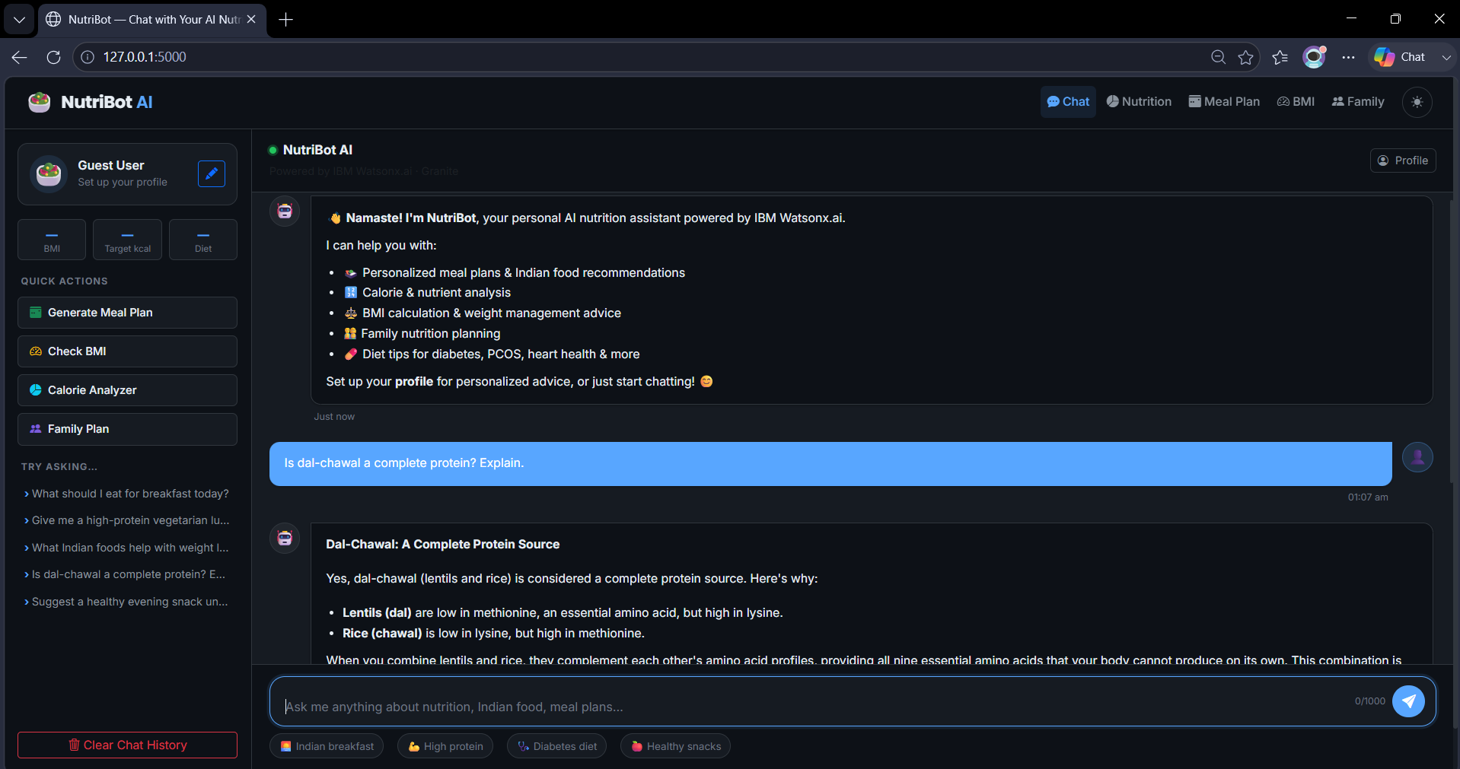
Application Screenshots – I

Slide 8
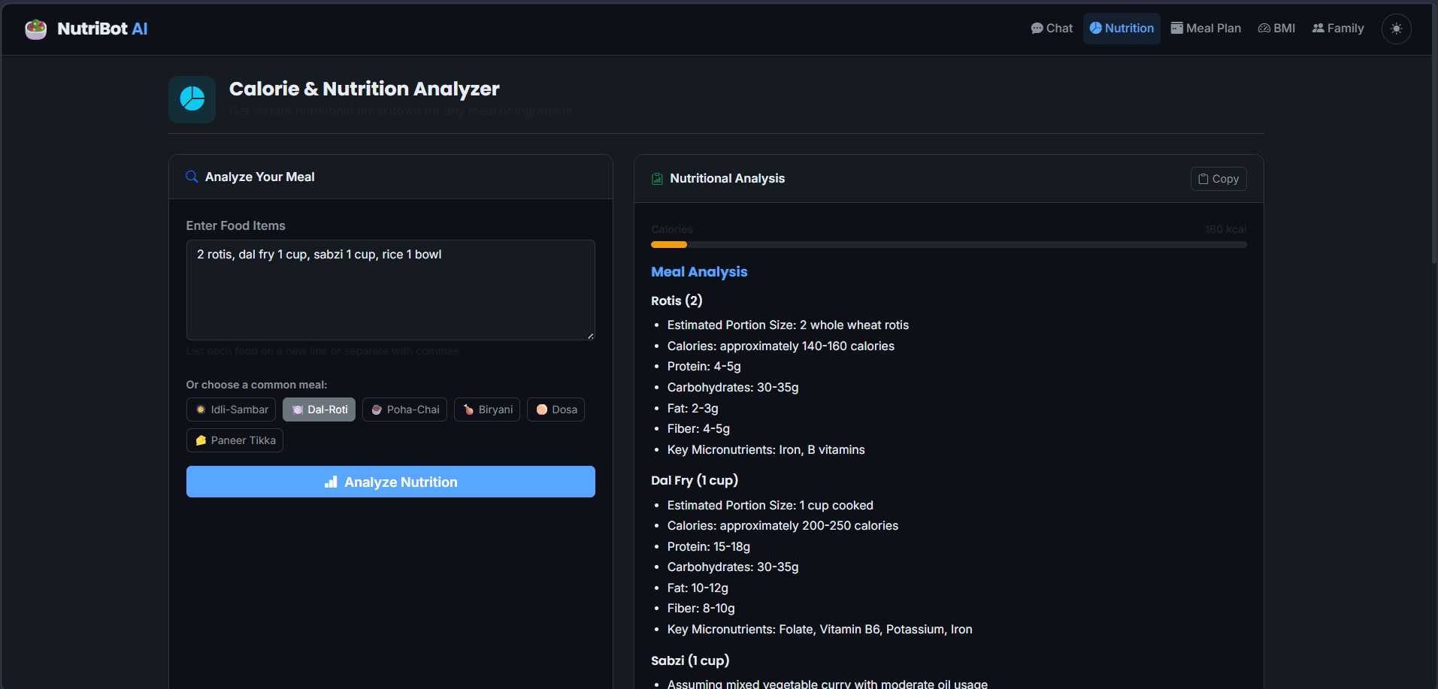
Application Screenshots – II

Slide 9
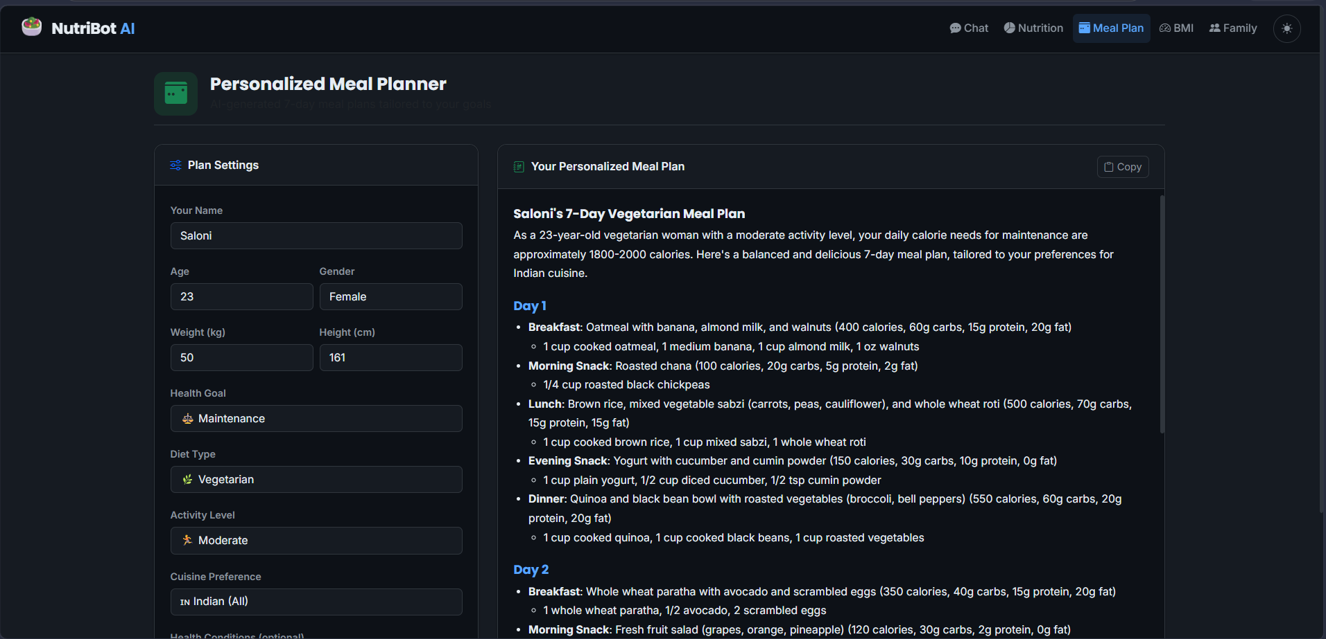
Application Screenshots – III

Slide 10

Role of Agentic AI in the solution
Agentic AI serves as the intelligence layer of NutriBot by understanding user context and generating meaningful nutrition recommendations.
Instead of relying on predefined rules, the AI analyzes information such as age, lifestyle, health conditions, dietary preferences, and fitness goals before suggesting suitable meal plans.
Its major contributions include:
Context-aware conversations
Personalized nutrition advice
Dynamic meal recommendations
Continuous interaction using conversation history
Intelligent health guidance based on user inputs
This enables NutriBot to function as a virtual nutrition consultant capable of assisting users in making informed dietary decisions.

Slide 11
Novelty and Uniqueness
NutriBot distinguishes itself from traditional nutrition applications by combining Artificial Intelligence, prompt engineering, and healthcare knowledge into a unified intelligent platform.
Unlike standard calorie calculators, NutriBot understands user context and generates personalized recommendations using IBM Foundation Models. The system also incorporates Indian dietary practices and BMI standards, making recommendations more relevant for Indian users.
Unique Features:
AI-driven personalized nutrition guidance
Indian food specialization
Integrated health analysis
Family nutrition planning
Interactive conversational AI
Dark mode responsive dashboard
IBM watsonx.ai integration
Preventive healthcare recommendations
Scalable cloud-based architecture
Modern user interface
This combination transforms NutriBot into a smart digital nutrition companion rather than a conventional diet planning application.

Slide 12
Git Hub Link
· Github URL –
https://github.com/Saloni90sharma/Nutrition-Agent

Slide 13
Future Scope
Although NutriBot currently provides intelligent nutrition guidance, several enhancements can further improve its capabilities.
Future Enhancements :
Support Hindi and additional regional Indian languages.
Deploy the application on IBM Cloud Code Engine for production use.
Introduce secure user authentication and cloud profile storage.
Integrate wearable devices such as Fitbit and smartwatches.
Implement AI-based food image recognition for automatic calorie estimation.
Track nutrition history through interactive dashboards.
Generate downloadable nutrition reports in PDF format.
Provide voice-based interaction using speech recognition.
Add doctor and dietitian consultation support.
Incorporate predictive health analytics using machine learning.
These improvements will transform NutriBot into a comprehensive AI-powered digital healthcare ecosystem suitable for both individuals and healthcare professionals.
·
·
·

Slide 14
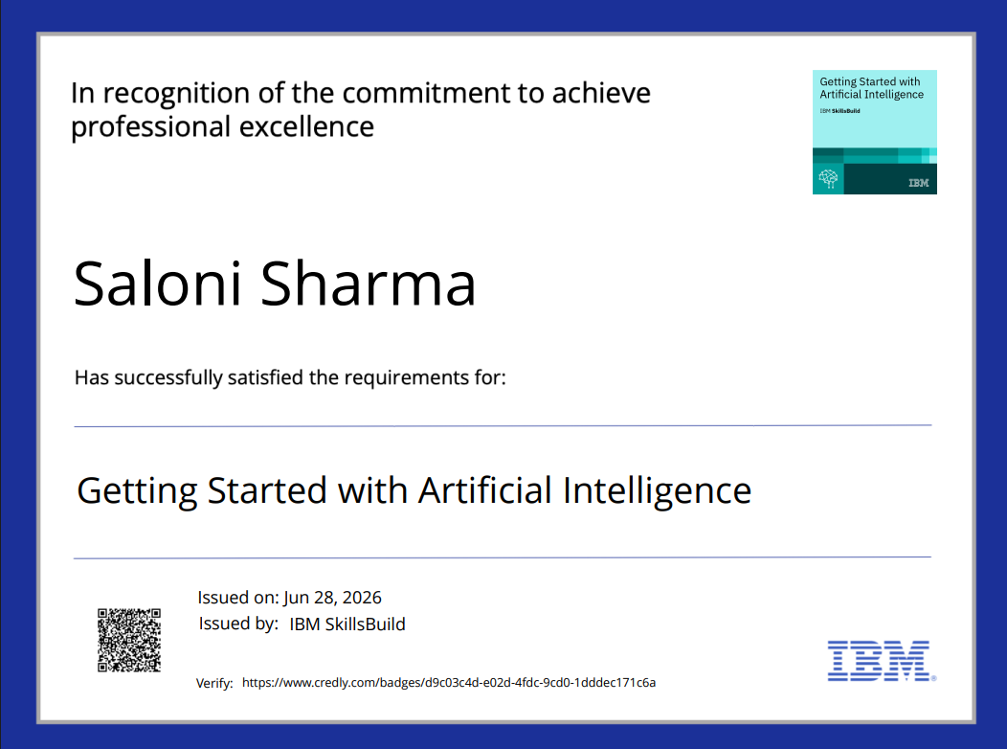
Certificates Earned:

Slide 15
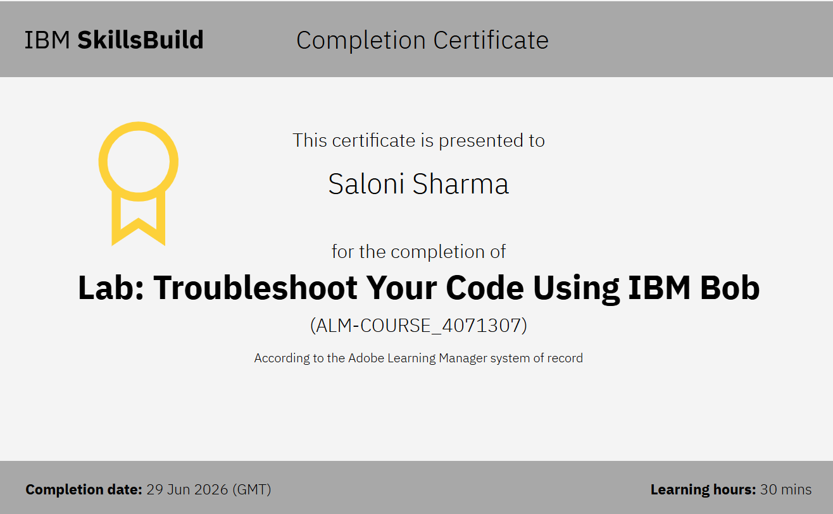
Certificates Earned:​

Slide 16


