Slide 1

PROJECT TITLE-
EMPLOYEE ATTRITION ANALYSIS

Slide 2

INTRODUCTION
INTRODUCTION
1. EMPLOYEE ATTRITION ANALYSIS
Employee attrition analysis is a project focused on understanding the reasons behind employees leaving an organization.
It involves analyzing various factors such as job satisfaction, work environment, compensation, and employee demographics to identify patterns.
The goal is to develop insights and strategies to reduce employee attrition, improve retention, and enhance overall organizational performance.

Slide 3
DETAILS OF DATA
EMPLOYEE ATTRITION ANALYSIS –
The Attrition Data contains 29 Columns and 4411 Rows.
The Data contains information related to the employees demographics and firmographics.

Slide 4

MAIN KPI’S
MAIN KPI’S IN EMPLOYEE ATTRITION ANALYSIS
EMPLOYEE COUNT- The total no. of Employees in the company is 4410.
2. ATTRITION COUNT- Attrition count refers to the number of employees who leave a company or organization over a specific period of time. Here the attrition count is 711.
3. ATTRITION RATE- Attrition rate is the percentage of individuals who leave a group, organization, or workforce over a specific period of time. Here the attrition rate is 16.12%.
4. ACTIVE EMPLOYEES – Employees which are actively working in the company are 3699.
5. AVERAGE AGE- The average age of employees in the company is 37.

Slide 5
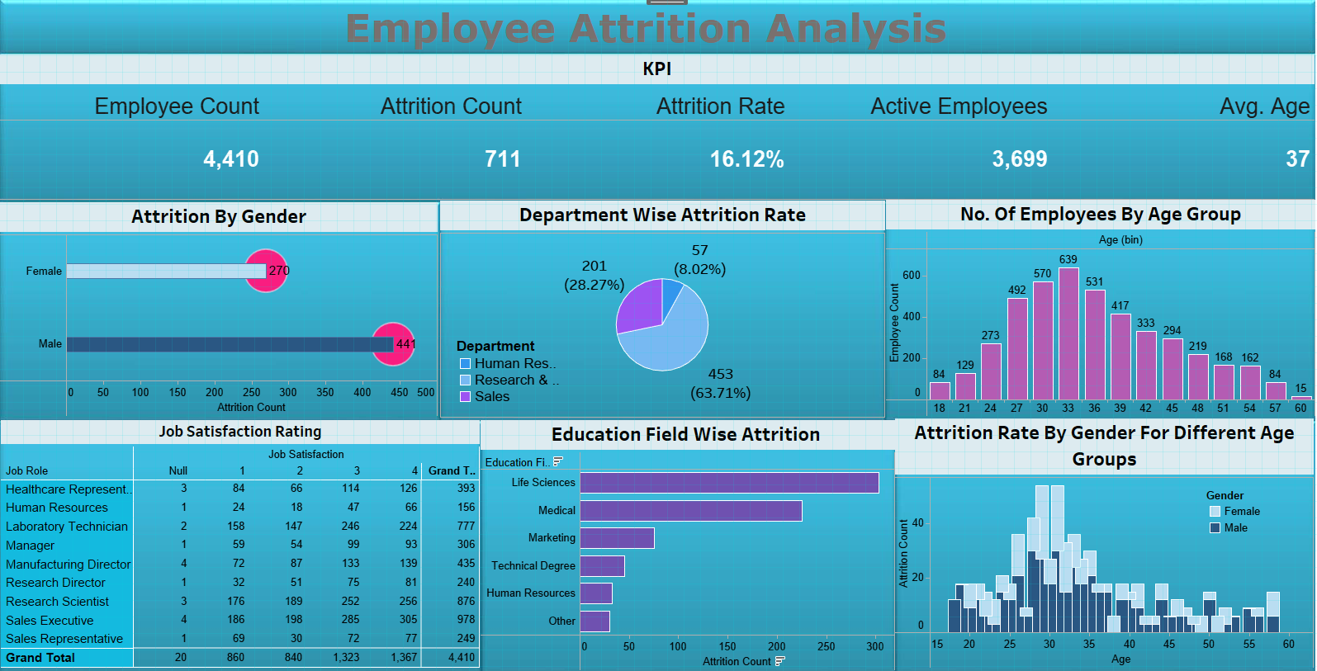
MY TABLEAU DASHBOARD

Slide 6



