Slide 1


COVID-19 INDIA DATA ANALYSIS
TEAM MEMBERS
MD NAUSHAD AHAMED
SALONI GUPTA
PRAJWAL S
AYUSH RANJAN
IBRAHUL HAQUE

Slide 2
TABLE OF CONTENT
Introduction
Data Collection & Preparation
Exploratory Data Analysis (EDA)
Insight Task
Challenges
Learning

Slide 3

COVID-19
The COVID-19 pandemic has had a profound impact on India, presenting unprecedented challenges to its public health system, economy, and social structure. First detected in the country in late January 2020, the virus rapidly spread, leading to a nationwide lockdown in March 2020 as a measure to curb its transmission. The lockdown, while necessary to control the virus, resulted in significant economic disruption, affecting millions of livelihoods, particularly in the informal sector.

Slide 4
Preparation And Analysis Strategy
Got Covid 19 India Data from covid19india.org
Made structured data-frame out of the data in python.
Imported the data in CSV format and analysed it to
gain insights from it.
Made a visualized dashboard on Excel using the output
output data from SQL

Slide 5
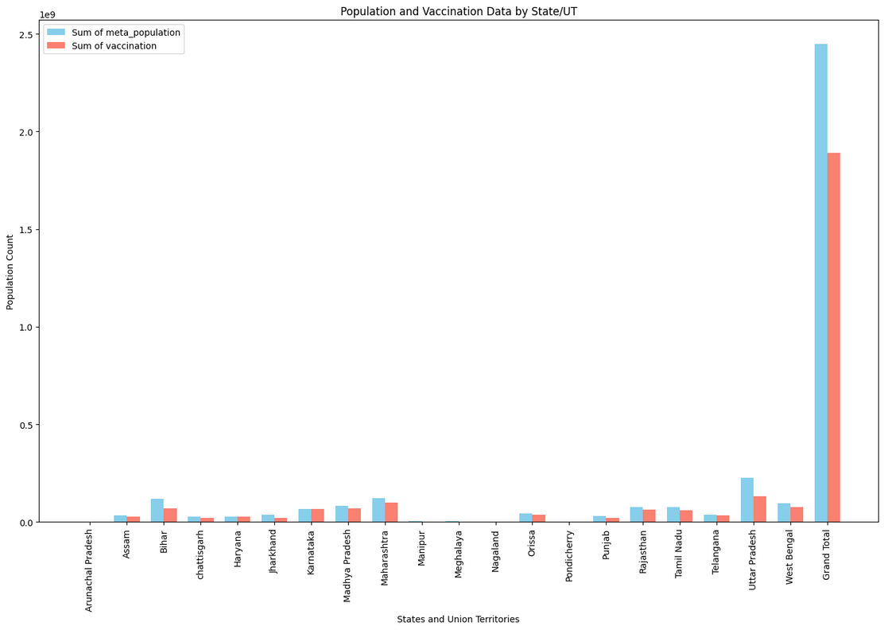
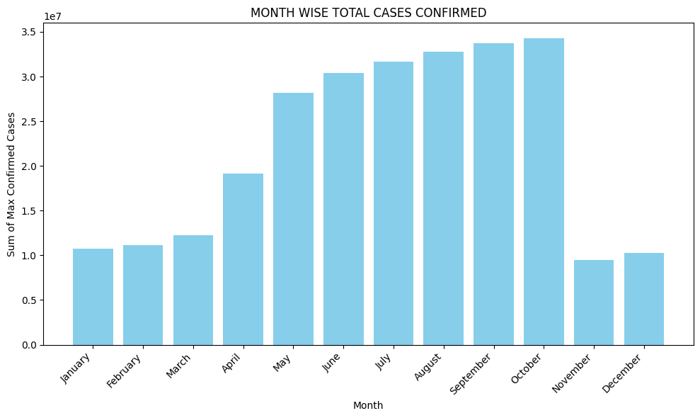
KPI

Slide 6
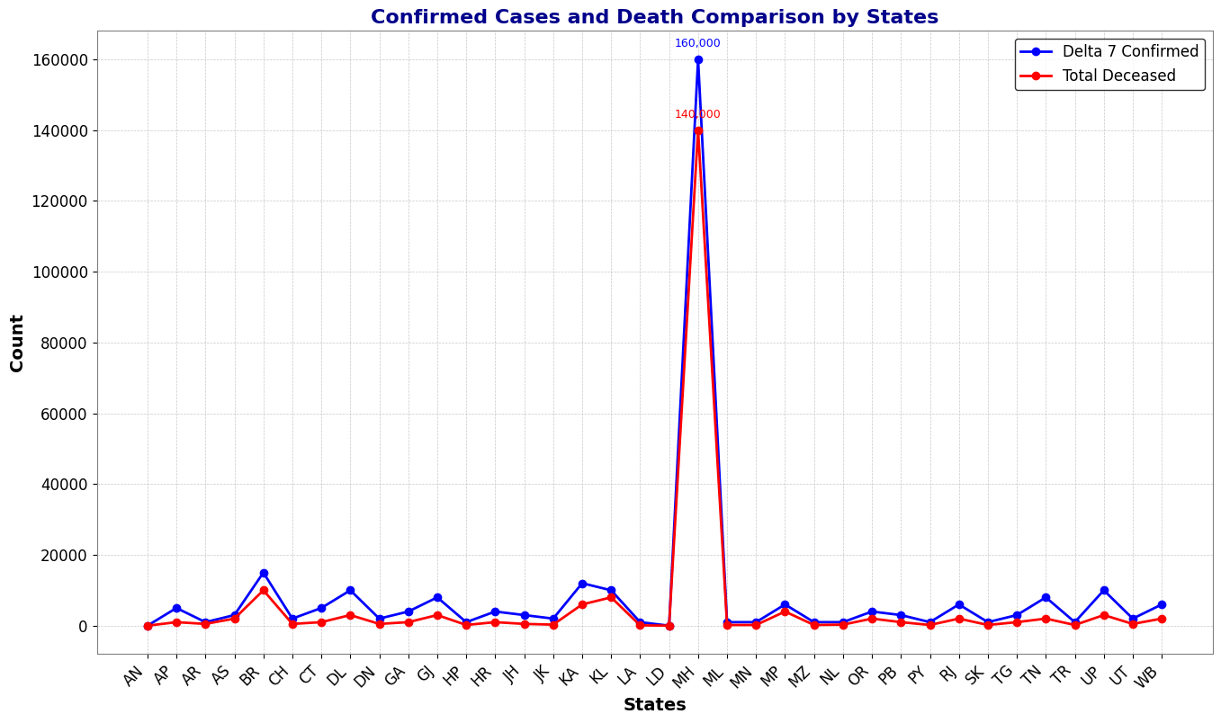

KPI

Slide 7
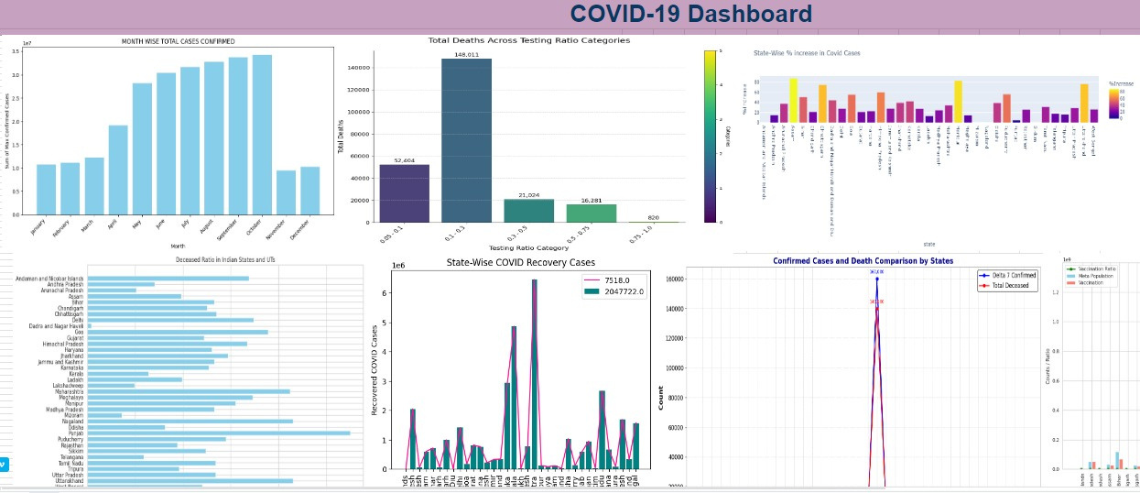


Slide 8
Insights
The number of deaths was inversely proportional to number of tests done.
Covid-19 was more volatile and dreadful in Metropolitan Cities as compared to tier II/ III cities.
The Deceased Ratio is maximum in Punjab and minimum in Dadra & Nagar Haveli.
The states with more vaccination stats have more recovered cases and comparatively less deceased cases.
States which are vaccinated and less has population density have less confirmed cases also death rate is minimum.

Slide 9
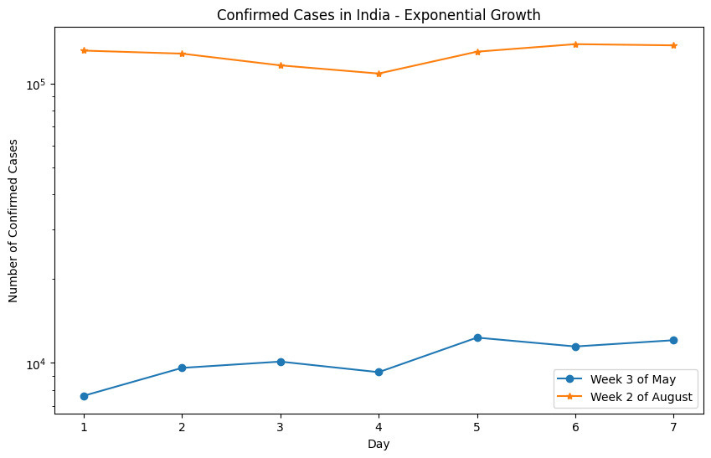
Compare Week 3 of May with Week 2 of August

Slide 10
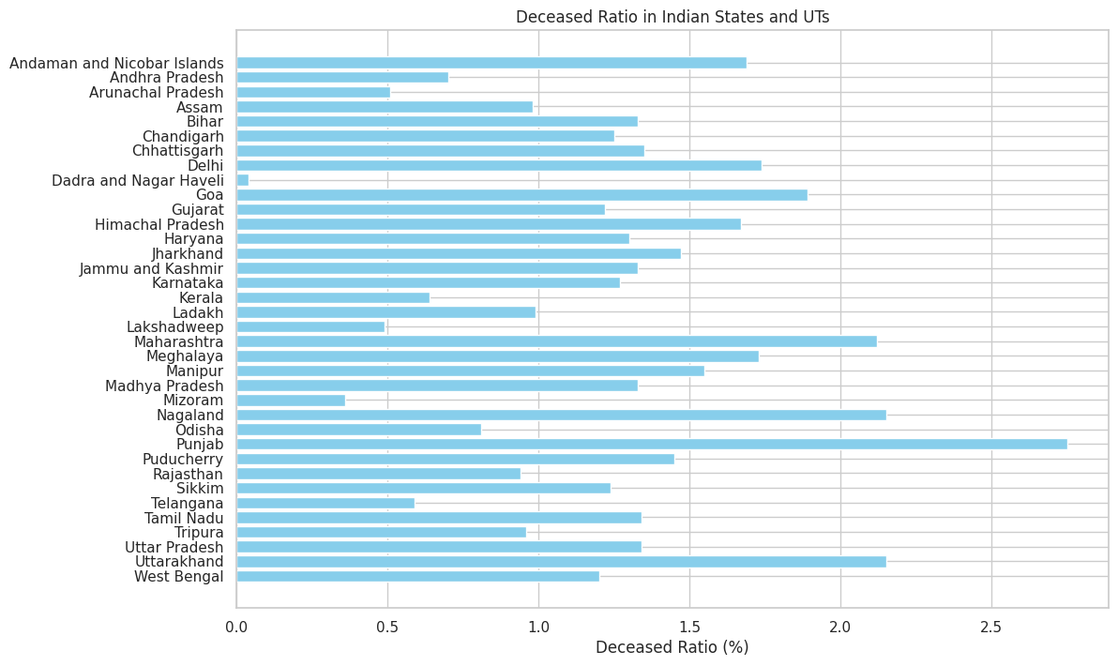
The Deceased Ratio is maximum in Punjab and minimum in Dadra & Nagar Haveli.

Slide 11
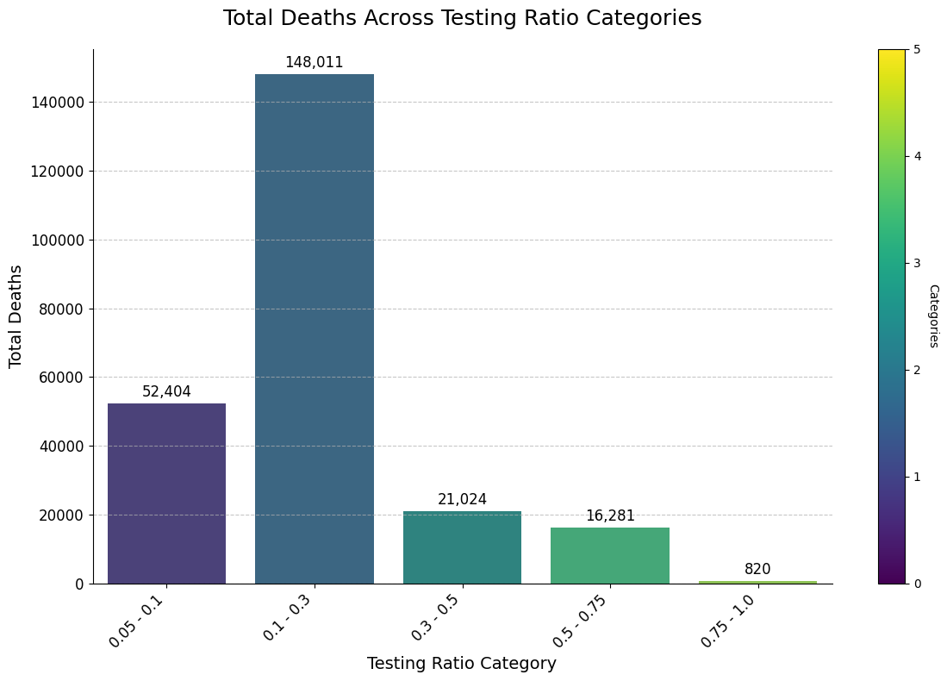
Analysis of several deaths across all categories

Slide 12

Challenges
Arrange and set a particular time for meet as some of us are working professionals and some are studying.
The other issue was to make the data-frame out of nested dictionary from JSON data.
Join all the data-frames which had such vivid structures.
Another issue was to share the data files according to the structure of the data.
Joining every data-frames to make a database.
No Challenge was so big that we cannot overcome it by Team Efforts.

Slide 13
Learnings
To Communicate ideas in a way which are understood and mutually altered by the each other.
How to divide multiple tasks amongst each other and have them done with the help of each other.
How Team Work helps in solving problems which look difficult at the beginning.
Learnt to push our learning limits and for that the web is the biggest boon.
The one who try never fails.

Slide 14
THANK YOU
We are Open to answer your Questions

