Slide 1
Heart Disease Prediction System
Using Machine Learning (Random Forest & Logistic Regression)

Slide 2
Problem Statement
- Heart disease is a leading cause of death worldwide.
- Early detection is crucial for effective treatment.
- Manual diagnosis can be time-consuming and error-prone.
- Need for an automated prediction system using patient data.

Slide 3
Dataset
- Dataset: UCI Heart Disease dataset.
- Key features: age, sex, chest pain type, blood pressure, cholesterol, etc.
- Target: Presence (1) or Absence (0) of heart disease.
- Data preprocessing: Missing values handled, categorical encoding applied.

Slide 4
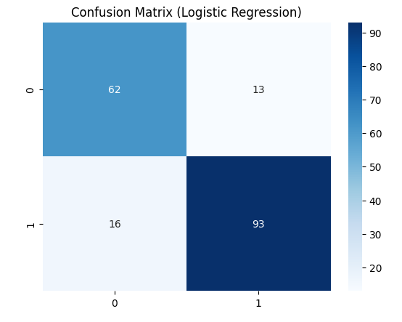
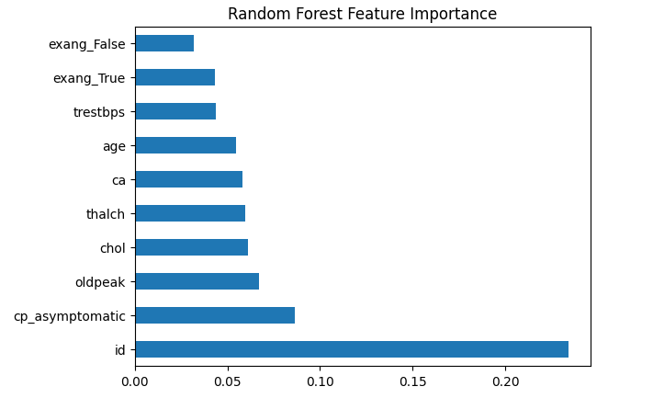
Methodology
1. Data Cleaning & Preprocessing
2. Exploratory Data Analysis (EDA)
3. Feature Engineering & Encoding
4. Train-Test Split & Scaling
5. Models Used:
Logistic Regression | Random Forest Classifier

Slide 5
Results
- Logistic Regression: Baseline model.
- Random Forest achieved ~88.6% accuracy.
- Feature importance analysis identified key risk factors.
- Output: Prediction = 0 (No disease) or 1 (Disease).

Slide 6
Conclusion & Future Work
- Developed an ML pipeline for heart disease prediction.
- Provides quick, reliable predictions based on patient data.
- Can be deployed as a web app for user-friendly access.
- Future improvements:
* Deep Learning models
* Larger & diverse datasets
* Integration with hospital systems.

