Slide 1
SDG 3 • GOOD HEALTH & WELL-BEING
Wellness Navigator AI
AI-Driven Personalized Guidance for Physical, Nutritional & Mental Well-Being
CSRBOX–IBM SkillsBuild Applied AI Internship 2025
PRESENTED BY
Saloni Kumari
SDG ALIGNMENT
Good Health
& Well-Being
INTERNSHIP ID
202526AICTECSRBOX0805
TECHNOLOGY STACK
React | FastAPI | LangGraph | Supabase

Slide 2
WHY HOLISTIC WELLNESS MATTERS
Introduction
Modern Lifestyles Increase Risks Of
✦
!
Obesity & Inactivity
Sedentary routines and reduced physical activity
OUR VISION
!
Poor Nutrition & Dehydration
To build an AI-powered Wellness Navigator that continuously supports users with empathetic, personalized, and privacy-first health guidance.
Irregular eating habits and inadequate hydration
!
Stress, Anxiety & Sleep Disorders
Rising mental strain affecting overall wellness
Traditional Wellness Apps Are
Fragmented • Non-Adaptive • Poorly Personalized
Wellness Navigator AI — SDG 3
2

Slide 3
KEY CHALLENGES
Problem Statement
1
Inconsistent wellness routines
CORE PROBLEM
How can we design a secure, adaptive, and holistic AI system that supports wellness without overwhelming users?
2
Disconnected tracking of physical fitness, nutrition & mental resilience
3
Lack of motivation & personalization
4
Privacy concerns with AI-driven health apps
Wellness Navigator AI — SDG 3
3

Slide 4
PRIMARY GOALS
Project Objective
✓
Personalized Guidance
✓
Iterative Data Collection
Fitness, nutrition, and mental resilience
One question at a time — no survey fatigue
✓
Secure Data Storage
✓
Automated Health Sync
Supabase-powered privacy-first architecture
Webhook-based milestone logging
✓
Accessible UI
Minimalist React dashboard
Wellness Navigator AI — SDG 3
4

Slide 5
SDG 3: GOOD HEALTH & WELL-BEING
Why This Problem Is Important
Early Intervention Reduces
Continuous Monitoring Enables
IMPACT
✔
Empowers individuals
›
Chronic illness
›
Preventive care
Healthcare costs
Better lifestyle decisions
✔
Encourages healthier habits
›
›
✔
Supports sustainable healthcare systems
Wellness Navigator AI — SDG 3
5

Slide 6
WELLNESS NAVIGATOR AI
Solution Overview
What Is Wellness Navigator AI?
KEY PRINCIPLE
An AI-driven wellness assistant that:
Empathy
●
Understands natural language health goals
Guides users step-by-step
+
●
Intelligence
●
Adapts recommendations dynamically
+
●
Stores data securely
Privacy
●
Syncs validated health milestones
Wellness Navigator AI — SDG 3
6

Slide 7
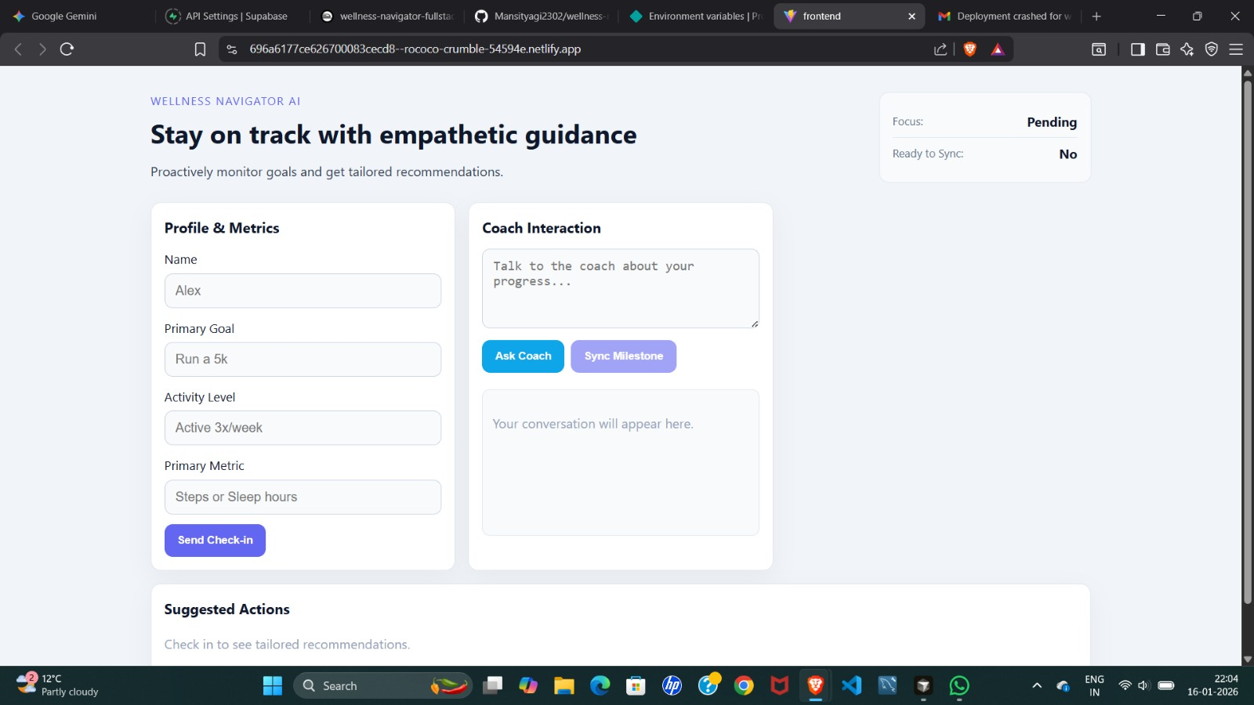
SYSTEM CAPABILITIES
Core Features
✓
Intent-Based Coaching
Fitness | Nutrition | Mental Resilience
✓
Iterative Metric Collection
Goal, activity level, primary health metric
✓
Empathetic Interaction
Supportive & scientifically grounded tone
✓
Adaptive Recommendations
Daily habits & milestone tracking
✓
Safety Compliance
INITIAL UI STATE
Redirects users to professionals if distress is detected
Wellness Navigator AI — SDG 3
7

Slide 8
Technology Stack
LAYER
TECHNOLOGY
PURPOSE
Frontend
React + Vite
Fast, accessible UI
Backend
FastAPI
High-performance APIs
AI Orchestration
LangGraph
Stateful coaching flows
Database
Supabase (Postgres)
Secure data storage
Deployment
Netlify & Railway
Scalability & reliability
Wellness Navigator AI — SDG 3
8

Slide 9
HIGH-LEVEL FLOW
System Architecture
1
2
3
›
›
User submits a wellness query
FastAPI backend receives input
LangGraph manages coaching state
4
5
6
›
›
Metrics stored securely in Supabase
Webhook triggers after validation
Dashboard updates in real time
Wellness Navigator AI — SDG 3
9

Slide 10
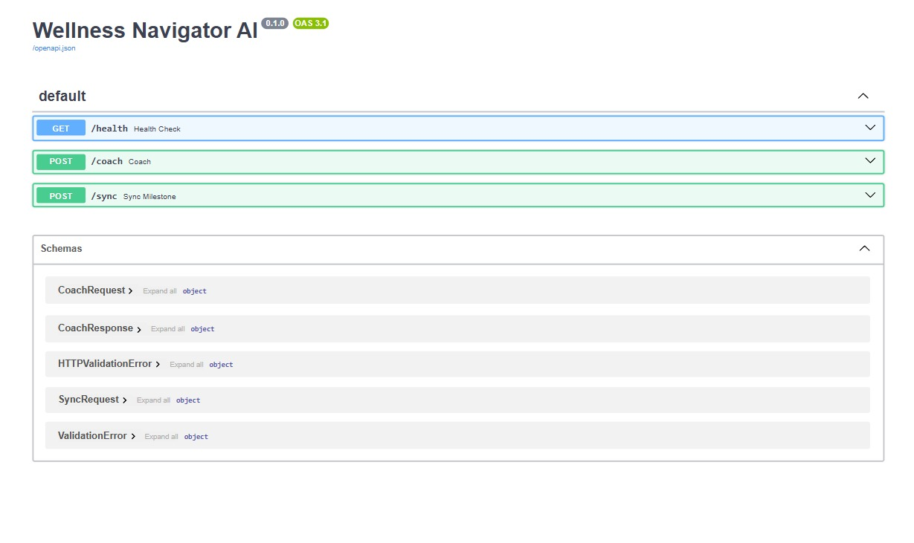
IMPLEMENTATION SNAPSHOT
Backend: Data Schema
Wellness Navigator AI — SDG 3
10

Slide 11
STATEFUL COACHING FLOW (LANGGRAPH NODES)
Backend Intelligence
1
start_node
2
intent_classifier_node
3
Wellness Nodes
Initializes session & user state
Routes query to:
Collect missing metrics
✔
Fitness Ward
✔
Ask one clarification at a time
›
Nutrition Ward
›
✔
Update Supabase logs
Resilience Ward
Wellness Navigator AI — SDG 3
11

Slide 12
DESIGN PRINCIPLES
Privacy, Safety & Compliance
✓
✓
✓
Privacy-First
Pacing
Empathy
No assumptions about health data
One question per response
Supportive & non-judgmental tone
✓
✓
Safety
Data Integrity
Medical distress → professional help
Webhook triggered only after validation
Wellness Navigator AI — SDG 3
12

Slide 13
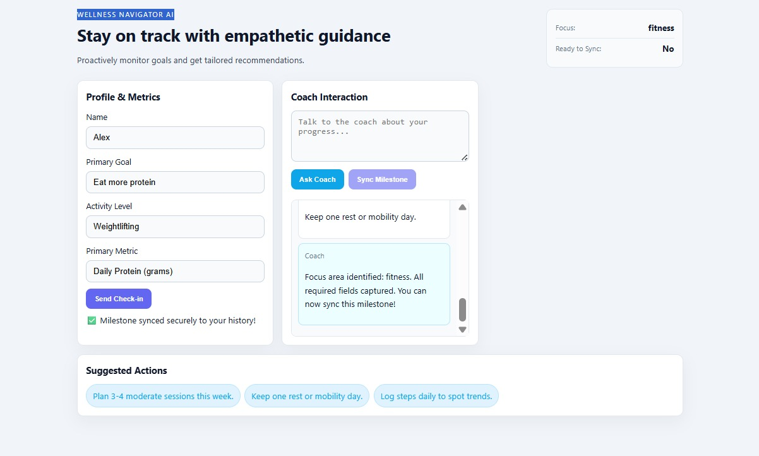
HEALTH MILESTONE SYNC
Webhook Integration
POST PAYLOAD
{
"user_name": "string",
"focus_area": "fitness | nutrition | resilience",
"health_metric": "string",
"primary_goal": "string",
"timestamp": "ISO8601"
}
TRIGGER CONDITIONS
✔ User Goal
✔ Activity Level
✔ Primary Health Metric
Wellness Navigator AI — SDG 3
13

Slide 14
WHAT WAS BUILT
Final Deliverables
React Wellness Dashboard
FastAPI Backend (/sync endpoint)
✔
✔
LangGraph Coaching State Machine
Supabase Habit & Milestone Storage
✔
✔
Secure Webhook Automation
✔
Wellness Navigator AI — SDG 3
14

Slide 15
PROJECT DEPLOYMENT
Live Project Link
https://696a6177ce626700083cecd8--rococo-crumble-54594e.netlify.app/
Wellness Navigator AI — SDG 3
15

Slide 16
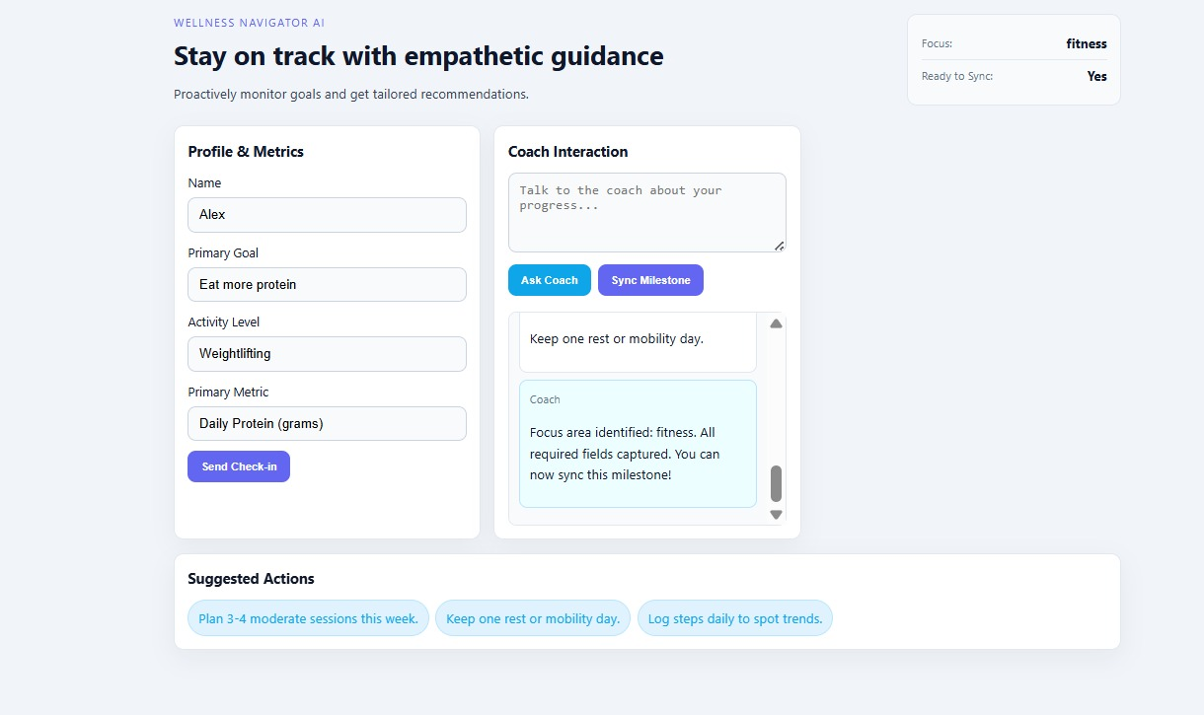
FINAL VIEW
AI-Enhanced Wellness Interface
Wellness Navigator AI — SDG 3
16

Slide 17
PROJECT OUTCOME
Conclusion
The Wellness Navigator AI:
FUTURE SCOPE
✔
Unifies physical, nutritional, and mental health
→
Wearable integrations
✔
Delivers adaptive, empathetic guidance
→
Predictive health analytics
✔
Ensures privacy and compliance
→
Multilingual support
✔
Supports SDG-3 objectives
→
Long-term habit intelligence
Wellness Navigator AI — SDG 3
17

Slide 18
Thank You
Thank you for the opportunity to present my project.
✓
This work reflects the application of AI, cloud technologies, and responsible design
✓
Emphasizes preventive healthcare and user-centric wellness support
✓
Showcases scalable and secure system architecture
Saloni Kumari | CSRBOX–IBM SkillsBuild Applied AI Internship 2025

