Slide 1
Project: Network Anomalies detection
Group-5
Group members: IFT520: Advance information system security
Saloni mourya (1228595123) Dr. Jim helm
Hetvi patel (1230386431)
Mithul sudharsan Ravikumar (1229035836)
VENKATA SAI CHANDRASEKHAR GUDIVADA (1230548360)

Slide 2

What is network anomaly?
Network Anomaly is a cybersecurity practice that involves identifying abnormal patterns or behaviours with a computer network.
Confusing right?

Slide 3
Real Life scenario
Imagine a computer network as a bustling city with many roads and people moving around.
Normal days
People communicating, cars moving on road everything functioning smoothly.
Not Normal days
Unusual happens, sudden traffic jam or large group of people gathering where they don’t usually gather.
(reason: accident/road block/special event)

Slide 4

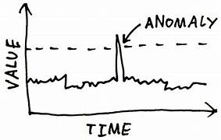
Anomaly Detector
Smart sensor throughout city that keep an eye raises an alert when something unusual happens.
Real world Network anomaly detection
smart sensor anomaly detector
(software that monitors flow of data)

Slide 5

What is our Goal?
To catch anomaly earlier, before they turnout to be an issue.

Slide 6
We know the problem, now lets get back to the solution!

Slide 7
abstract
The Network Anomaly Detection System project is a significant advancement in machine learning for network security. Key milestones include:
Collecting Data: The project gathers information about how the network usually behaves.
Building a Model: It creates a smart system that learns what normal network activity looks like and can spot anything unusual.
Making it Fast: They're working on making the system quick so it can catch any problems in real-time.

Slide 8
Introduction

Slide 9
Significant of study
This study highlights the importance of advanced anomaly detection systems in network security. These systems can identify deviations from normal network behavior, allowing organizations to mitigate risks before they escalate. They also revolutionize incident response strategies, enabling organizations to adapt to emerging risks and enhance resilience against evolving cyber threats.

Slide 10
Problem statement
The digital landscape's complexity and interconnectedness make identifying security threats challenging. Traditional methods like firewalls and intrusion detection systems are insufficient. A Network Anomaly Detection System, powered by machine learning, aims to adapt to evolving network behaviors, distinguishing genuine anomalies from benign fluctuations. This system provides a dynamic defense against evolving cyber threats.

Slide 11
objective
This project aims to develop a network anomaly detection system using machine learning algorithms, evaluate its performance using real-world data, and propose improvements for enhanced accuracy and effectiveness.

Slide 12
Design process

Slide 13
Requirements
The design process for anomaly detection uses specific materials, tools, and datasets, with assumptions like accurate transaction characteristics and appropriate machine learning models. Limitations include data quality, generalization, and hyperparameter tuning.

Slide 14
Scope
The project scope spans various stages:
Data Analysis
Data Preprocessing
Feature Engineering
Model Training
Model Evaluation

Slide 15
Data Analysis
Load Data: Read the datasets onto your preferred data analysis environment (e.g., Python with Pandas).
Basic Statistics: Calculate basic statistics like mean, standard deviation, and explore the distributions of your features.
Time Series Visualization: Plot time series graphs for the 'value' in the training set to visually identify any patterns or anomalies. We are also using heat maps, scatter plots and confusing matrix

Slide 16
Data pre-processing
Handling Missing Data: Check for missing values and decide on an appropriate strategy (e.g., imputation or removal).
Data Normalization/Scaling: If needed, scale numerical features to a standard range.

Slide 17
Feature Enginnering
Temporal Features: Extract temporal features from the timestamp (e.g., hour, day of the week) if relevant.
Target Variable: If 'is_anomaly' is your target variable, ensure it's properly encoded (e.g., TRUE/FALSE to 1/0).

Slide 18
Model Training
Train-Validation Split: Split the training data into training and validation sets to evaluate the performance of your model.
Select a Model: Choose a suitable anomaly detection model.
Model Training: Train your chosen model on the training data.
We are using 5 models:
Isolation Forest: Isolation Forest is an ensemble method for anomaly detection that isolates anomalies by randomly selecting a feature and then randomly selecting a split value between the maximum and minimum values of the selected feature.
Advantage: It is efficient, especially for high-dimensional data, and it tends to work well for isolating anomalies.

Slide 19
2) Local Outlier Factor (LOF): LOF is a density-based anomaly detection method that measures the local density deviation of a data point with respect to its neighbors. Anomalous data points often have lower density compared to their neighbors.
Advantage: LOF can identify anomalies in regions with varying densities.
3) Novelty Local Outlier Factor: Similar to LOF, but here, it is used as a novelty detection method. It means the algorithm is trained on a "clean" dataset, and during testing, it identifies deviations from this clean dataset.
Advantage: It is useful when you have a dataset with only normal instances for training.

Slide 20
4) One-Class SVM:Idea: One-Class SVM is a support vector machine algorithm that learns a decision boundary around normal instances. It aims to separate normal instances from outliers.
Advantage: It is effective for one-class classification tasks where the majority of data points belong to one class.
5) XGBoost Classifier: XGBoost is a powerful gradient boosting algorithm that can be used for classification tasks. It builds a series of decision trees and combines their predictions to create a robust model.
Advantage: XGBoost is known for its high performance, scalability, and ability to handle complex relationships in the data.

Slide 21
Model Evaluation
Validation Set: Evaluate the model on the validation set to fine-tune hyperparameters.
Test Set: Use the trained model to make predictions on the test set and evaluate its performance.

Slide 22
Result ANALysis
Confusion Matrix: Analyze the confusion matrix to understand the model's performance in terms of true positives, false positives, etc.
Precision, Recall, F1-score: Calculate these metrics to assess the model's performance.

Slide 23
DEVELOPMENT PROCESS

Slide 24
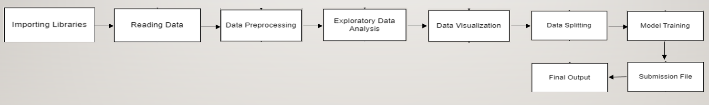
Functional diagram

Slide 25
Tools
Programming Language: Python
Data Processing and Analysis: NumPy and Pandas
Data Visualization: Matplotlib and Seaborn
Machine Learning Models: scikit-learn and XGBoost
Outlier Detection Models: Isolation Forest, Local Outlier Factor, Novelty local outliner factor, One-Class SVM, XGB classifier
Model Evaluation Metrics: Accuracy, Confusion Matrix, Classification Report
Data Submission: Pandas for CSV Operations
XGBoost Model Deployment: X_test

Slide 26
Demo

Slide 27
Testing & result

Slide 28
Testing and result
The data quality and preprocessing testing was successful, ensuring data integrity. Model development and evaluation included Isolation Forest, Local Outlier Factor, One-Class SVM, and XGBoost Classifier. Real-time alert generation was tested, and a submission file was created for future enhancements.

Slide 29
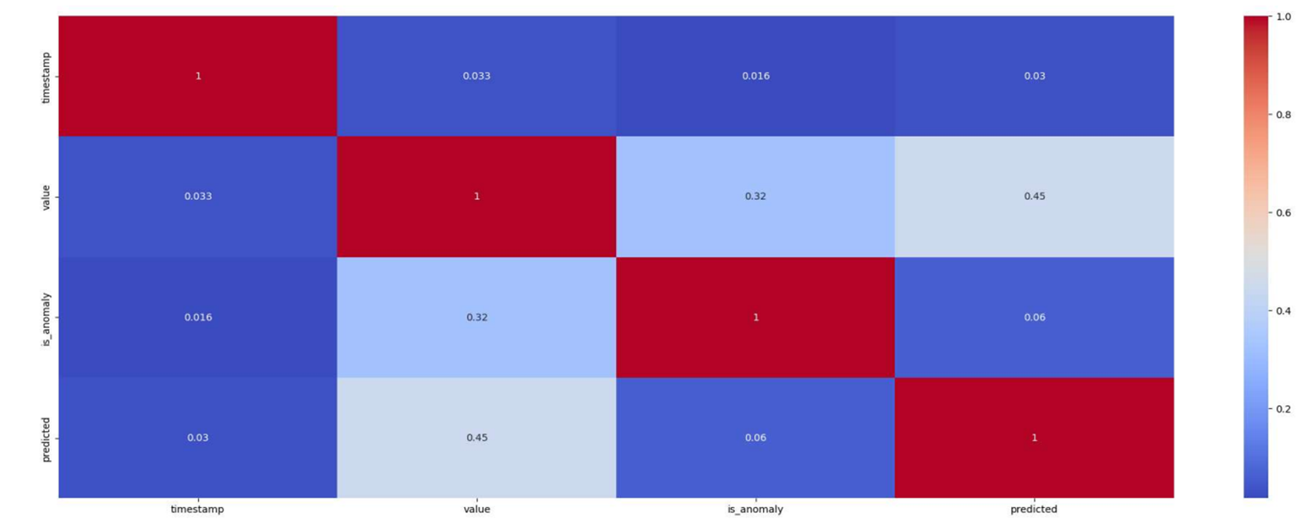
Heat map
Utilize heat maps for visualization.
Common technique to showcase correlation among the variables.

Slide 30
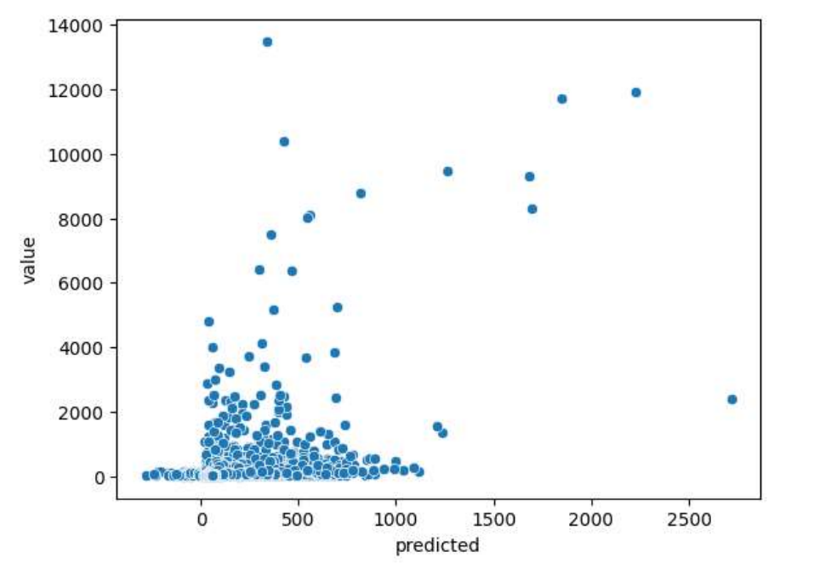
Scatter plot
Most basic type of plot for visualization
Variables are plotted along two axis

Slide 31
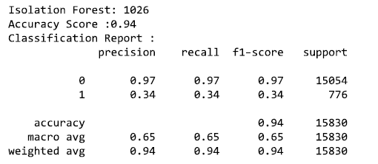
Isolation Forest

Slide 32
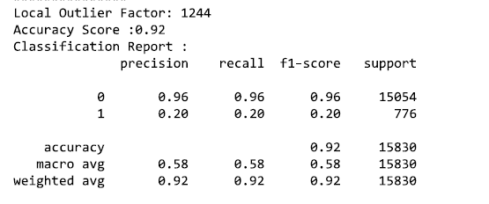
Local Outlier Factor

Slide 33
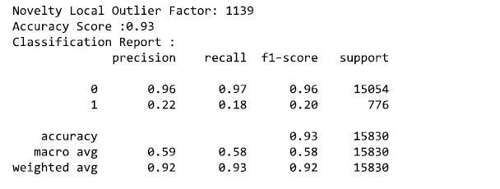
Novelty Local Outlier Factor

Slide 34
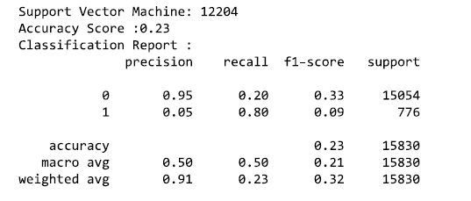
Support vector machine

Slide 35
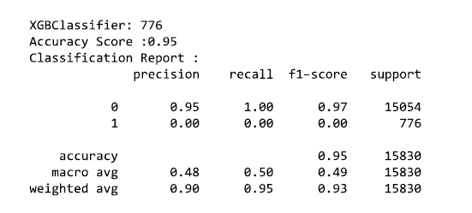
Xgb classifier

Slide 36
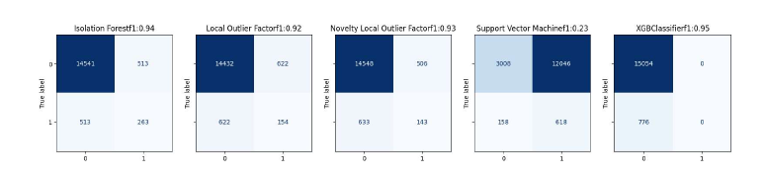
CONFUSION MATRIX
Most basic type of plot for visualization
Variables are plotted along two axis

Slide 37
Summary and conclusion
The network anomaly detection project utilized machine learning techniques to identify anomalous transactions in network traffic. The project involved data collection, preprocessing and using different models. Key findings included robust model performance and data quality. Future enhancements include live deployment, integration with security systems, and automated hyperparameter tuning.

Slide 38
Reference
https://github.com/ddbindra/Anomaly-Detection-Dataset
https://scholar.google.com/scholar?hl=en&as_sdt=0%2C3&q=network+anomaly+detection&btnG=
https://www.flowmon.com/en/blog/science-of-network-anomalies
https://www.ncbi.nlm.nih.gov/pmc/articles/PMC10059045/
https://link.springer.com/article/10.1007/s11235-018-0475-8

